Slide 1
FREQUENTLY ASKED QUESTIONS ABOUT THE GI BILL
What is the process for receiving my GI BILL benefits?
Any student who is entitled to GI Bill entitlements and intends to activate the benefits
should follow these steps to do so.
Ensure that a file has been established by turning in the appropriate paperwork.
(For veterans this includes a copy of their DD214-(member #4), the Certificate of Eligibility for
their particular GI Bill, if the student has not applied for the GI Bill they must apply for it by
filling out VA Form 22 1990 and afterwards provide us with a copy of your confirmation
page of the application.
( For dependents of veterans this will include a copy of their transfer of entitlements
letter, or for Chapter 35, a copy of the Certificate of Eligibility for that particular GI Bill.
If the student has applied for the GI Bill we will need a copy of the confirmation page of their
application for the GI Bill(VA Form 22-1990E for Post 9/11, and VA Form 22-5490 for
Chapter 35 dependents.
Dependents are required to place the GI Bill in their name in order for the benefits to come
directly to them.
Register for classes.
3. Complete the electronic VA Request for Certification and Deferment-this can be found in
The student’s “My Memphis” account under the “student” or “Veteran” tab.

Slide 2
What is the process for receiving my GI BILL benefits if I am a transfer student?
Any student who has used the GI Bill at another school or institution and wishes to use their
entitlements at the University of Memphis should follow these steps;
Establish a file by turning in the appropriate paperwork.
(For veterans this will include providing a copy of their DD214-(member #4), and VA form 22-1995 (change
program/place of training) If the student has not filled out the VA form 22-1995 they may do so in our office
and afterwards provide us a copy of your confirmation page.
Dependents of veterans under either Chapter 33 or 35 this will provide a copy of VA form 22-5495. If the
Student has not filled out the VA-form 22-5495, they may do so in our office and provide a copy of
the confirmation page to our office.
Register for classes.
3. Complete the electronic VA Request for Certification and Deferment-this can be found in
The student’s “My Memphis” account under the “student” or “Veteran” tab.

Slide 3
What is the process for receiving my GI BILL benefits and how long will it take for the VA to begin payments?
The Veterans Services branch at the University of Memphis will take approximately two weeks to pre-certify students after the student has completed their VA request for Certification and Deferment. This time will vary depending on our work load.
Once you are pre-certified your file is electronically sent to the regional VA office in St. Louis.
They will take approximately 30-45 days to process your file and send payments to the account that you established in your application for the GI Bill.

Slide 4
Some pitfalls that will interfere with the certification process for receiving GI BILL benefits?
Registering for courses that do not fit in your degree plan. You may preclude this by checking UM Degree before you register for your courses.
Changing your schedule immediately following your request for certification. This will result in an adjustment to your certification and may possibly lead to the student having to repay a portion of paid tuition.
Forgetting to complete your VA Request for Certification and Deferment. Your benefits are not automatically renewed, if you do not apply for certification each semester your benefits will not be activated.

Slide 5
How does Financial Aid effect my GI Bill?
GI Bill recipients may use Financial Aid in conjunction with GI Bill benefits; however be aware if you are using the Post 9/11 (CH 33) GI Bill, the VA Deferment does not prevent your Financial Aid monies from posting to your account before the VA posts payment.
The VA Deferment acts as a hold for payment when you do not have any other funding besides your GI Bill or as a hold for payment when other funding does not cover the full amount.
The university’s payment system is set up to use whatever monies are available to pay the balance of tuition & fees upfront, regardless if you have a VA deferment on file.

Slide 6
What is the best time to submit my Request for Certification
for my GI Bill?
Students who are coded as a recipient of GI Bill benefits may request certification for their GI Bill benefits as soon as you have registered for that particular term. (Students who are coded as “veterans” (not dependent’s), also receive priority registration privilege and may register as soon as the window opens).
Since students are processed in the order of “first submitted, first served,” it generally is a good idea to submit your certification request as early as possible.
However, if the student makes changes or adjustments to their schedule after they have been certified, there will be repercussions such as being forced to pay for any classes that have been added to the schedule beyond what they were certified for.

Slide 7
Does submitting my Request for Certification & Deferment early guarantee that I will receive my benefits by the start of the term?
Not necessarily. While it is recommended that you submit your certification early, this does not guarantee the processing of your benefits in a timely manner.
There are many variables that can interfere with the processing of your benefits.
This includes such pitfalls as;
changing your class schedule after you have submitted your request for certification.
not checking UM Degree and having a number of “fall-through” courses that the VA will not pay for.
workload for the university’s Veterans Educational Benefits and Certification/VEBC office and the regional VA being so heavy that it precludes timely certification. (Our VEBC office processes approximately 600-700 claims for each major term).

Slide 8
Why does it take so long to process my benefits?
The VA requires that each file that is to be certified for benefits be screened for various criteria.
This includes such features as;
Insuring that the courses paid for fit within a degree plan
Insuring that the correct GI Bill is applied to each student
Insuring that the correct tuition and fees are applied to GI Bill recipients who are entitled to have their tuition & fees paid. (Post 9-11 or Chapter 33)
Verifying or updating biographical data and school information in the VA ONCE database
Of course, the student can help with this process by insuring your biographical information is up to date and accurate and your certification request is submitted in a timely manner.

Slide 9
How and when do I receive my refund if my financial aid
or scholarship monies are taken to pay tuition & fees?
If you are using the Post 9/11 (CH 33) GI Bill and received other funding such as Financial Aid, Pell Grants, and/or general educational expense based scholarships in conjunction with GI Bill benefits, you may be eligible for a refund.
Once the VA posts tuition payment to your student account, the Bursar’s Office sends a list of refund eligible accounts to the VEBC office to manually review. Once this list is reviewed and verified by the VEBC any refunds that are due to the student will be released by the bursar.
Turnaround time for refunds varies per office and per office work load.

Slide 10
How does Tuition Assistance work?
There are two types of Tuition Assistance or (TA); this includes TA for the Montgomery GI Bill-Selected Reserve and that for Active duty personnel.
The Department of Defense will no longer authorize Tuition Assistance for classes for which you are also receiving benefits under the Montgomery GI Bill – Selected Reserve program (chapter 1606) or Reserve Educational Assistance Program (chapter 1607) or any other GI Bill program other than the Montgomery GI Bill – Active Duty program (chapter 30 of title 38, United States Code) or the Post-9/11 GI Bill program (chapter 33 of title 38, United States Code).
If you planned to use both Tuition Assistance and CH 1606 or CH 1607 you will need to choose which benefit you prefer to use.
If you choose to continue to use Tuition Assistance, then the course for which Tuition Assistance is used will not be included in the number of hours certified to the VA.
If you choose to receive chapter 1606 or 1607, then you need to contact DoD to discontinue your use of Tuition Assistance.

Slide 11
QUALIFICATION TABLE FOR THE POST 9/11 GI BILL
ACTIVE DUTY COMPLETED AFTER SEPT. 10, 2001 | PERCENTAGE OF MAX AMOUNTS PAYABLE
36 MONTHS | 100%
30 CONTINUOUS DAYS (MUST BE DISCHARGED DUE TO SERVICE-CONNECTED DISABILITY.) | 100%
AT LEAST 30 MONTHS, BUT LESS THAN 36 MONTHS | 90%
AT LEAST 24 MONTHS, BUT LESS THAN 30 MONTHS | 80%
AT LEAST 18 MONTHS, BUT LESS THAN 24 MONTHS | 70%
AT LEAST 12 MONTHS, BUT LESS THAN 18 MONTHS | 60%
AT LEAST 6 MONTHS, BUT LESS THAN 12 MONTHS | 50%
AT LEAST 90 DAYS, BUT LESS THAN 6 MONTHS | 40%

Slide 12
How does Tuition Assistance work?
If you are receiving benefits under CH 33 Post-9/11 any Tuition Assistance received will be deducted from the amount of tuition and fees reported to VA, since VA pays net tuition.
If you have specific questions regarding this change, please contact the Veteran Educational Benefits and Certification office by phone at 901-678-2996 or e-mail vetedbenefits@memphis.edu.

Slide 13
Do I need a deferment letter and what will it do for me?
Service members, veterans, and dependents of veterans who are eligible for and receiving VA educational assistance benefits may request that tuition and fees for a semester be deferred until the end of the semester. The deferment letter will prevent a student from being purged for non-payment of fees after classes begin.

Slide 14
How does enrollment in separate Parts-of-Term affect VA payment?
If you enroll in separate Parts of Term during a semester (Full, lst, and/or 2^{nd )} the VA will determine your rate of pursuit as full time, ¾ time, or ½ time separately for each part of term based on the number of hours you are enrolled in each Part of Term.
VA only combines the total hours enrolled in each Part Of Term to determine training time when the Parts Of Terms overlap.

Slide 15
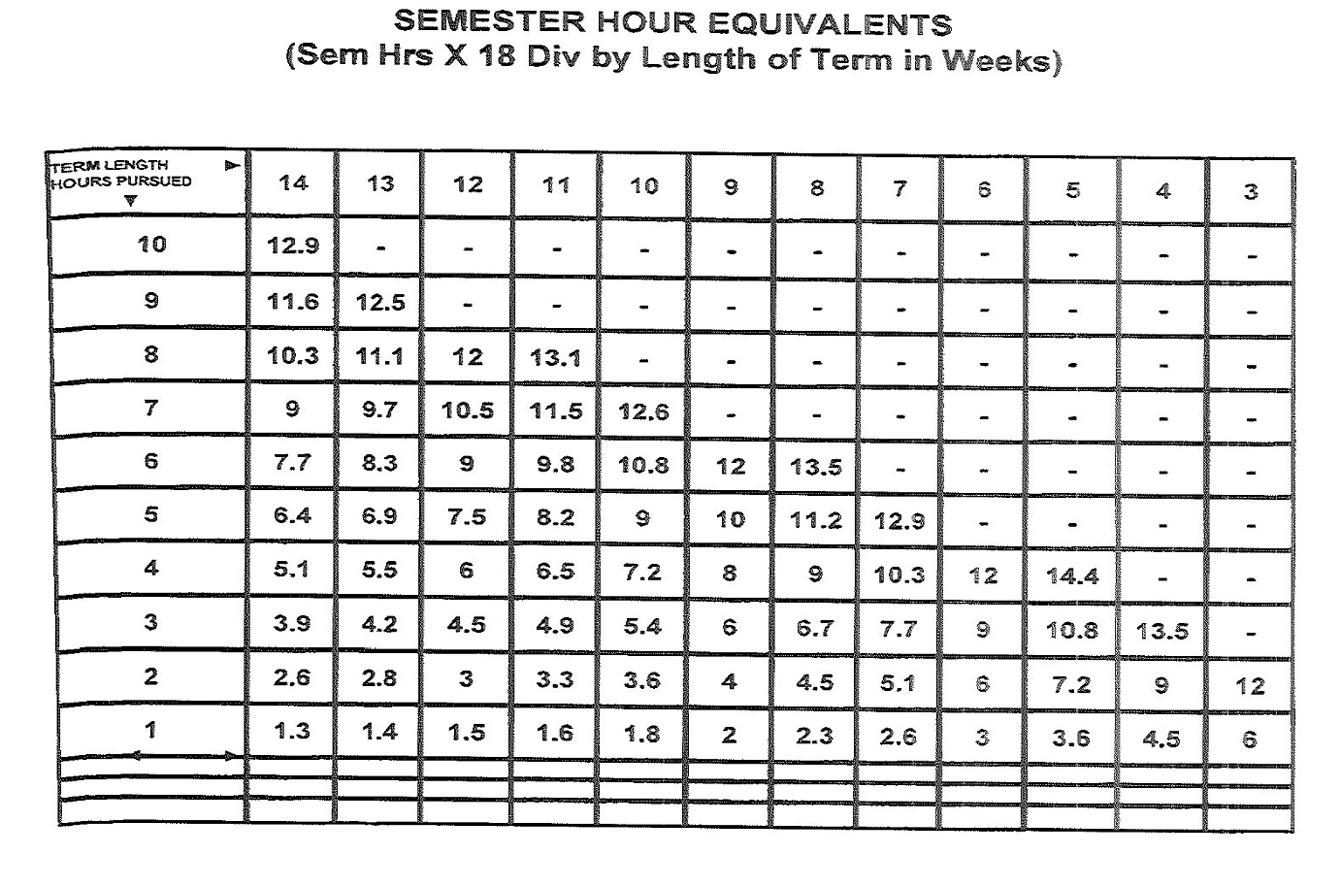
This is how the VA determines training time by semester hours.

Slide 16
How does enrollment in all Online or Distance Learning Courses (Web, Hybrid, TNecampus, RODP) impact CH 33 Post-9/11 GI Bill Monthly Housing Allowance (BAH)?
The monthly housing allowance is payable under the Post-9/11 GI Bill to eligible students enrolled for MORE than ½ time (pursuing training at a rate of pursuit greater than 50%) and enrolled in at least one in-residence course per semester. Students who are enrolled in all online or distance learning courses with method of instruction listed as Web, Hybrid, TNecampus, RODP courses receive 50% of the National average BAH.

Slide 17
Will students be required to pay money back if they drop courses, stop attending, or withdraw from courses on or after the first day of classes?
YES!!! If a student drops courses, are reported as stopped attending, or withdraw from courses on or after the first day of classes, after the VA has paid tuition, the student will incur a debt for the paid tuition.
Although this will vary based on the university’s refund policy and schedule for drop/adds, the bottom line is that the veteran will be required to repay any tuition paid by the VA, after the student has dropped or withdrawn from courses.

Slide 18
CONTACT INFORMATION REGARDING THE GI BILL AT
THE UNIVERSITY OF MEMPHIS
VETERANS EDUCATIONAL BENEFITS & CERTIFICATION-LOCATED IN THE OFFICE OF THE REGISTRAR
003 WILDER TOWER
COORDINATOR 901-678-3874/2996
ASSISTANT COORDINATOR 901-678-3874/2996/5520
Other important contacts: VA Regional Office- www.GI BILL.va.gov
Link to fill out the Veterans Online Application or VONAPP: www.vets.gov
Link to access your personal VA and DOD Information: www.ebenefits.va.gov

