Slide 1



Slide 2


Slide 8
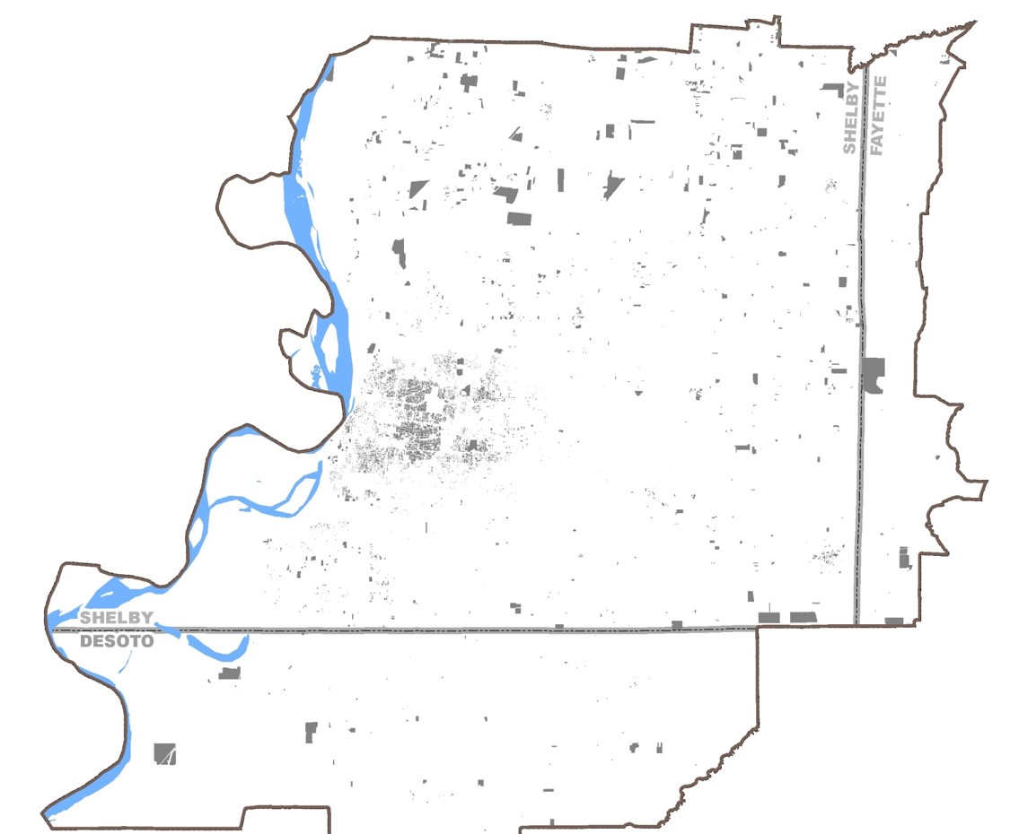
1930

Slide 9
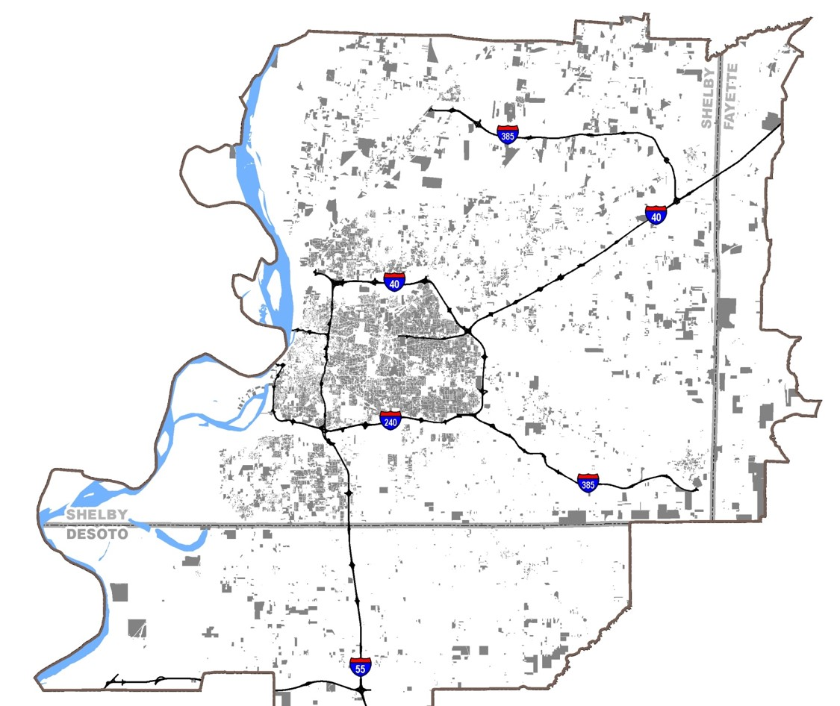
1960

Slide 10
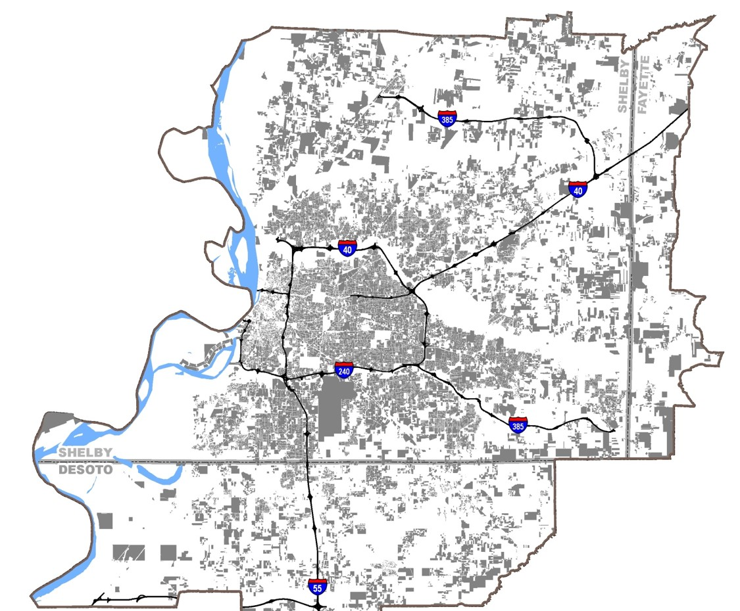
2000

Slide 11
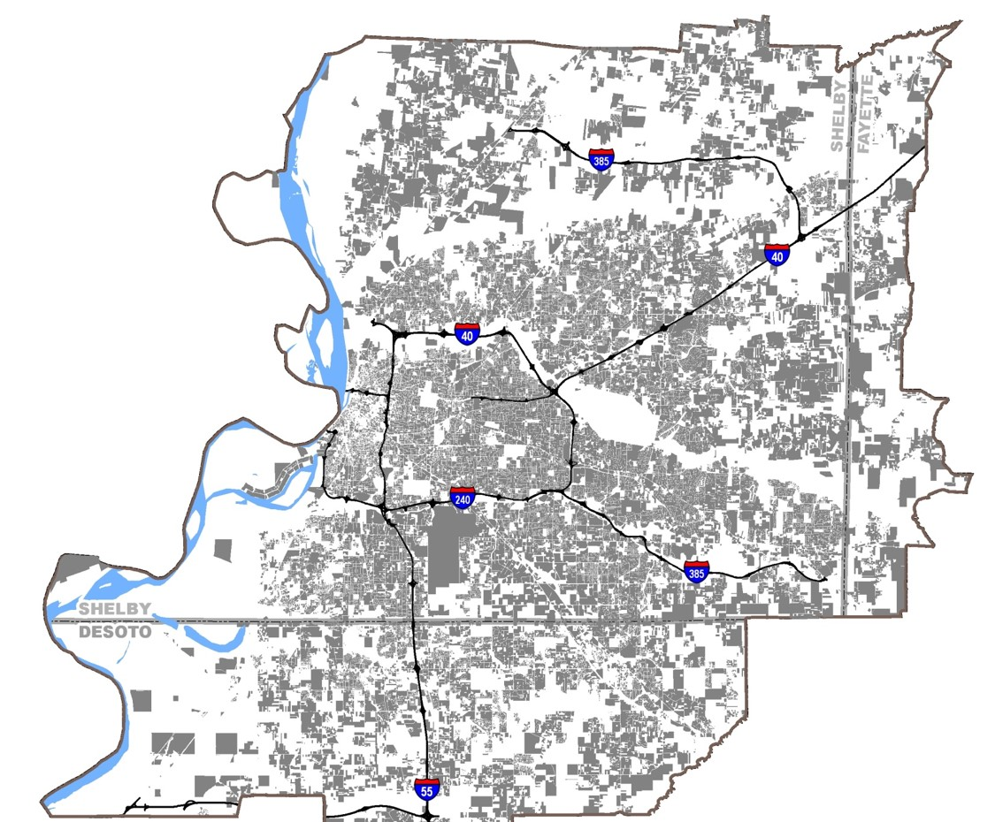
2010

Slide 12
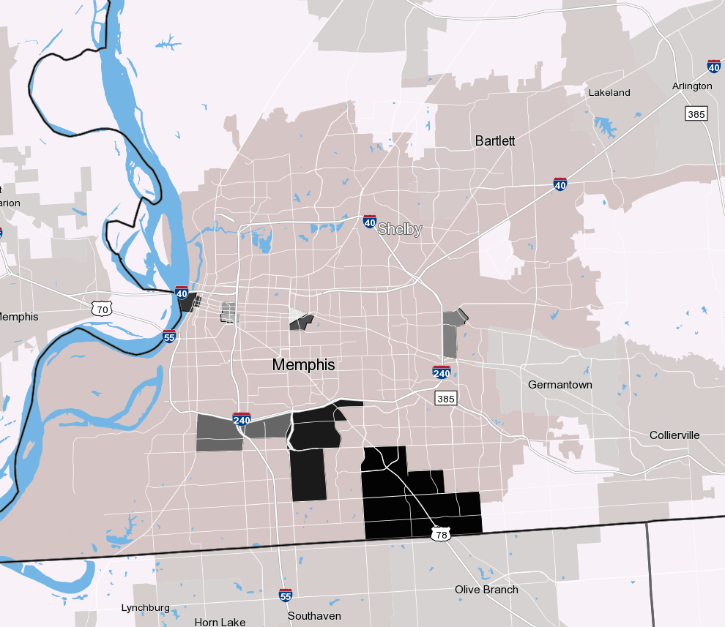
Top 10 Employment Centers by Block Group (2010)
42.1
31.1 and 31.2
37.1 and 38.1
213.11
225.1
9801.1
226.1
Not Shown: Tunica

