Slide 1


Slide 2
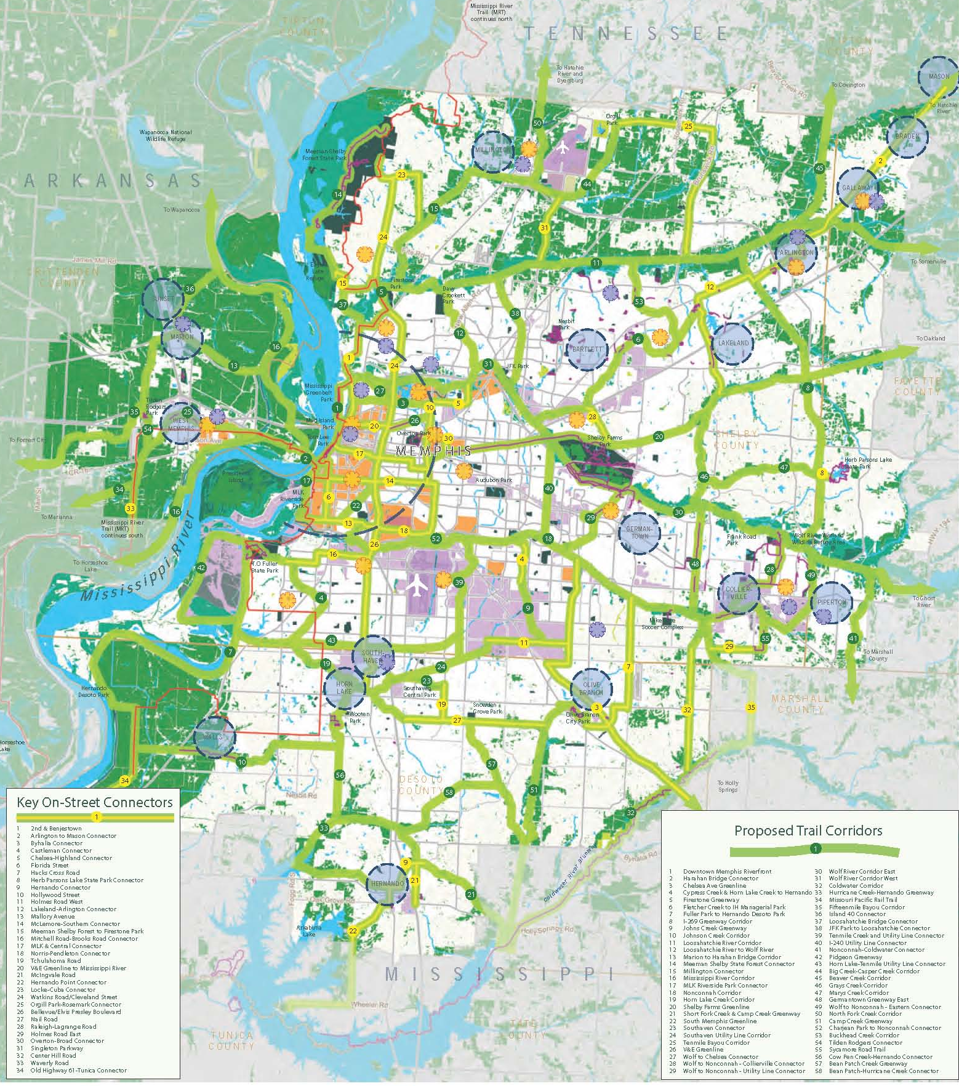
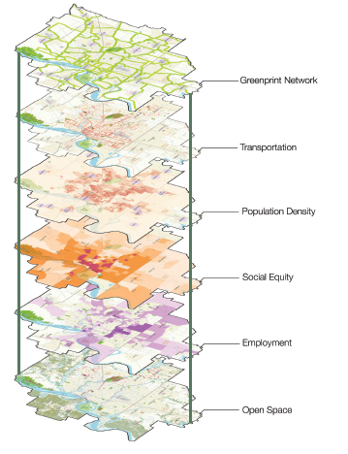

Slide 3
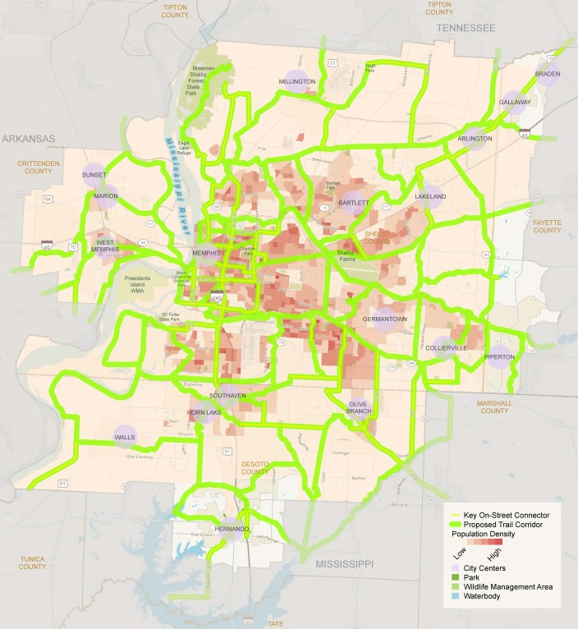
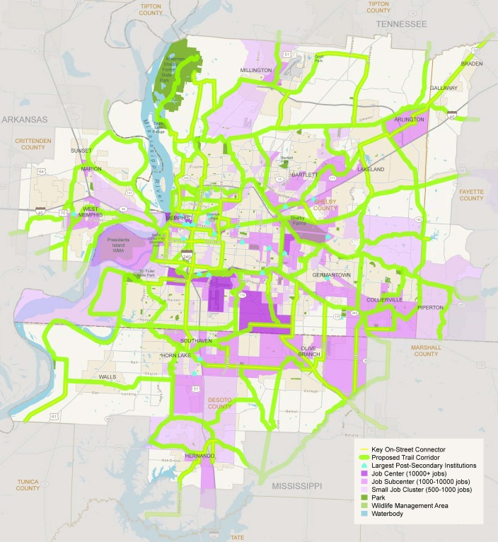
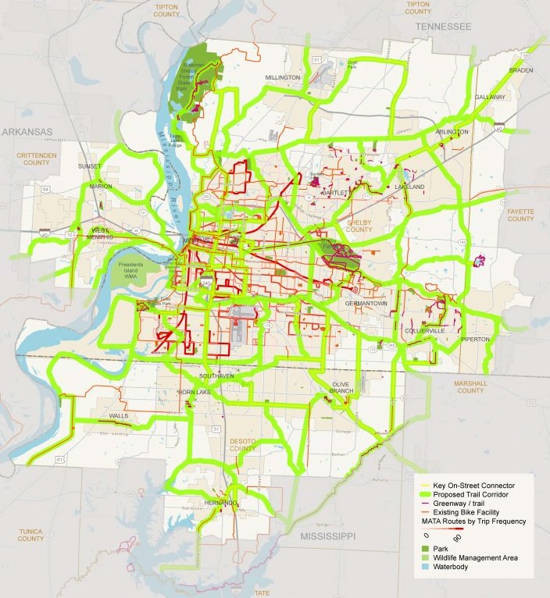

Slide 4
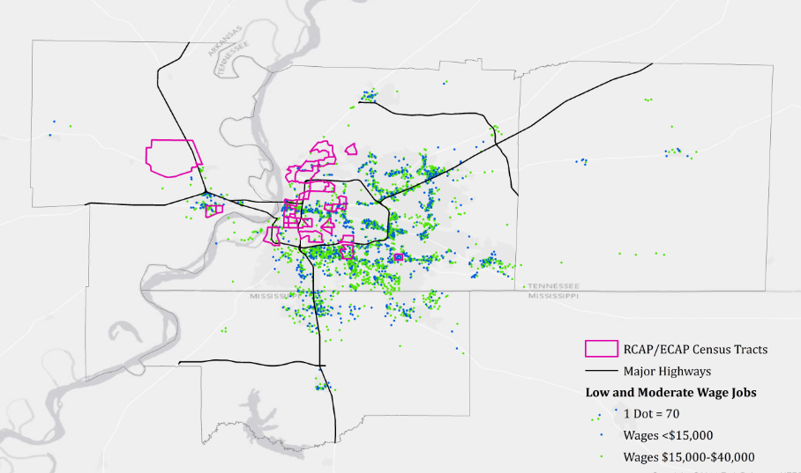

Slide 5
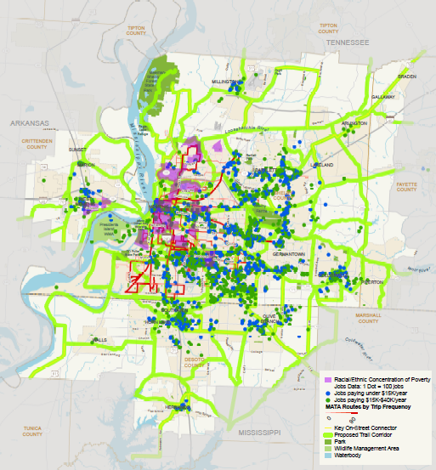

Slide 6
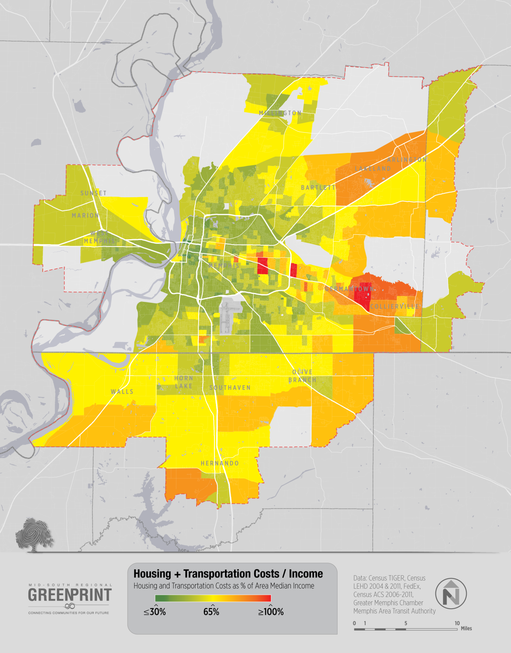
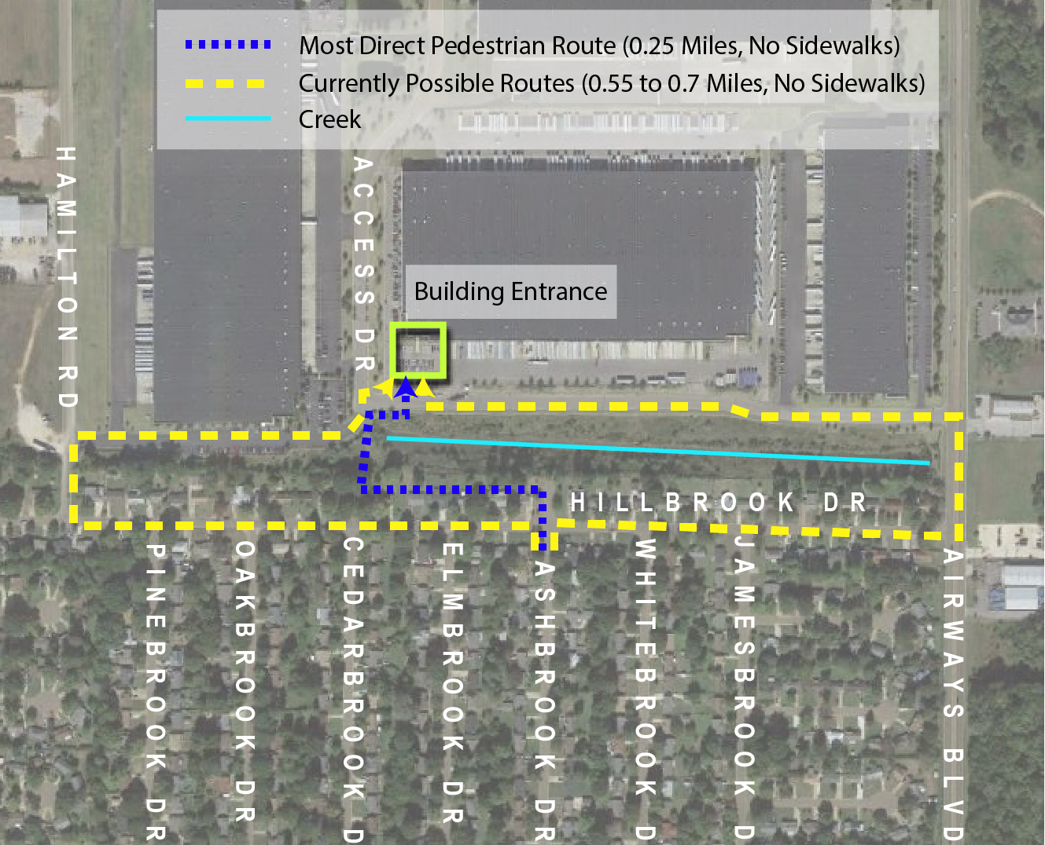
Why a Bus Transit to Workplace Study?
COST TO OWN A VEHICLE
Notes:
Driving is the only option

Slide 7
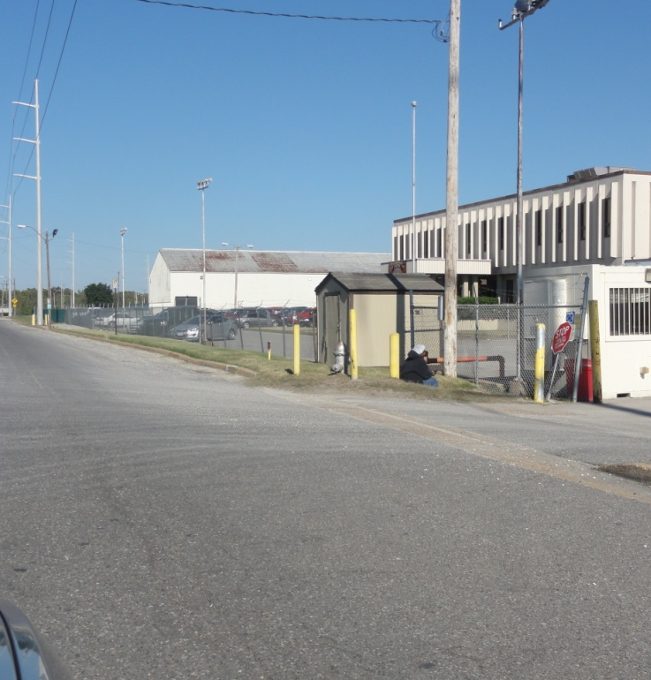
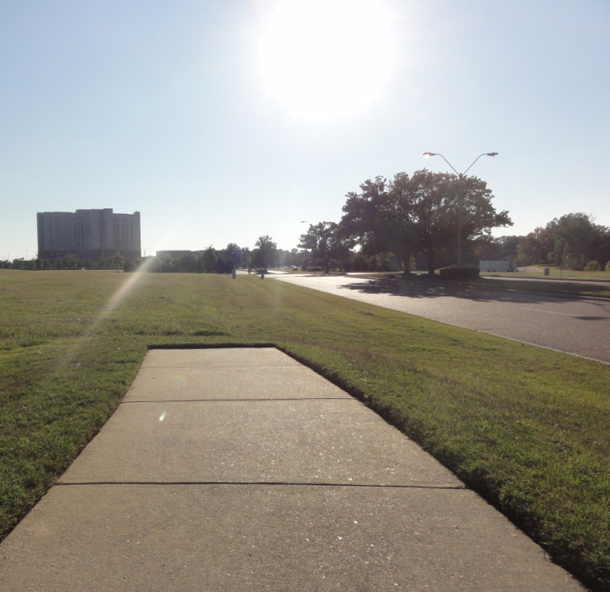
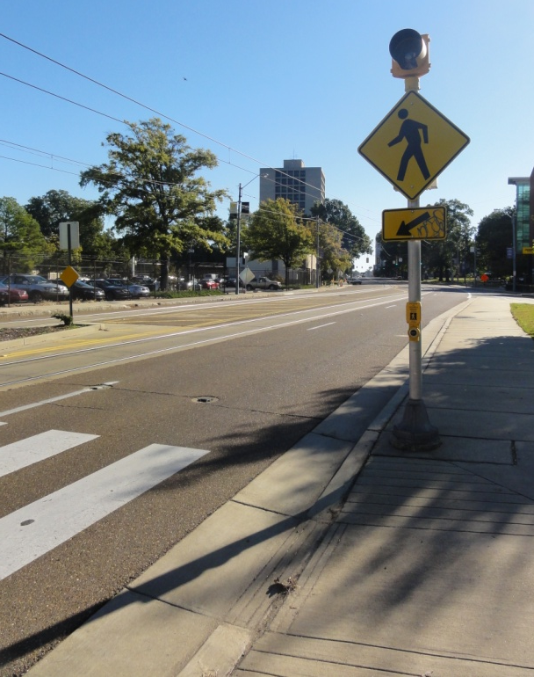
Infrastructure Assessment
Pedestrian Amenities
President’s Island
Southaven
Medical District

Slide 8
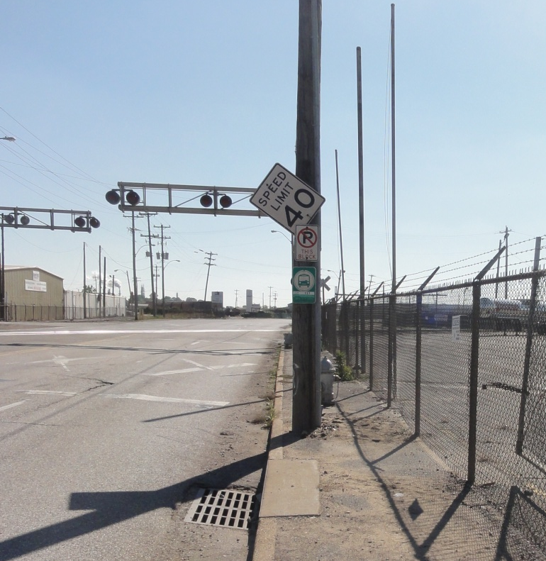
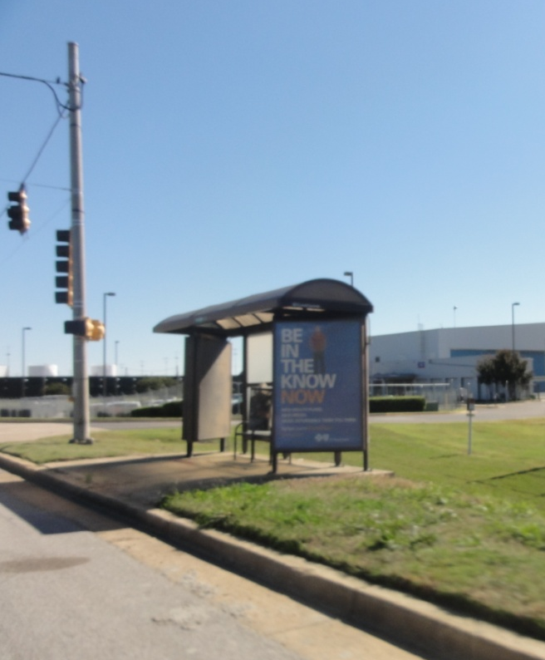
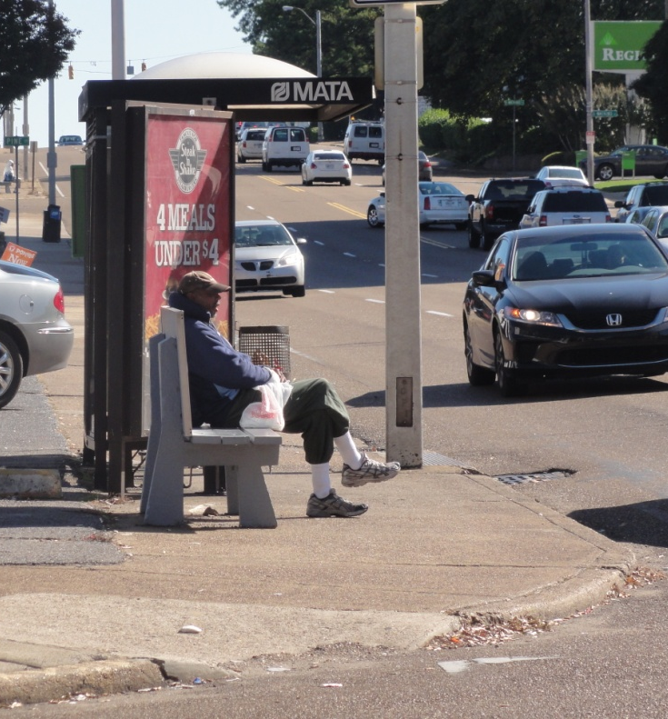
Infrastructure Assessment
Bus Stops
President’s Island
Aerotropolis
Medical District

Slide 9
Program Opportunities
Transportation Management Associations
Employer Subsidized Transit Passes
U-Pass
Pocket Park and Ride
Carpools/Rideshare/ Ride Matching
Commuter Bus
Employer Shuttles
Bus Stop Amenities
Bicycle and Pedestrian Facilities
Commuter Benefits
Bicycle Parking
Safe Routes to Work
Bike Share
Parking Cash Out

Slide 10
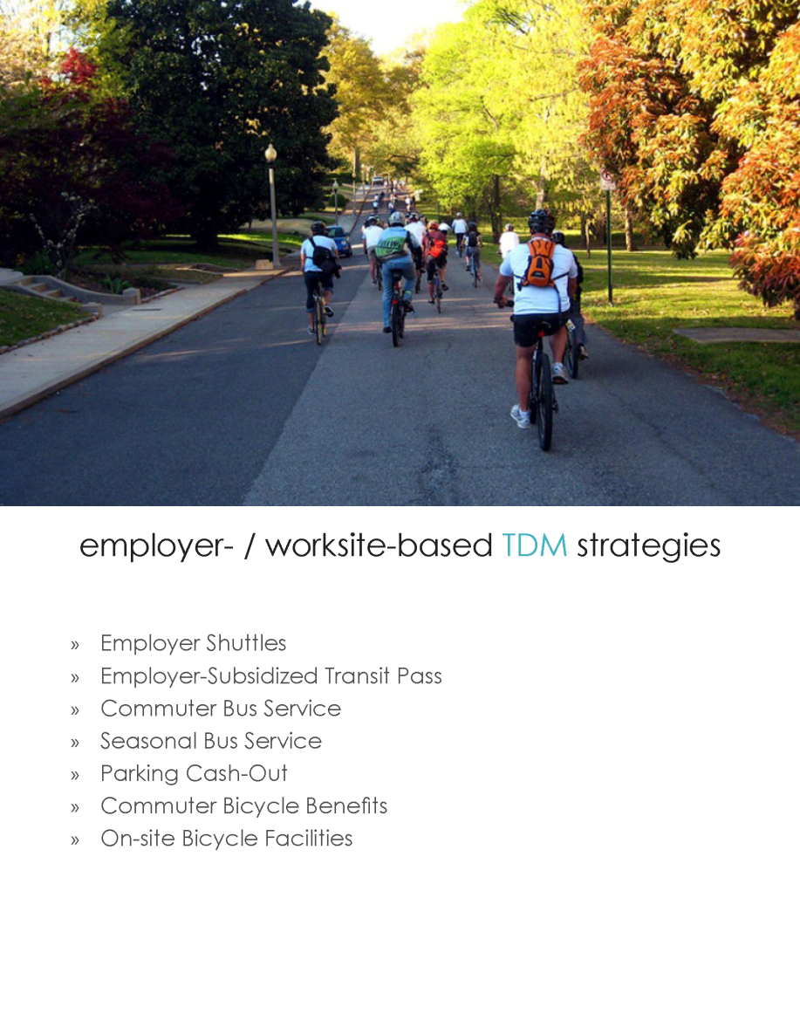
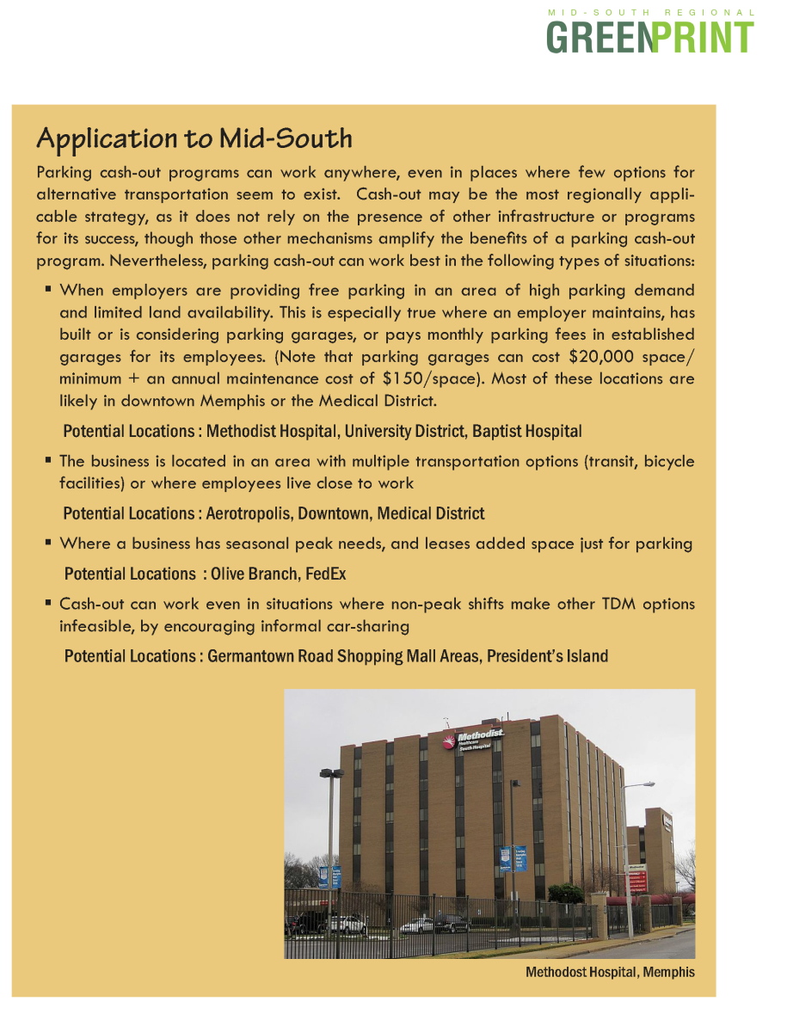
TDM Toolkit

