Slide 1
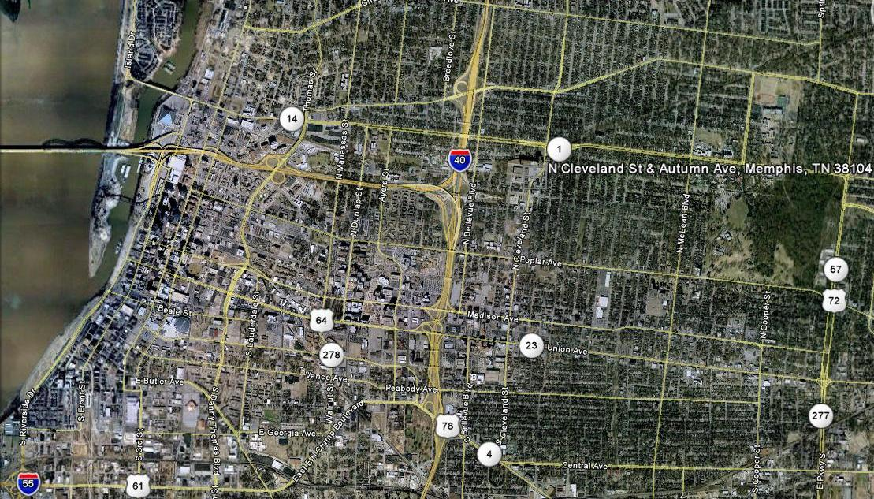
Crosstown
Downtown
Midtown
Medical Center
Notes:
Memphis has three vibrant areas that make up the inner city – Downtown, the Medical Center and MIdtown – but there has long been a missing piece, the area of Crosstown. The revitalization of the Sears Crosstown building holds the key to this whole area.

Slide 2
A BIG Building
Notes:
Sears Crosstown was begun in 1927 and grew over the years to be 1.5 million square feet. It is BIG. The building is solid; it was build to be both a Sears retail store and a distribution center. It sits on several acres of land that will be revitalized along with the building. The developers work began late in 2014 and is on schedule to have the core and shell of the building renovation completed in early 2016. At that time, the tenants will begin the buildout of their spaces with move-in planned for early 2017.

Slide 3
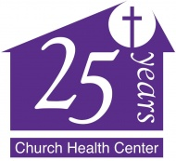
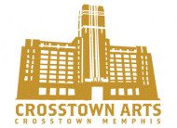


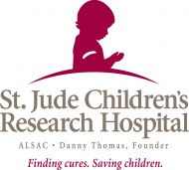
Notes:
There are three key areas represented by the founding tenants: arts, education and health. Crosstown Arts will anchor the arts with workshops where artists can make their work and people can observe them at work, gallery space for art exhibits and performance space for live theater, dance, music, speakers and more. Education will be anchored by Memphis Teacher Residency, with all program participants living and learning in the building before becoming teachers in Memphis schools. There will be two high schools: the Excel Center where adults can return to school to get a diploma and a regular high school for high performing students from across the City. Health will be anchored by Church Health Center (more on us in a minute), Methodist Healthcare and St. Jude and is fundraising arm, ALSAC.

Slide 4

Notes:
A variety of other early leasing tenants add strength to the arts, education and health.

Slide 5
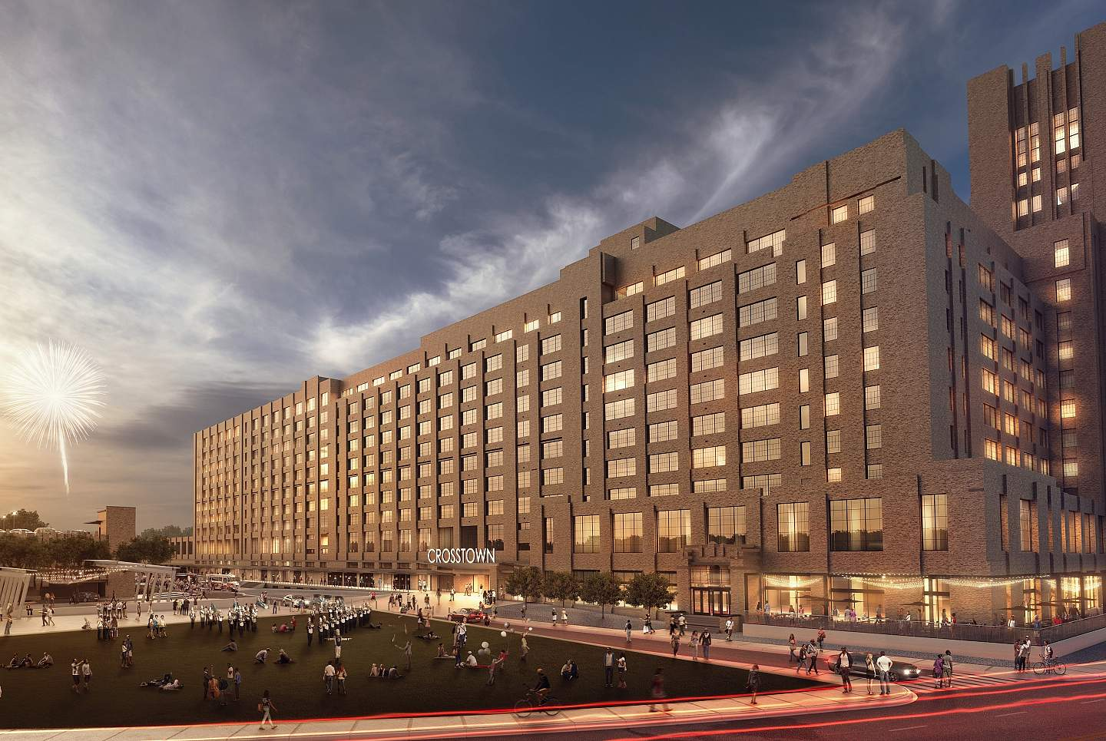
Notes:
The BIG building will become Crosstown Concourse, The plaza in front of the building will be activated with a green space, water feature, place for food trucks to plug in and where festivals and events can take place. This picture shows how large the building’s front will be all along this southern side facing the plaza. It also shows the top 4 floors that will be 270 apartments. There are numerous groups that have committed to commit to fill blocks of the apartments with young people who are in their programs. These include fellows from St. Jude Children’s Research Hospital, residents from Southern College of Optometry, scholars from Church Health Center, artists in residence with Crosstown Arts, all participants in the Memphis Teacher Residency program, medical students from University of Tennessee and more to come. It will be an exciting mix of bright young people representing multiple disciplines.

Slide 6
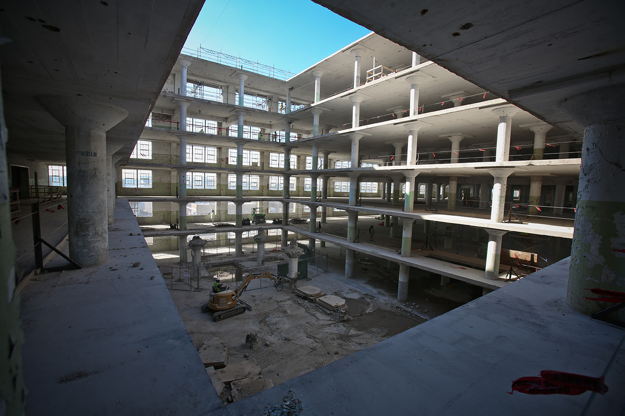
Notes:
The building’s 1.5 million square feet will be reduced by the creation of three atria through all 10 floors along with light wells in the residential floors. Light will flood the space. Natural light will be in every apartment.

Slide 7
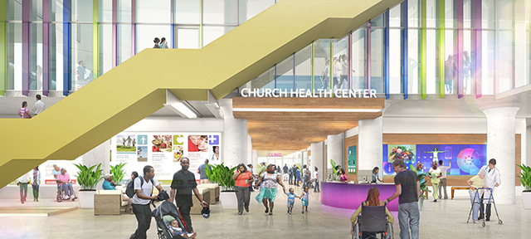
Notes:
This rendering shows the west atrium where the welcome center will be for the Church Health Center. You can get a sense of the size and the welcoming environment of the building. The tenants are committed to creating true community among those who live, work and visit Crosstown Concourse. We are working together to share in program planning and access to each other’s resources.

Slide 8
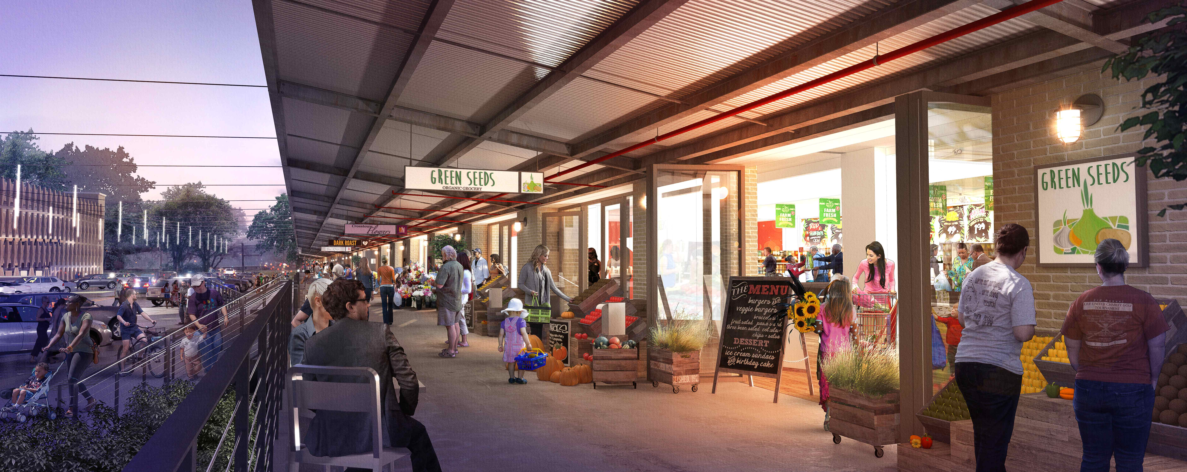
Notes:
This rendering shows the retail shops and services that will line the southern side of the building next to the plaza. This area was the loading dock when Sears’ distribution center was active. Again, this area is being designed to create a sense of community.

Slide 9
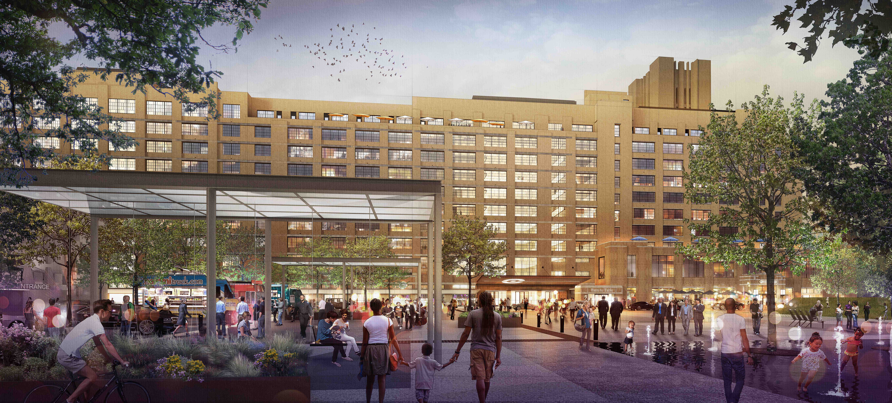
Notes:
The dreams are big for this big building but the goal is a vertical urban village where everyone joins together in creating a wonderful community.

