Slide 1
PROFESSIONAL ATTIRE
Dr. Delavega

Slide 2
MEN & WOMEN
Clean
Ironed
Correct fit
Neutral Colors: black, grey, brown, navy
  Women have some leeway here
Neutral hosiery or trouser socks
Shoes that match suit
Discrete jewelry (e.g. small ring)

Slide 3
MEN & WOMEN
Avoid trendy styles
Avoid tight clothes
Avoid crops and capris
Avoid shiny fabrics and strident colors
Avoid showing large tattoos

Slide 4
WOMEN
Skirts should fall at the knee
  Two fingers above knee is shortest allowed
Avoid high slits
No cleavage
Basic pumps with a low to mid heel
Discrete makeup

Slide 5
MEN
Tie
Jacket
No stubble
Combed hair
Very, very little jewelry

Slide 6
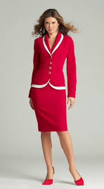

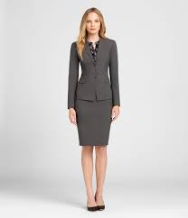
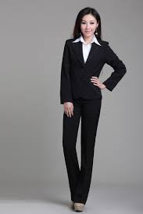
RIGHT

Slide 7
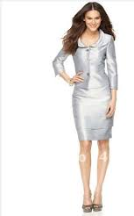
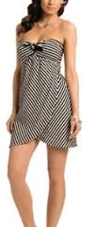
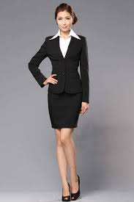
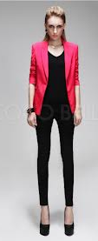
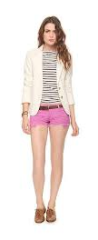
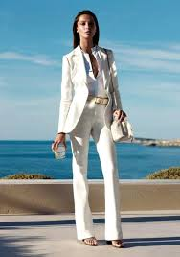
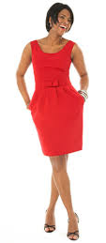
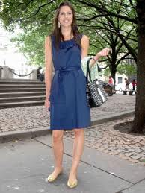
WRONG
Too tight, informal jacket
Too short
JUST NO!
TOO SHORT!
Cleavage
Not a suit

Slide 8
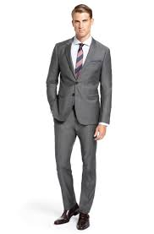
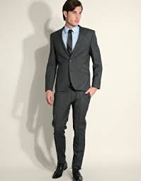
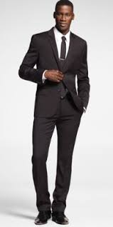
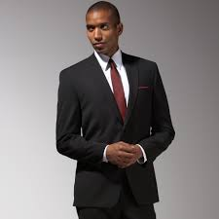
RIGHT

Slide 9
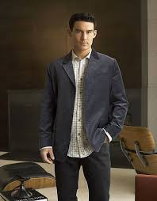
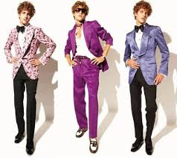
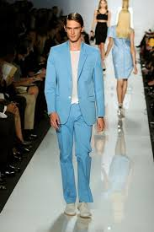
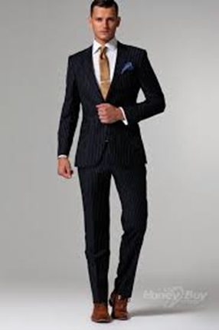
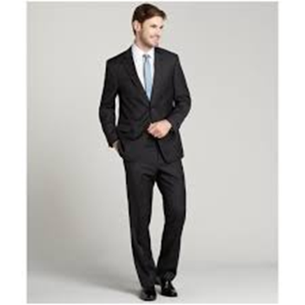
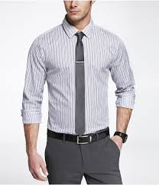
WRONG!
No tie, not tucked in, not crisp
JUST NO!
Wrong color shoes
Stubble
Not a suit

Slide 10
GOING CASUAL
Dress pants or khakis
Sweaters or sweater sets
Ties and jackets are optional
A bit more color
Dresses are OK
Polo shirts are OK

Slide 11
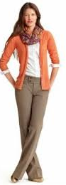
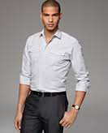
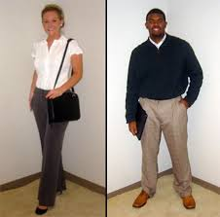
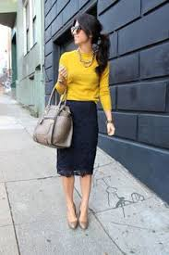
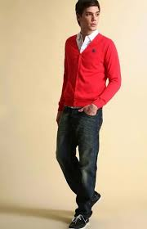
Keep in mind that business casual is harder to do well

Slide 12
NEVER!
Dirty, disheveled clothes
Tennis shoes, sandals, clogs, uggs, or flip-flops
Cleavage
Too short, too tight, too sexy
Evening wear
Beach wear
Jeans (with few exceptions)

