Slide 1

Homicide, Domestic Violence, Youth & Guns in Memphis
Dr. James McCutcheon
Dr. Bert Burraston
Dr. Amaia Iratzoqui
Department of Criminology & Criminal Justice
Dr. Angela D. Madden
Public Safety Institute

Slide 2
Introduction
This presentation results from various research conducted at the request of various agencies and for program development and implementation.
Memphis Police Department, Shelby County Sheriff’s Office, Shelby County Juvenile Court, Shelby County District Attorney General’s Office, Family Safety Center

Slide 3
Study 1: Homicide Research (2016)
Homicides and supplemental homicide reports were evaluated and mapped
Census tract level data were used along with other socioeconomic factors
Education
Residential Mobility (movement in and out of neighborhoods)

Slide 4
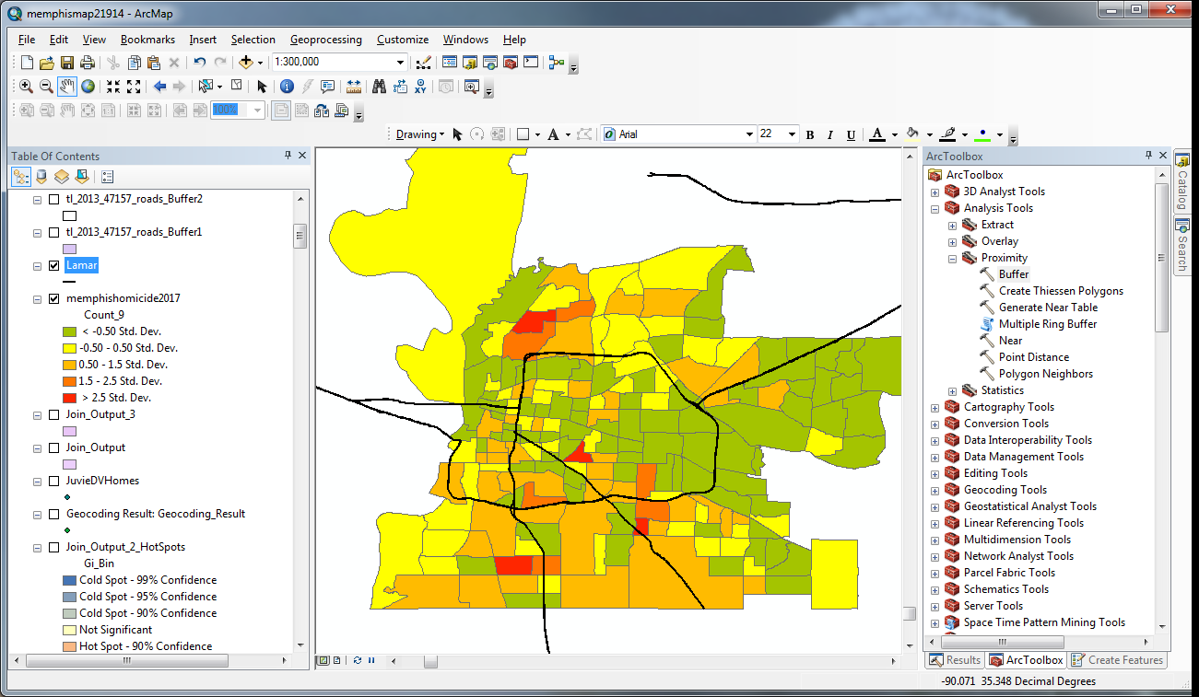
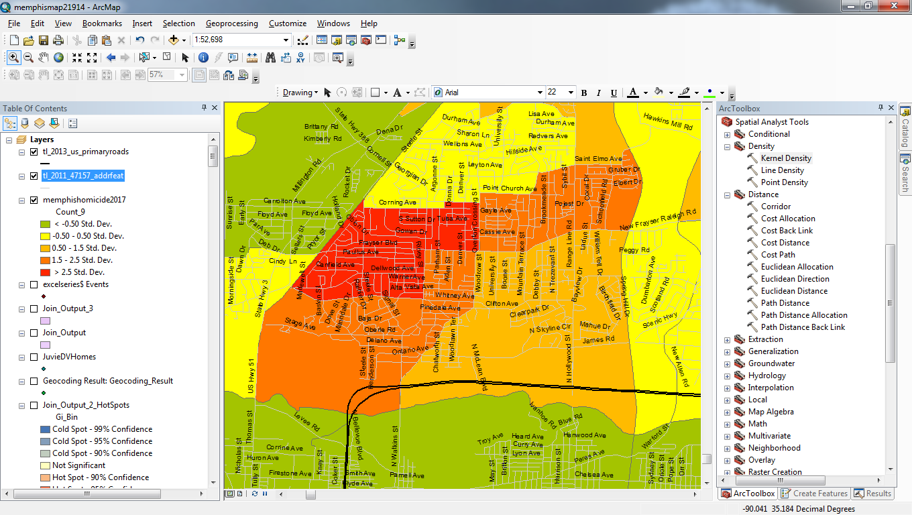
Census Tracts Showing Deviation from “Average” in Number of Homicides: Red has the Highest Deviation from Average

Slide 5
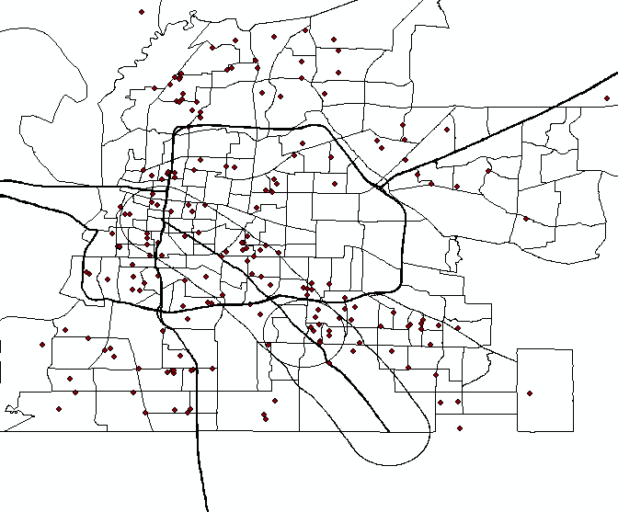
Homicides In Memphis

Slide 6
Location of Homicides
26% of the homicide incidents within Memphis were within a 1.5 mile proximity of Lamar Ave.
This roadway crosses various precincts (Mt. Moriah, Ridgeway, Tillman, Crump, Airways)
14% were in Old Allen
16% were south of I-240, between Bill Morris Pkwy (Hwy 385) and Hwy 78 (Ridgeway and Mt. Moriah)

Slide 7
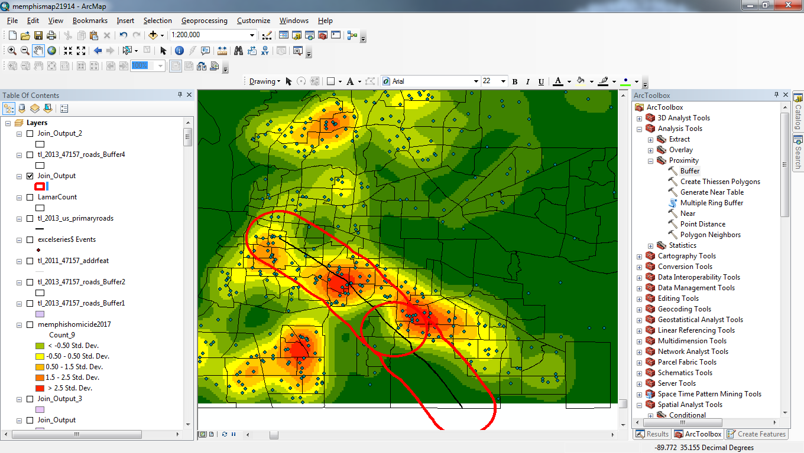

Lamar Ave. corridor (circled in red) with area between Hwy 385 and Hwy 78 highlighted (circled in black)

Slide 8
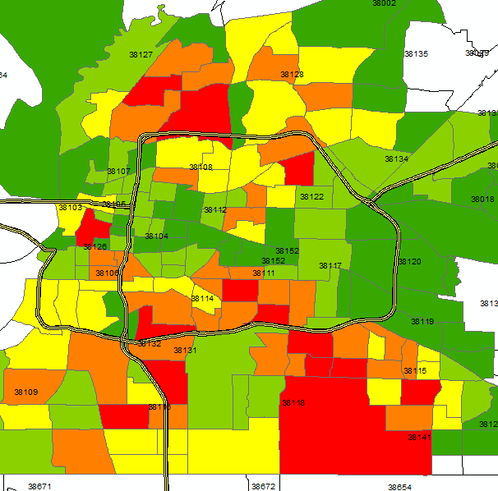

Juvenile Violent Crime Counts by Census Tract

Slide 9
Study 2: Lamar & Juvenile Domestic Violence (DV)
About 25% of juveniles brought to juvenile court are brought for DV
Home addresses of juvenile DV offenders were mapped
23% of all juvenile DV offenders lived within a 1.5 mile proximity of Lamar
Violence is learned in the home, so DV is likely a precursor to neighborhood violence (rates of general violence high where rates of DV high)

Slide 10
Homicide’s Known Predictors
“Economic Disadvantage”
Poverty, Unemployment, Median Income, Median Home Values, % Vacant Homes
% Female-Headed Households
% Black, % Hispanic
“Social/Cultural Capital Disadvantage”
% of population age 25 and over without a high school diploma or GED
“Residential Mobility”
% of the population who moved into the census tract between 2010 and 2015

Slide 11
What Predicts Homicide in Memphis?
% of population age 25 and over without a high school diploma/GED
Juvenile domestic violence
Residential mobility
% Black residents, but this relationship was weak

Slide 12
What Predicts Homicide in Memphis?
“Economic disadvantage” was not significantly associated with neighborhood homicides
Family and child development are important in the development of antisocial and criminal behavior (Social Learning Theory & Social Bond Theory).
Neighborhoods with significant populations without an education, with high levels of juvenile DV and high residential mobility (a measure of neighborhood instability) had the highest numbers of homicides.

Slide 13
Homicides and Percent of High School Dropouts

Slide 14
Study 3: Homicide and Prior DV History (2015-2016)*
Was the homicide a “DV case”?
Did either involved party have a “DV history”?
61% of homicides were DV cases and/or involved a party with a DV history.
The % would probably have been much higher had we looked back further
Only 39% had no DV connection.
*30 cases could not be determined

Slide 15
DV History Predicting Homicide
*30 cases could not be classified

Slide 16
Domestic Violence Predicts Homicide
A history of domestic violence predicts not only domestic violence homicide but ALL homicide
55% of robbery homicides
51% of “disagreement” homicides
45% of gang homicides

Slide 17
Implications of Homicide Studies
Risk factors for homicides (DV or not) are the same
Strategies to prevent homicide must include preventing DV
Increase education level in the community
Uncovering crime attractors and generators at the city level

Slide 18
Implications of Homicide Studies
For police:
Crime prevention strategies should extend beyond precinct level
Increase communication
Interpreting Memphis as a larger unit
City-level crime generators and attractors: streets, interstates, schools, apartments, and other physical features
Notice to victims of services available
Police as educators of community resources

Slide 19
Implications of Homicide Studies
For community:
Conflict resolution and domestic violence classes in schools
Focus efforts toward high school retention
Community GED programs

Slide 20
Study 4: Guns, DV, and youth
Firearm violence, domestic violence, and youth involvement were evaluated.
Both “offenses/reports” and “arrests” were examined.
AA/DV: “aggravated assault/domestic violence”

Slide 21
2016 Violent & AA/DV Offenses/Reports
19% of all violent offenses/reports were for AA/DV.
30% of these AA/DV offenses/reports involved a firearm.

Slide 22
2016 Violent & AA/DV Arrests
26% of all arrests for violent crime were for AA/DV (500/1,915).
25% of these AA/DV arrests involved a firearm (125/500).

Slide 23
Proportion of Gun Arrests* by Age: 2014-2016
*includes Weapon/Misdemeanor & Weapon/Felony
Notes:
Although slightly decreasing, more than 1 in 10 gun arrests are of juveniles; more than HALF of gun arrests are of “youthful” offenders (under age 25); Intervening with the juvenile and youthful population presents a significant opportunity to reduce violent and violent gun crime.

Slide 24
Proportion of Juvenile Arrests for Violent* Gun Crime: 2014-2016
The proportion of juvenile arrests for violent firearm crime increased 6.7% between 2014 and 2016.
2014
2015
2016
*excludes Weapons/Misdemeanor & Weapons/Felony

Slide 25
Gun Arrests & Violent Gun Arrests by Age: 2014-2016
Notes:
Juveniles were 11.4% of all gun arrests and 16.2% of all violent gun arrests; 18-24 year-olds were 45.9% of all gun arrests and 43.2% of all violent gun arrests; In total, “youthful” offenders comprised 57.3% of all gun arrests and 59.4% of all violent gun arrests.

Slide 26
Gun Crime Recidivists Since 2010 By Age Group (2015 arrestees)
Notes:
16% of gun crime arrests in 2015 were of juveniles with at least 1 prior gun crime arrest since 2010; 56% of gun crime arrests in 2015 were of individuals 18-24 with at least 1 prior gun crime arrest since 2010; 71% of all gun crime arrests in 2015 were of “youthful” offenders with at least 1 prior gun crime arrest since 2010.

Slide 27
Implications
Gun violence, DV, youth, and homicide are all connected in Memphis.
Juvenile and “youthful” involvement in violent gun crime is increasing.
The proportion of violent crime committed with a firearm has increased nearly 11% since 2013 (from 41.7% to 46.1%).
Gun violence prevention, suppression, and intervention programs are critical for youth.

