Slide 1

University Process Improvement
Methodology Training

Slide 2


AGENDA
UofM Approach to University Process Improvement
Resources
Process Improvement Methodology

Slide 3

University Process Improvement – Why?
University Process Improvement Department was formed in 2010.
In line with President’s challenge
Improve efficiency
Continued focus on reducing administrative costs
Supports University Strategic Goals
Innovation
Student Success

Slide 4
(22
Process Improvement Initiatives for UofM
Need to address rapid ERP Banner Implementation (2005-2008)
Banner implementation is a standard 5-year plan, TBR charged to the University was to complete in 3 years
Implementation schedules did not allow for process review
Initially was formed to review business processes relating to Banner implementation
Over 800 staff and faculty members have participated on teams to-date
Successfully implemented over 100 projects relating to Student, Employees, Faculty, Business and Academic processes

Slide 5
Process Improvement Initiatives for UofM
Recommendations come from our campus community
Team members are our best advocates
All suggestions are reviewed by our governing structure
All project teams successfully implement an improved process
Top Executive support is key to our success
PIP Website: www.memphis.edu/processimprovement

Slide 6

Governing Structure

Slide 7

Executive Leadership Board
Academic Affairs – Exec VP/Provost David Russomanno
Business & Finance – Exec VP/CFO Renee Bustamante
Information Technology – CIO Jeff Delaney
Research & Innovation- Executive VP Jasbir Dhaliwal
Student Academic Success – VP Karen Weddle-West
Ex-Officio – Tom Nenon

Slide 8
Executive Committee Role
Provides overall sponsorship, vision, and guidance
Ensures changes are successfully communicated, achieved and measured for progress toward service excellence
Review suggested projects and approve the slate of projects to implement
Meets 2 – 3 times a year with PMG co-chairs

Slide 9
Project Management Group
Co-Chair – Deborah Becker
Co-Chair – Cassandra Dinwiddie
Business Officers – Latica Jones
Human Resources – Maria Alam
Information Technology Services – Sue Hull-Toye
Process Improvement – Colette Williams
Process Improvement – Shruti Bapat
Registrar Office – Darla Keel
Research Sponsored Programs – Terrice Watson
Student Academic Success – Meghan Pfeiffer

Slide 10
Program Management Group (PMG) Role
Serves as champions of change and support improvement efforts, both large and small
Work to eliminate project roadblocks within the organization
Oversight committee for Process Improvement projects
Construct project scopes to ensure it is well-defined
Identify team members
Bi-weekly meetings

Slide 11
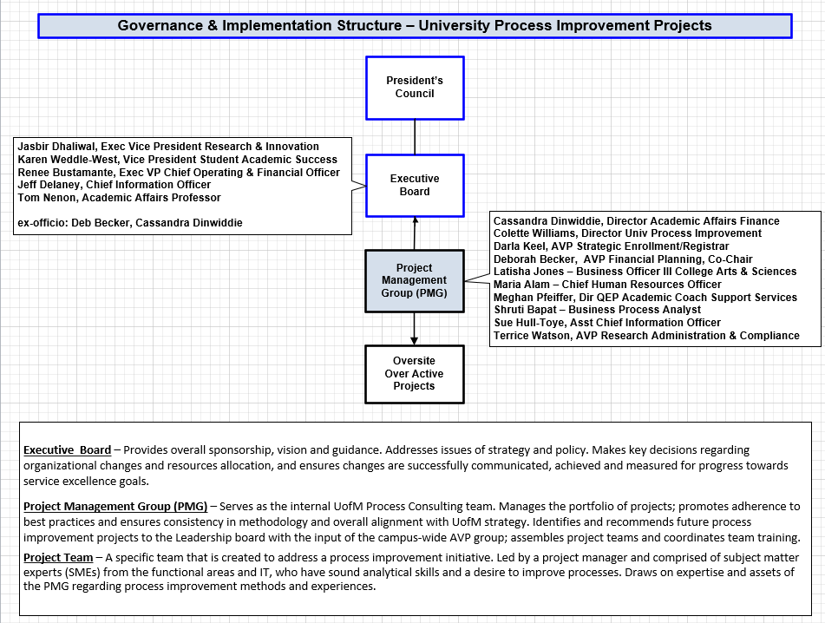

Slide 12
Process Improvement
Methodology

Slide 13
1
Process Definition and Analysis Terminology
What is Process Improvement?
A systematic approach to identifying , analyzing and improving existing processes.
What is a Process?
A sequence of controlled or managed activities, with a natural beginning and end, triggered by time or an event, that is intended to produce a specific result (hopefully of value) for an internal and/or external customer

Slide 14
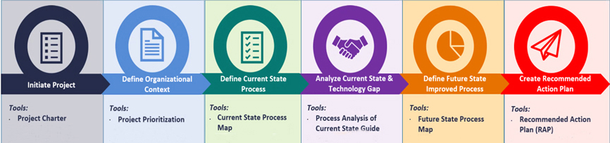
University Process Improvement Methodology
Six Stages
Initiate
Define Project Prioritization
Define Current State
Analyze Current State & Technology Gap
Define Future State Improved Process
Create Recommendation & Action Plan

Slide 15
Process Improvement – Approach
“Bite-sized” projects (Band-Aid approach)
Well-defined, short timeframe for process analysis
Small core team
Defined methodology
Leadership commitment
Manage communications
Support from PMG & Executive Leadership

Slide 16
1
What does Process Improvement do for UofM?
Breaks down Barriers
Empowers Staff
Supports Change
Improves Customer Service
Encourages Open Communication

Slide 17
Terminology
“As Is” State
The actual ways a process is currently performed (not how it is supposed to be performed)
Teams tend to want to tell you how it should be working
Includes workarounds, shortcuts, extra paper copies/files maintained, extra notifications, etc.
Understand where the process begins, ends and what key variations (exceptions) are within the process
“To Be” State
The way you want the process to be performed in the future
Only constrained by law, socially acceptable behavior and the technological capabilities that are in existence in the marketplace today
Should incorporate elements to achieve UM’s goals (Service Excellence)

Slide 18
Terminology
“Swim lanes”
Swim lane flowchart differs from other flowcharts in that processes and decisions are grouped visually by placing them in lanes.
Parallel lines divide the chart into lanes, with one lane for each role, group or sub process.
Symbols enables clear linkage to be shown between related flow charts when charting flows with complex relationships.
“Subject Matter Experts” (SME)
People with firsthand knowledge about the process, how why it is performed the way that it is; generally involved day to day

Slide 19
Terminology
“Value Added”
The benefit resulting from work exceeds the cost or effort to produce that benefit
“Efficiency”
Refers to doing things in a right manner
“Effectiveness”
Doing the right things

Slide 20
Process, Tools and Methods

Slide 21
Process Work Session Steps
Identify the general scope (beginning & end) of the process
Define the process including:
Who are the “players” in the process today
What triggers the process to begin
Inputs and outputs
What concludes the process
Approximately how frequently is this performed (on a daily, weekly or monthly basis) and how long do the activities take
What cost, quality, service and speed issues exist?

Slide 22
Generating “As Is” Process Flow
Gather and review preliminary process information
Understand where the process begins, ends and what key variations are within the process
Define the process as it ‘ACTUALLY IS’ NOT ‘How it Should Be’
Conduct small group work sessions to map the process
Collect key documents used within the process
Create and circulate process maps for review and approval
Focus will be on the primary flow, exception flows will be documented if necessary
Level of Detail
Avoid atomic level of definition
Focus on – step by step “what do you do, how do you do it (e.g., use Excel to...)”

Slide 23

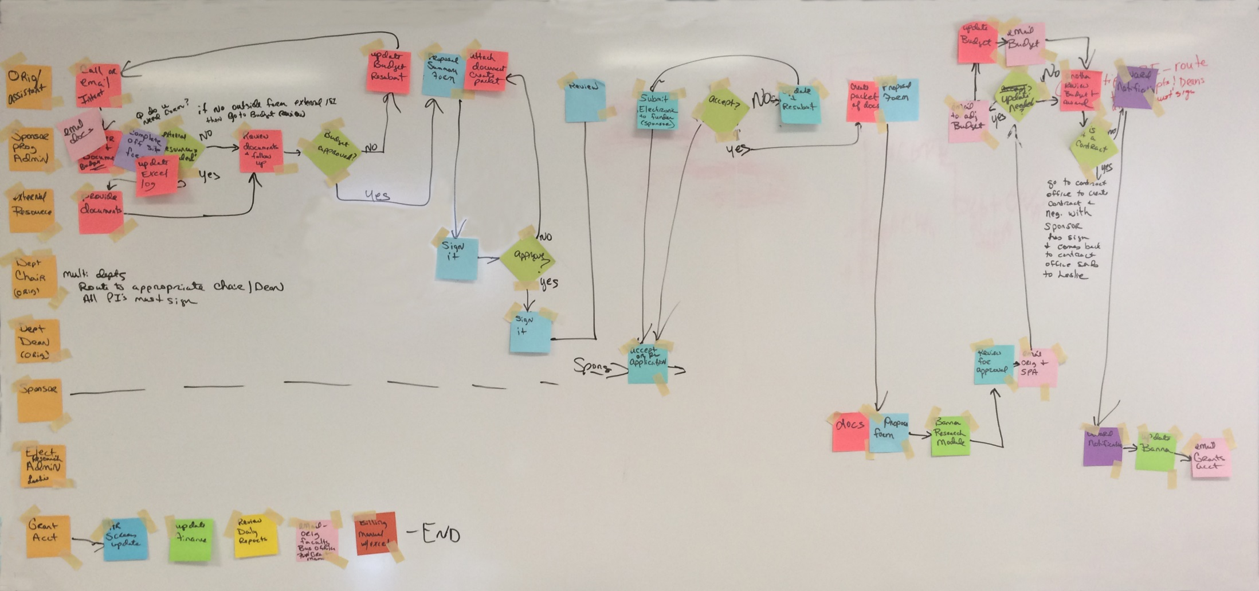
‘AS IS’ MAPPING SESSION - Visual
Notes:
This is picture what a mapping exercise looks like

Slide 24

Process, Tools and Methods
Analysis
Is it what/how our customer’s want it?
Why is it done?
What value does it add?
How is the quality, speed and timeliness?
What is the value compared to the cost?
What work is done?

Slide 25
Process, Tools and Methods
Analysis
Why?

Slide 26
Process, Tools and Methods
Analysis – Examination of “As Is” Process
Are we doing the RIGHT work in the RIGHT way?
Why does the manual task exist?
Necessary Business Function
Legal or Regulatory Requirement
Software Limitation
Other (e.g., “always did it that way”, departmental silos...)
What steps can be:
Eliminated, substituted or combined, or done earlier
Automated
Completed by Employee or Student?
What steps should be added to:
Improve communication
Prevent problems?

Slide 27

Process, Tools and Methods
Generating “To Be” Process Flow
Conduct process design work sessions to identify:
What work should be done?
How should the work be done?
When should the work be done?
Who should do the work/Where? (to increase quality, scale, communication and reduce hand-offs…)
Create “To Be” process maps and circulate for review and approval

Slide 28
Effective Process Work Sessions
Maintain a moderate pace and high degree of focus
Focus on describing what work you do (in the context of the process) and how. Try to avoid:
Too much detail (e.g., describing the process at the screen or field level)
Describing how the process used to be performed
What policy or regulatory differences exist?
Assign a back up person to participate in work session in the event you can not attend.

Slide 29
Mapping - Outcomes
Sample AS IS and TO BE Maps

Slide 30
‘AS IS’ MAPPING – Pains Identified
Notes:
The orange circles identify where the pains exits that were identified – gives a good visual

Slide 31
‘TO BE’ MAPPING – The IMPROVED Streamlined Process

Slide 32
What’s Next
Let’s talk about the current process:
Where does this process begin?
Where does the process end?
What “pain” or frustration is around this?
What might complicate our definition of how it works today?

Slide 33

Questions?

