Slide 1


Demystifying Census Data:
Navigating the New American FactFinder
Charlie Santo, PhD
Associate Professor and Director,
Graduate Program in City & Regional Planning

Slide 2
Where does the data come from?
Old Model
New Model
Decennial Census
Short Form (100%)
Long Form (1 in 6 sample)
Decennial Census
Short form only (100%)
NO LONG FORM
Continuous American Community Survey

Slide 3
2000 short form
2000 long form

Slide 4
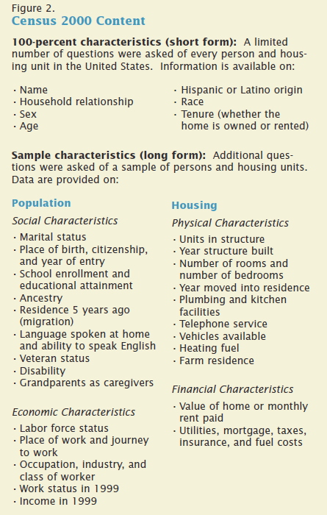

Slide 5
2010 Census form
ACS Form

Slide 6
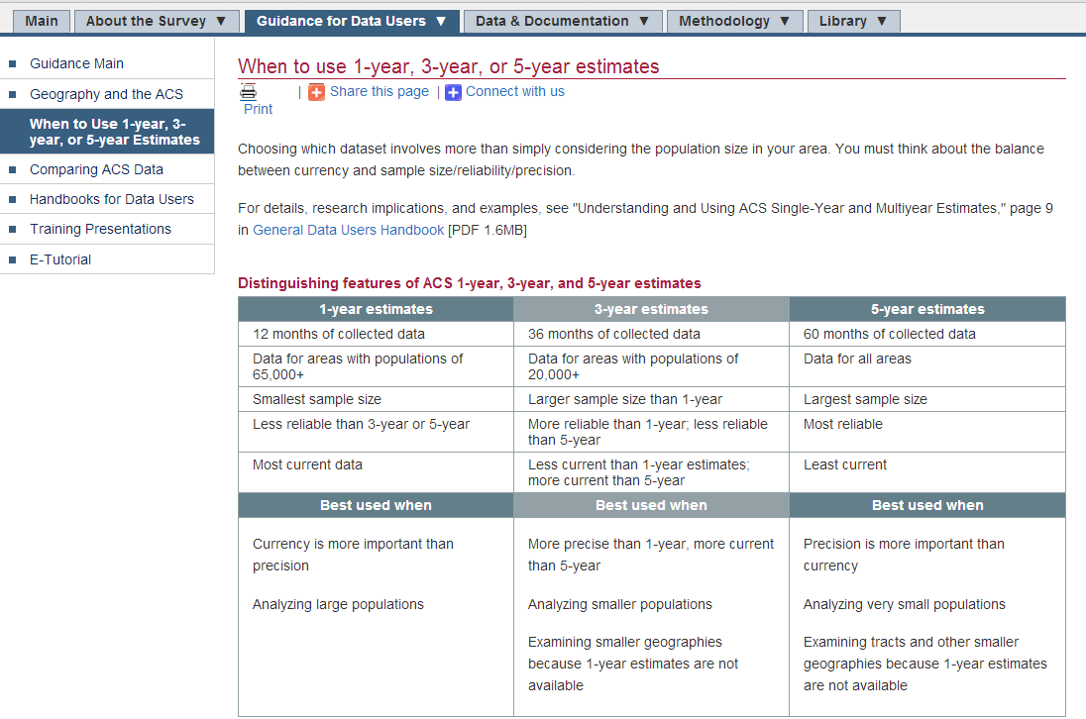

Slide 7
Table Naming Conventions
Decennial Census
American Community Survey
P: Population Variables (People)
H: Housing Variable
DP: Demographic Profile
(includes more than one variable)
QT: Quick table
(includes some calculations)
B: Base (detailed) Table
C: Collapsed (version of a base table)
GCT: Geographic Comparison Table
R: Ranking Table
S: Select Population Profile

Slide 8
Table Naming Conventions
BASIC tables (raw data)
Decennial Census
American Community Survey
P: Population Variables (People)
H: Housing Variable
DP: Demographic Profile
(includes more than one variable)
QT: Quick table
(includes some calculations)
B: Base (detailed) Table
C: Collapsed (version of a base table)
GCT: Geographic Comparison Table
R: Ranking Table
S: Select Population Profile

Slide 9
Table Naming Conventions
Decennial Census
American Community Survey
P: Population Variables (People)
H: Housing Variable
DP: Demographic Profile
(includes more than one variable)
QT: Quick table
(includes some calculations)
B: Base (detailed) Table
C: Collapsed (version of a base table)
GCT: Geographic Comparison Table
R: Ranking Table
S: Select Population Profile
NP: Narrative Profile
“Manipulated” Data

Slide 10
2000 SF1 Technical Documentation (with table/variable names)
2000 SF3 Technical Documentation
2010 SF1 Technical Documentation
2006-2010 ACS 5-year Summary Technical Documentation
ACS Table Codes

Slide 11
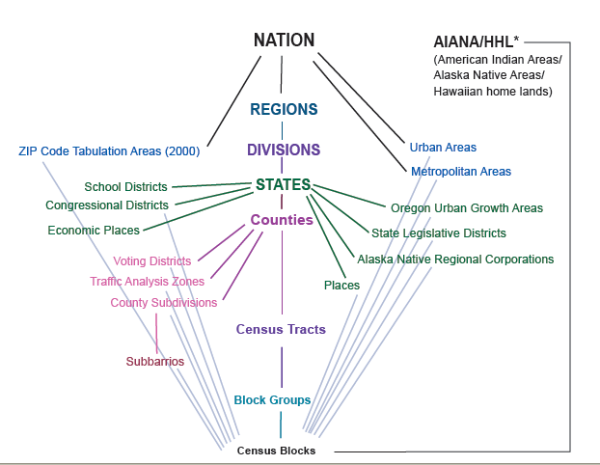
Census Geography Hierarchy
(with 2010 Statistical Area Criteria)
Central axis describes a nesting relationship
Cities and towns -- incorporated
Census Designated Places (CDPs)
1,200 to 8,000 population (optimum 4,000)
480 to 3,200 housing units
Blocks are not defined by population
and are the smallest geographic level at which data are ever released (Decennial Census, not the ACS)
600 to 3,000 population
240 to 1,200 housing units

Slide 12
http://factfinder2.census.gov/

