Slide 1
TREATING Post Incarceration trauma
iIMPACT Summit
April 6, 2022
Jerry Watson, PhD, LCSW, MBA

Slide 2
Introduction & Grounding
Welcome
Who is in the room? And why?
What do you want to know?
We begin with a brief history lesson
Post Incarceration, Reentry, After “justice involvement”
Post Incarceration Stress & Trauma
“A Tale of Three Cities”

Slide 3
Learning Objectives:
Participants will understand the trauma experienced by post-incarcerated individuals.
Participants will appreciate the disproportionate impact that incarceration and the subsequent trauma have on African American men.
Participants will learn a culturally appropriate reentry support group model designed for African American men

Slide 4

First Prison in the Americas
Fortaleza Ozama
Erected in Santo Domingo, Dominican Republic, 1502
Pirates and Black slaves were usually housed there. (Wikipedia)

Slide 5
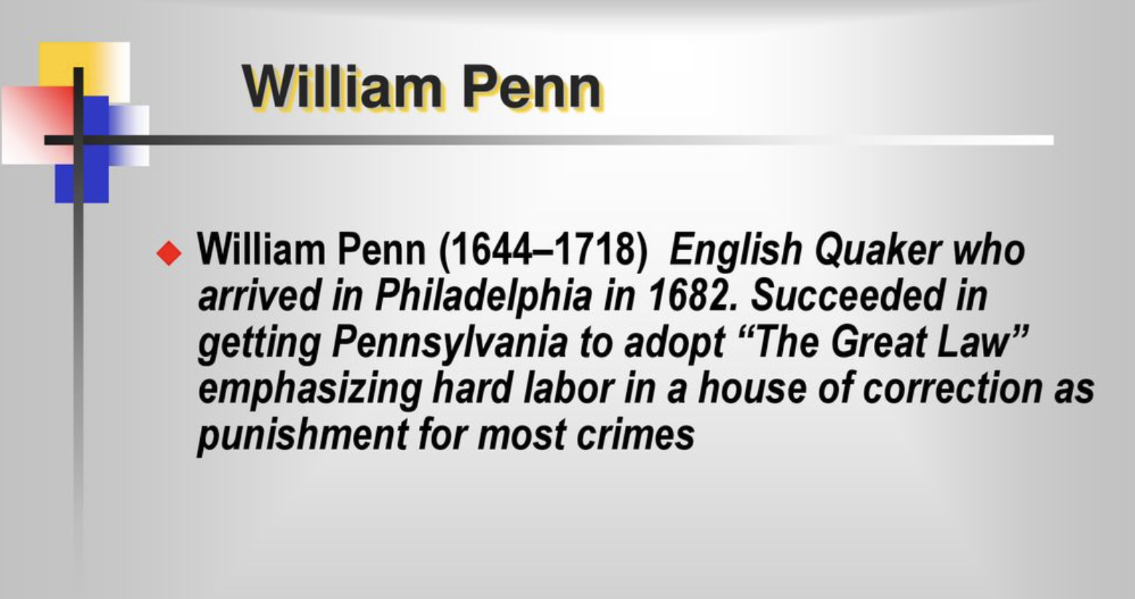

Slide 6
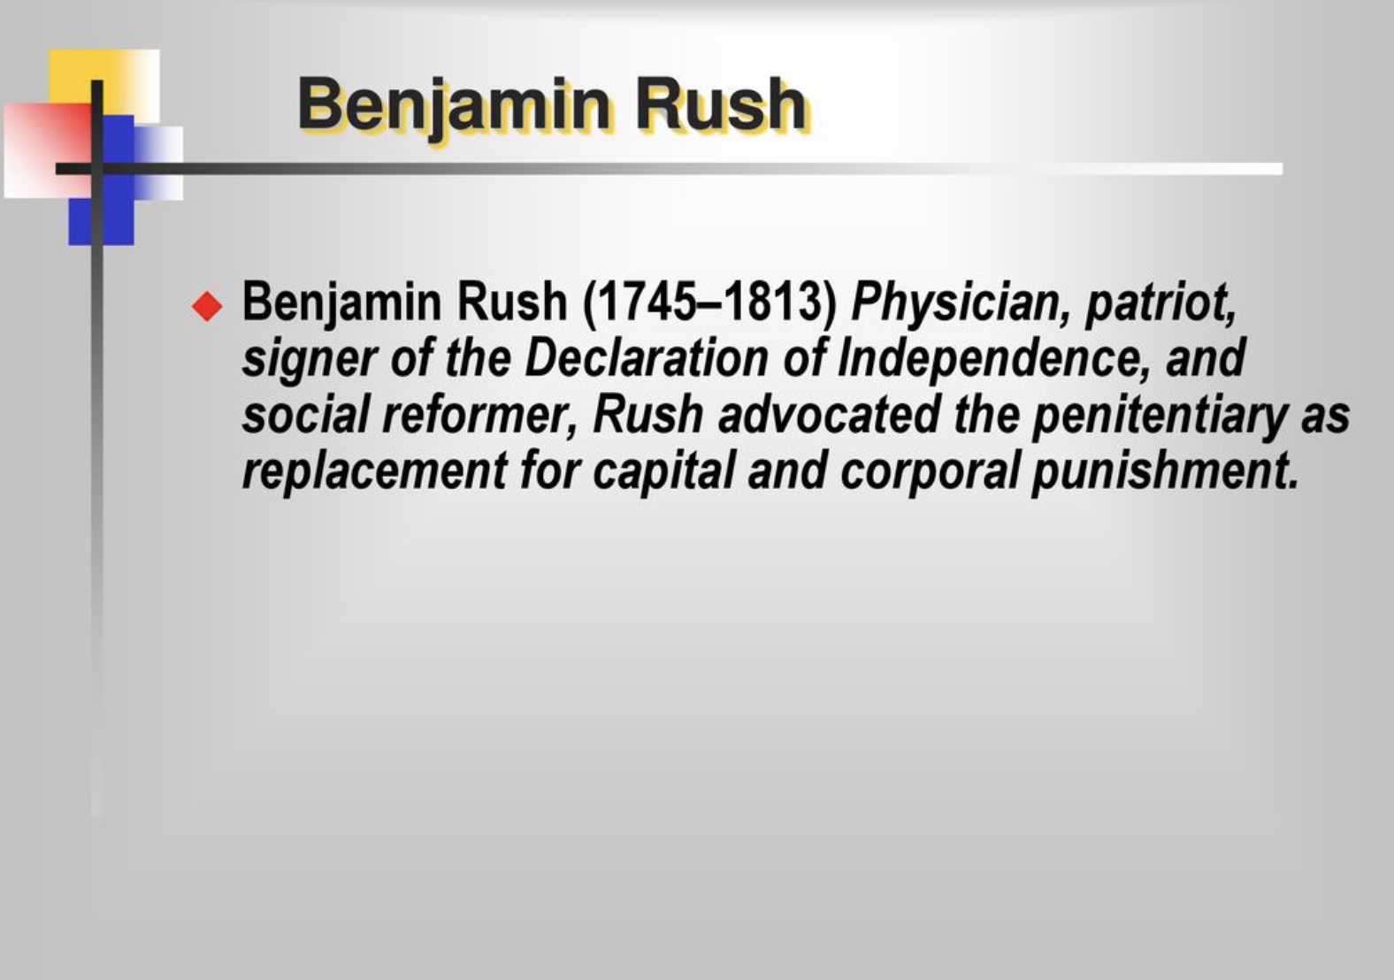
An institution intended to isolate individuals from society and from each other so that they could reflect on their past misdeeds, repent, and thus undergo reformation.

Slide 7
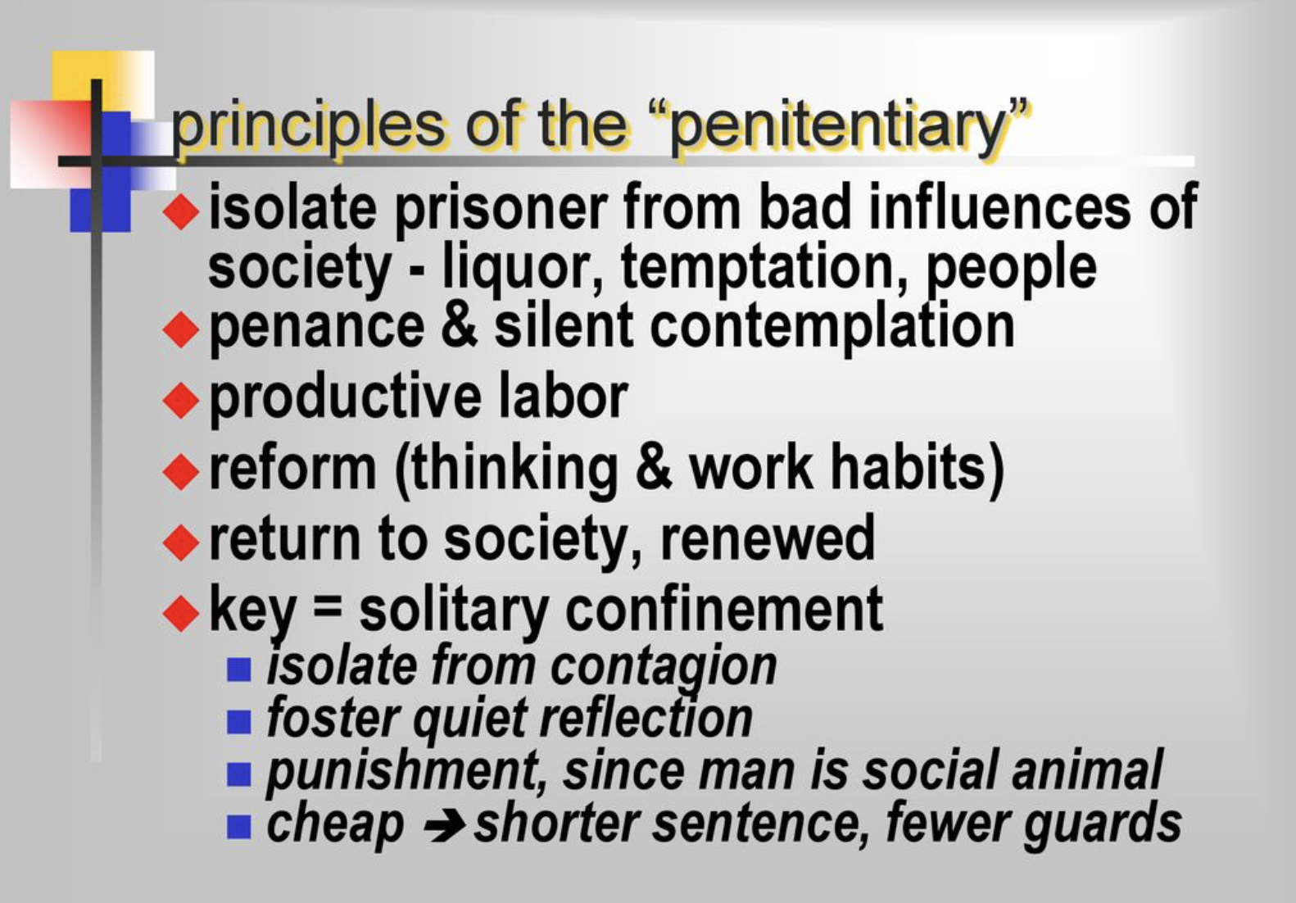

Slide 8
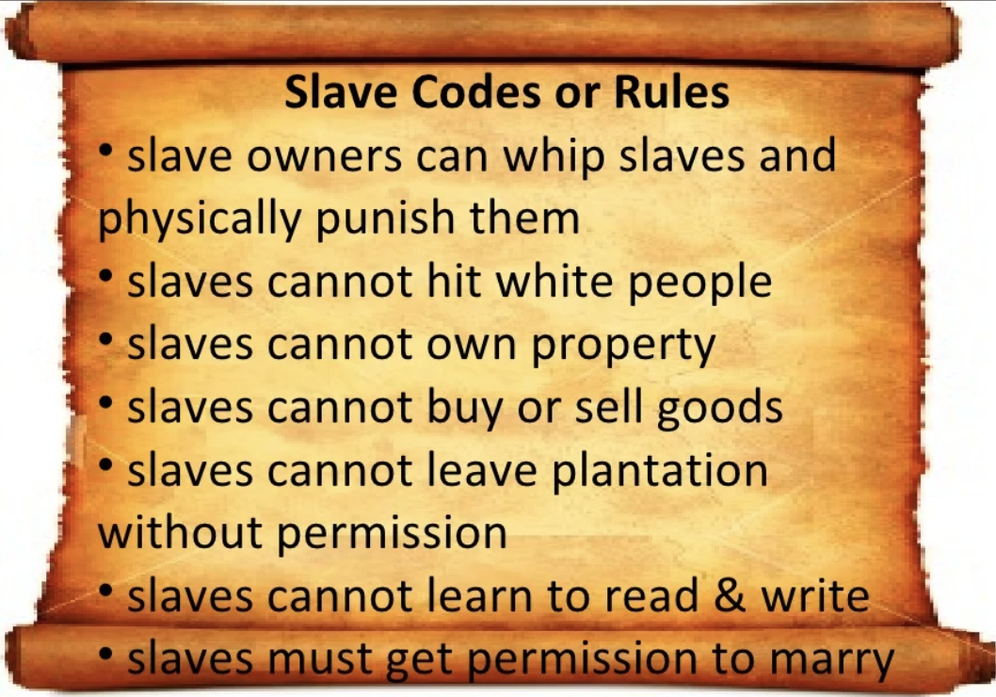
Slave codes

Slide 9
Stripping of citizenship rights
  In Louisiana in 1860, 2/3 of the prisoners were white; By 1868, 2/3 were Black
  By 1870, 95% of those incarcerated in southern states were Black
  1871-Virginia Supreme Court declared that incarcerated persons were “slaves of the state” From Black Codes to Jim Crow

Slide 10
The Black Codes
In the years following the Civil War, Southerners resisted the rights granted to African Americans. In November 1865, the government that President Andrew Johnson had set up in Mississippi passed a set of oppressive laws that only applied to African Americans. Other Southern states quickly followed suit. The intent of these laws was to restrict African Americans’ freedom, and compel them to work for white employers in a situation reminiscent of slavery. These laws were enacted to ensure continued white supremacy in a post Civil War society. They became known as the Black Codes.
https://mpb.pbslearningmedia.org/resource/reconstruction-black-codes/reconstruction-the-black-codes/

Slide 11
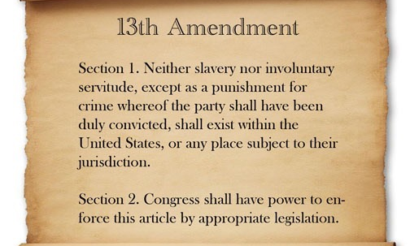

13th Amendment
The year 1865 is noted as just as significant as the year 1970 for criminal justice advocates
The end of the Civil War
The passage of the 13th amendment
  abolished slavery and indentured servitude except as punishment for a crime
The nation’s first prison boom

Slide 12
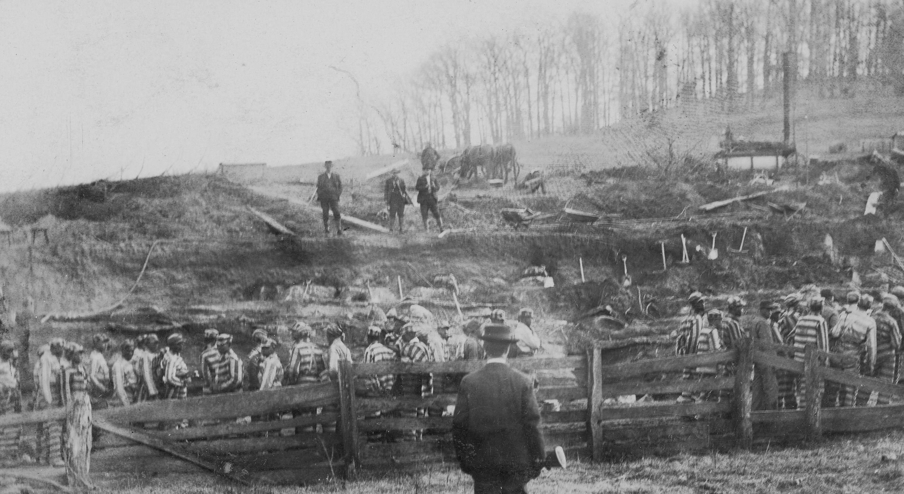
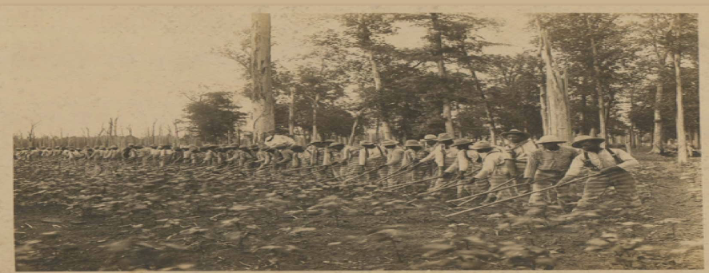
Convict Leasing
State prisons deployed imprisoned people to rebuild the South
  Convict leasing-the renting of convicted people to private companies
  Prisons became profitable
  External supervision by the private company that payed the state for their labor
  Thus eliminating the state cost for prisons
“Nobody was relieved until he dropped in his tracks. The guards often said the men did not cost them any money and the mules did. That’s why there was more sympathy for the mules than for the men.”
Bill Mills, “25 years behind prison bars”

Slide 13
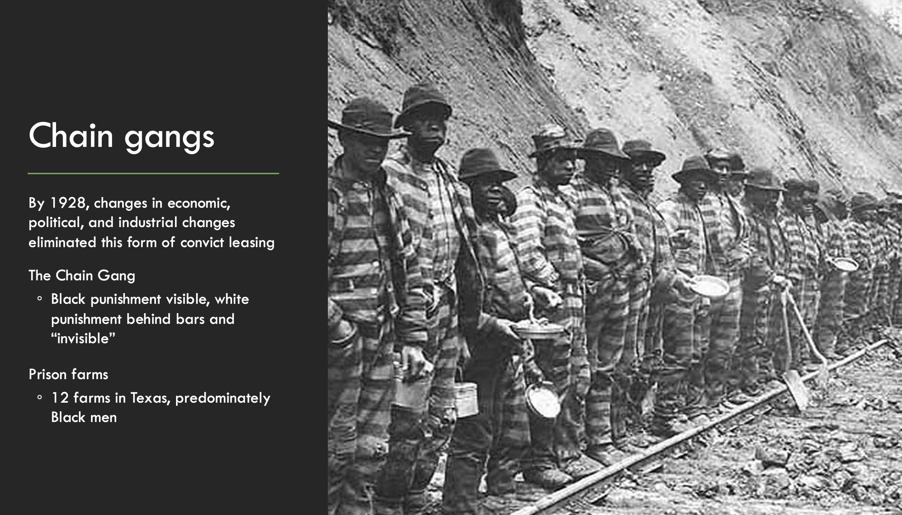


Slide 14
So, “Where are we now?”
US Prison Population compared to the rest of the world… The United States contains less than 5 percent of the world’s population but incarcerates one-quarter of all prisoners across the globe. Statistics have long shown that persons of color make up a disproportionate share of the U.S. inmate population. African Americans are five times more likely than whites to serve time in prison. For drug offenses alone, they are imprisoned at rates ten times higher.

Slide 15
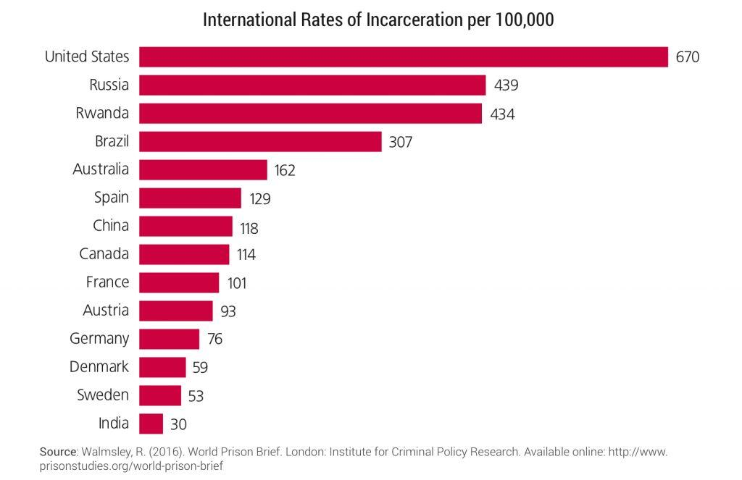

Slide 16
The Makings of Mass Incarceration
The system in which many people are imprisoned for decades at significant cost to taxpayers and families is called mass incarceration. Rather than an inevitable outcome, mass incarceration is the result of a series of political choices.
Before the 1970s, 100 people out of every 100,000 were incarcerated. In 2018, 655 people out of 100,000 were behind bars. Mass incarceration has had a disproportionate effect on Black and Latino people. In 2016, the incarceration rate for White people was 465 per 100,000, while Latinos made up 1,091 and Blacks comprised 2,724.
Some historians trace the beginning to President Richard Nixon’s War on Drugs, declared in 1971. “The declaration and escalation of the War on Drugs marked a moment in our history when a group of people defined by race and class was defined as the ‘enemy,’” Michelle Alexander, author of “The New Jim Crow,” told The Marshall Project in 2017. Other researchers point to an actual rise in violent crime, as opposed to drug crimes, in the 1970s through the 1990s. This led to the hiring of more prosecutors, greater prosecutorial power and more felony convictions, many through plea bargains.

Slide 17
Impact on African American Community
13% of all drug dealers and users are African American
17% are from Latino groups
65% are white
50% of those incarcerated from drug related offences are people of color. (Crutchfield and Weeks, 2015)

Slide 18
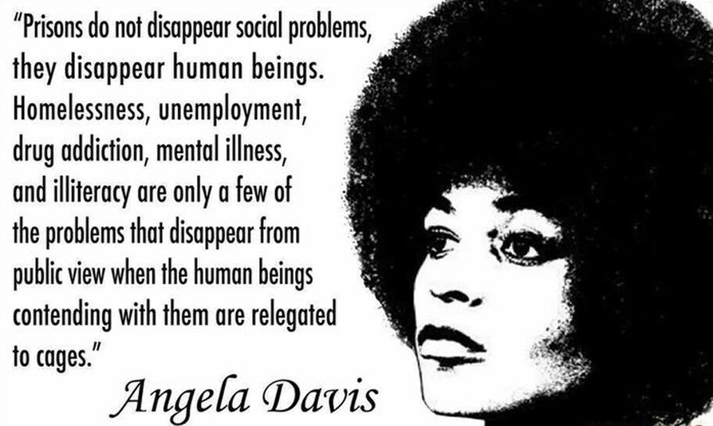
The Problem of Prison
There is a direct connection between the mass incarceration of African American men and the resulting critical need for viable reentry services

Slide 19
Reentry Trends in the United States 2018 reports that…
-Over 95% of the prison population today will be released at some point in the future”.
And,
-95% of released prisoners will return to their community of origin (Carson, 2016).

Slide 20
Recidivism (Tennessee)
On the local level, a Tennessee Department of Corrections 2017 communique states that, “Tennessee statewide recidivism numbers for 2016 was 47.1%, down from 50.5% in 2010.
Tennessee recidivism is defined as the percentage of felony inmates who are re-incarcerated within three years of their release.
The Tennessee Department of Corrections, Fiscal Year 2018 reports that over 13,000 prisoners were released in the state of Tennessee. Using the 2016 recidivism rate of 47.1%, the projected number of reoffenders (recidivism rate) within three years of release is over 6,000 persons for the state of Tennessee.

Slide 21
Collateral Consequences
“The psychological consequences of incarceration may represent significant impediments to post-prison adjustment. They may interfere with the transition from prison to home, impede an ex-convict’s successful re-integration into a social network and employment setting, and may compromise an incarcerated parent’s ability to resume his or her role with family and children. Parents who return from periods of incarceration still dependent on institutional structures and routines cannot be expected to effectively organize the lives of their children or exercise the initiative and autonomous decision making that parenting requires.” (Haney, 2003)

Slide 22
What is PITS/PIS?
Post Incarceration Stress is a possible distinct subtype of PTSD that is found in those who have been released from prison.
Characterized by:
  institutionalized personality traits
    distrusting others, difficulty engaging in relationships, hampered decision-making
  social–sensory disorientation
    spatial disorientation, difficulty in social interactions
  social and temporal alienation
    the idea of ‘not belonging’ in social and temporal setting (Liem, Kunst 2013)

Slide 23
Identifiable signs and symptoms of PITS?
Recurrent distressing dreams mostly involved the prison experience
Hyper arousal (sleep disturbances)
Persistent avoidance of stimuli
Emotional numbing
Recurrent distressing dreams
Inability to trust others, difficulties with social and familial relationships (Liem, Kunst 2013)

Slide 24
Other Symptoms
Dependence on institutional structure and contingencies
Hypervigilance, interpersonal distrust and suspicion
Emotional over-control, alienation, and psychological distancing.
Social withdrawal and isolation.
Incorporation of exploitative norms of prison culture.
Post-traumatic stress reactions to the pains of imprisonment

Slide 25
PITS Treatment
Currently no research on PITS treatment exists…
Treatment for prisoners with PTSD shows that cognitive based modalities such as CBT are effective at reducing recidivism…
Further research and treatments are needed…

Slide 26
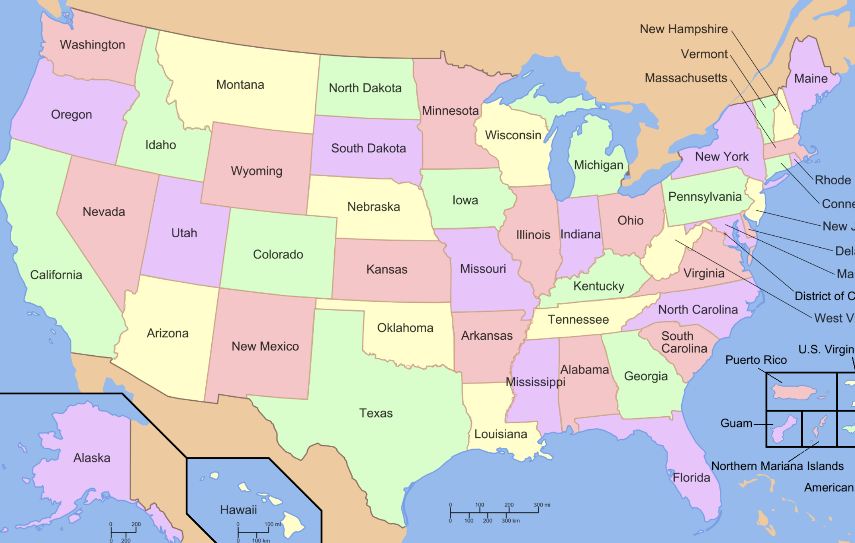
A Tale of three Cities: Qualitative Reentry Program Research
✵
✵
✵

Slide 27
Council on thought and Action (COTA)
Long Island, New york
COTA is a grass-roots movement developed by Suffolk County’s Deputy Police Commissioner Risco Mention-Lewis in 2008 while she was working as an assistant District Attorney for Nassau County. It is a response to communities that are economically or socially repressed – often both – and works to change the mindset of residents through council meetings where members can discuss the week’s events and evaluate what needs to change. Mention-Lewis says she hopes COTA becomes a grassroots movement that changes the culture of communities where drug dealing, gang violence and prison sentences are common problems.
https://www.youtube.com/watch?v=iK4NlsNdB0Q&t=33s

Slide 28

How a New York Police Official
Is Targeting Thoughts to Fight Crime
https://vimeo.com/228730791?embedded=true&source=vimeo_logo&owner=14960678

Slide 29
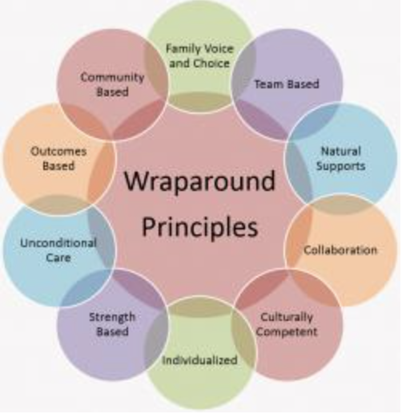
Cognitive Behavioral Therapy & Wrap-Around

Slide 30
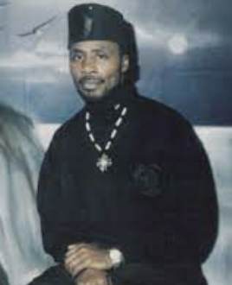
“A Voice From the Hood”
A Grassroots & Culturally Specific Approach to Reentry
https://www.youtube.com/watch?v=wz_LCerqCk0

Slide 31


Slide 32
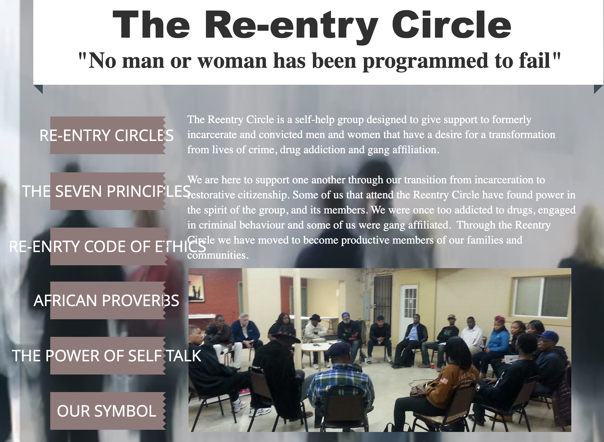

Slide 33
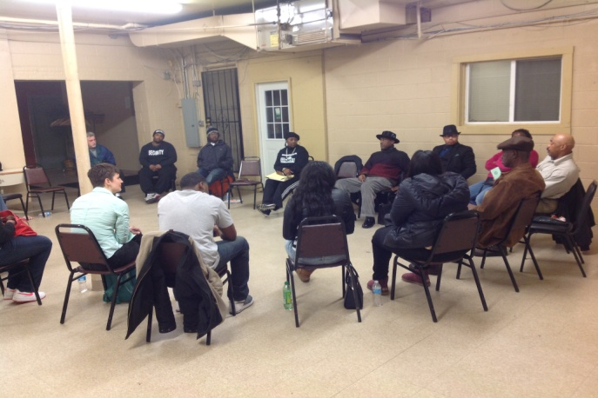
NAEFI - The Reentry Circle
Through the reentry circle, and the support of a reentry coach, the formerly incarcerated person can break the recidivism cycle.
The reentry circle can influence new beliefs that one can refrain from the thinking and behaviors that enable them to recidivism.
Participants will be empowered to build new and healthy relationships with their families, Peers and community.
By attending the reentry circle, participants are exposed to resources and a support network that will give them a new paradigm of life, and themselves.
Participants can come to a new awareness of themselves and their lives through the relationship with a reentry coach, support network and community support.

Slide 34
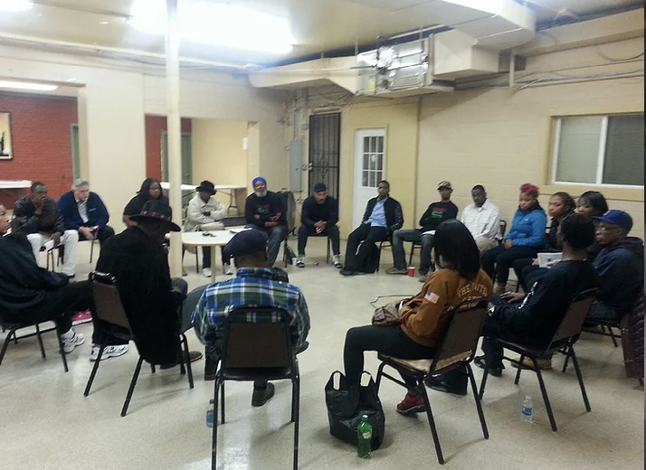

NAEFI Reentry Support Circles
GOALS
Participants demonstrate the ability to give and receive supportive communication to build and maintain crime free behavior.
Participants learn and practice the dynamics of responsible, crime-free decision making.
Participants learn strategies and skills to peacefully resolve conflict.
Participants learn to identify who is impacted by their positive and criminal behavior.

Slide 35
Reentry Support Circle –
Indomitable Families Memphis
Credible Messengers
Rites
of
Passages
Cognitive Behavioral
Intervention
Therapy
Self-help
&
Mutual Aid
Emotional Intelligence
Trauma
Informed
Approach

Slide 36
Six Key Principles of a Trauma-Informed Approach (SAMHSA)
Safety
Trustworthiness and Transparency
Peer Support
Collaboration and mutuality
Empowerment, voice and choice
Cultural, Historical, and Gender Issues

Slide 37
Principles of Trauma-Informed Approach
Safety
Trustworthiness and Transparency
Peer Support
Collaboration and Mutuality
Empowerment, Voice, and Choice
Cultural, Historical, and Gender Issues

Slide 38
Post Traumatic Growth
➢“Resilient survivors continue therefore, to grow and even thrive in spite of and quite often because of their history.” (Armour, 2007)
➢Survivors of trauma who strengthen their abilities and find wisdom that allow them emotional growth in relationship with others are often referred to as experiencing post-traumatic growth.
➢Post-traumatic growth is reflected in the following:
strengthening of relationships/sense of connection
increased sense of personal strengths
awareness of increased possibilities in life

Slide 39
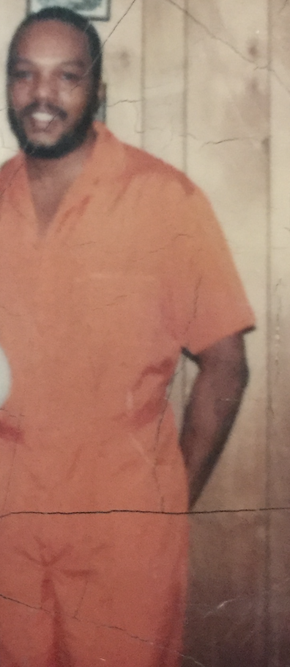
Integrated Immersive Research
From the Inside-Out
City Jails - Three Cites
State Prison - Two locations
Federal Prison - One Location

Slide 40
Questions, Comments, Conclusion

