Slide 1
Supporting Families and Solving Entrenched Problems Through Medical-Legal Partnership
Tim Flack, J.D., Senior Attorney, Memphis CHiLD
Nicole Tuchinda, J.D., M.D., LL.M., Pro Bono Volunteer Attorney with Memphis CHiLD, Visiting Assistant Professor at University of Memphis Cecil C. Humphreys School of Law

Slide 2
Agenda
What health disparities face Memphians?
How are they impacted by social determinants of health?
What is health equity?
What are Medical-Legal Partnerships?
History of MLPs
Data supporting the efficacy of MLPs
MLPs are trauma-responsive
History of Memphis CHiLD

Slide 3
What is MLP?
Partnership between medical and legal professionals...
In which legal service providers use the law . . .
To address social determinants of health . . .
In order to create better.health.outcomes.
Notes:
Tim

Slide 4
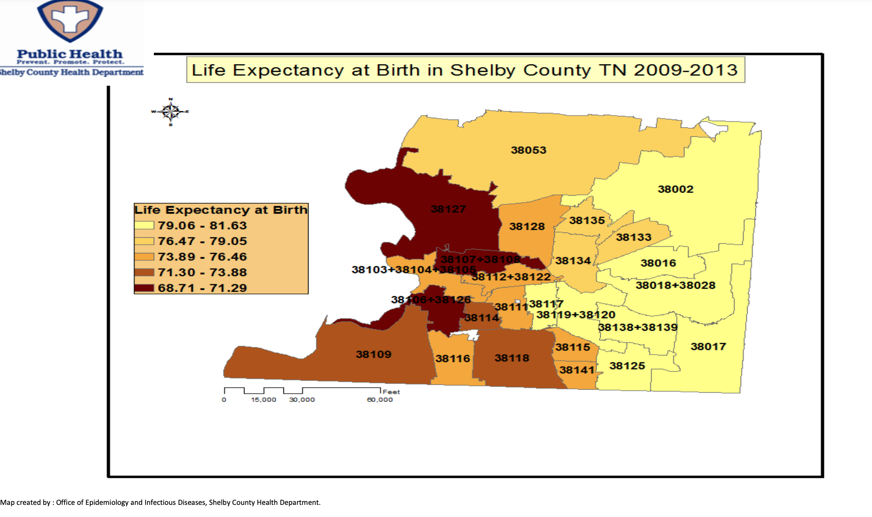
Health Disparities and Memphis
Notes:
Nicole
A health disparity is a difference in health status that is closely linked with social, economic, and/or environmental disadvantage. In other words, these are health differences that exist between groups of people who have systematically experienced greater obstacles to health based on their race, echnicity, religion, socioeconomic status, gender, age, mental or physical disabililty, sexual orientation or gender identity, or geographic location when compared with majority populations.
The disparities in Memphis are getting worse: Studies by Health Department officials found that residents in 38106 and neighboring 38126 -- a swath of South Memphis stretching from Beale Street to Nonconnah Creek containing nearly 35,000 people -- were living an average of just 69.01 years as of 2015. more than 13 years below the 82.59-year average lifespan in the healthiest ZIP code, 38017, which encompasses Collierville. That's more than 13 years below the 82.59-year average lifespan in the healthiest ZIP code, 38017, which encompasses Collierville.
a mere 20 miles separate South Memphis and Collierville, the gap between them, in terms of their life-expectancy rates, is akin to the difference between Cambodia and Norway.
In North Memphis, Frayser, South Memphis and Southwest Memphis, residents live an average 69 to 71.5 years, while in an area from Mud Island to Hickory Hill the life expectancy is from 71.6 to 75.3 years, compared to 75.34 to 79.2 in places like Millington and Southeast Shelby County. East Memphis, Cordova, Arlington, Germantown and Collierville had rates between 79.22 and 82.59 years.

Slide 5
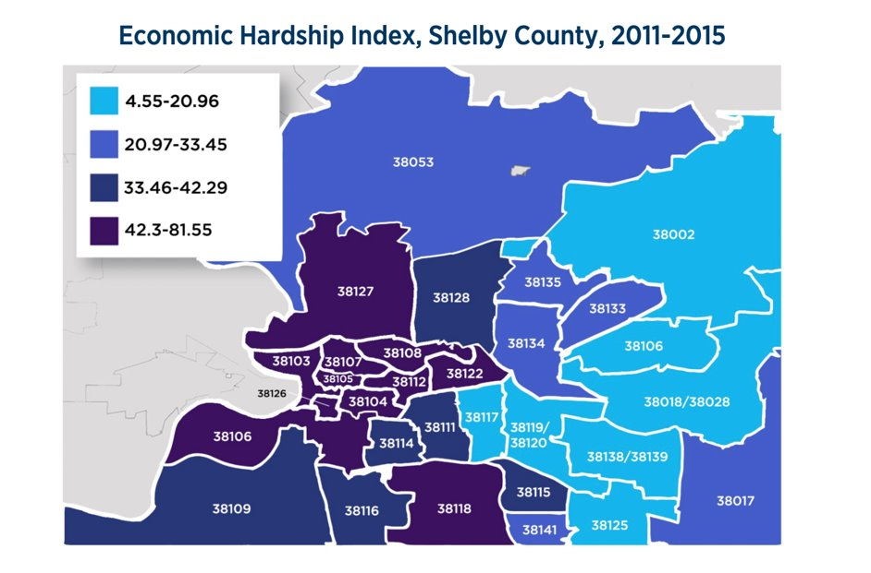
Economic hardship index
Addresses:
Unemployment
Dependency
Education
Income
Crowded housing
Poverty
The income disparity between Black and White Memphians has not changed in 50 years.
Notes:
Nicole
Residents of poverty-stricken neighborhoods typically have poor access to health care. In 38106 and 38126, some 28 percent and 22 percent, respectively, of adults aged 18-64 had no health insurance in 2016, census figures show.
"You have people working two or three jobs, but they still don't have health insurance or excess funds to deal with medical issues, so medical issues get pushed to the back-burner," said Reginald Porter, pastor of Metropolitan Baptist Church, located on Walker in 38126.
"It is very real that people have to choose between paying the light bill, paying the rent, buying shoes for the kids or buying some medicine. More often than not, it's the prescription that gets left at the pharmacy."
In terms of poverty, the median income in Shelby County is $44,051. 30% of children in Shelby County live in poverty. In 2016, black median household income in Memphis was only 58% of local white income. The income disparity has NOT improved in the last 50 years
There are few pharmacies or health-care providers in either of the two South Memphis ZIP codes.
"There's a much higher rate of chronic disease by ZIP code, much of it related to a lack of food -- appropriate food, healthy food -- and activity," said Renee Frazier, CEO emeritus of the Common Table Health Alliance, There are a lot of stores, but not a lot of fresh food due to a lack of grocery stores.
Also: stress experienced by low-income residents struggling to pay bills and avoid crime.
Stress releases cortisol, a hormone that increases inflammation, hypertension and insulin resistance while suppressing immune response.
the two ZIP codes have by far the heaviest concentration of cigarette smokers of any area of the county. About 50 percent of adults there smoke a pack a day -- more than twice the percentage of smokers in most other ZIP codes,
residents in 38106 and 38126 face threats from the high level of violent crime in the area. Countywide, homicides were the fourth-leading cause of premature death in 2016,

Slide 6
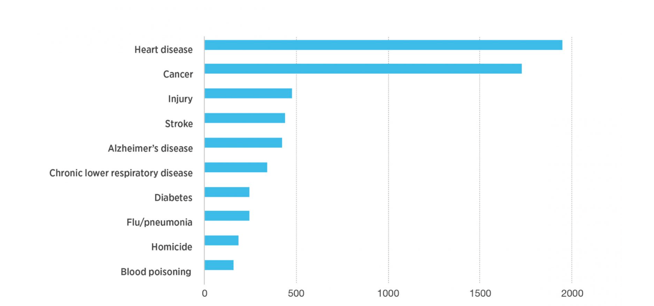
Shelby County Leading Causes of Death
Notes:
Nicole

Slide 7
In Shelby County, Black people die from these conditions at 2X the rate as white people:
Heart disease
Diabetes
Stroke
Homicide
HIV
Notes:
Nicole

Slide 8
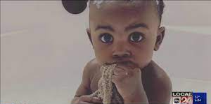
Childhood Trauma Is Increasing during the Pandemic
Notes:
Nicole
https://www.localmemphis.com/article/news/local/trauma-injuries-rise-at-le-bonheur-during-pandemic/522-b8b2158b-e4bb-4dd9-8d6f-1e02a88c53a8

Slide 9
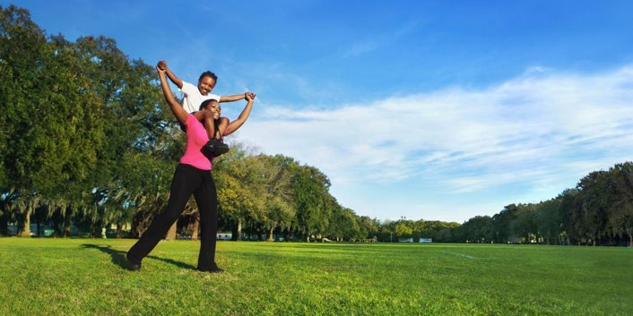
"Health is a state of complete physical, mental and social well-being and not merely the absence of disease or infirmity."
—Constitution of the World Health Organization, Geneva, 1948
A "state that allows the individual to adequately cope with all demands of daily life" - Norman Sartorius
Notes:
Nicole

Slide 10
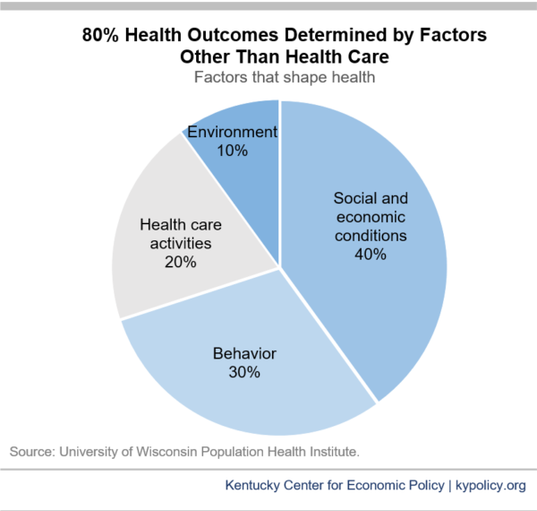
What determines health?
Notes:
Nicole
Poor health and health disparities do not result from medical causes alone. In fact, environment and lifestyle factors have seven times more impact on overall population wellness than health care (see pie chart below). A population health approach seeks to address these factors to reduce health disparities and safeguard everyone’s right to optimal health and self-determination.
Social factors play a critical role in individual and population health.

Slide 11
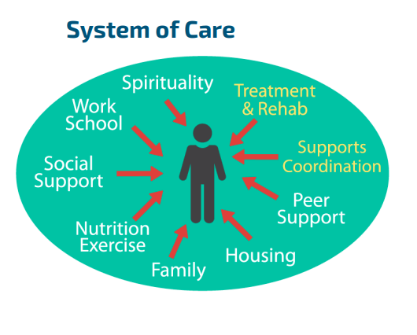
Care systems that matter go beyond health care systems
Notes:
Nicole

Slide 12
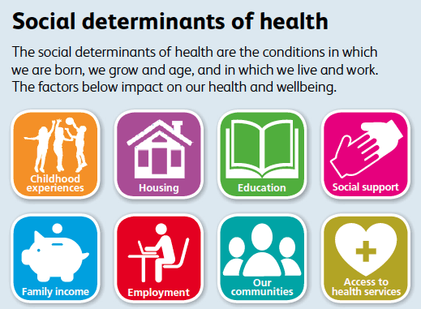
Social Determinants of Health Matter
Notes:
Nicole
Social determinants of health are the non-medical conditions in the environments in which people are born, live, learn, work, play, worship, and age that affect a wide range of health, functioning, and quality-of-life outcomes and risks. They are the wider set of forces and systems shaping the conditions of daily life. These forces and systems include economic policies and systems, development agendas, social norms, social policies and political systems. Examples include neighborhood conditions (including the amount of crime and violence); housing quality; early childhood education and development; economic stability; access to transportation; employment; access to sufficient amounts of food; access to heealth care services; a comunity's level of social cohesion.
SDOHs are drivers of health inequallities, health disparities, and health care disparities.

Slide 13
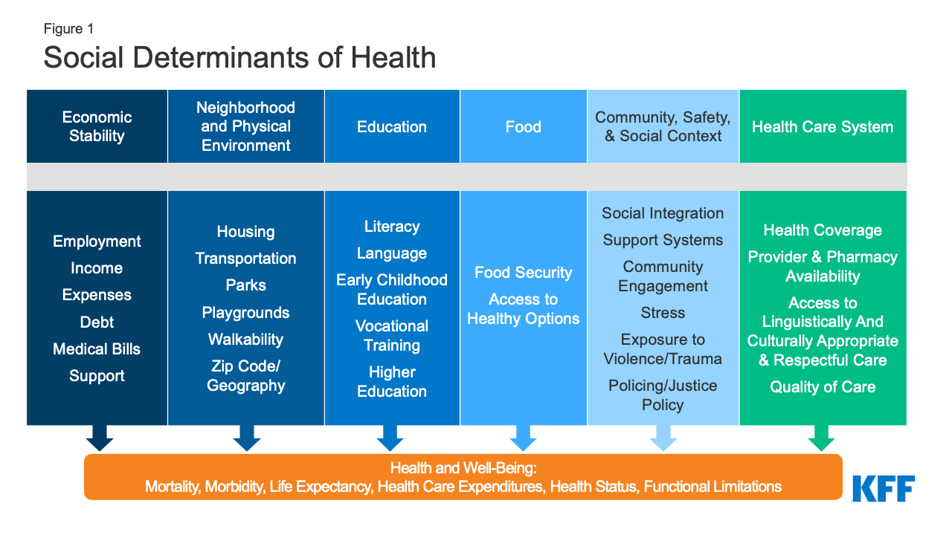
Social Determinants of Health
Notes:
Nicole
What we know is that the lower the socioeconomic status a person has, the worse their health.

Slide 14
Education as a social determinant of health for individuals
Higher income
Quality Education More job opportunities
more likely to have health insurance
Longer life
Less likely to smoke; more likely to exercise
Better mental health
Notes:
https://www.uopeople.edu/blog/benefits-of-education-are-societal-and-personal/#:~:text=Those%20who%20get%20an%20education,overall%20health%2C%20and%20civic%20involvement.&text=Lack%20of%20access%20to%20education%20is%20considered%20the%20root%20of%20poverty.

Slide 15
Education as a social determinant of health for individuals
poverty
Poor Education shorter life
unmet medical needs
early pregnancy
poorer mental health

Slide 16
Education as a social determinant of health for communities
Crime, poverty
Quality Education More skilled and productive workforce
More people employed
Higher average income
Pregnancy occurs later in life
Greater civic involvement and volunteerism

Slide 17

Black students generally still perform significantly less well than white students educationally

Slide 18
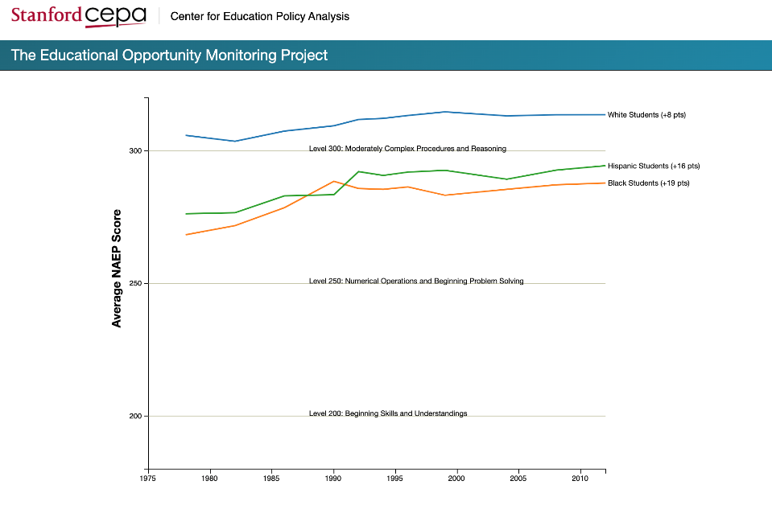
Race and Education
Math scores,
17 year olds
Time
Notes:
Nicole
There is a persistent educational achievement gap between white and black students once children are in school. This slide shows the achievement gap on the NAEP test (National Assessment of Educational Progress) Test. The achievement gap has shrunken since the 1970s, but it still persists and is still close to 1 standard deviation for 12th graders.
For each subject and age group, the figure displays three lines, each of which shows the trend in the average NAEP scores for white, black, or Hispanic students. The vertical axis shows NAEP scores. To help interpret these scores, the horizontal lines indicate the type of skills that students must demonstrate to score at various levels (more detailed information on the NAEP performance levels is available here). Each line’s label (on the right) indicates the overall change in average scores for that group since the first NAEP test shown (in the 1970s).

Slide 19
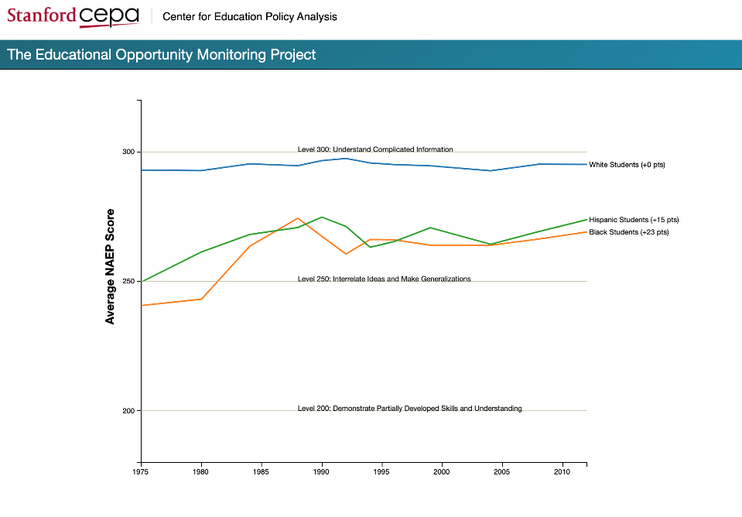
Reading scores,
17 year olds
Time
Notes:
Nicole

Slide 20

High School Graduation Rates
89.1% of all White students graduate
79.0% of all Black students graduate
81.0% of all Hispanic students graduate
U.S. Dept. of Education, 2017-2018 data

Slide 21
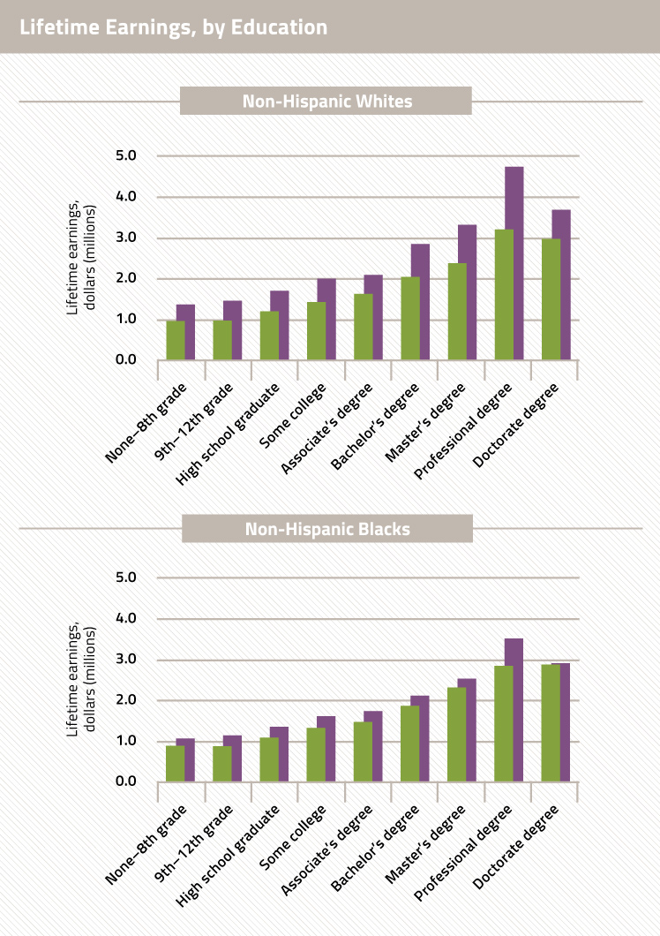
Notes:
Still racial disparity.
A person does not have the chance to improve their socio-economic status without a bachelor's degree

Slide 22
What is the School to Prison Pipeline?
The school-to-prison pipeline is the collection of education and public safety policies and practices that push our nation’s schoolchildren out of the classroom and into the streets, the juvenile system, or the criminal law system.
Notes:
Black students are sent disproportionately down the STPP

Slide 23
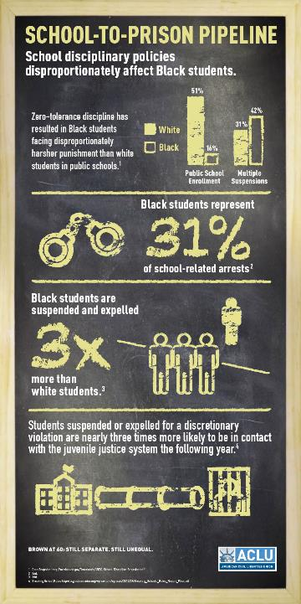
Black students are disproportionately sent down the school-to-prison pipeline
Black students are only ~15% of the student population, but…
Notes:
Derek
ACLU data:
Black students bear the brunt of the school to prison pipeline.
Black students are only 15% of the student population BUT

Slide 24
Notes:
Derek
New data on 2015-2016 says that black students are suspended on average 5 times more than white students.

Slide 25
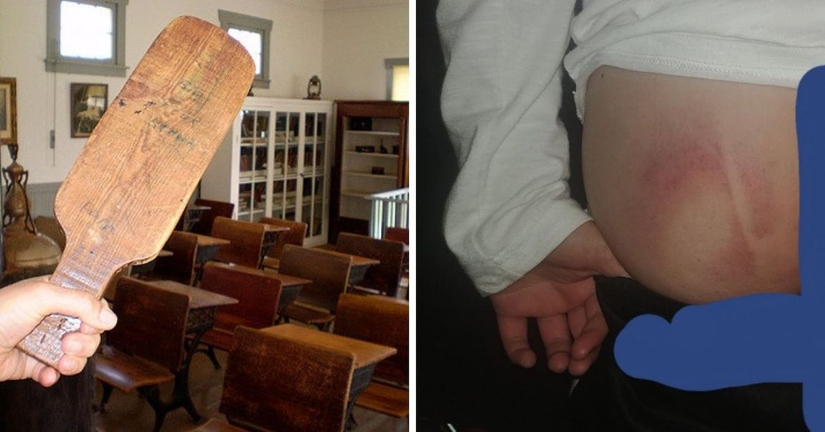
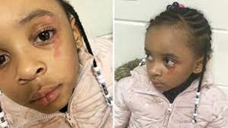
School Brutality
The excessive, unwarranted, and traumatizing use of physical force by state agents upon students.
222,000 documented incidents per year
Notes:
It's time to call school corporal punishment, seclusion, and restraint, and other violence upon children by a name that captures the traumatic and unreasonable nature of these practices and centers the needs of children, rather than adults. School brutality is like police brutality in that it involves the excessive and unnecesary use of force by state agents when dealing with civilians.
School brutality includes corporal punishment, which is typically defined as the intentional hitting or other use of force to inflict physical pain on students for purposes of discipline or control.
Includes seclusion, which is the involuntary confinement of a student alone in a room or area from which the student is physically prevented from leaving.
Includes restraint, which is the immobilization of a student torso, arms, legs, or head
[[Even the school to prison pipineline misses this problem. (the pipeline describes policies and practices that push primarily children of color and children with disabilities out of the classroom and into the streets, the juvenile syste, and the criminal law system.]]
More than 222,000 documented incidents a year, but incidents are chronically underreported and investigations show that schools hide their brutality. 11% of all U.S. School districts practice corporal punishment. 80% of school corporal punishment occurs in 7, mostly Southern States. [The 7 states are Texas, Alabama, Arkansas, Georgia, TN, and Oklahoma.] Counties with higher poverty rates, that are in rural areas, that have > concentrations of Republican voters, and where Evangelical Protestantism thrives have higher corporal punishment prevalence in schools.
Traditionally, the use of physical force upon children was seen as a way to educate children, promote "group discipline" and "control" children.
BUT current understandings of trauma and the effects of the use of physical force on children make clear that the use of physical force on children is NOT reasonable. Research shows that school brutality is an adverse childhood experience, an ACE, which is potentially traumatizing. Recent research into ACES demonstrate that the more that children experience ACEs, the worse their health, disability, learning, and behavior, and the shorter their lifespan. Trauma is is adversity that can cause long-term harm.
Research shows that trauma can take a profound physical, mental, and academic toll on children. It overactivates and dysregulates the stress-response system, causes inflammation in multiple body systems, and changes gene expression, increasing the risks of disease and disability during childhood and adulthood.
Due to the vulnerability of the developing brain to extreme and chronic stress, trauma reorganizes the architecture of children's brains, causing the parts of the brain that are responsible for the fight or flight response, fear, anxiety, and impulsivity, to overproduce neural connections while decreasing the development of neural connections in the parts of the brain needed for behavioral self-regulation and academic success.
Accordingly, trauma increases the likelihood of academic failure, aggressive and disruptive behavior, absenteeism and disengement with school; the need for special education; difficulty in forming positive relationships with peers and adults; suspension, expulsion, and arrest; and involvement in the juvenile deliquency and criminal justice systems. It also worsens mental and physical health.
Studies show that seclusion, restraint, and corporal punishment increase the behaviors that schools are attempting to eliminate or control.
Non-coercie, Non-violent methods of promoting good behavior exist, including positive behavioral interventions and services, Ukeru, trauma-responsive care, and restorative justice.
Studies also show that children need physical safety at school in order to learn, and schools are not effective at creating a sense of physical safety for children and their parents, although they are effective at creating a sense of physical safety for adults. In other words, the use of physical force upon children in school is NOT reasonable, despite what the law says.

Slide 26
Disproportionate school brutality upon Black children
Black students corporally punished 2.5 x more than their peers
Black girls are 2.17 x more likely than White girls to be restrained, and Black boys are 1.58 x more likely than white boys to be restrained.
Black girls are 3.01 x more likely than White girls to be referred to law enforcement and 3.66 x more likely to be arrested at school. Similarly, Black boys are 2.15 x more likely than White boys to be referred to law enforcement and 2.44 x more likely to be arrested at school
But studies show that Black students are NOT misbehaving more than White students

Slide 27
Most of this disproportionality occurs in the South
80% of school corporal punishment occurs in 7 states: Mississippi, Texas, Alabama, Arkansas, Georgia, Tennessee, and Oklahoma
These states account for 90% of the corporal punishment of Black students
6 of these states are in the South
Counties with larger Black populations display less racial disproportionality
Notes:
Most of the corporal punishment (half of the nation's corporal punishment of black girls) occurs in Mississippi.
Shelby county outlawed corporal punishment

Slide 28
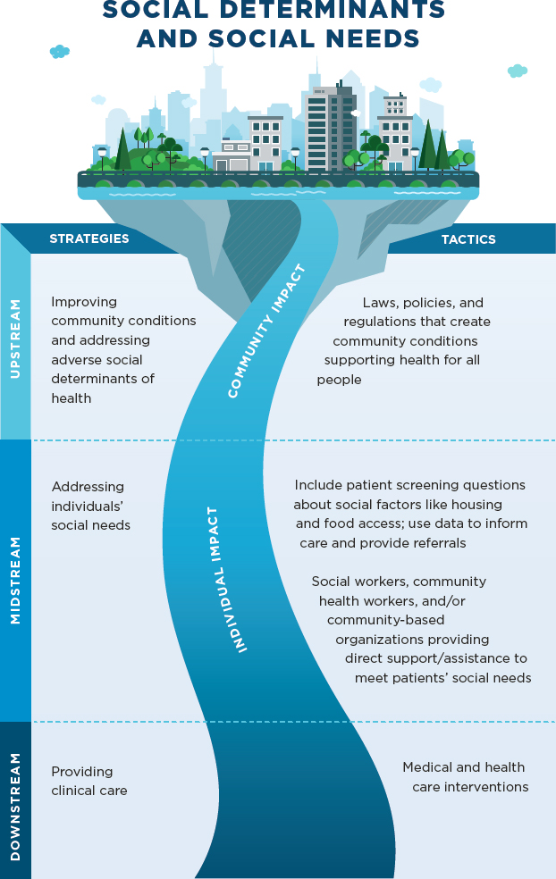

Notes:
Nicole
“upstream” factors, such as social disadvantage, risk exposure, and social inequities that play a fundamental causal role in poor health outcomes— and thus represent important opportunities for improving health and reducing health disparities

Slide 29
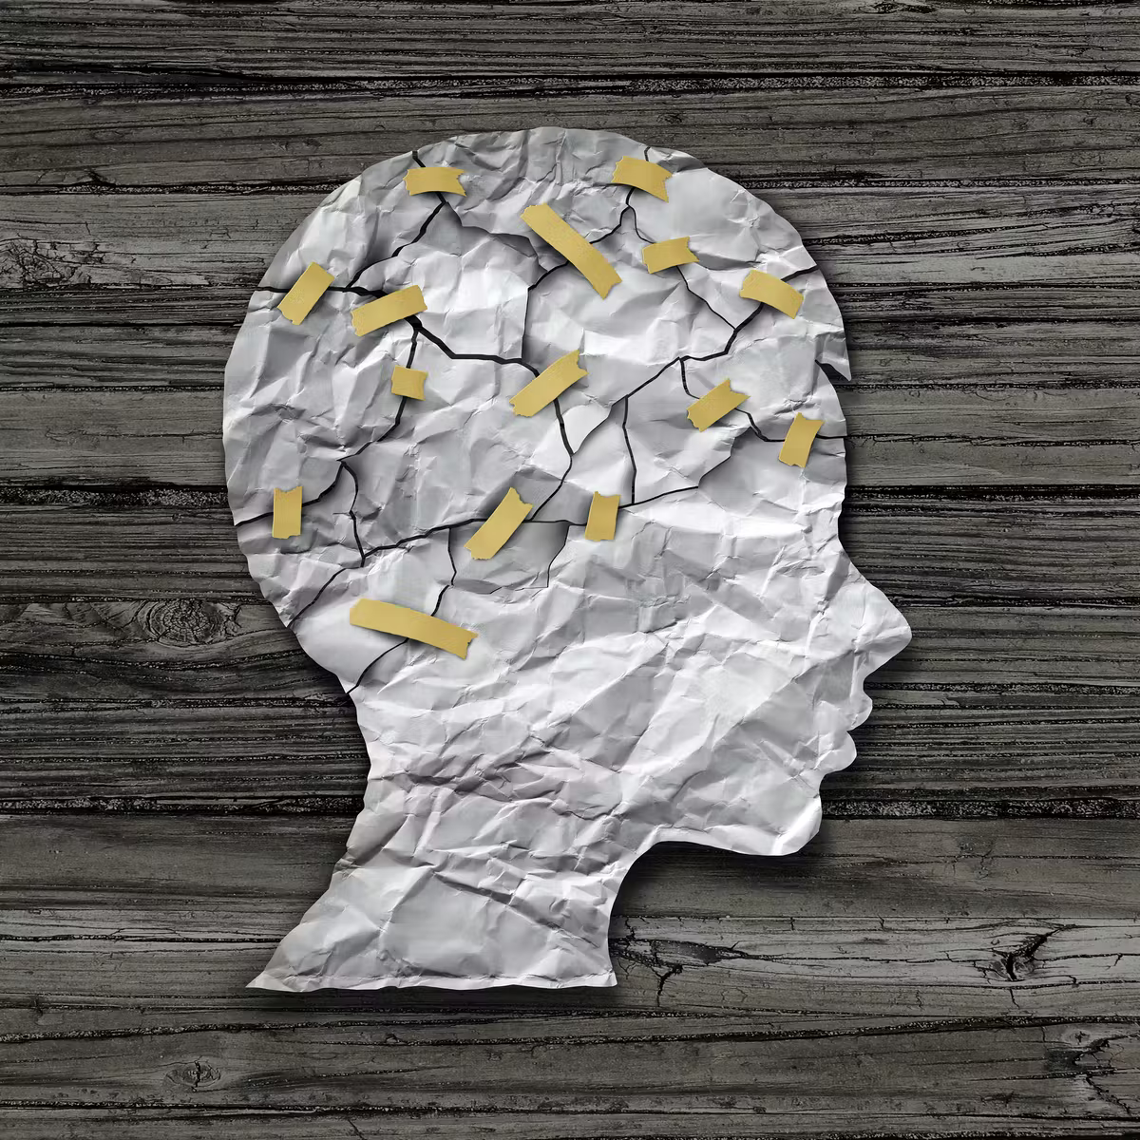
Adversity/ Adverse Childhood experiences are significant Social determinants of health
Notes:
early experiences affect children’s cognitive, behavioral, and physical development, which in turn, predict current and future health. Biologic changes due to adverse socioeconomic conditions in infancy and toddler years appear to become “embedded” in children’s bodies, determining their developmental capacity (Hertzman, 1999). Longitudinal studies (that follow individuals from early childhood into young adulthood) have linked childhood developmental outcomes with subsequent educational attainment (which is associated with adult health). H

Slide 30
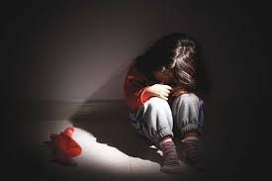
Trauma is…
Any event that overwhelms the child’s ability to cope with the experience and elicits feelings of terror, powerlessness, and out-of-control physiological arousal
Typically occurs when a child is faced with an intense, frightening event that threatens or causes harm to the child or another’s physical or psychological well-being and the child lacks sufficient support from others to cope.
Can be episodic or occur over a long period of time.

Slide 31

Adversity in any form can be trauma if it causes long-term harm
Poverty and lack of access to basic necessities
Dysfunction at home: domestic violence, neglect, physical/sexual/emotional abuse, substance use, incarceration of a family member, untreated mental health problems in a family member, parental separation, removal from primary caretakers
Community violence: abuse by police, gang & drug activity, bullying
Medical: Covid-19 death and illness, chronic illness, medical procedures, major injuries and illnesses.
Educational: Expulsion, suspension, arrest,
retention, bullying

Slide 32

Adversity in any form can be trauma if it causes long-term harm
Environmental: lack of green or recreational space, blighted housing, poor housing conditions, climate change, natural disasters, homelessness
Immigration: parental deportation, family separation, forced placement in boarding schools
Structural oppression: abuse by police, mass incarceration, barriers to voting, inadequate educational and employment opportunities
Historic trauma: Slavery, the Holocaust, forced displacement, family detention,
Intergenerational trauma: passed through families

Slide 33
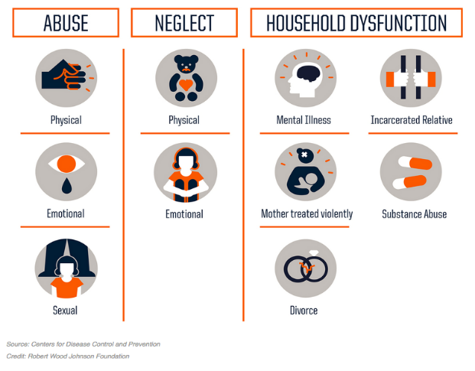
Trauma is common
2 of 3 American adults have at least 1 Adverse Childhood Experience (ACE):

Slide 34
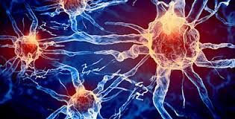
Trauma’s impact on children is broader than originally thought
Causes toxic stress, disability, disease, early death
Changes the brain’s architecture
Disrupts ability to form trusting relationships
Causes hypersensitivity to threat
non-threatening stimuli → fight/flight/freeze mode
Sensory processing and language problems

Slide 35
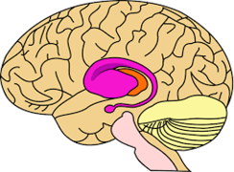
Trauma impairs success at school
Impairs learning
Impairs executive function, memory, language development, and sensory processing
Impairs behavior
Increases impulsivity and hypersensitivity to threat (fight/flight/freeze response)
Impairs logical and sequential thinking
Impairs development of healthy relationships

Slide 36
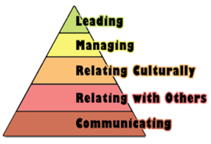
Executive Functioning Problems Affect School Performance
Difficulty:
concentrating in school
accomplishing tasks at school
remembering what’s taught
completing homework
pursuing goals
→ Poorer grades and test scores, less likely to graduate
Impulse control problems
Problems in controlling behavior
→ Discipline problems
→ More likely to be incarcerated

Slide 37
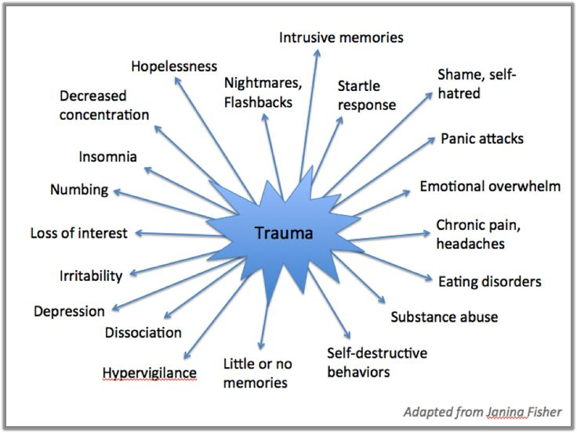
Trauma is associated with many mental health effects and diagnoses
→ depression, anxiety, PTSD
→ ADHD
→ oppositional defiant disorder,
conduct disorder,
reactive attachment
disorder
“Developmental Trauma” is a proposed diagnosis

Slide 38
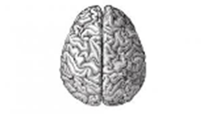
Trauma impairs language development
Trauma impairs the development of brain connections needed for language development.
Traumatized children often have less developed verbal skills than non-verbal reasoning skills.

Slide 39
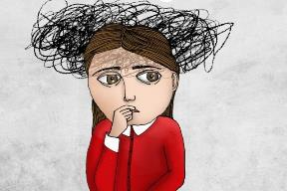
Impacts on Sensory Development
Over or Under Response to:
Sounds
Lights
Touch
Pain
Inability to verbally express what body is feeling:
Hunger
Exhaustion
Anger
Fear
Hyper or hypo arousal to both sensory stimuli and trauma triggers

Slide 40
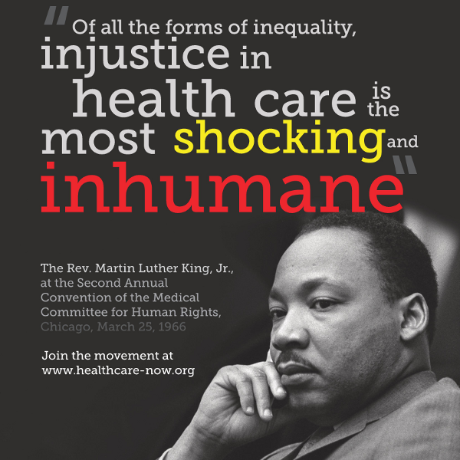
What is Health Equity?

Slide 41
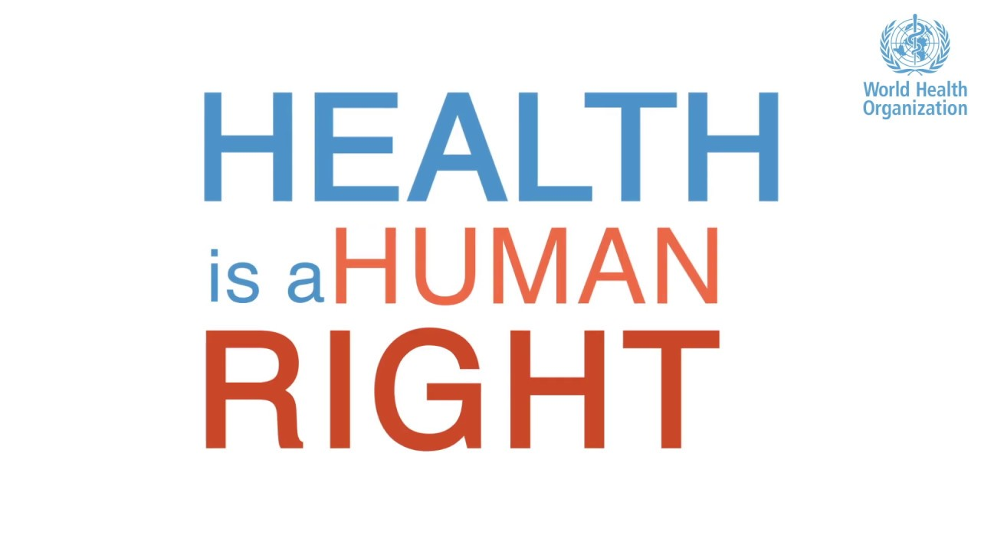
The enjoyment of the highest attainable standard of health is one of the fundamental rights of every human being without distinction of race, religion, political belief, economic or social condition.

Slide 42

Health Equity Means...
...Everyone has a fair and just opportunity to be healthy.
It requires removing obstacles to health, such as poverty, discrimination, and their consequences, including powerlessness and lack of access to good jobs with fair pay, quailty education and housing, safe environments, and health care.

Slide 43
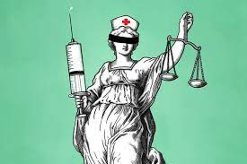
What is Health Justice?
"Laws, policies, systems, and behaviors that are evenhanded with regard to and display genuine respect for everyone's health and well being." - Joel Teitelbaum and Elizabeth Tobin-Tyler
"[T]he eradication of social injustice and health inequity caused by discrimination and poverty. The health justice framework provides a model . . . to recognize the structural and intermediary determinants of health at the root of clients' hardship, and to actively work with the community to address barriers to health equity and social justice." - Yael Cannon, Emily Benfer

Slide 44
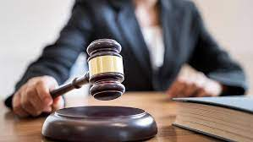
Many health-harming social conditions have legal remedies
Notes:
What does this have to do with MLPs?

Slide 45





Legal Needs Impact Health
Edited from Original Source: National Center for Medical –Legal Partnerships, “Core Components and Activities,” http://www.medical-legalpartnership.org/model/core-components, The Advisory Board Company interviews and analysis.
Income & Insurance
Housing & Utilities
Education & Employment
Legal Status
Personal & Family Stability

Slide 46
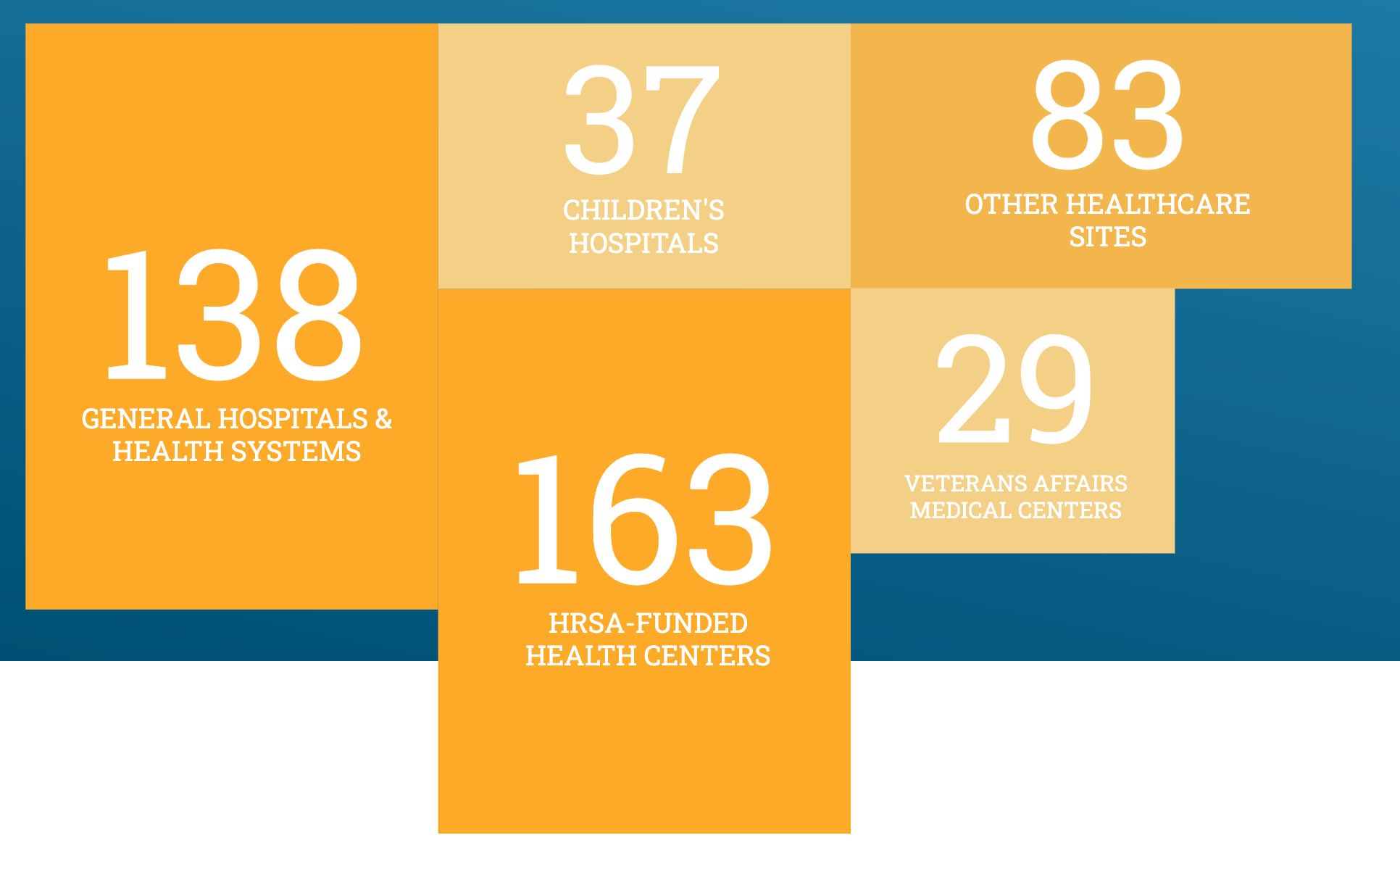
Hundreds of medical-legal partnerships exist in the U.S.
Notes:
Hundreds of the nation’s leading health organizations integrate patient-centered legal services into their care delivery to address their communities’ health-related social needs.

Slide 47
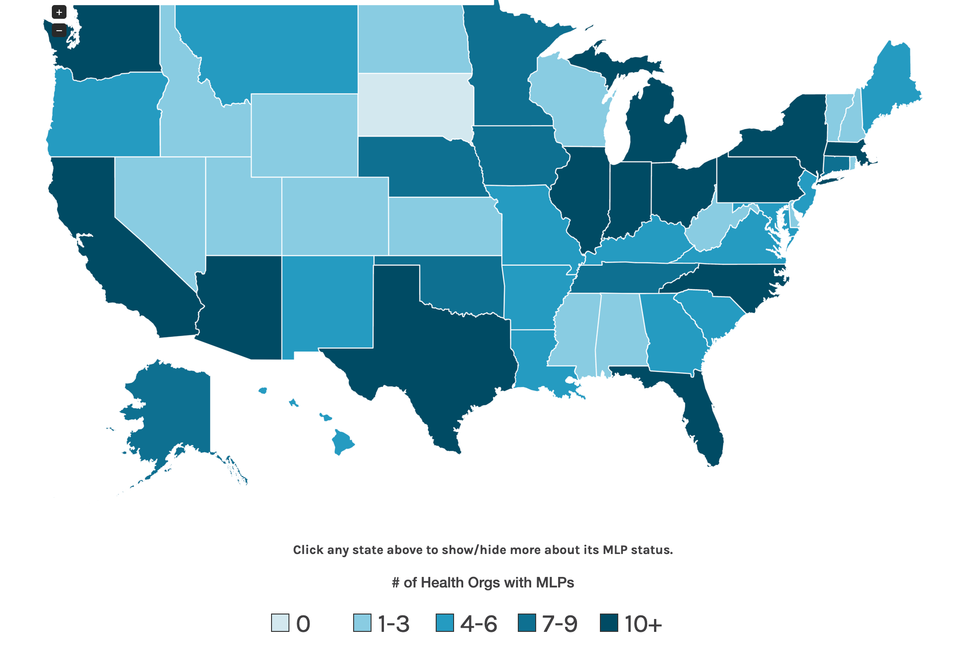
MLPs exist in 49 states and D.C.
Notes:
medical-legal partnerships are taking root at these health organizations in 49 states and the District of Columbia
There are 8 MLPs in Tennessee
2 in Mississippi
6 in Arkansas
A few health organizations directly employ attorneys to address patients’ health-harming social needs (the "build it as a direct service" model.) The vast majority partner with a local legal services agency or academic legal clinic in their community (the "contract it" model.) Several of these legal organizations partner with multiple health organizations to provide MLP services. The legal leadership and workforce for these programs currently come from:
170
legal aid agencies
58
law schools

Slide 48

MLPS holistically address social determinants of health in people's lives
using the expertise of medical, legal, and social work professionals

Slide 49
Problems that MLPs can help to address
Housing conditions (mold in the home, insecure doors, peeling paint, utilities shutoff)
Housing instability (preventing eviction; addressing homelessness)
Poor education (obtaining special education and accommodations; keeping kids in school and not suspended or arrested)
Family instability (addressing child custody and adoption; support parents when they accused of neglecting their children)
Financial and food instability (increase access to public benefits, including SNAP, TANF, and SSI)
Lack of access to health care (increase access Medicaid)
Domestic Violence (connecting victims to shelters, protective orders)
Notes:
many complex health-related social problems are entrenched in federal, state, and local policies and laws that require expertise in poverty law and administrative law.
Attorneys in general—and poverty lawyers in particular—have an in-depth understanding of relevant policies, laws, and systems, and seek out solutions at the individual and policy levels to a range of health-related social and legal needs. When embedded as specialists in a health care setting, lawyers can directly resolve specific problems for individual patients, while also helping clinical and non-clinical staff navigate system and policy barriers and transform institutional practices. Using legal expertise and services, the health care system can disrupt the cycle of returning people to the unhealthy conditions that would otherwise bring them right back to the clinic or hospital.

Slide 50
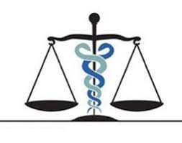
Documented benefits of MLPs
Reduced hospitalization
Reduced health care spending
Increase coverage of health care by insurers
Greater patient compliance with prescriptions and other treatments
Reduced patient stress and improved mental health
Improved patient physical health in those with chronic conditions (like asthma, diabetes, sickle cell disease, etc.)

Slide 51

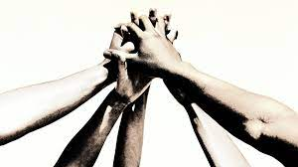
MLPs can
Prevent/mitigate crises and trauma
Strengthen, support, & protect families
Empower parents
Increase resources for families
Reduce stress
Advocate for changes in law and policy
Increased Personal and Community Heallth and Resiliency
Notes:
MLPs can be a crucial source of social support.

Slide 52
Healthcare providers involved with MLPs see the benefits of their MLP:
86% saw improved health outcomes for patients
64% saw improved patient compliance with medical treatment
38% experienced ability to practice at the "top of their license"
- 2016 survey of health care providers
Notes:
What if MLPs became part of the standard of care for patients?

Slide 53
Brief History of Memphis CHiLD
2015
Memphis CHiLD launches as the only pediatric MLP in Tennessee, September 2015.
2017
Memphis CHiLD adds a full time social worker reaches 1000 referrals (in less than three years)!
2019
Memphis CHiLD remains the only integrated, on-site MLP in Tennessee.
2018
2016
Memphis CHiLD Medical Partner commits to providing one more attorney to the project, making Memphis CHiLD one of two MLPs in the country to have a full time attorney funded by the medical partners.
Memphis CHiLD hires a full-time Program Coordinator.

Slide 54
MLP Partners
Le Bonheur Children’s Hospital (LB)
Memphis Area Legal Services (MALS)
The University of Memphis School of Law
University of Tennessee Health Science Center, Department of Pediatrics
Notes:
Explain specific positions

