Slide 1
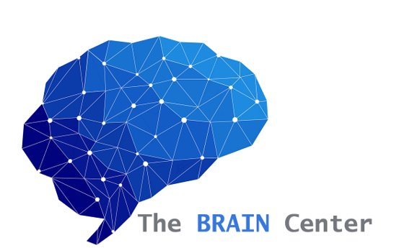
Mental Health Counseling in an
Acute-care Pediatric Hospital Setting
Kiersten Hawes, Ph.D., LPC, NCC
Clinical Director, The BRAIN Center
Le Bonheur Children's Hospital
Sydnie Roberts, M.S.
Trauma Mental Health Counselor, The BRAIN Center
Doctoral Student in Counseling Education and Supervision
Le Bonheur Children's Hospital
Mitch Clayton, MBA
M2 at The University of Tennessee Health Science Center
The BRAIN Center Research Team

Slide 2
Mental Health Counseling in the Acute-care Pediatric Hospital Setting
Objectives​
1. Highlight the prevalence of acute stress in a pediatric population. ​
2. Explore the critical need for mental health screening and counseling services during the onset of acute pediatric trauma. ​
3. Discuss the clinical utility of trauma-informed interventions in a pediatric hospital setting. ​
​
​
Notes:
The concept of childhood trauma received recognition in the medical field after the original ACE study findings were discovered by Dr. Vincent Felitti in 1981.
Results showed the link between previous exposure to adverse childhood experiences such as abuse neglect, and household dysfunction and chronic illness later in life.
Although the ACE study findings were significant and started the conversation about the connection between mental health and physical health, there are other types of trauma outside of the 10 ACES that impact the emotional and physical health of children and families that can escalate if left untreated.

Slide 3
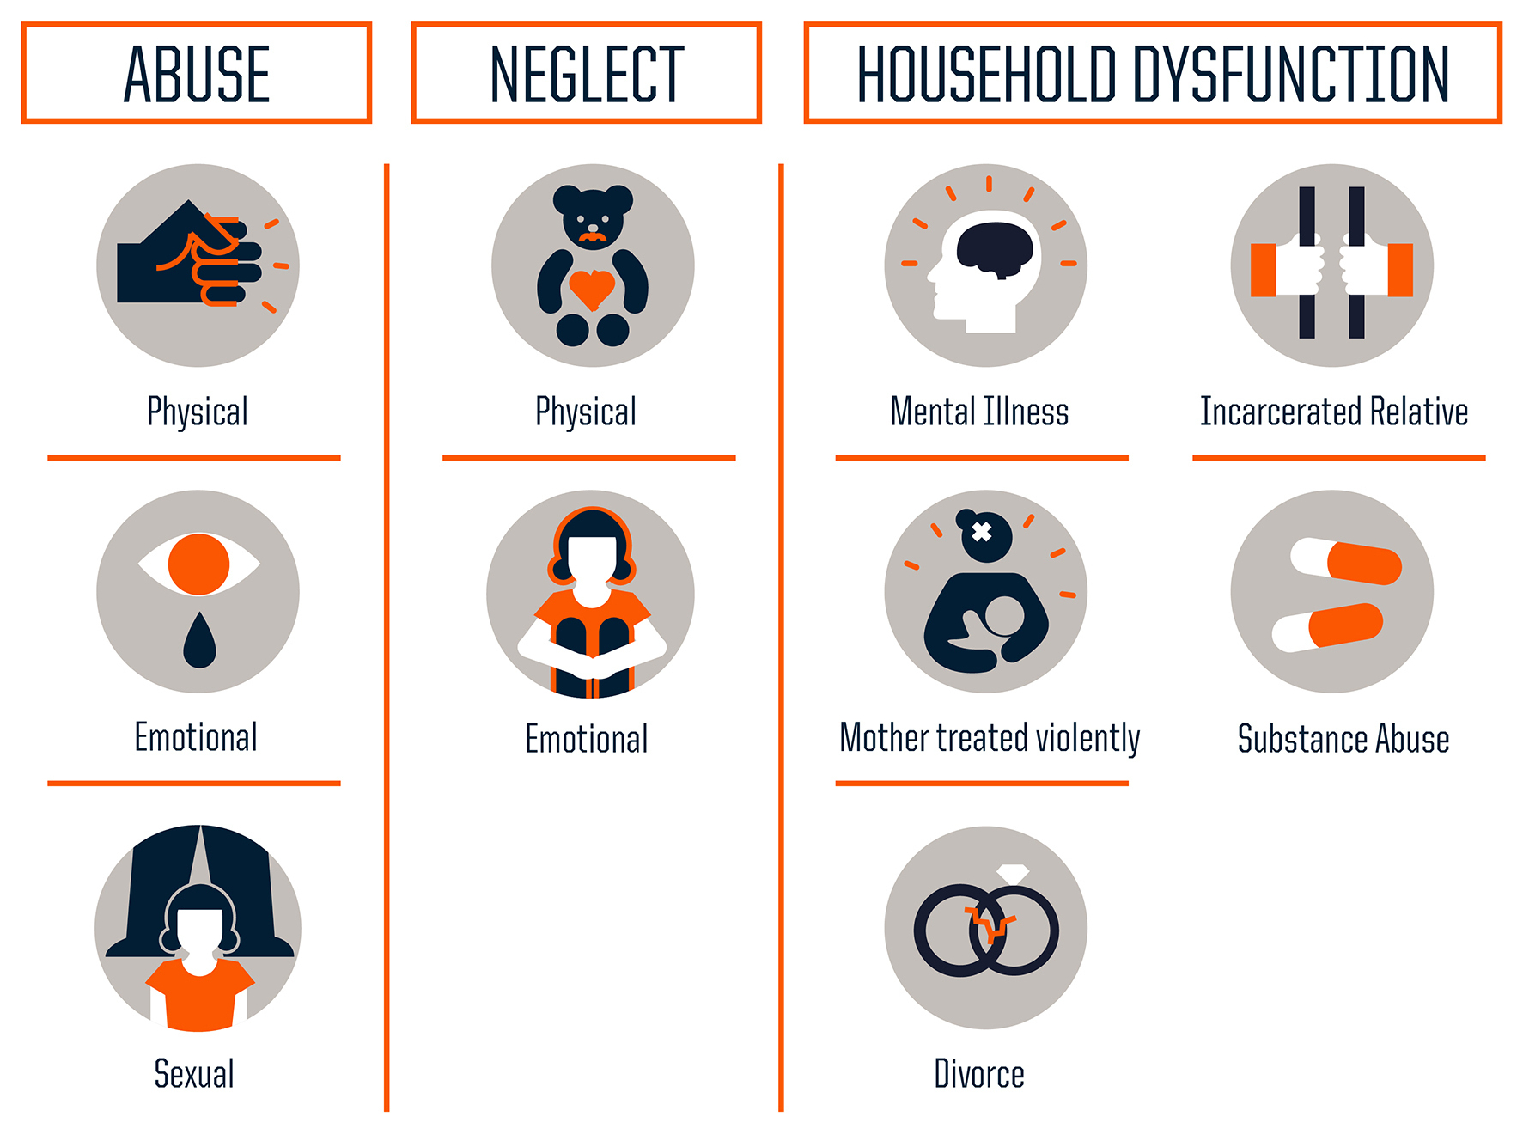
The ACE Study
Notes:
The concept of childhood trauma received recognition in the medical field after the original ACE study findings were discovered by Dr. Vincent Felitti in 1981.
Results showed the link between previous exposure to adverse childhood experiences such as abuse neglect, and household dysfunction and chronic illness later in life.
Although the ACE study findings were significant and started the conversation about the connection between mental health and physical health, there are other types of trauma outside of the 10 ACES that impact the emotional and physical health of children and families that can escalate if left untreated.

Slide 4
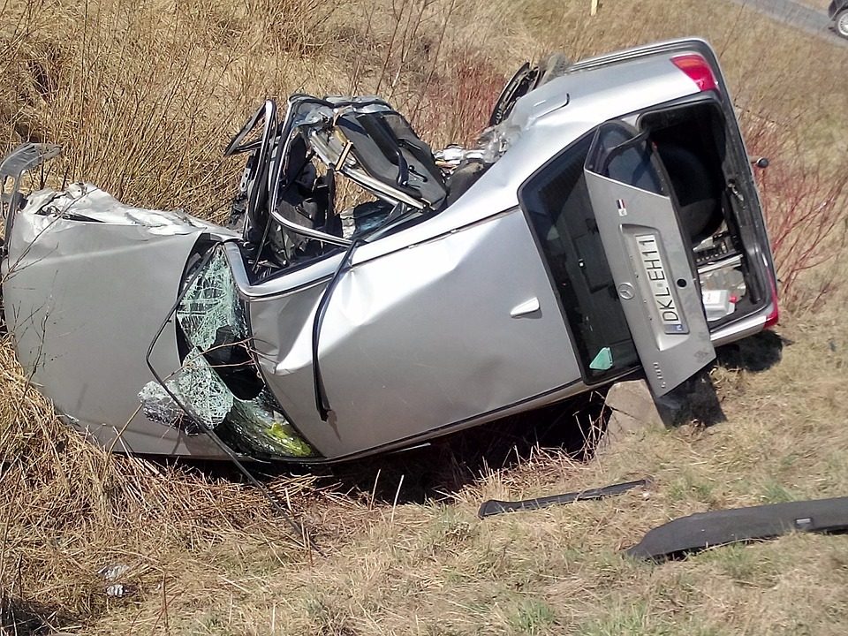
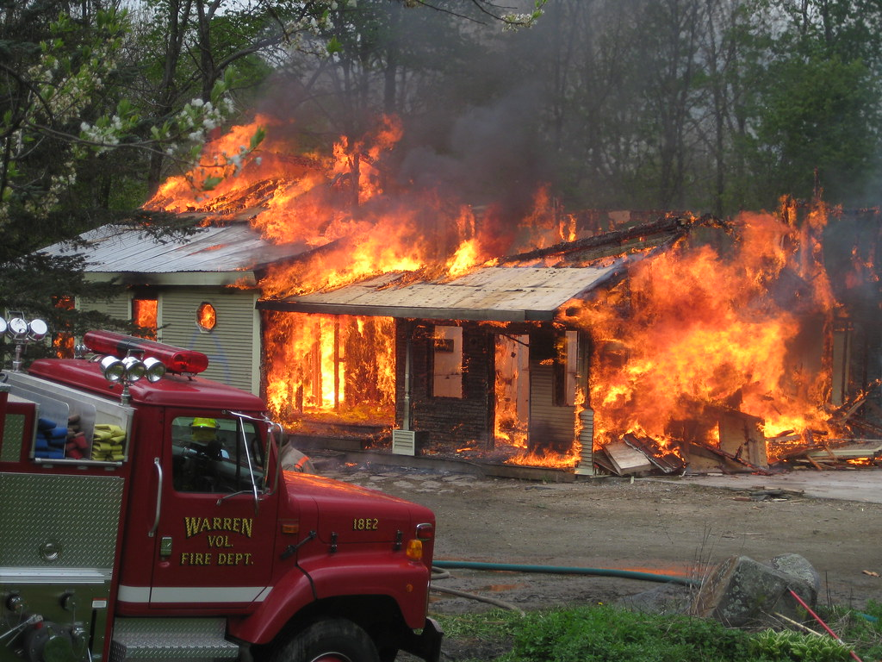





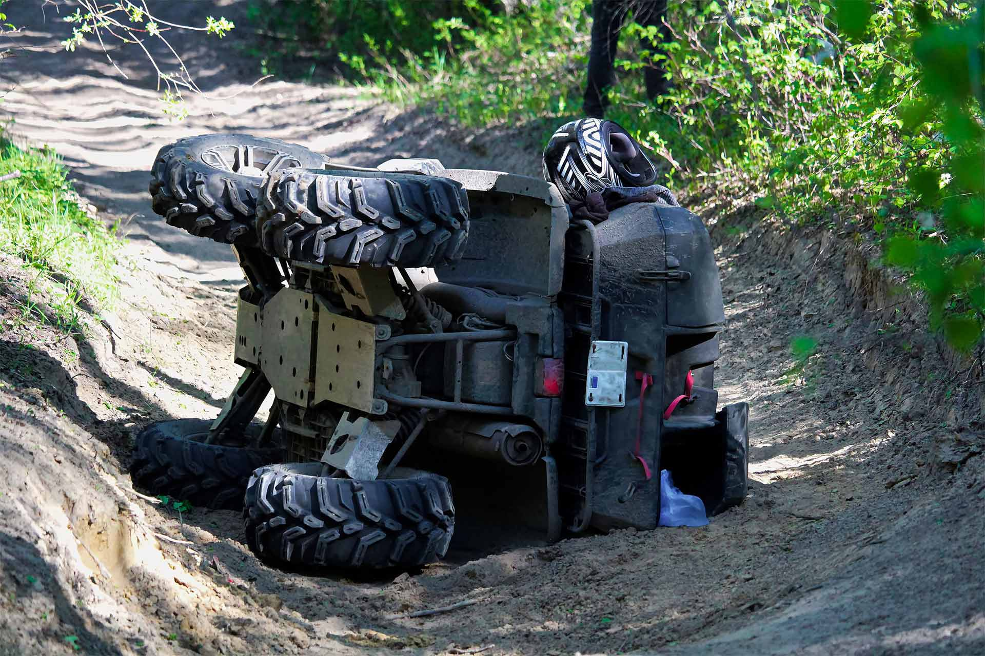

What does trauma look like?
Notes:
Kiersten: Currently, in the pediatric hospital setting we serve patient's and caregivers who are in currently in crisis due to trauma such as a....MVC, ATV.

Slide 5

Mission of Mental Health Counseling Services
To address and heal the emotional wounds and mental health symptoms that accompany the physical effects of trauma for patients and caregivers.
Notes:
Kiersten So our goal and purpose is to provide trauma-informed counseling interventions at the bedside when a family is at their most critical point of need.

Slide 6
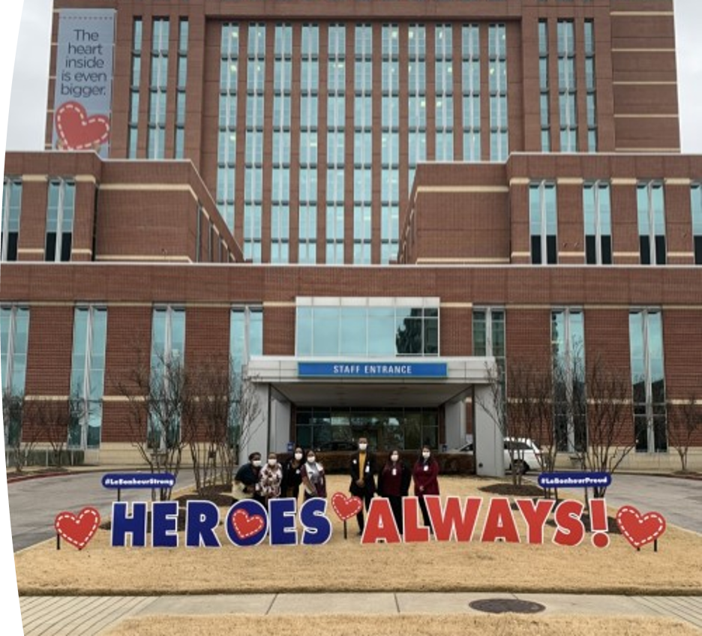
Mental Health Counseling Services
Mental Health Counseling Services (Sessions include but are not limited to the following:
  Inpatient Counseling children and families at the bedside.
  Outpatient Follow-Up (long term therapeutic counseling services are available to any patient and family treated in the Trauma Services Division)
  Telehealth Counseling Services (available to patients and caregivers residing in Tennessee)
  American College of Surgeons Gunshot Wound Assessment
Notes:
Regardless of their acute stress screening score, all trauma patients and caregivers are offered counseling services free of charge.
these include a wide range of interventions and are individually tailored to the unique needs of each child and family.

Slide 7
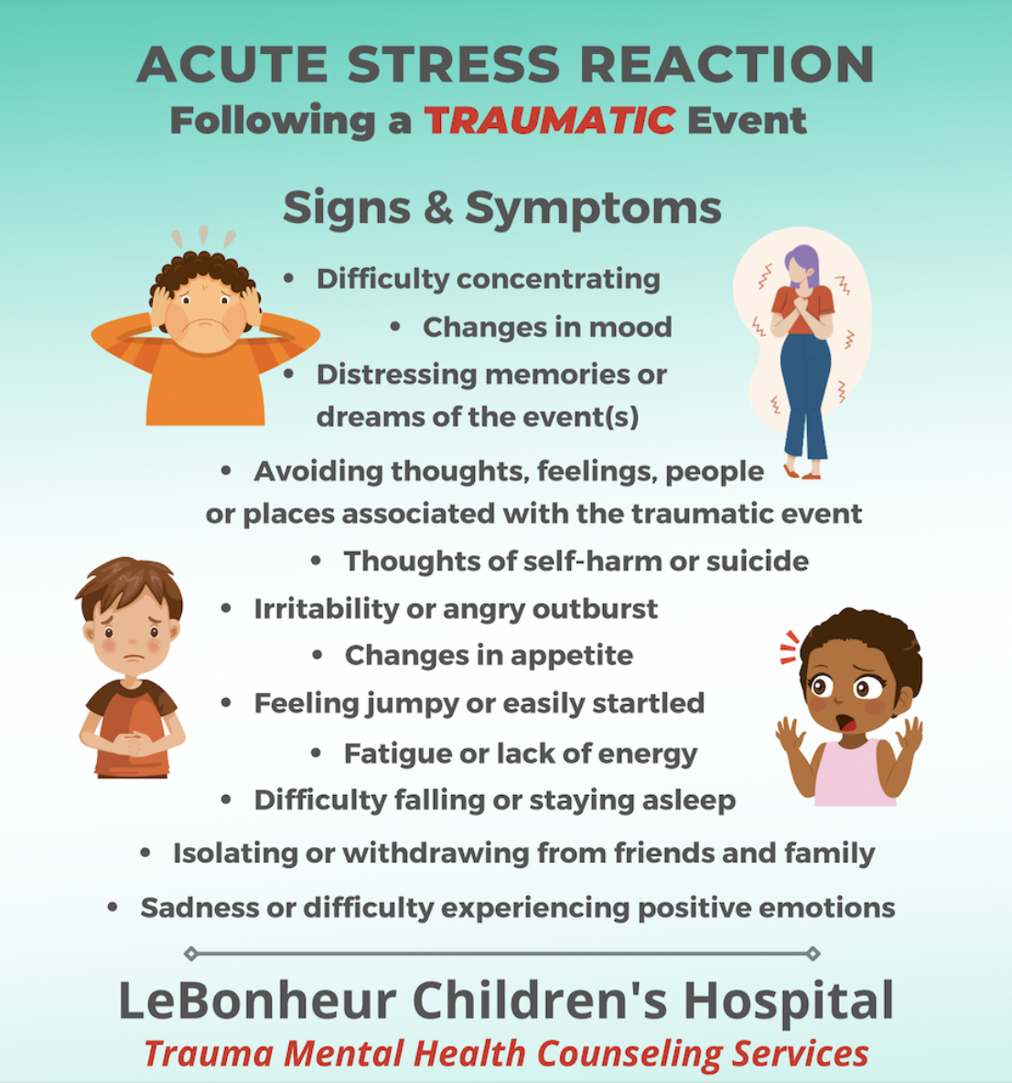
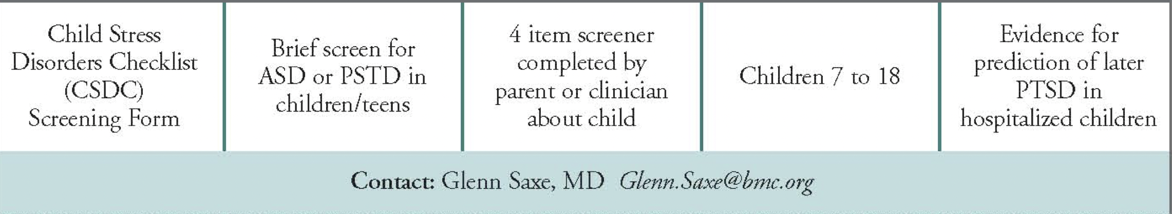
Screening: Acute Stress Disorder & PTSD Symptoms
Notes:
Sydnie: Naturally, children and families are often distressed by a sudden or life threatening illness or injury, painful treatment procedure, or simply just being in the ED or hospital.
Children who experience traumatic physical injuries are at risk of developing acute stress disorder and posttraumatic stress disorder (PTSD).
Acute stress and PTSD is a psychological and emotional response to an event after the event occurred that persists for over a month. Some of the symptoms are
Trauma Mental Counselors screen all of our trauma patients utilizing the Child Stress Disorders Checklist Short Form at the initial counseling consultation. Common acute stress symptoms are. (Children and families who are gun shot wound survivors are afraid to return home, or MVCs are afraid to drive or get in the car).
Early identification and treatment of these high-risk children can lead to improved mental health outcomes in this population.
Due to the particular developmental risks associated with young children's traumatic experiences, it is essential that vulnerable children be identified as early as possible after the trauma.

Slide 8
Child Stress Disorders Checklist - Short Form
Scoring
  0 = Not true at all
  1 = Somewhat or sometimes true
  2 = Very true or often true
Child reports more physical complaints when reminded of the event, such as headaches, stomach aches, nausea, difficulty breathing.
Child avoids doing things that remind him or her of the event.
Child startles easily. For example, he or she jumps when hears sudden or loud noises.
Child gets very upset if reminded of the event.
Notes:
Mitch: Here is an example of the screening form that we give to all of our patients. The first questions is to evaluate the physical symptoms associated with thoughts of the event, the second questions is to evaluate if the patient now actively avoids the event, the third question is to evaluate a new startle response due to stress from the event, and the fourth question is to evaluate negative emotions associated with thoughts of the event. When asked each question, the child gives a score from 0-2 with 0 being not at all, 1 being somewhat or sometimes true, and 2 being very true or often true. A score of >1 indicates signs of acute stress. While only 4 questions, it's been shown to be highly correlated to the longer 30 question form, and it yields timely results, which is critical in a trauma setting.

Slide 9
Acute Stress Study
​
Total population: 617 ​
330 African American (55.9%)​
210 White/Caucasian (35.6%)​
30 Hispanic/ Latinx (5.08% )​
9 Biracial/ Multiracial (1.53% )​
20 Others (1.87% )​
Results​
​
CSDC-SF scores an average of 1.71 (SD=1.75)​
64.8% of participants reported acute stress symptoms ​
Age was positively correlated with signs of acute stress​
Female patients experienced higher levels of acute stress than male patients​
Patients with violent injuries such as weapons-related injury and motor vehicle collision reported experiencing greater symptoms of acute stress disorder
127 Early Childhood (2-5 years old)​
165 Elementary School (6-10 years old)​
120 Middle School (11-13 years old)​
197 High School (14-18 years old)
Notes:
Mitch: To give context to the importance of our counseling services and the urgency to advocate for widespread adoption of such programs, I want to share a little bit of our data with you. On the top of the slide you'll see some demographic information for our study population. In our study, the average CSDC-SF score was 1.71, and we found that almost 2/3rds of our participants reported signs of acute stress, which is a huge number considering acute stress can develop into more serious mental health issues such as PTSD over time, especially if left untreated. So now Dr. Hawes is going to discuss how we prevent and treat traumatic stress in our patients.

Slide 10

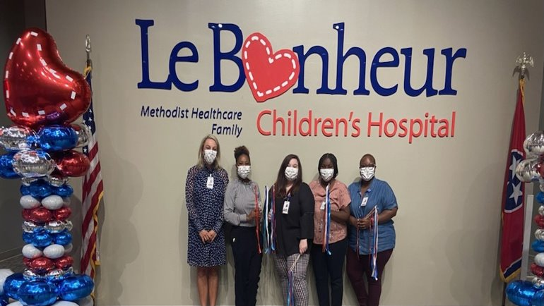
Preventing and Treating Traumatic Stress
Strengthen social emotional health
Reduce feelings of distress
Gain personal awareness and insight into current stress.
Learn new skills for managing stress.
Safe, non-judgmental, and confidential
Notes:
Kiersten: Children and adults experiences the same emotions that present after a traumatic experience…but children and teenagers express their thoughts and feelings differently from adults. Counselors provide a safe, non judgmental, and confidential outlet to explore emotions.

Slide 11
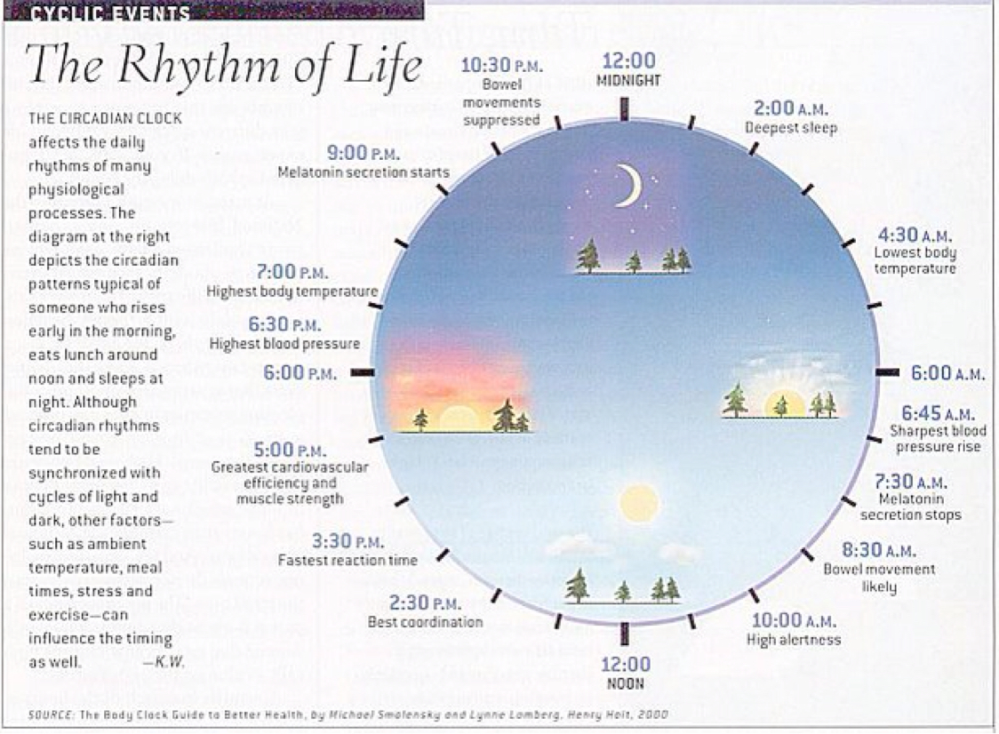
Interpersonal & Social Rhythm Therapy (IPSRT)
IPSRT encourages patients to also consider the role of circadian rhythms, the cycling of their moods, and how they relate to others.​
The ultimate goal, then, is to stabilize these rhythms as best as we can in a hospital settings and better regulate emotions. ​
Social rhythm
Regulate daily routines
Emphasizes the link between regular routines and mood
Emphasizes the link between mood and life events
Focus on interpersonal problem area
Grief (loss of the healthy self)
  Discuss what is lost and what is not lost
Role transition
Notes:
Kiersten: Children and adults tend to thrive when we operate in some element of structure. Typically when that schedule is modified it effects our mood, our flow, our sleep, appetite.
It’s the same experience as a our body adjusting to jetlag. It takes time. When patients and caregivers are being treated at the hospital their lives have been flipped upside down.
IPSRT encourages patients to also consider the role of circadian rhythms and their role in the cycling of their moods and how they relate to others.
The ultimate goal, then, is to stabilize these rhythms as best as we can in a hospital settings and better regulate emotions.
-In our counseling sessions we discuss how the patient can regulate daily routines, discuss how regular routines and mood. So feeling anxious, depressed, on edge
The second component is how their injury has effected them interpersonally. Many of the children we work with are grieving.
They are grieving the loss of their ability. They are sad they can no longer participate in sports at the moment. In counseling we
1) allow them to process those feelings 2) We are also sure to highlight what is LOST and what is NOT lost and 3) We explore other alternatives until they recover.
Some children who can't play sports, we discuss getting involved with the team and offering assistance until they can return to the field or court or competition.

Slide 12
Grief and Loss Therapy
Be honest and concrete
Grief Psychoeducation
Process emotions, recall memories of loved one.
Normalize and validate their emotions
Encourage caregivers to share their emotions, children model their parents
Children often feel guilty after a death has occurred.
Explain that when painful or “bad” things happen, people often wonder if it was because they did something bad.
Avoid being critical about these feelings.
Help children identify appropriate ways to express their feelings:
  Journaling, writing a letter to their loved one, and expressive arts
Disbelief
Sadness
Anger
Fear
Guilt
Anxiety
Numbness
Notes:
Kiersten: Grief and loss therapy is a major component of the work we do, because we typically counsel patients who are recovering from injuries where a fatality could have been involved. For example some of our patients were in car accidents or ATV accidents where a friend or relative did not make it. We also counsel caregivers who might be in the process of planning their child's end of life care due to an accident.
During our initial consultation we are seeing children and families when they are still in shock and might still be processing the loss. During this time
honest and concrete about a loss and continue to offer support as they experience the range of emotions that come up.

Slide 13
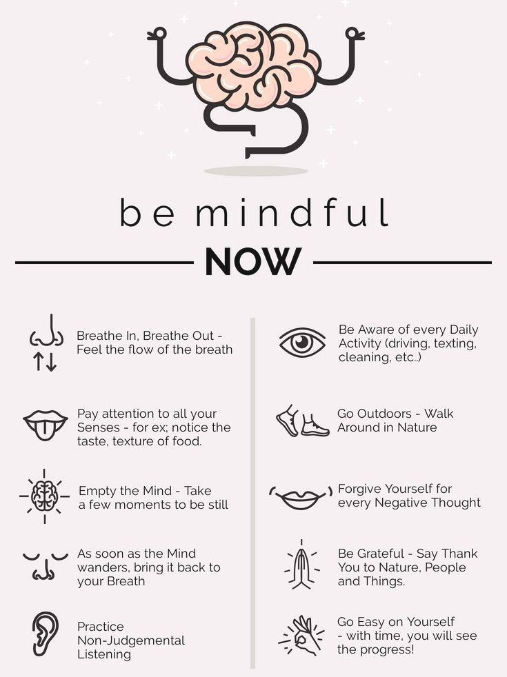
Mindfulness-Based Stress Reduction (MBSR)
MBSR: 8-week mindfulness training program that was created by Jon Kabat-Zinn in 1979 at the University of Massachusetts Medical Center for chronically ill patients who were not responding well to traditional treatments.
Present moment awareness and acceptance without judgement.
Avoid rumination, either on the past or the future.
Respond to stress, rather than reacting to it.
Change habitual reactivity patterns.
Notes:
Sydnie: Sooths the nervous system
widely used for pain management.
-Square breathing exercise (breath in for 4, hold for for 4, exhale for 4, and sit for 4.
Ronald M. Epstein, M.D. – a professor of medicine at the University of Rochester in New York.
"Mindfulnness Doorknob"
But what if you paused – for just 3 seconds – as you touch the door handle, took a breath to be present, and let go of all that has gone before and all that is ahead of you?
Everyone has time to do this,

Slide 14
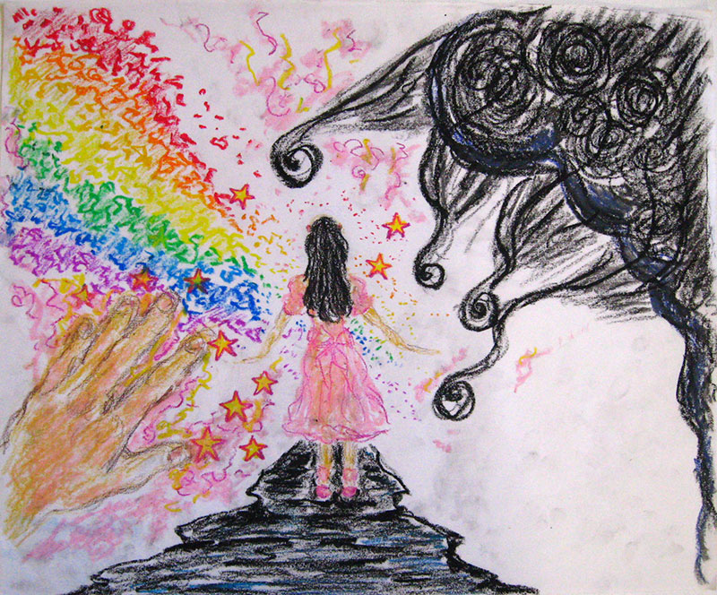
Play and Expressive Arts Therapy
Combines psychology principles with the creative process to promote emotional growth and healing.
Assists with communicating and processing emotions, self-discovery, and helps decrease anxiety and stress.
Music, poetry, dance, coloring, or other artistic activities.
Notes:
Sydnie: Explain cases

Slide 15
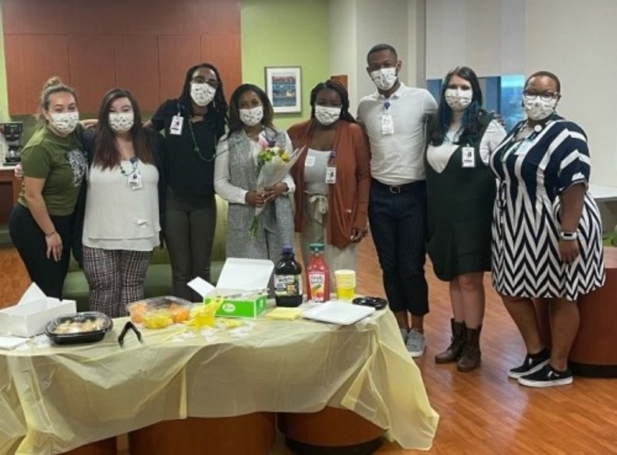

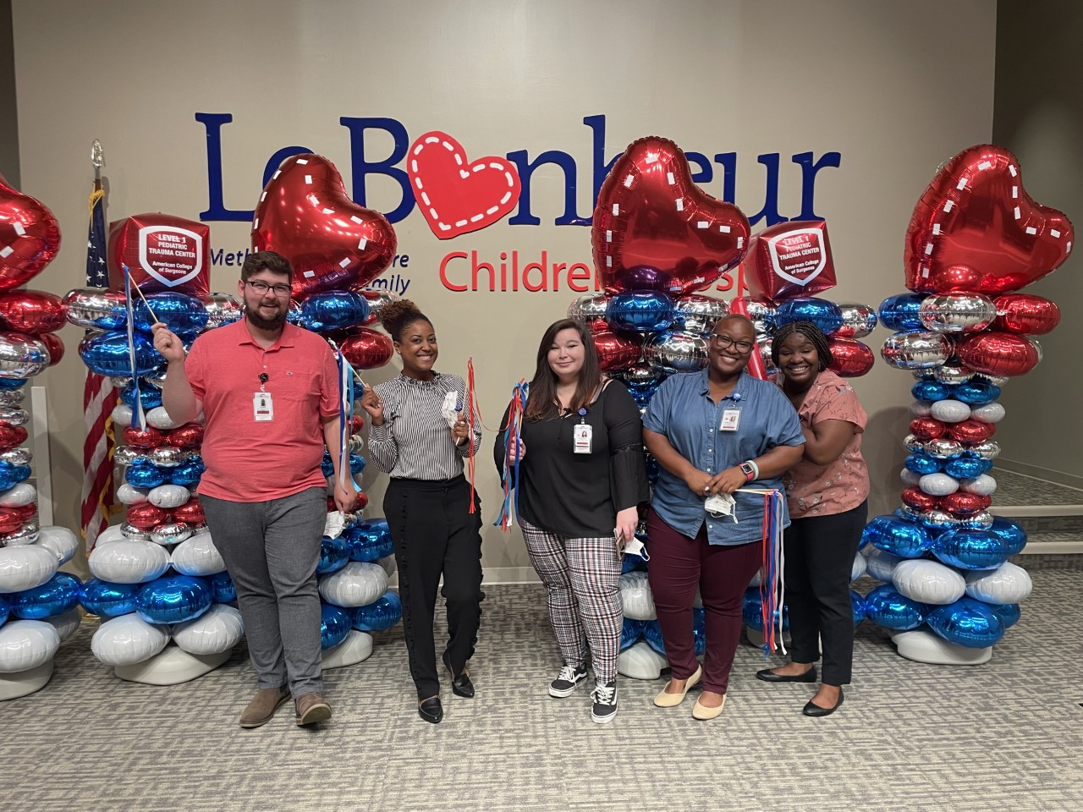
Student Training
Advanced Internship students in the Masters and Doctoral Degree Programs in Clinical Mental Health Counseling, Counselor Education and Supervision and Counseling Psychology provide trauma-informed counseling services to patients and families under the supervision of Dr. Kiersten Hawes and Dr. Eraina Schauss.
All students are trained and certified in the following neuroscience and trauma-informed interventions:
  Interpersonal Social Rhythm Therapy
  Mindfulness Based Stress Reduction
  ACTIVE Parenting
Notes:
Kiersten: This work would not be possible without the clinical mental health counseling students who are so passionate about serving the families at LB.

Slide 16
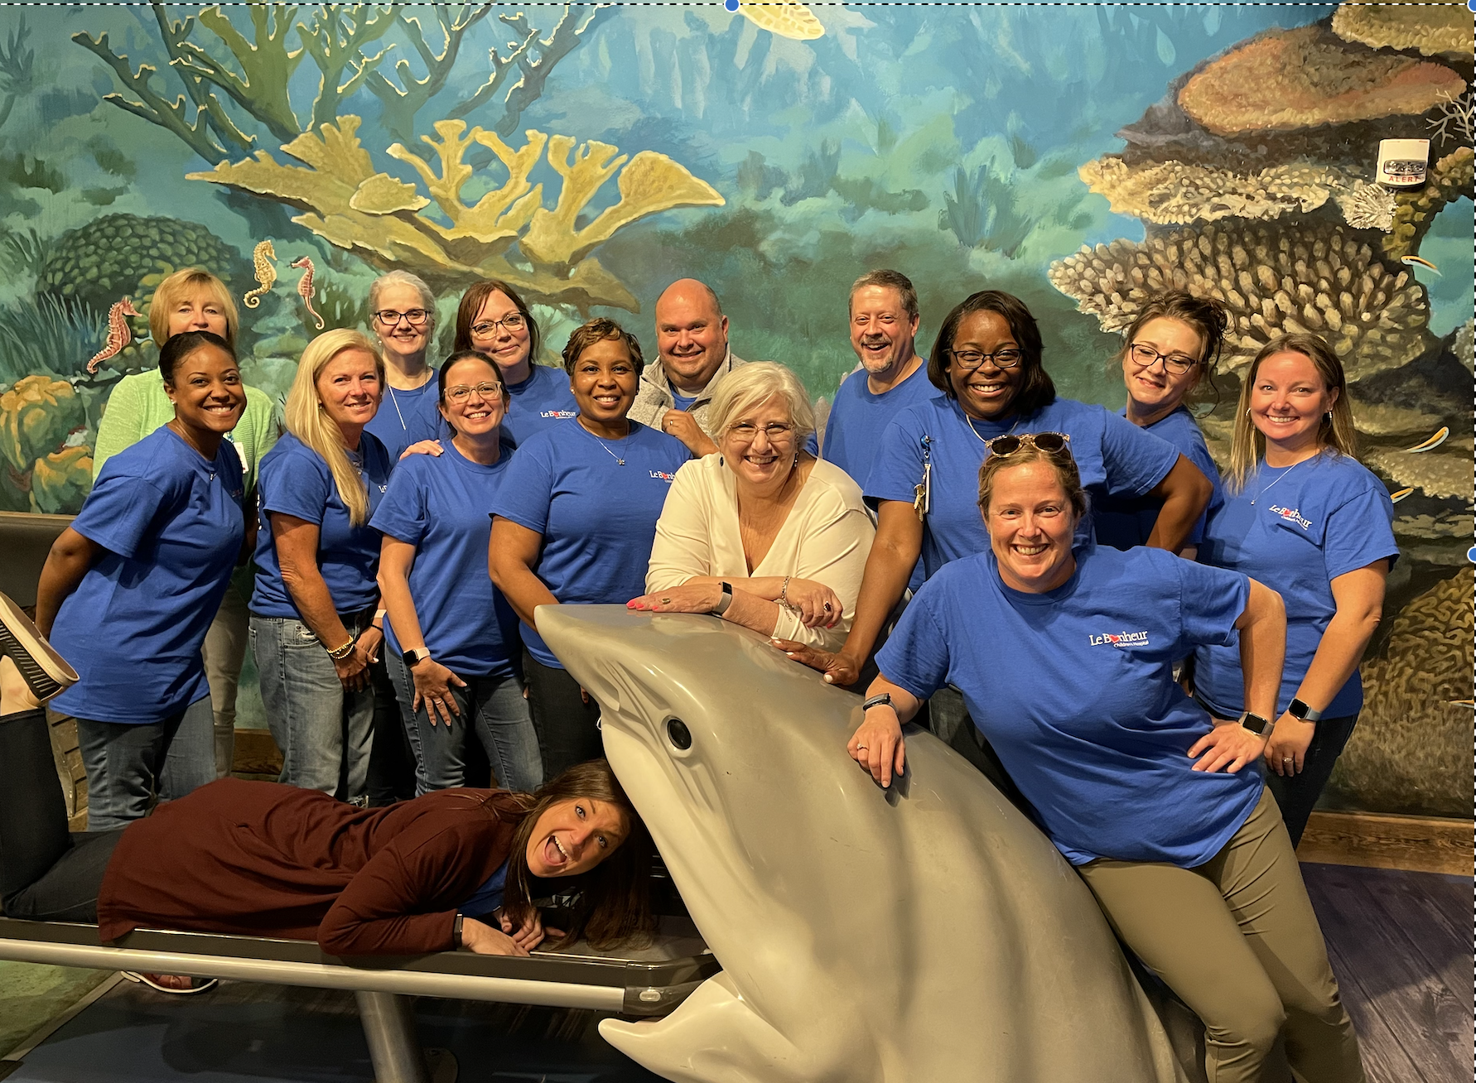
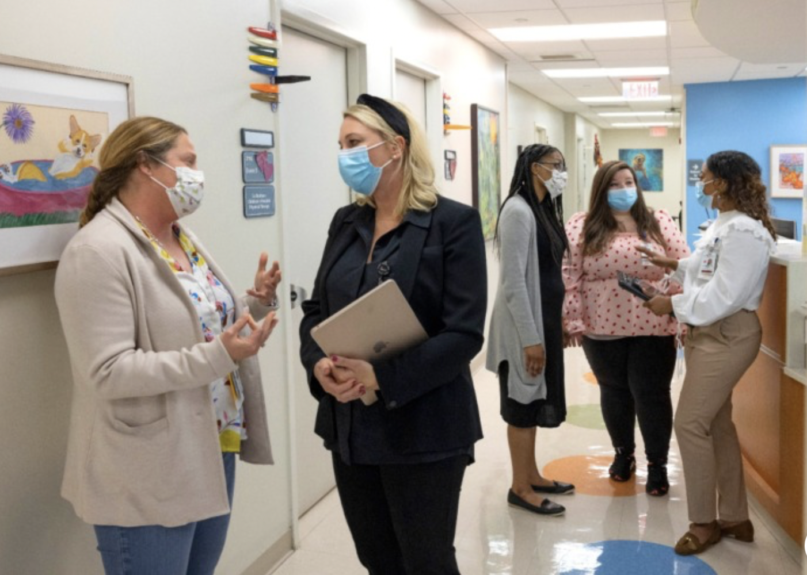
Mental Health in an Integrated Health Setting
Number of counseling sessions since program start date February 2021: 1,900 counseling sessions
Families served: 830 families
Reduces mental health help-seeking barriers
  Access to counseling services
  Willingness to engage in counseling
Integrated Health Team collaboration to treat the "whole child and family"
Notes:
Kiersten

Slide 17
References
Felitti VJ, Anda RF (2010). The relationship of adverse childhood experiences to adult medical disease, psychiatric disorders, and sexual behavior: implications for healthcare. In: Lanius R, Vermetten E, eds. The Hidden Epidemic: The Impact of Early Life Trauma on Health and Disease. Cambridge University Press :77–87.
Kaufman, A. S. (2004). Kaufman Brief Intelligence Test-Second Edition (KBIT-2). Circle Pines, MN: American Guidance Service.
Kinniburgh, K. J., Blaustein, M., Spinazzola, J., & van der Kolk, B. A. (2017). Attachment, Self-Regulation, and Competency: A comprehensive intervention framework for children with complex trauma. Psychiatric Annals, 35(5), 424-430.
National Child Traumatic Stress Network. Types of traumatic stress, 2015. (http://www.nctsn.org/trauma-types.)
Oral, R., Ramirez, M., Coohey, C., Nakada, S., Walz, A., Kuntz, A., Benoit, J., & Asa, C.P (2015). Adverse childhood experience and trauma informed care: the future of healthcare. Pediatric Research, 79, 229-233.
Rizzo, C., Serg, S., Winokur, R., Weaves, C., Thad, P., & Youngblade, L. (2020). Implementing trauma screening and trauma assessment in child welfare, the journey of seven Colorado counties. Child Welfare, 98(4). Child Welfare League of America Inc.
Wiig, E. H., Secord, W. A., & Semel, E. (2013). Clinical evaluation of language fundamentals: CELF-5. San Antonio, TX: Pearson.

