Slide 1

Studying Abroad for History
Presented by: The UofM Study Abroad Office

Slide 2
- Immerse yourself in another culture
- Unique class offerings
- Fun, but challenging experience
- Study Abroad makes you stand out.
Why Study Abroad?

Slide 3

Anywhere you can earn credits for your major!
The options are wide open for History students:
- Europe, Asia, Latin America, Oceania, and Africa.
Highlighted History Programs:
- Palazzi (Florence, Italy)
- ISA Language, Literature & Culture (Cuzco, Peru)
Where Can You Study Abroad?
Palazzi Program Info
ISA Peru Program Info
Additional Study Abroad Information

Slide 4

- Dates: Pick from a variety of 3- or 4-week class sessions during the summer.
- Credits Earned: 3 credits
- Location: Florence, Italy
- University: Florence University of the Arts (FUA)
- GPA Minimum: 2.5
- Application Deadline: September 1st
- Cost: $2,950-$4,500, including tuition and application fee.
Palazzi Program Details
Check out the Program page for Additional Information!

Slide 5


Offered History Courses: Palazzi
Italian Civilization and Culture: History and Religion
Focuses on:
  Northern vs. Southern Italy
  Proximity of Middle East
  Central Italian Culture
Florentine Art Walks
Understand cultural roots from the Roman foundation to the Contemporary Zeitgeist
Learn about central historical influences from the Florentine Guilds to Michelangelo.
Contemporary Mafia and Antimafia
Explore the structural aspects of mafia operations.
Analyze contemporary cultural features of mafia-related groups and illegal markets
History of the Italian Renaissance
Explore the Renaissance period circa 1350-1550
Understand social, political, economic, etc. aspects of the period.
Focuses on Renaissance Humanism
*Courses are subject to change

Slide 6
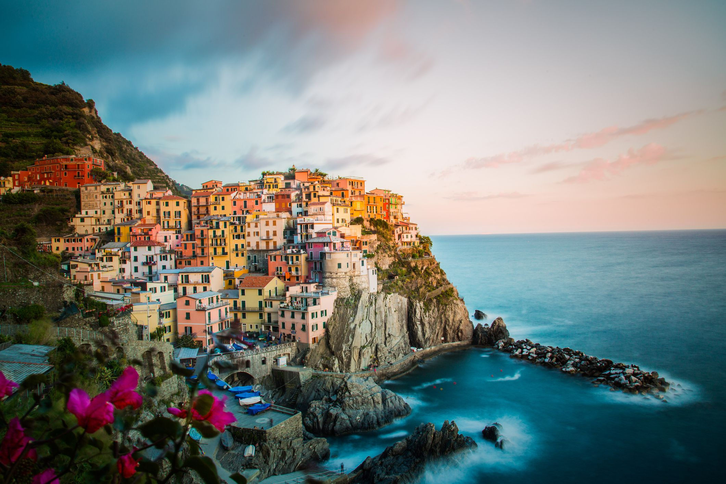
Excursion and Cultural Activity Opportunities
- Wine Tasting in Tuscany
- Cinque Terre
- Firenze
- Ferrari Factory
- Venice
- Pompeii
- Leaning Tower of Pisa
*Listed excursions may require arranging yourself

Slide 7
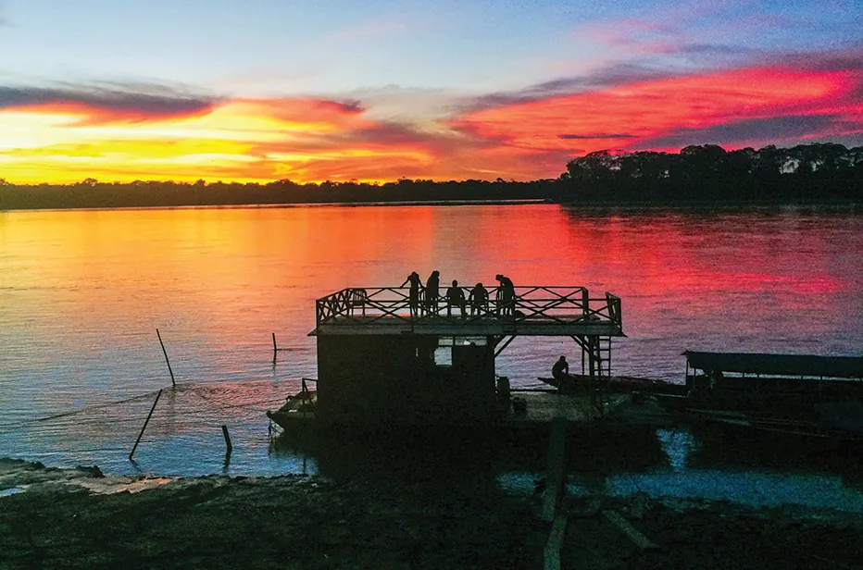
ISA Peru Program Details
- Dates: January 27th – May 6th, 2023 (recurring every Fall/Spring)
- Credits Earned: 12-17
- Location: Cuzco, Peru
- University: ISA Cusco Study Center
- GPA Minimum: 2.5
- Application Deadline: November 1st, 2022
- Cost: $11,995, including Tuition, Meals, and more.
Check out the Program page for Additional Information!

Slide 8
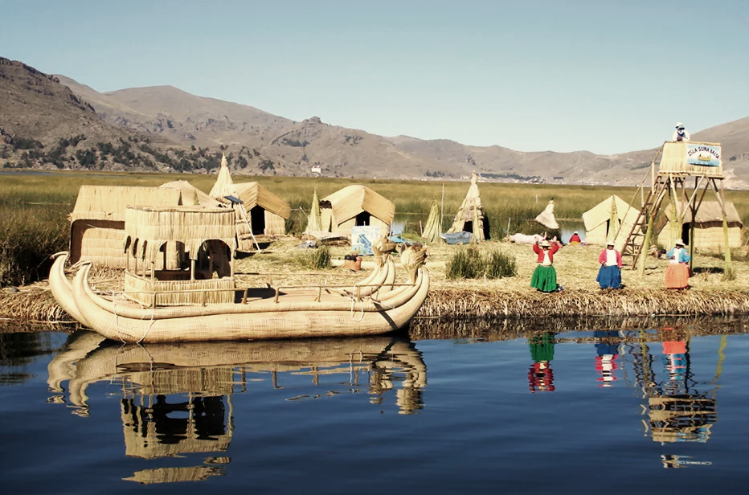
Offered Courses: ISA Peru
History of the Incas
Focuses on:
  Pre-Incan Society
  Rise of the Incan Empire
  Andean Politics
  Conquest and Colonialism
Traditional Classroom
People and Cultures of Peru
Focuses on:
  Peru from Colonial to Modern times
  Social and Environmental movements of Peru
  Colonizing the Amazon and Slavery
Multidisciplinary Course
Complete Language Requirements Abroad Too!

Slide 9
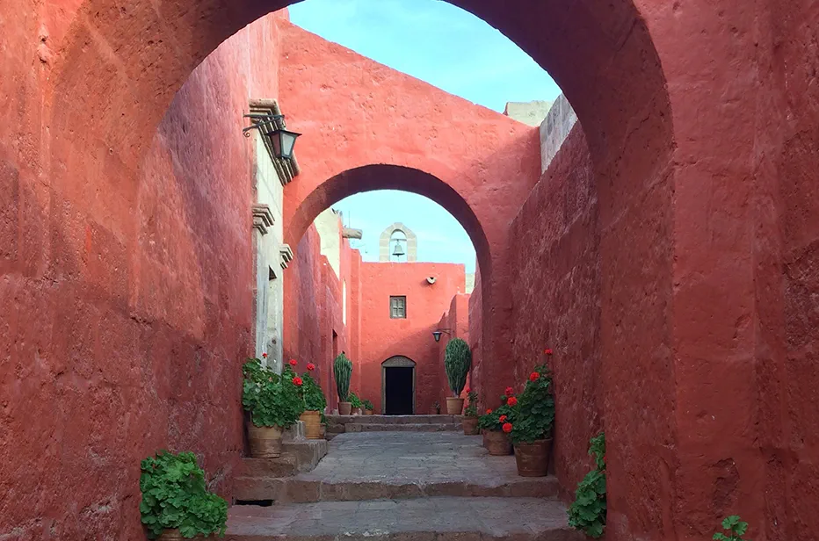
Excursions and Cultural Opportunities
Puno & Lake Titicaca
Machu Picchu
Sacred Valley
Cultural Activities in Cusco
Puerto Maldonado
Arequipa
*All Excursions Available Through ISA

Slide 10
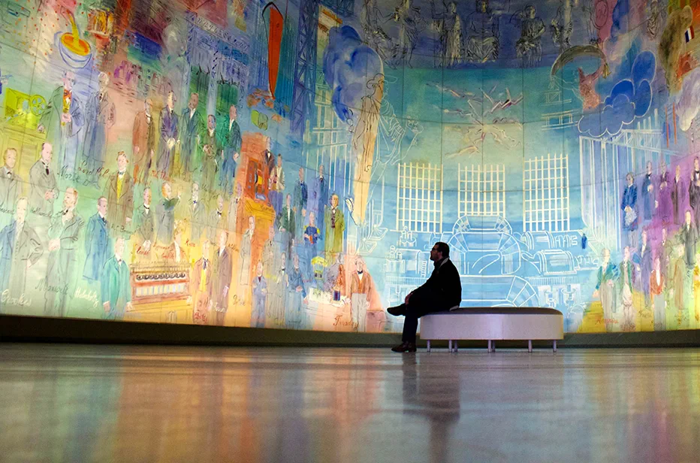
Scholarship Opportunities
UofM Study Abroad Scholarship (approx. $1,000 for summer programs)
Use your Hope Scholarship and Pell Grants if eligible
ISA Scholarships for ISA Programs
Gilman Scholarship (For Pell Grant Recipients)
Additional Opportunities dependent on Eligibility!

Slide 11

Need A Passport?
A Passport is:
Valid for 10 years (unless you obtained it before your 16th birthday)
Your ID abroad
Your entry document to return to the USA
Do you need to renew your passport?
If your current passport will expire within 6 months after you re-enter the USA at the end of the program, then YES, you must renew your passport before you leave! The general rule is to have 6 months validity remaining at all times (Some countries may require additional validity.)

Slide 12



Schedule a study abroad appointment today. Our advisors can help identify potential programs, book flights, assist in obtaining a passport, and answer additional questions.
Your parents are welcome to join in on your advising appointments.
Schedule an appointment today through our website or through the QR code:
  www.Memphis.edu/abroad/about_us/contact_us.php

