Slide 1
A Data Science Approach to Predicting Poverty Using Socio-Economic Indicators – The Case of Shelby County and City of Memphis
Srikar Velichety
Chen Zhang
Brian Hoogstra

Slide 2
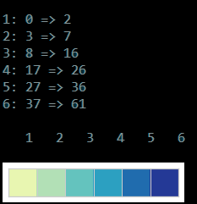
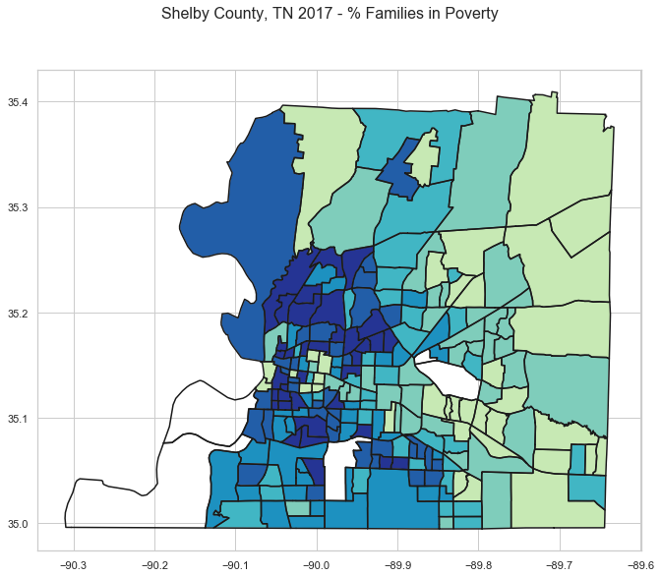
The Problem
Unacceptable

Slide 3
Where does Memphis Stand?

Slide 4
Issues with Poverty data estimates
Household surveys of wealth are expensive and not comprehensive.
Data is spread over a variety of agencies and sources.
Incompatibility of local and national level data sources.

Slide 5
Data – Driven Approaches
Use of Cell Phone Call Data Records to predict incidence of poverty
Nighttime imaging as a proxy for economic activity to identify concentrations of poor regions.

Slide 6
Research Questions
How do we quantify infrastructure and urban revitalization measures from Satellite Image data and how are they associated with poverty rates?
How are the neighborhood characteristics of a census tract associated poverty rates of the focal tract?
How do measures of education attainment supplement infrastructure and neighborhood characteristics to predict poverty rates?

Slide 7
Methodology

Slide 8
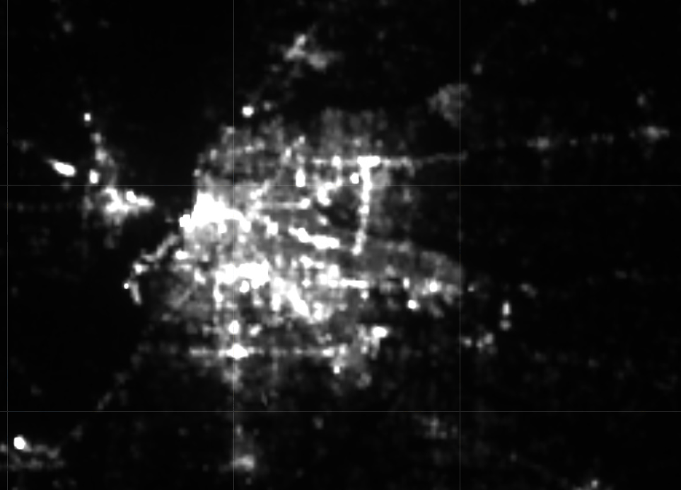


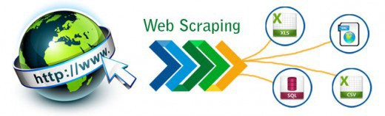

Data Sources
Day-time Satellite Images
Night-time Satellite Images
Real Estate Transactions
Real Estate Attributes

Slide 9
Challenges with Data Collection
Cloud Cover for Daytime images
Biases in Census Bureau reporting
Missing Latitude/Longitude data in City Assessor’s Office DB

Slide 10
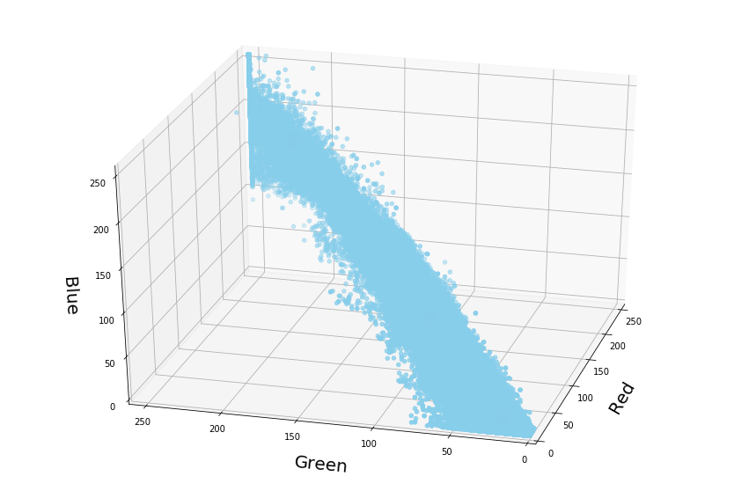
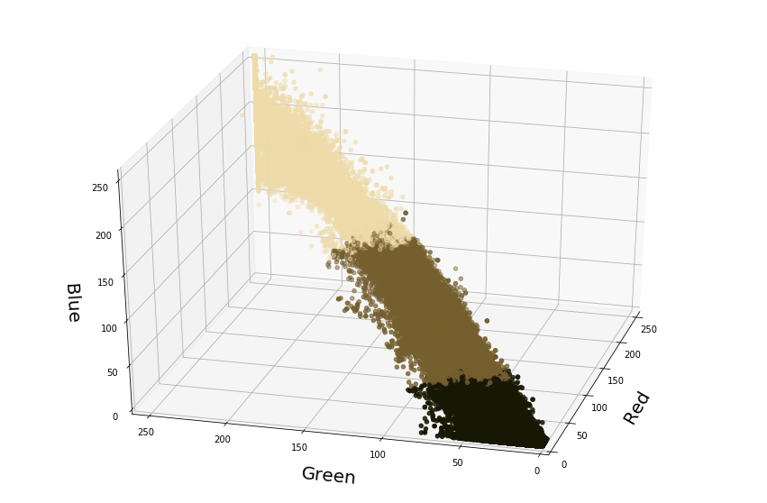
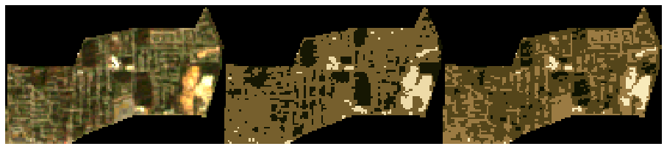
Image Segmentation
Original
3 Clusters
4 Clusters

Slide 11
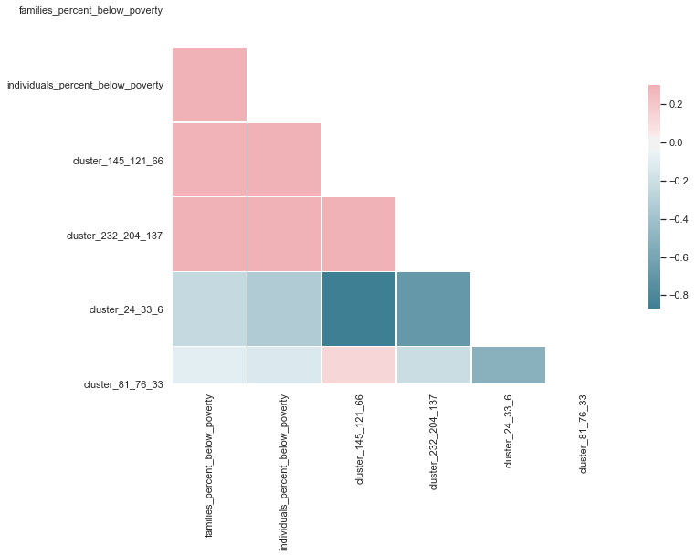
Basic Correlation Plot
Target

Slide 12
Next Steps…
Combine Convolutional Neural Networks (CNN) and Recurrent Neural Networks (RNN) to develop infrastructure development indicators (Validate with the number of business licenses data).
Use high dimensional statistics to build predict poverty rates.
Analyze feature importance and interactions (Using interpretability metrics).

