Slide 1

Diagnosing Amblyaudia and Treating it with ARIA
A webinar sponsored by the FedEx Institute of Technology and School of Public Health at the University of Memphis
  Deborah Moncrieff, Ph.D., CCC-A
  Jennifer P. Taylor, Au.D.
  School of Communication Sciences and Disorders
  Memphis Speech and Hearing Center

Slide 2

Disclosures
DM is the owner of Dichotics Inc, the developer of a software program that can be used to assess individuals for binaural integration deficits with dichotic listening tests.
DM and JPT are faculty members at the University of Memphis where we research auditory processing across the lifespan. JPT provides clinical services for auditory processing in the Memphis Speech and Hearing Clinic.
With support from the Office of Technology Transfer at the FedEx Institute of Technology and UofM Innovation in Research, DM is developing a stand-alone device to provide diagnostic and treatment services for individuals with dichotic listening deficits.

Slide 3
Content Disclosures
This course will focus on Auditory Rehabilitation for Interaural Asymmetry intervention and will not discuss other similar or related treatments.
This presentation is sponsored by the FedEx Institute of Technology and the School of Public Health at the University of Memphis and was prepared in part through a Community of Research Scholars grant to promote interdisciplinary research and clinical services to our community.

Slide 4
Where have we been with APD?
Clinical APD batteries were created in the 1960’s and 1970’s to evaluate different auditory processing skills
  Comprised primarily of “site-of-lesion” tests used in adult neurologic patients
  Adapted for use with children and adults with no known lesions
Buffalo Model (Katz, 1957, 1961, 1966); Jerger (1965); Willeford(1977); Bellis/Ferre (1999); Musiek/Chermak (1977; 1983); SCAN-C (Keith, 1986)
Poor standardization exists among tests used in APD assessments and the test battery varies depending on the clinical site and audiologist administering the test
  Clinicians can use whichever test battery and model they prefer, often based on how they were originally trained

Slide 5
Current “standards” in many places
Below normal performance on any two tests from any battery
  Generally requires performance deficits of at least two standard deviations below the mean on two or more tests in the test battery (Chermak & Musiek, 1997).
If poor performance on only one test, the audiologist should withhold diagnosis unless scores fall three standard deviations below the mean or if an additional functional difficulty is assessed.
2 standard deviations below the mean corresponds to the 2.3 percentile. That means that the only children you can consider diagnosing have performance that is poorer than 97.7% of their age-related peers.

Slide 6

Should APD be on the chopping block?
We’re only identifying the poorest of the poor performers
  NO specificity for ear (unilateral left, unilateral right, bilateral)
  NO uniformity for persons given the same diagnosis
Some tests have poor validity (British Society of Audiology, 2011)
Wildly different outcomes across multiple standards (Wilson & Arnott, 2013)
APD is too heterogeneous and does not constitute a clinical entity (Vermiglio, 2014)
The diagnosis of APD provides no specificity for treatment

Slide 7
MSHC Test Battery before 2018
Pitch Pattern – temporal ordering, frequency discrimination
Competing Sentences – binaural separation, memory
Dichotic Digits – binaural integration, memory
Compressed Speech – closure
Low Pass Filtered Speech - closure
GIN – temporal resolution
MLD – binaural release from masking
RASP – fusion and binaural integration
Notes:
ACPT
HINT-C
- Used as needed

Slide 8
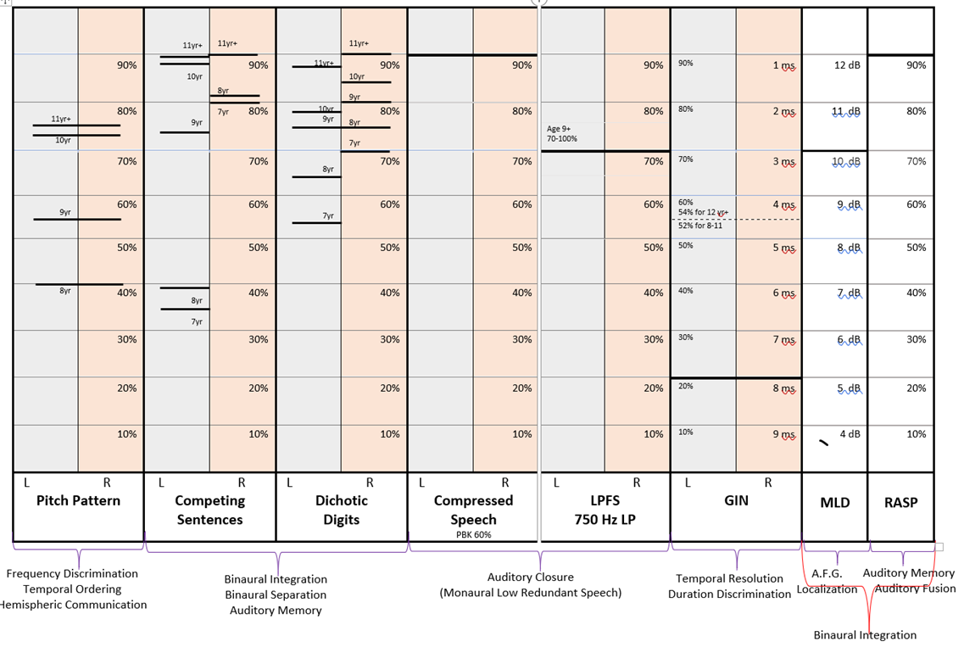

Slide 9
MSHC Battery Today
SCAN-C
Randomized Dichotic Digits Test
Dichotic Words Test
Frequency Pattern Test
LiSN-S
Words in Noise Test
Primary objective is to identify dichotic listening weaknesses so that those can be remediated before further assessments

Slide 10
Dichotic listening deficit is a target condition within the APD construct
Amblyaudia and dichotic dysaudia are deficits in binaural integration, a perceptual process that is important for spatial hearing
  Amblyaudia is an auditory equivalent of amblyopia in the visual system, a binocular integration deficit (convergence failure) commonly known as “lazy eye”
    It is characterized by an abnormal interaural asymmetry during dichotic listening tasks (Moncrieff, 2010)
  Dichotic dysaudia is a bilateral weakness during dichotic listening tasks with normal asymmetry between the two ears
    Disability to identify words occurs only during dichotic tasks

Slide 11
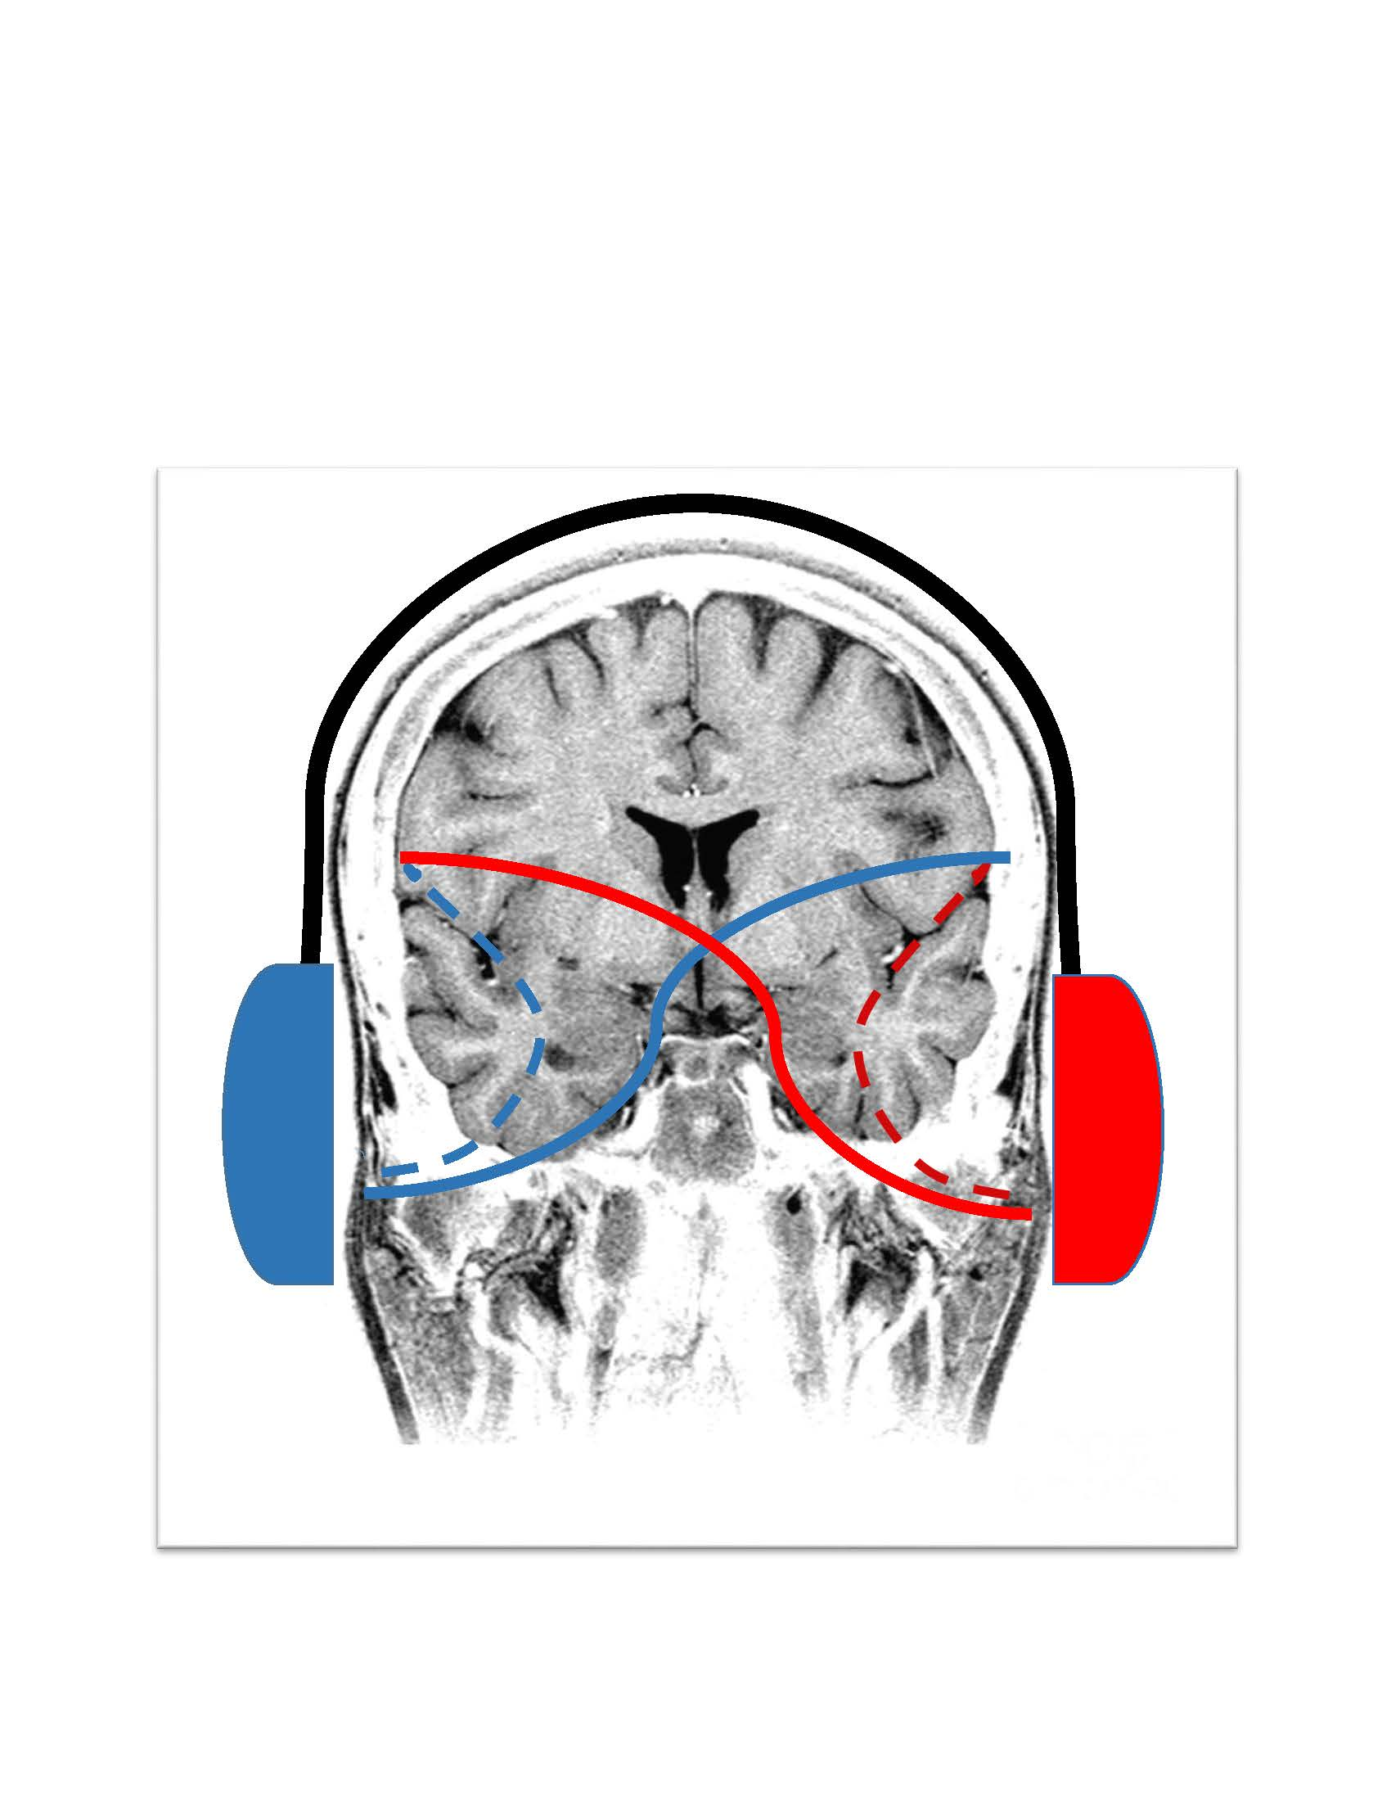
Amblyaudia and dichotic dysaudia are identified through dichotic listening tests (DLT)
Competing stimuli are presented simultaneously to the left and right ears
  Digits
  Words
Listener is asked to repeat everything that has been heard
“10, 5”
“6, 3”

Slide 12
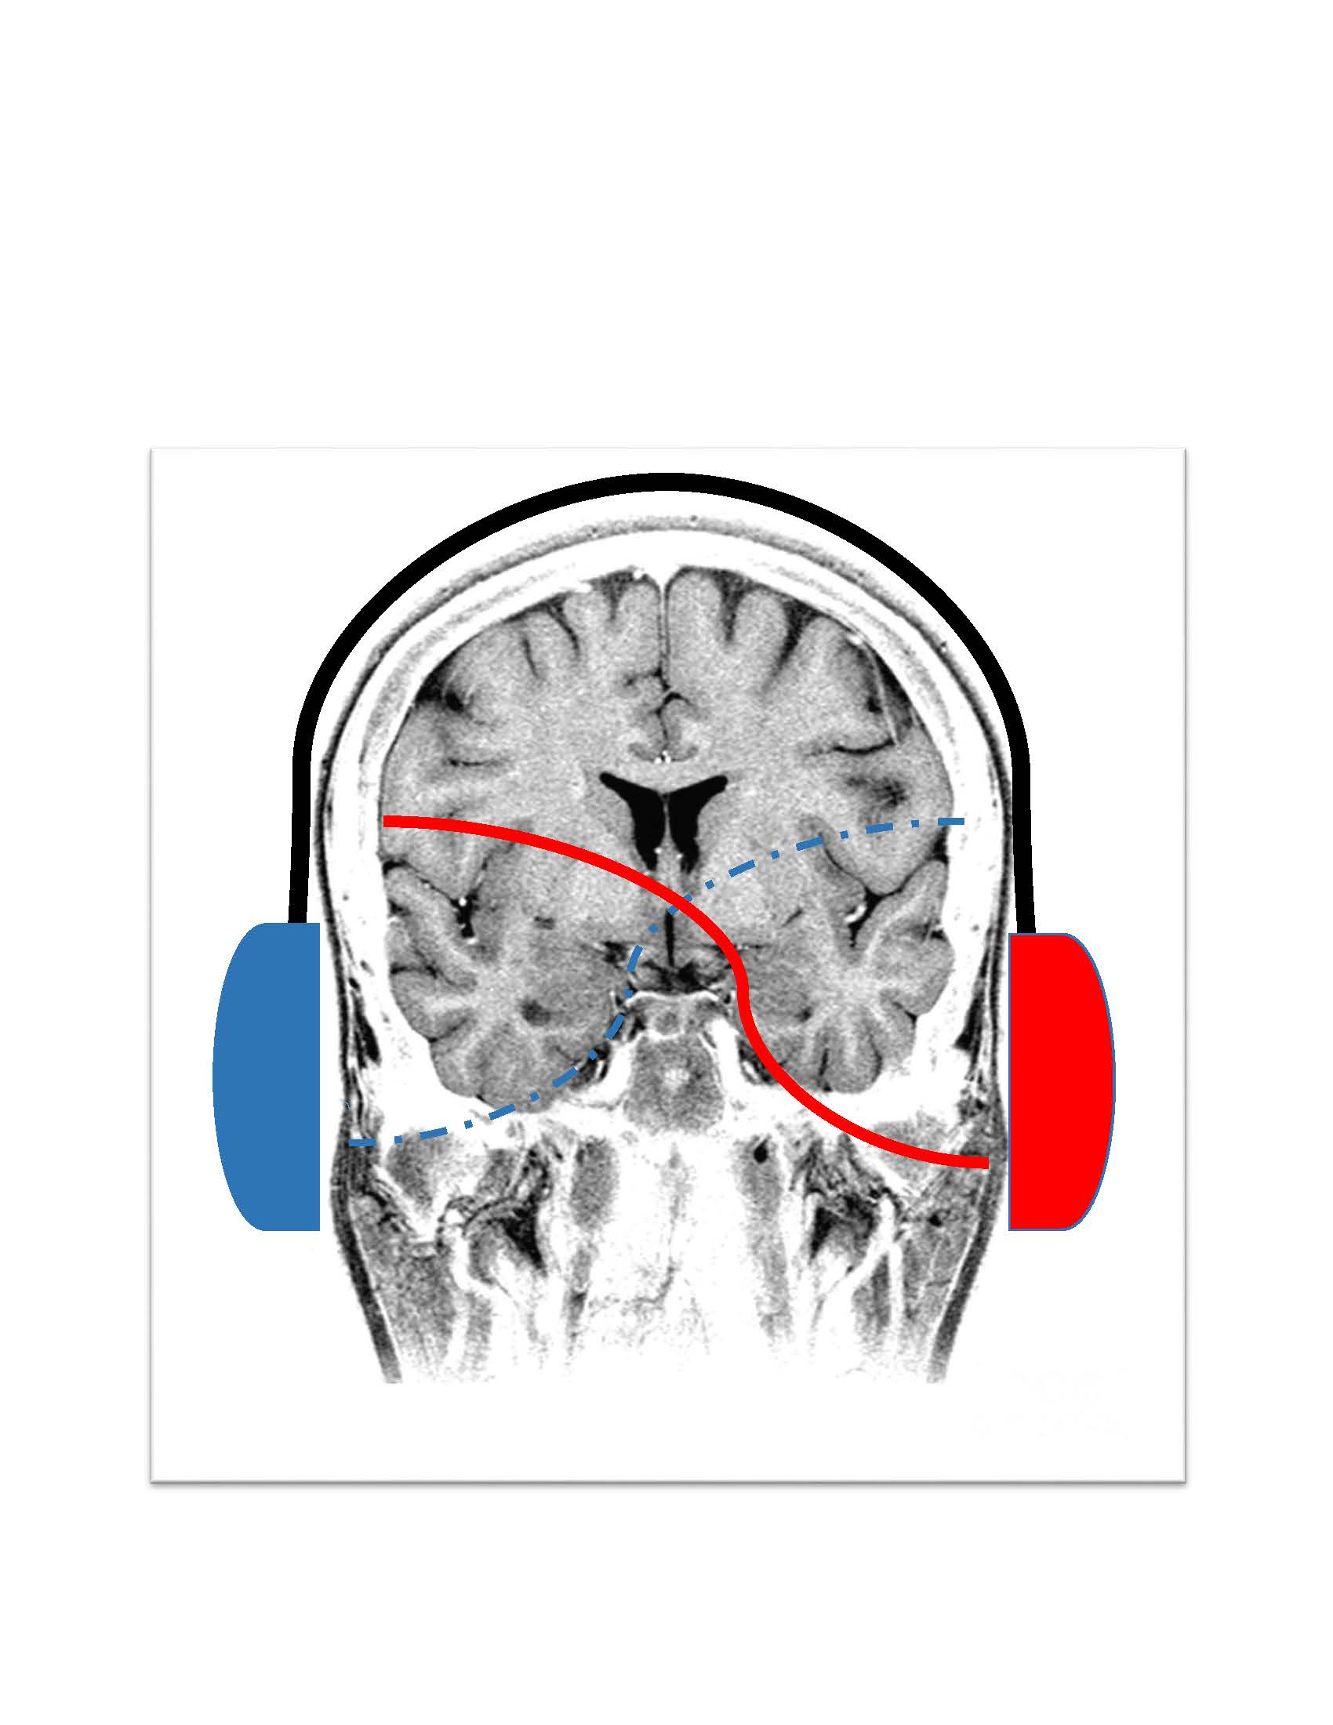
Listeners typically produce an “ear advantage"
The listener’s “dominant ear” performs better than “non-dominant ear”
  The dominant ear is defined as the ear that is contralateral to language-dominant cerebral hemisphere (Kimura, 1961, Canadian Journal of Psychology)
  The dominant ear is connected to the cortex via abundant neural fibers that comprise the contralateral auditory pathway
Processing of binaural signals begins in the auditory brainstem with outputs from the cochlear nucleus converging in the superior olivary complex
LH
RH
LE
RE

Slide 13
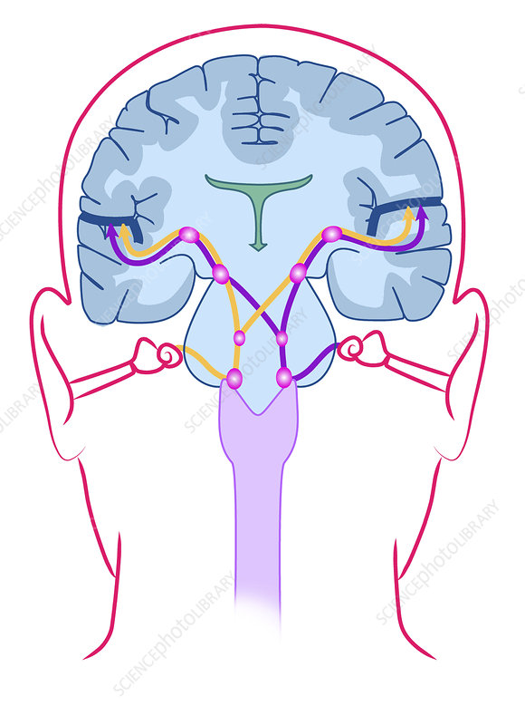
Sounds come in from all around us
into our ears
Sounds are coded first in the
inner ear – the cochlea
Sounds from the left and right ears
are combined and integrated in the
auditory brainstem
The final neural signal arrives in the
cortex on the left and right sides

Slide 14
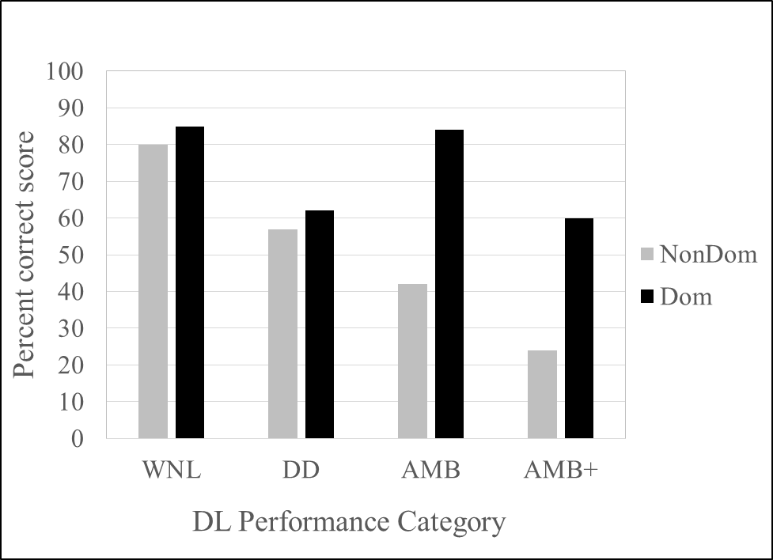
Listeners produce one of 4 patterns
WNL
  Normal performance in both ears, small asymmetry
DICHOTIC DYSAUDIA
  Low performance in both ears, small asymmetry
AMBLYAUDIA
  Normal performance in dominant ear, low performance in non-dominant ear, large asymmetry
AMBLYAUDIA PLUS
  Low performance in both ears, large asymmetry

Slide 15
We look for a pattern of test results
Patient must show the same pattern of deficit on at least TWO dichotic listening tests (Moncrieff, et al., 2016)
If results are inconsistent, we use a third DL test as a “tie-breaker”
  Ear specificity (right-dominant or left-dominant)
  Degree of severity (discrepancy from normal cut-off)
If results still don’t agree, it’s termed “mixed” and we may ask the patient to return for another test session at a later time

Slide 16
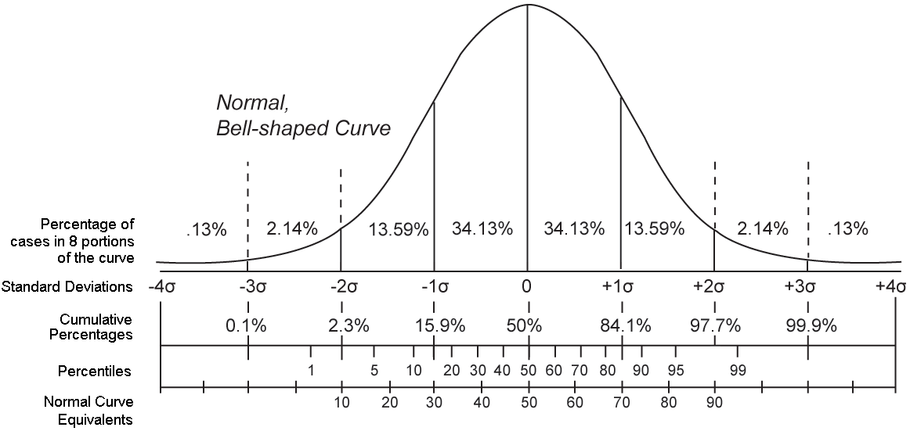
We have new data for interpreting scores
We have been identifying anyone whose score fell into the lower quartile (25th percentile) compared to normal individuals of the same age (Moncrieff, et al., 2017) – blue line
Normative information for the RDDT (n=853) and DWT (n=861)
  Cut-off scores now available for the 5th and 10th percentiles (1.65 SD below the mean and 1.28 SD below the mean) – green and red lines

Slide 17
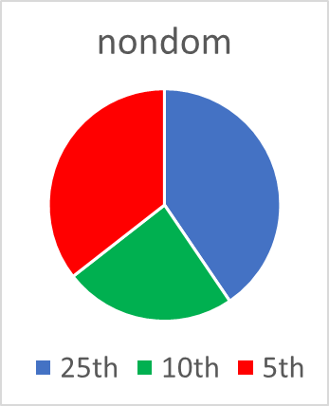
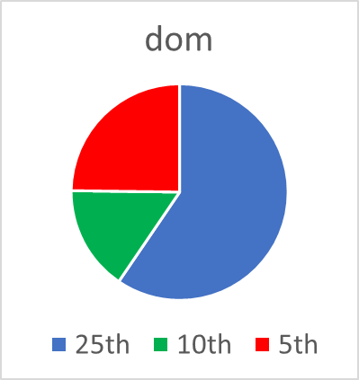
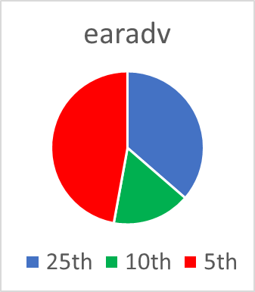
Prevalence of severity groups in clinical population, n = 121
from clinical population reported in Moncrieff, Keith, Abramson & Swann, 2017

Slide 18
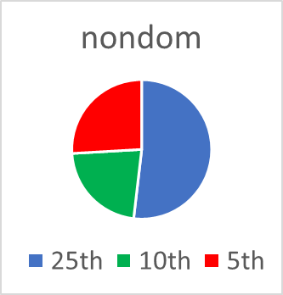
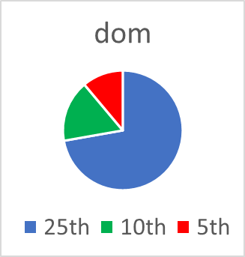
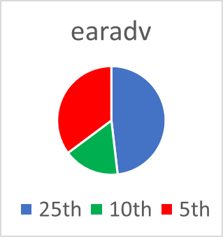
Prevalence of severity groups in clinical population, n = 54
From Auditory Processing Laboratory at University of Pittsburgh and MSHC, n = 54

Slide 19
Prevalence of matched abnormal scores across different populations
Identification of a matched pattern of results increased from 59% of children assessed clinically to 79% when a third dichotic listening test was used as a tie-breaker
  66% of children (n=141) at 5 clinical sites produced abnormal patterns of results (Moncrieff, Keith, Abramson, & Swann, 2016)
    35% amblyaudia, 19% dichotic dysaudia, and 12% amblyaudia + dichotic dysaudia
25% of adolescents (n=782) in juvenile detention center (Moncrieff, Miller, & Hill, 2018) and 17% in follow-up study (n=52) (Berken, Miller & Moncrieff, 2019)
  Nearly 70% demonstrated an abnormal result on one dichotic test, but none of these were tested with a third tie-breaker

Slide 20
Hearing loss is a clinical entity
Measurable loss
Differentiate among patterns of results
Range of severity
Uniformity of diagnostic results
Reference standard – what brings the patient in to see you
Audiologic assessment of acuity
CHL, SNHL, Mixed HL
Mild, moderate, severe, profound
Standard audiogram
SELF-REPORT since the 1930’s

Slide 21
How about amblyaudia and dichotic dysaudia?
Measurable loss
Differentiate among patterns of results
Range of severity
Uniformity of diagnostic results
Reference standard – what brings the patient in to see you
Performance scores in each ear
AMB, DD, and AMB+
25th, 20th and 5th percentiles
Comparison to normative data
SELF-REPORT – self for adults, usually parent or teacher with child

Slide 22
CHAPS can serve as a reference standard for amblyaudia and dichotic dysaudia
Pearson chi-square findings indicated that the Ideal condition showed the highest significance for predicting a diagnosis of amblyaudia
  Pearson chi-square = 4.961, p = .026
Trending toward significant for predicting a diagnosis of dichotic dysaudia
  Pearson chi-square = 2.881, p = .090
  “Keep the Baby, Throw Out the Bathwater,” Moncrieff & Vermiglio, 2018
Other questionnaires may be useful in helping to identify patients at risk of listening difficulties

Slide 23
Auditory Rehabilitation for Interaural Asymmetry (ARIA)
Developed with Diane Wertz, CCC-SLP in two clinical trials done in 2000-2001 to establish feasibility of a treatment approach for an asymmetric pattern from dichotic tests (Moncrieff & Wertz, 2008)
  30 minutes per session, 3 times per week
Modified to current standardized protocol of two 20-minute sessions at a 1-hour appointment, 1 time per week (Russo, Snyder, & Moncrieff, 2014)
Clinician-driven auditory therapy presented in the sound field

Slide 24
ARIA
Created to specifically target binaural integration deficit by improving performance in the listener’s non-dominant ear
Based on principles of perceptual learning – repeated presentations of auditory stimuli to drive synaptic neuroplasticity through facilitation of neural networks in the auditory brainstem
Uses systematic adjustments of intensity to capitalize on the capacity of the lateral superior olive to encode interaural intensity differences
Rest and consolidation occur in between sessions and after therapy is completed after four sessions

Slide 25
Who should get ARIA?
Current standards would indicate that only children in the lowest performing group qualify for a diagnosis and possible treatment
Based on the medical model where treatment could be highly invasive and entail risk
We provide hearing aids for individuals with mild hearing losses
  Especially if the patient reports functional deficits
A child’s performance is below normal
  Should we tell the parent that it’s OK and that he/she can only receive treatment when the performance falls even further behind peers?
  Will performance worsen or will it just remain below normal?

Slide 26
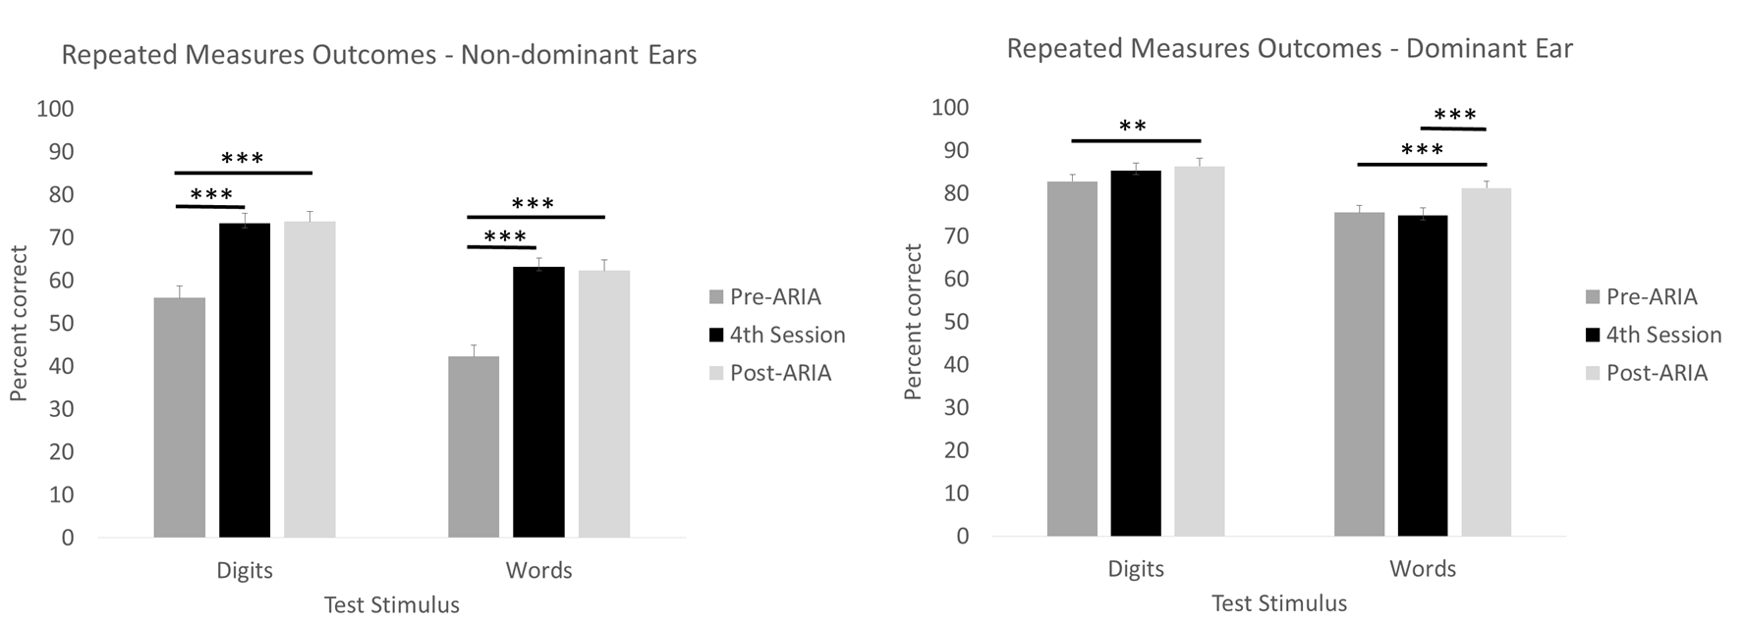
Significant improvements in dichotic test scores
following ARIA
Benefits seen at 4th training session were maintained when re-tested at 3-12 months post-ARIA
Moncrieff, Keith, Abramson, & Swann, 2017

Slide 27
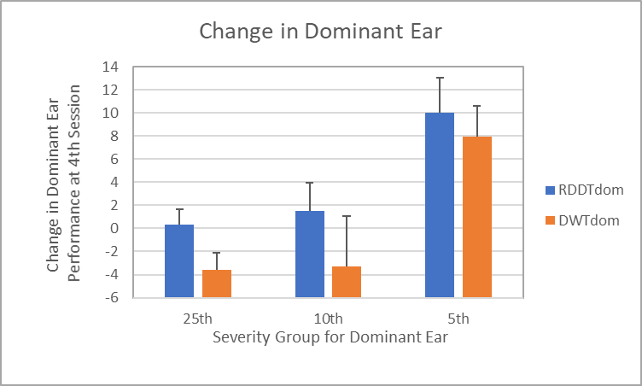
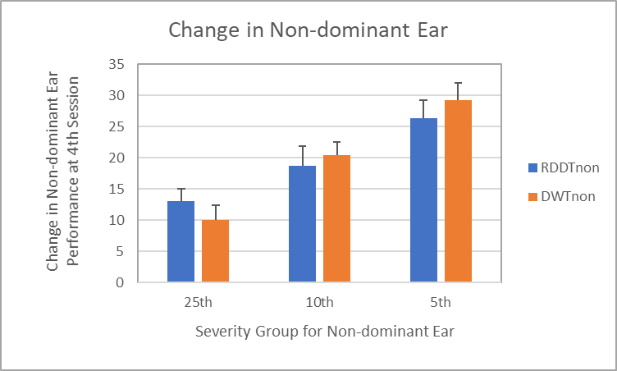
ARIA benefit depends upon deficit severity

Slide 28
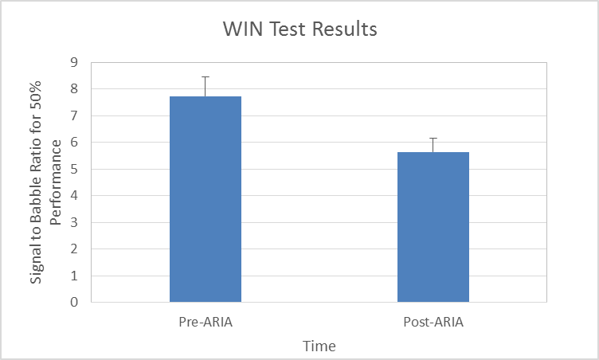
ARIA results in improvements in speech-in-noise test results
n = 21
All children diagnosed with AMB, AMB+, or DD and enrolled in ARIA training
Pre- and post-ARIA measures of speech-in-noise from the Words in Noise (WIN) test showed significant improvements, F(1, 20) = 10.426, p = .004

Slide 29
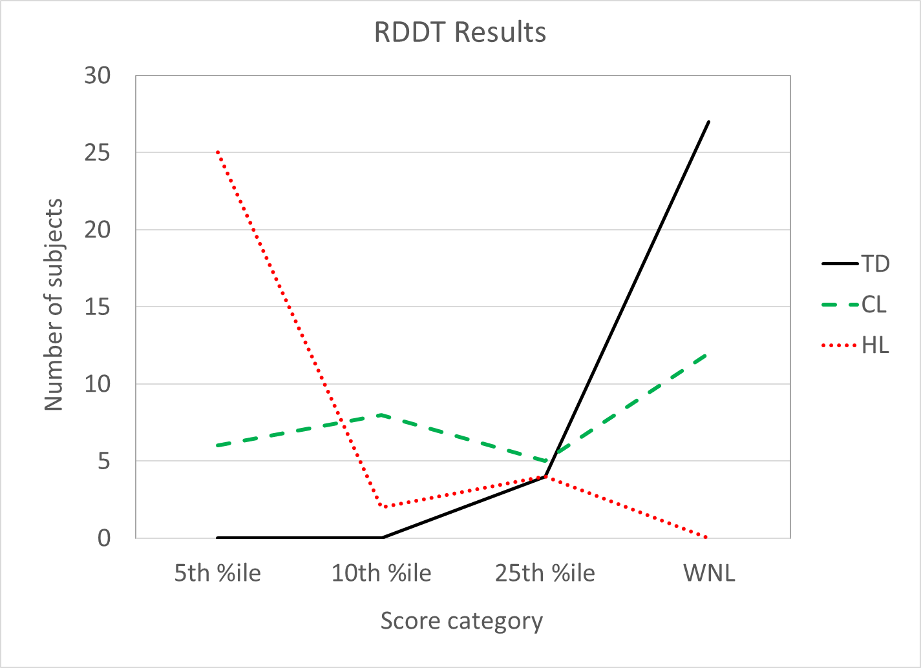
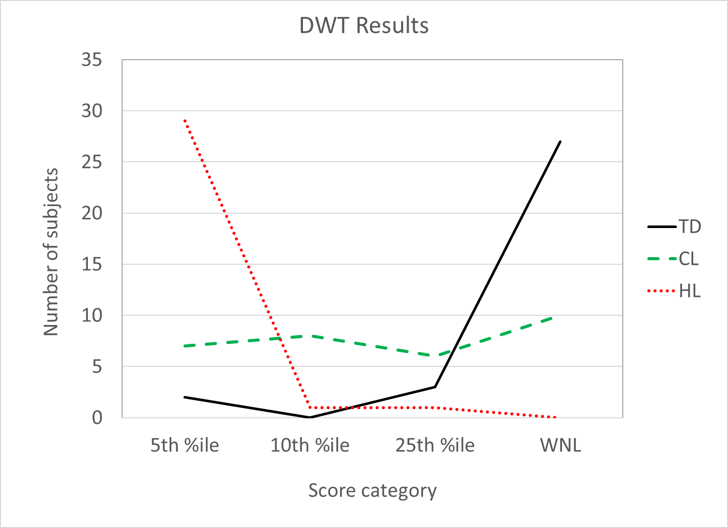
What about children with hearing loss?
31 children with profound hearing loss wearing hearing aids, cochlear implants or both
Compared to age- and gender-matched peers from typically developing and clinical cohorts

Slide 30
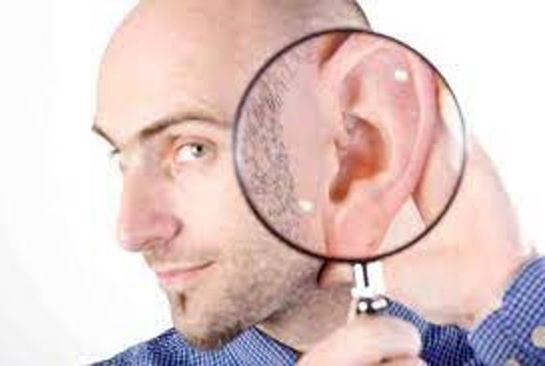
Is amblyaudia just for kids?
WE TEST ONE EAR AT A TIME
Adults with normal hearing who complain of listening difficulty
Do we assess their binaural skills?
What about patients with hearing loss?
How successful are they at processing binaural signals?

Slide 31
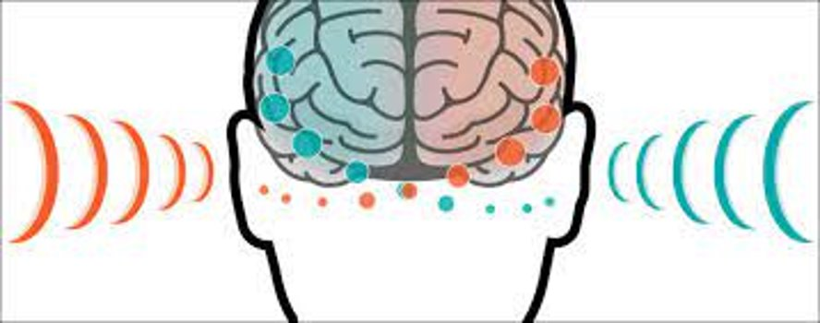
WE LISTEN WITH TWO EARS ALL THE TIME

Slide 32
Binaural Interference in Hearing Aid Users
A surprising 71% of bilaterally amplified adults showed better speech recognition in background noise with one hearing aid fitting than with two (Henkin, Waldman, and Kishon-Rabin,. 2007) ​
In a 12-week field hearing aid trial, the 46% of participants who preferred to use only one hearing aid had a 10% larger right ear advantage on a dichotic digits test (Cox, Schwartz, Noe, and Alexander, 2011) ​​
Other hearing aid users also preferred monaural amplification in their ear with poorer dichotic results (Ribas, Marques, Mottecy, Silvestre, and Kozlowski, 2014) ​​
Jerger attributed this preference for using one rather than two hearing aids to "binaural interference," a central auditory phenomenon caused by suppression of information ascending from the weaker, non-dominant ear by excitation in the dominant ear (Jerger, Silan, Lew, & Chmiel, 1993; Chmiel, Jerger, Murphy, Pirrozolo, & Tooley-Young, 1997)​​

Slide 33
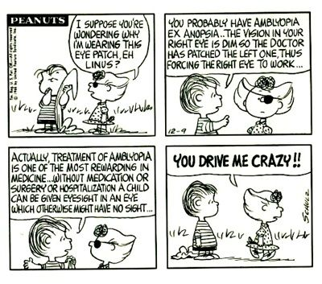

Slide 34


Slide 35

Final thoughts….
Clinician-driven therapy limits dissemination
of important benefits
Software applications and teletherapy can
provide diagnostic and rehabilitative services
to more patients
Inclusion of individuals at risk can lead to
Better outcomes for more individuals with
binaural processing weaknesses

Slide 36
WHAT DO YOU THINK?

