Slide 1
Orientation
College of Education
Doctoral
Fall 2023

Slide 2
Schedule
01
Welcome
02
About the COE
03
Campus Resources
04
COE Resources
05
Doctoral Timeline
06
How to Get Involved

Slide 3
01
Welcome!

Slide 4
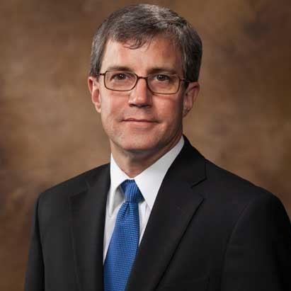
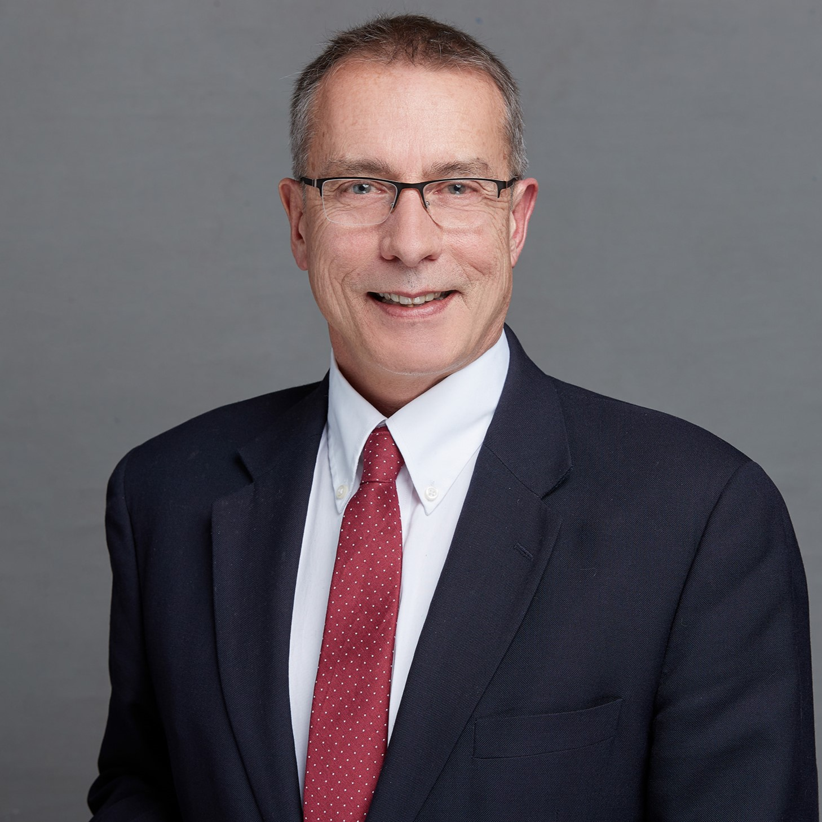
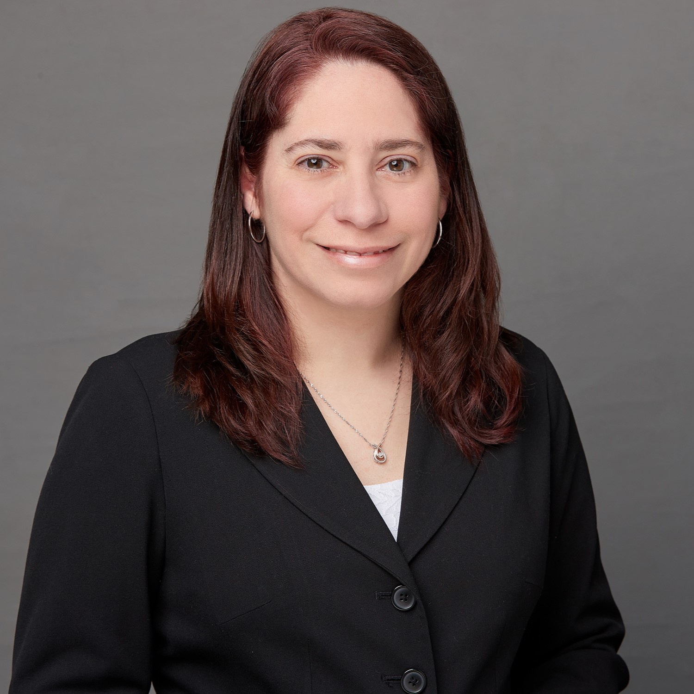
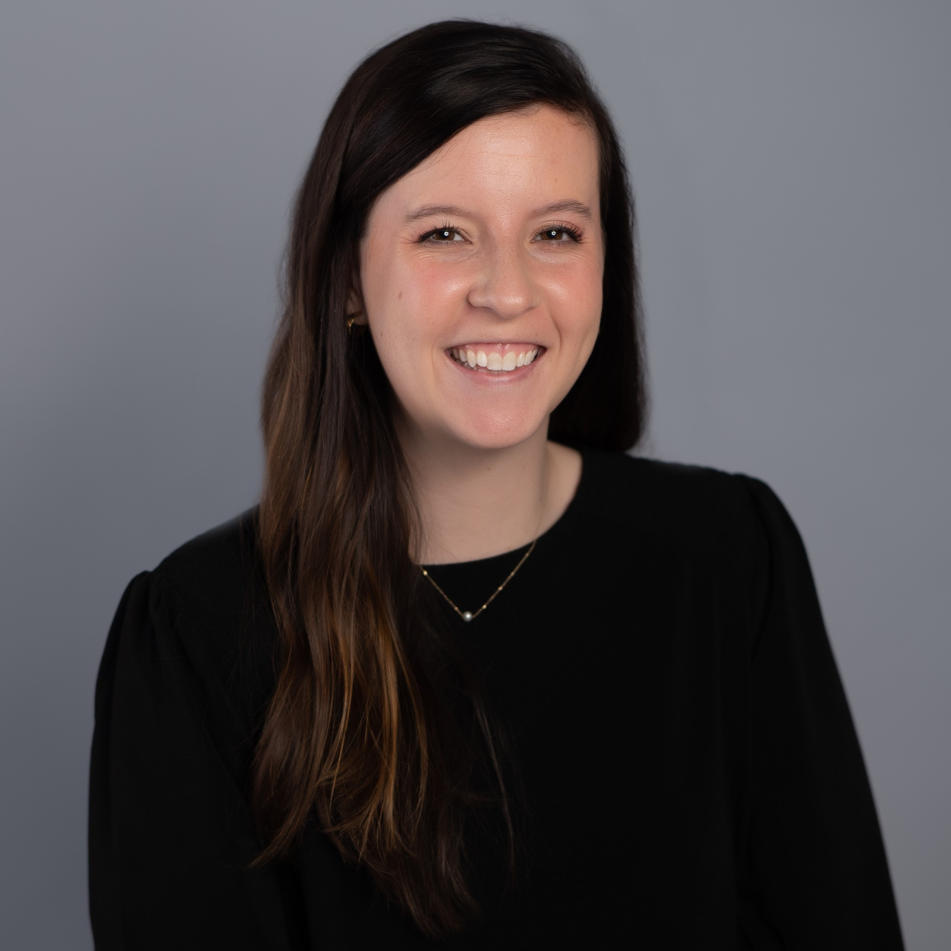
Dean’s Office Contacts
Dean
Associate Dean
Dean's Faculty Fellow
Graduate Program Coordinator
Dr. Michael Miller
Dr. Steve Zanskas
Dr. Leigh Harrell-Williams
Brittany Foster
mtmller6@memphis.edu
szanskas@memphis.edu
leigh.williams@memphis.edu
bvfster1@memphis.edu

Slide 5
02
About the COE

Slide 6
Departments & Degrees
CEPR
ICL
LEAD
Department Chair:
Dr. Pam Cogdal
Department Chair:
Dr. Sandra Cooley-Nichols
Interim Department Chair:
Dr. Alison Happel-Parkins
Counselor Education & Supervision
Applied Behavioral Analysis
Higher & Adult Education
Integrated Early Childhood Education
Counseling Psychology
Leadership & Policy Studies
Instruction & Curriculum
Educational Psychology & Research
Instructional Design & Technology
Literacy Education
Special Education
Social Studies Education

Slide 7
How to Resolve Issues
01
Instructor/Advisor​
02
DEPARTMENT CHAIR​
DEAN’S OFFICE ​
College Director of Graduate Studies
03
04
GRADUATE SCHOOL​​

Slide 8
03
Campus
Resources

Slide 9
Campus Resources
EMAIL
CANVAS
All communication will be coming to your Memphis email address.
Ummail.Memphis.edu
All courses will have Canvas pages.
Student training is available on UM3d.
LIBRARY
WRITING CENTER
Research Support
Ask-A-Librarian
Libraries
Writing and APA Style support
Center for Writing & Communication

Slide 10
Campus Resources
COUNSELING CENTER
HEALTH CENTER
Students enrolled in at least 6 credit hours in fall or spring are eligible for counseling appointments.
Counseling Center
Minor Medical Clinic
Available to enrolled students
Student Health Center
DEAN OF STUDENTS
FINANCIAL AID
Tiger Food Pantry
Emergency Fund
Dean of Students
Loans and Grants
Graduate Financial Aid
Tiger Scholarship Manager

Slide 11
04
COE
Resources

Slide 12
COE Resources
COE WEBSITE
Memphis.edu/education
Graduate Student Services- information regarding COE policies
HANDBOOKS
The handbooks have important information regarding department and program policies
The handbooks can be found on the departments’ webpage

Slide 13
COE Resources
FORMS
Grad School Forms- forms will need to be submitted for course substitutions, dissertation, graduation, etc.
COE Forms- programs may have specific forms for fieldwork, licensure, etc.
GRADUATE CATALOG
The Graduate Catalog has all answers to your curriculum, admission, and academic questions.

Slide 14
COE Resources
TRAVEL FUNDING
College funding
Department funding
Graduate Student Association funding
GRADUATE SCHOOL
Graduate School- Academic calendar, dissertation guidelines & graduation process
All Graduate School Resources

Slide 15
Advising
Faculty advisor
Informal major advisor
Students will choose or be assigned a faculty advisor based on research interests to help plan course work.
Students can be assigned an informal major advisor that can help with course sequencing, clearing pins, and issuing permits.

Slide 16
Pin Clearance & Permits
Pin clearance:
Permits:
Each student will have a pin on their account restricting them from registering for classes.
After meeting with their advisor, the pin will be lifted, and the student can register.
Some courses will require permits.
With the permission of the advisor, the student can reach out to the instructor of the class to be allowed into the class.
A permit may also be offered by the department and the student will be allowed to take the course.

Slide 17
05
Doctoral Timeline

Slide 18
Doctoral Studies: A Journey
How does doctoral study differ from your other educational experiences?
A steward of your discipline or profession
Responsible for
developing new knowledge
communicating that knowledge
defending what you have learned through your research

Slide 19
General Guidelines Regarding Time limits
Coursework up to 10 years
Dissertation 2 years
At 12 years, request an extension from the College Director of Graduate Studies & Graduate School

Slide 20
First Semester
Your letter of acceptance may include the name of your advisor.
Your first step is to meet with your advisor to plan your course work for the first semester and to discuss the doctoral process.
During your first semester, you will put together your Program Advisory Committee and develop a program of studies.
Your Program Advisory Committee will consist of three graduate faculty members that will assist in developing your program of studies and conducting your comprehensive examination.

Slide 21
Residency Research Project
First independent research project
Must meet programmatic requirements before taking comprehensive exams

Slide 22
Comprehensive Examination (Comps)
When all coursework is completed, students are required to pass comps.
This examination will have both oral and written portions and will be conducted by the Program Advisory Committee.
The Program Advisory Committee will judge the comps as either pass or fail.
After passing comps, students will be at Doctoral Candidacy status.

Slide 23
Dissertation
After passing comps, the Dissertation Advisory Committee will be formed.
This committee will consist of at least four graduate faculty members.
The Dissertation Advisory Committee will help with the proposal, dissertation, and defense.
Students must be continuously enrolled (fall & spring) in dissertation hours until the dissertation is complete.
More information regarding dissertation guidelines can be found on the COE Doctoral Program Guide.

Slide 24
Dissertation Milestones & Process
After passing your doctoral comprehensive examination, you become a late stage doctoral student or candidate
Dissertation Advisory Committee Formed
Draft the first three chapters of your dissertation
Dissertation Proposal Meeting
IRB Submission & Approval
Begin Study
Complete Dissertation
Allow 2 weeks for dissertation chair's review
Following your chair's approval send out your dissertation draft to your committee, allowing two weeks for review, and schedule your defense
Dissertation Defense
Submission to the Graduate School & the land of forms
Graduation!

Slide 25
Keys to Success
Establishing Priorities
Organization
Persistence
Support

Slide 26
06
How to Get Involved

Slide 27



Getting Involved
Student Associations
Research Groups
Graduate Student Association
Travel funding
Leadership opportunities
Student support & advocacy
Connect with others in your program
Gain support from classmates
Gain research experience
Collaborate with faculty & classmates

Slide 28
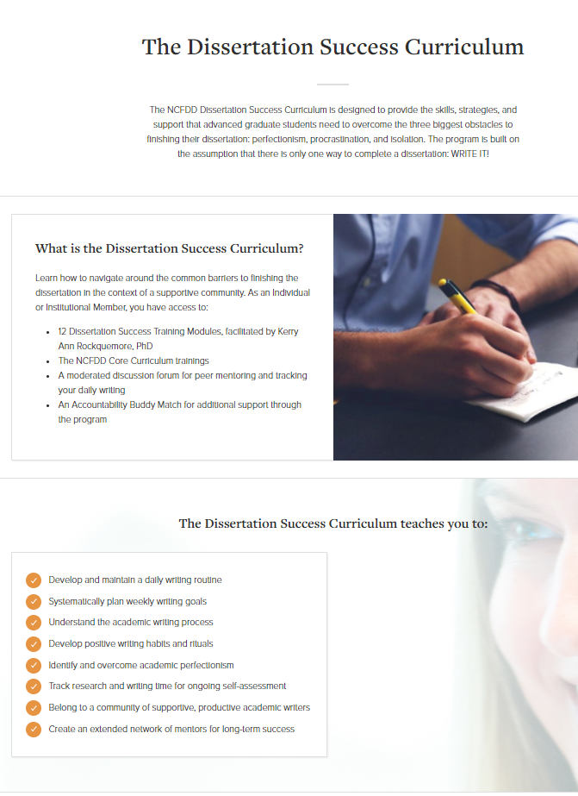

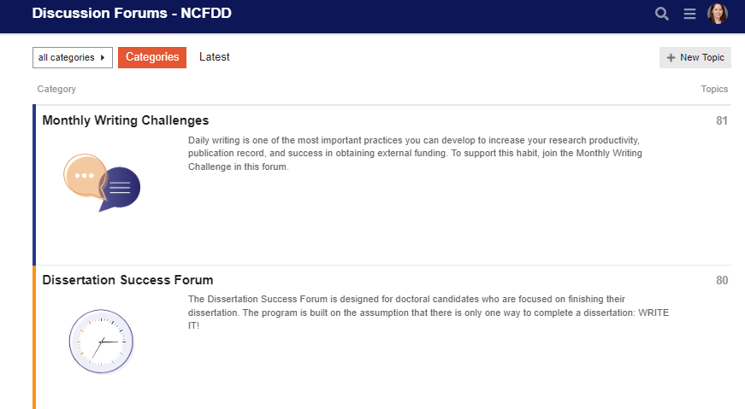
Access to FREE NCFDD Membership
Sign up here with your UofM email address: https://www.facultydiversity.org/
Select Lowenberg College of Nursing
Upcoming Guest Webinars​
Forums

Slide 29
Questions?

