Slide 1


College of Education
Welcome Back
Fall 2023
  Faculty and Staff Meeting
  August 22, 2023

Slide 2

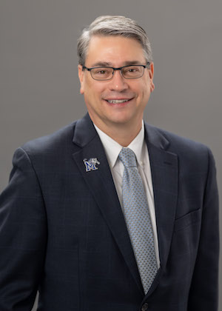
Executive Vice President for
Academic Affairs and Provost
Dr. David J. Russomanno

Slide 3
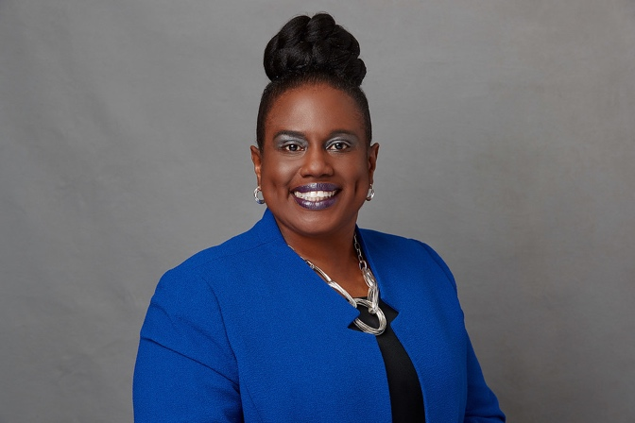
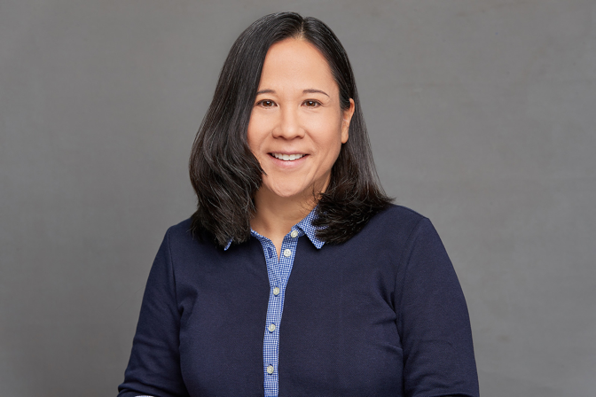
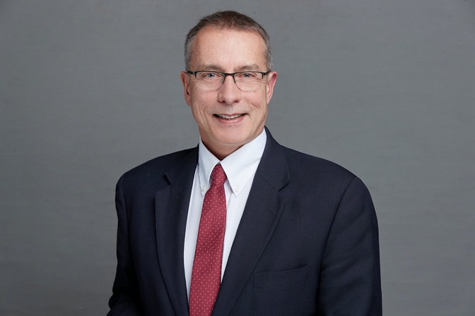
Dean’s Office Leadership
Dr. Kandi Hill-Clarke
Dean of the College of Education
Dr. Celia Anderson
Interim Assistant Dean of Student Success and Strategic Initiatives
Dr. Steve Zanskas
Associate Dean of Research, Graduate Programs and Faculty Development

Slide 4

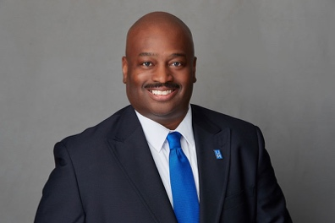
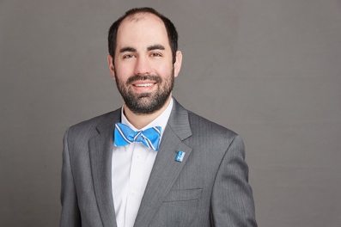
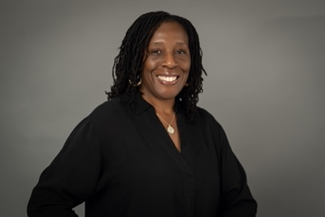
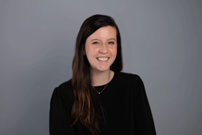
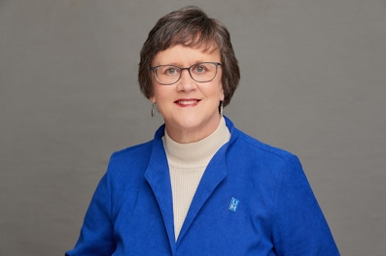
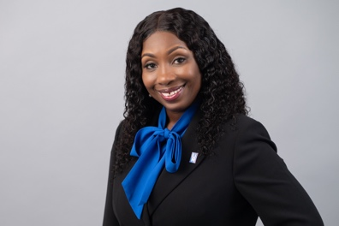
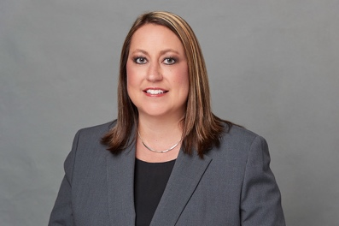
COE Dean’s Office Staff
Willie D. Clark, Jr.
Director of Development
Keith Hembree
Recruitment and Retention Coordinator
Dr. Teresa Banks
Director of Assessment, Accreditation and Accountability
Brittany Foster
Academic Services Counselor II, Graduate
Janet Wiens
Pre-Award Coordinator
Tracy Williams
Business Officer III
Amy Wilson
Assistant to the Dean

Slide 5

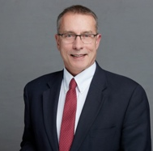

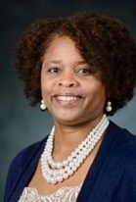
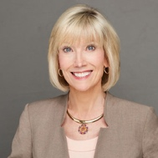
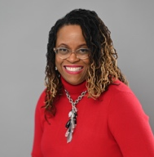
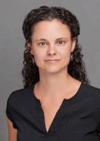
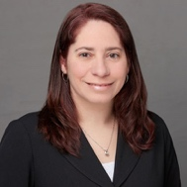
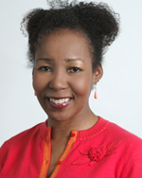
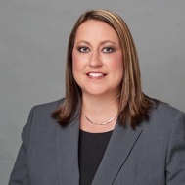



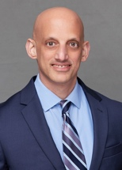
2023-24 COE Leadership Team
Dr. Kandi Hill-Clarke Dean
Dr. Steve Zanskas Associate Dean
Dr. Celia Anderson
Interim Assistant Dean
Dr. Nichelle Robinson Director of Teacher Ed & Clinical Practice
Dr. Pamela Cogdal Department Chair, CEPR (effective 9/1/22)
Dr. Sandra Nichols Department Chair, ICL
Dr. Alison Happel-Parkins
Department Chair, LEAD
Dr. Leigh Harrell-Williams Dean’s Faculty Fellow
Dr. Beverly Cross
Chair of Excellence
Amy Wilson
Assistant to the Dean
Tracy Williams
Business Officer III
Janet Wiens
Pre-Award Coordinator
Dr. Teresa Banks
Director of Assessment, Accreditation and Accountability
Dr. Todd A. Zoblotsky
Research Director, CREP

Slide 6
Approved Faculty Searches and
Staff Postings
Approved 2023-24 Faculty Searches and Staff Postings
  CEPR
    T/T Assistant Professor, COUN PSYCH
    T/T Assistant Professor, CLIN REHAB COUN
    Clinical Assistant Professor, COUN
  ICL
    T/T Assistant/Associate, SPED
    Clinical Assistant Professor, SPED-Lambuth
  LEAD
    T/T Assistant Professor, HIAD
    Department Chair, Associate/Professor
  Staff Postings
    Communications & Marketing Manager
    Induction & Clinical Placement Coordinator

Slide 7
College Updates
COE Leadership Team Retreat
  HR, Office of Legal & Grad School
Provost's Deans Retreat
  Enrollment Management, Inclusive Academy, Office of Legal, THEC
Dean's Advisory Council (new members)
  Sam O'Bryant
  Dr. Justin Dodson
Reactivation of the COE Alumni Association
Development & Advancement
  New Scholarships
    Josephine Circle Endowed Scholarship -$100k
    Drs. Sunita & Manoj Jain Education Scholarship- $40k
    Roger E. Mary Campbell Endowed Scholarships -UG & GR scholarships with a combined total of $34k for year 1 and $34k for year 2
    A. & Dr. B. Prescott Pledge to the COE/River City Partnership - $20k
    M. Harless -$10,000 to the College of Education Dean’s Fund

Slide 8
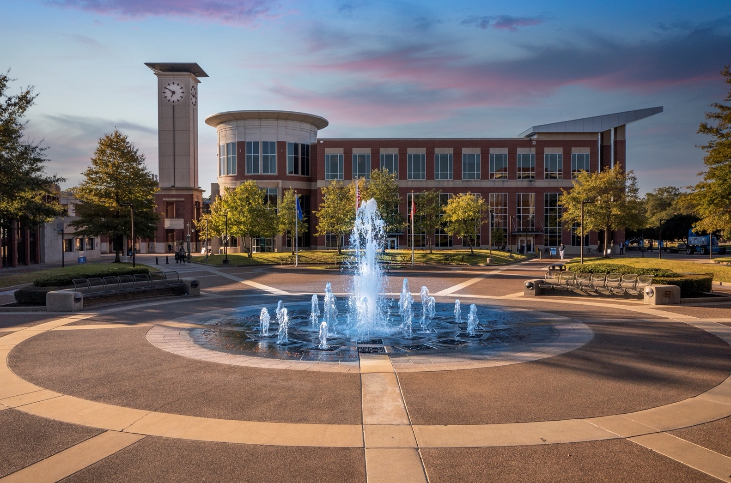
COE Leadership Academy

Slide 9
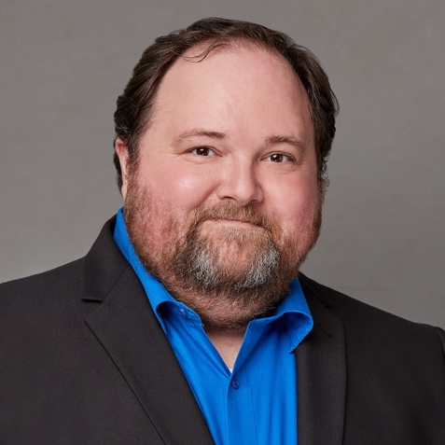
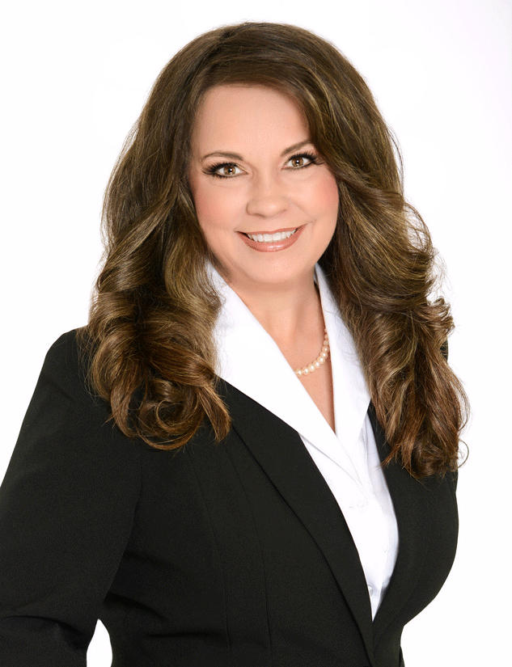
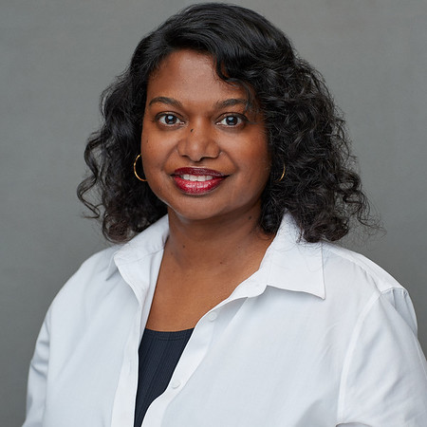

COE Faculty and Staff Senate Representatives
Dr. Patrick Murphy,
CEPR
Dr. DeAnna Owens-Mosby,
ICL
Dr. Edith Gnanadass,
LEAD
Amy Wilson, Assistant to the Dean
Staff

Slide 10
Faculty Senate President
Dr. DeAnna Owens-Mosby,
ICL

Slide 11
Shared Governance Meetings with Deans
Dr. DeAnna Owens-Mosby, Faculty Senate President

Slide 12
What is Shared Governance?
The AAUP's Committee on College and University Governance composed its first statement on the subject, shared governance, in 1920, emphasizing the importance of faculty involvement in personnel decisions, selection of administrators, preparation of the budget, and determination of educational policies. ...
aaup@aaup.org
Notes:
The relationship calls for adequate communication among these components, and full opportunity for appropriate joint planning and effort.”

Slide 13
Principles of Shared Governance
In its simplest form, shared governance is shared decision- making based on the principles of partnership, equity, accountability, and ownership at the point of service.
Notes:
Contains principles that can “lead to the correction of existing weaknesses and assist in the establishment of sound structures and procedures.”
Essentially, the faculty has responsibility (voice and decision‐making authority) for matters in proportion to the degree of their expert knowledge.
“The faculty has primary responsibility for such fundamental areas as curriculum, subject matter and methods of instruction, research, faculty status, and those aspects of student life which relate to the educational process.
“Faculty status and related matters are primarily a faculty responsibility; this area includes appointments, reappointments, decisions not to reappoint, promotions, the granting of tenure, and dismissal .

Slide 14
How to assess Shared Governance in your Unit
Assessment of shared governance structures could include
  Faculty organization regularly meet
  Faculty serve on departmental/unit level committees in college
  By-Laws - Faculty representation exist on university committees
Process assessment areas. Faculty:
  exercise decision‐making authority in their areas of expertise
  participate in meetings
  Communicate on general educational policy

Slide 15
Faculty Senate Charges
Type | Date | Reporting Date | Charge | Committee Assigned | Status
One-time | 8/2022 | January 2023 | Review and Revise Faculty Hiring Search Policy | Faculty Policies | In progress
Standing | 8/2022 | Report monthly as needed but at least twice a year | Review and make recommendations to the Senate on academic freedom and responsibility, the Faculty Handbook, and on all policies and procedures, including appeals, pertaining to faculty appointment, dismissal, promotion, and tenure. | Faculty Policies | Ongoing
One Time | 8/23/2022 | November 2022 | Membership, Recognition of Service - release time per semester for President of the faculty Senate. Make a recommendation to the senate. | Executive Committee | New
One Time | 8/23/2022 | January 2023 | Establish a University Budget Council through negotiations with senior administration. | Executive Committee | New
Standing | 8/23/2022 | Monthly June – Nov. | Review annual University Budget Proposals with Univ. Executive VP of Business and Finance and make recommendations as needed. | Business & Finance | Ongoing
Standing | 8/23/2022 | Report as needed. At least twice a year. | Review of last year’s budget priorities and implementation of the Faculty Senate’s motion on salary allocations. Review previous year’s faculty senate compensation motion and retain/revise. | Business & Finance | Continuing
One-time | 8/23/2022 | January 2023 | Perform a comprehensive salary comparison with peer institutions (update peer institutions to be consistent with R1 status). | Business & Finance | New
One-time | 8/23/2022 | January 2023 | Perform a salary comparison by rank between faculty in every department and access compression/inversion. | Business & Finance | New
Standing | 8/23/2022 | Report monthly as needed but at least twice a year | Coordinate with Faculty Senate representatives on the Undergraduate and Graduate Councils and report to the Faculty Senate on major programmatic, curricular changes, academic advising, and admissions policy changes that may require broader Senate input. | Academic Polices | Continuing
One-time | 8/23/2022 | Monthly June – Nov. | Review current instrument for student evaluation of teaching (SETE). Provide recommendations to the Senate for improving and/or replacing the current instrument. | Academic Polices | Continuing
Standing | 8/23/2022 | Report monthly as needed but at least twice a year | Meet with VP for Research and Innovation at least twice each term to review faculty research opportunities, the award and administration of university supported grants, administration and support of grant and contract research, important changes in research policies, computer applications and utilization, and allocation and use of over-head funds. | Research Policies | Continuing
Standing | 8/23/2022 | August – April, 2022-23 | Appointment of FS representatives for standing university committees Replace FS representative on the COIA | Committee on Committees | New
One-time | 8/23/2022 | November 2022 | Review previous senate motion regarding Canvas Observers and consider alternative solutions for limiting access for Canvas Observers from CAAS. | Academic Support | New
One-time | 8/23/2022 | November 2022 | Review Survey of Administrators to determine whether the Faculty Senate should continue with the annual survey. If the Committee determines that it is still useful and should continue, review the survey and suggest revisions as needed. | Administrative Policies | New
Faculty Senate Charge Log AY2022-2023

Slide 16
Contact Information
Email the Faculty Senate Office: presfacultysenate@memphis.edu
Dr. DeAnna Owens-Mosby Email: DeAnna.Owens@memphis.edu

Slide 17

Charting a Path for the Future

Slide 18
COE Strategic Planning co-Chairs: Dr. Beverly Cross, Janet Wiens
Dr. Sandra Nichols
Dr. Pam Cogdal
Dr. Alison Happel-Parkins
Dr. Nichelle C. Robinson
Dr. Steve Zanskas
Willie Clark
Brandon Munoz
Dr. Wendy Griswold
Dr. Andrew Tawfik
Dr. Rosie Davis
Tiffany Bates
Cindy Muzzi
Keith Hembree
Madan Birla

Slide 19
COE Strategic Plan Survey Results
  51% of faculty and staff responded to the survey
  70% of respondents - progress toward fulfilling the vision
  75% of respondents - progress toward fulfilling our mission
  70% of respondents - progress toward fulfilling our core values

Slide 20
COE Strategic Plan Survey Results
  Focus Area 1: Research & Scholarship - 75% of respondents believe progress toward fulfilling
  Focus Area 2: Community Engagement and Partnerships - 71% of respondents believe progress toward fulfilling
  Focus Area 3: Excellence & Accountability - 65% of respondents believe progress toward fulfilling
  Focus Area 4: Student Success & Instructional Programming - 69% of respondents believe progress toward fulfilling

Slide 21
COE Strategic Plan Survey Results
Strengths
Faculty and Staff
Students
Family-like culture and relationships
Commitment to DEI
Community Collaborations & Partnerships
Diverse Faculty, Staff and Students
Support for Faculty

Slide 22
COE Strategic Plan Survey Results
Opportunities
Cross-departmental collaborations, cohesiveness and connections
Enhanced communication within and across university, departments and college
Technological advances and AI
Increased grant productivity, research and scholarship
Graduate student engagement and success

Slide 23
COE Strategic Plan Survey Results
Hopes, Dreams and Aspirations
Nationally ranked teacher prep programs
Nationally recognized for research and scholarship
Collegiality and connectedness
Ball Hall renovated or a new building
Increased Research supports and resources (e.g., consistent w/R 1, post award support, engagement of new faculty, navigating grants and research projects, etc.)
Statewide and national recruitment strategy

Slide 24
COE Strategic Plan Survey Results
Additional comments
Concern about new law(s)
More competitive salaries
Additional resources & supports for students

Slide 25
Strategic Planning
University Goals Success Driven Education & Impact-Driven Research | College of Education Focus Areas Innovation in Action
Strengthen Research Enterprise | Research and Scholarship
 | Community Engagement and Partnerships
Outcomes-Focused Academics; Recruit, Retain, Reward & Recognize Our People; Exemplify Operational Excellence; Generate & Steward Financial Resources | Excellence and Accountability
Aggressively Provide Access; Create Opportunities to Succeed | Student Success and Instructional Programming

Slide 26
COE Strategic Plan Survey Results
Recent and Upcoming Actions
Meetings with Chairs and CREP Assistant Director regarding affirmation of vision and mission
Meeting with the Leadership team – COE alignment with UofM plan
Meeting today with Strategic Planning Committee
Ongoing communications with COE faculty, staff and students – surveys, focus groups, etc.

Slide 27

Student Success Updates
Dr. Celia Anderson
Interim Assistant Dean of Student Success and Strategic Initiatives

Slide 28
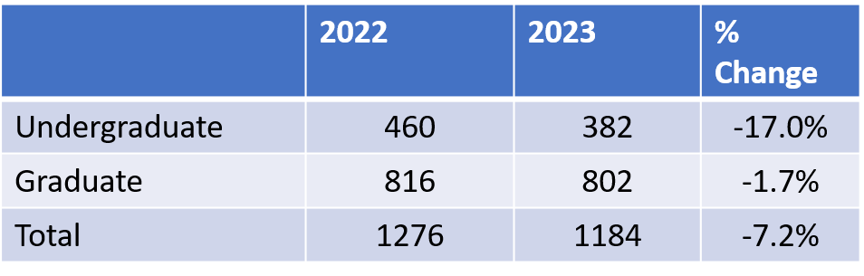
Enrollment Update

Slide 29
Enrollment Update (as of August 16, 2023)
2023 Enrollment Increases (up from 2022)
Program | 2022 | 2023 | % Increase
ICL – M.S. | 69 | 91 | 32%
LEAD – M.S. LDPS | 25 | 30 | 20%
CEPR – Ph.D. | 65 | 67 | 3%

Slide 30
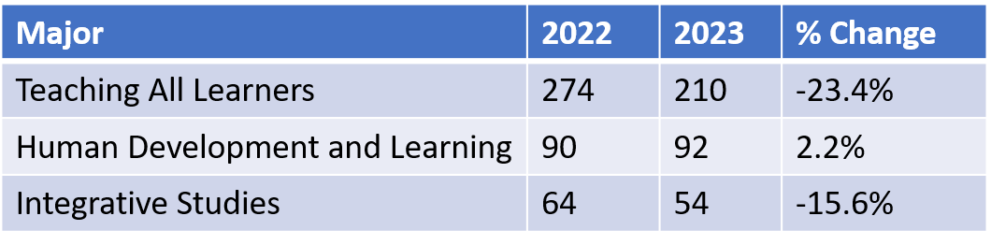
Enrollment Growth Opportunities

Slide 31
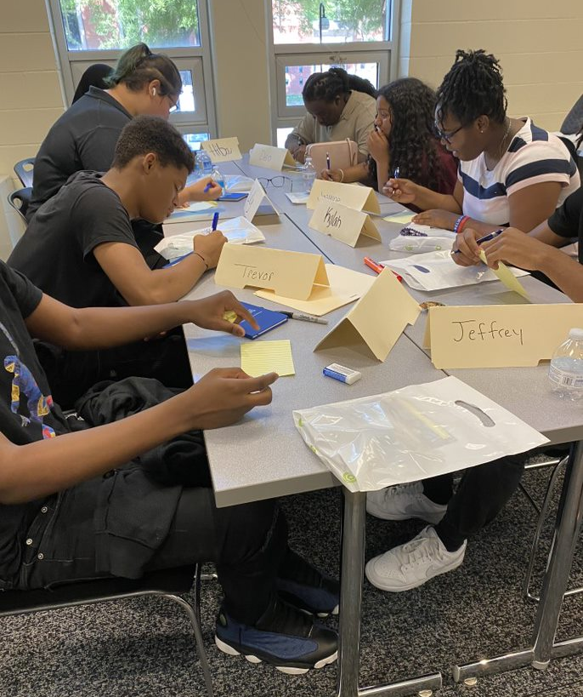
Student Success and Strategic Initiatives
Student Success Coach (Pilot)
  Student Success 2.0
  Graduate Assistant Coaches
Recruitment/Retention
  COE Recruitment/Retention Committee
  Recruitment/Retention Coordinator (Keith Hembree)
    Graduate Recruitment
Teaching as a Profession
  1-Day Summer Experience
  Dual Enrollment

Slide 32
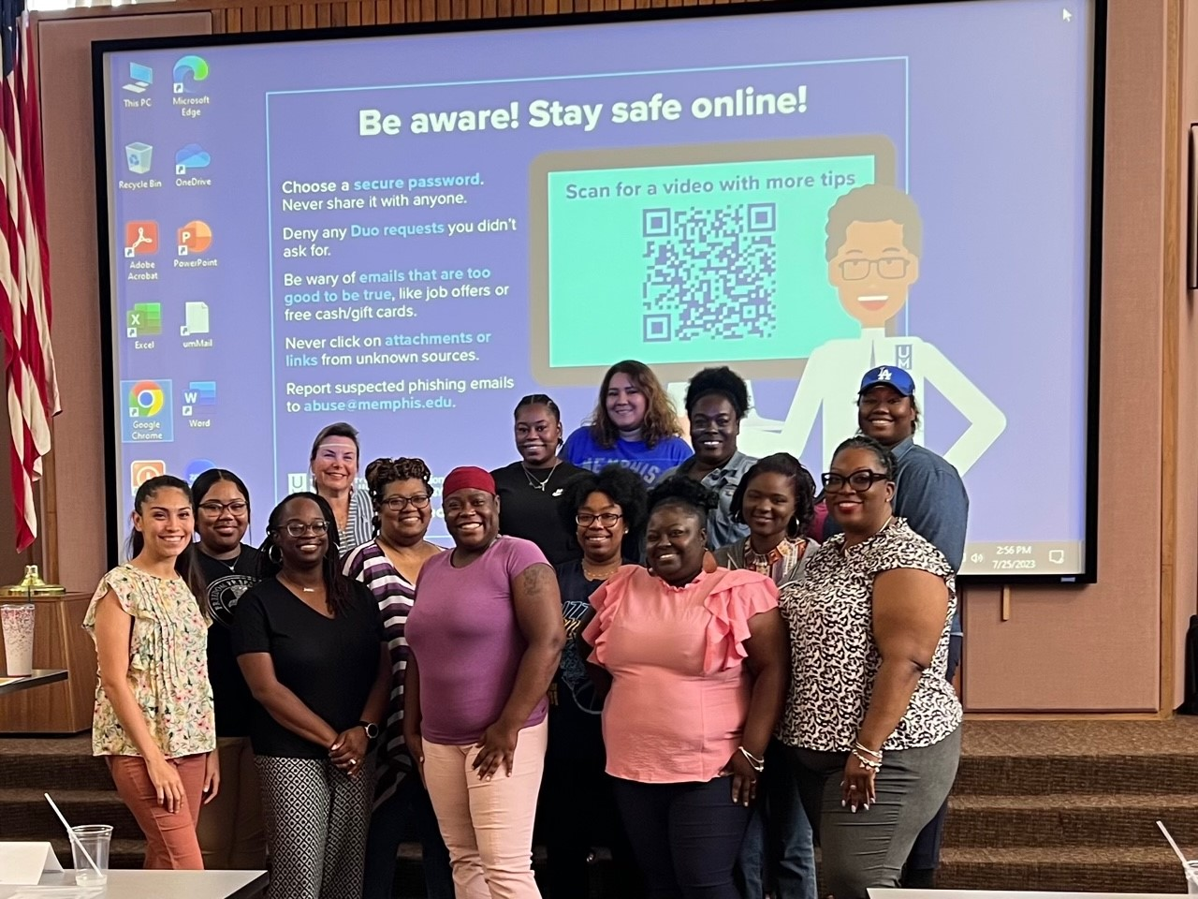
Student Success and Strategic Initiatives
Grow Your Own Teacher Apprenticeship Program
  Bachelor’s Cohort (TALN) – Summer 2023
  MAT Cohort (ECED) – Fall 2023
COE Welcome Back Events
  September 5 & 6 (morning and afternoon events)
  Departmental Events

Slide 33
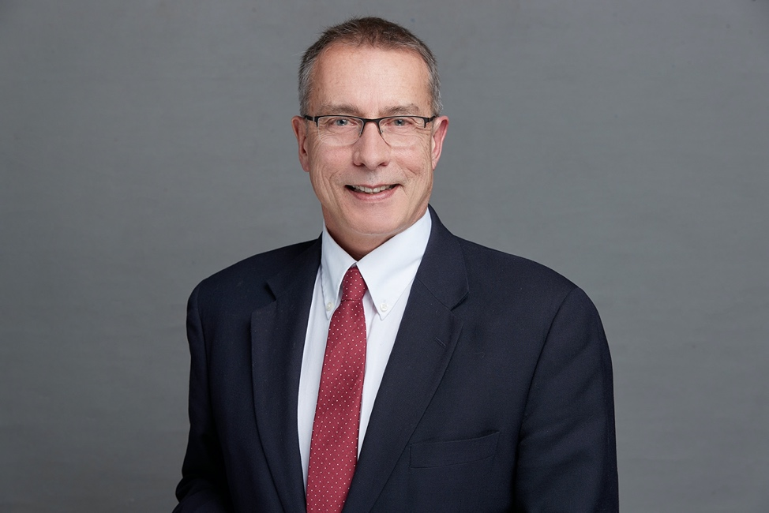
Graduate Programs, Research & Faculty
Updates
Dr. Steve Zanskas
Associate Dean of Graduate Programs, Research and Faculty Development

Slide 34
Research, Graduate Programs and Faculty Development
Divisive Concepts Act Information & Resources
Grants & Contracts
  FY 2022-2023: $5,460,976
  19 Principal Investigators
CoE Faculty Resources
  2023-24 Faculty Research Grant Application
  2023-24 Faculty Supplemental Travel Grant Application
  Graduate Student Conference Travel Grant
  Professional Development Assignment (PDA)
  New Syllabus Template

Slide 35
Graduate Studies Doctoral Student Supports Survey
During Coursework
After Comprehensives

Slide 36
Graduate Studies
Inaugural COE Doctoral Student Orientation August 21st
Takeaways from the Doctoral Student Survey
  Accessibility of faculty & committee
  Additional funding
  Advising support
  Consistency of communication program requirements, milestones & orientation
  Cohorts & collaborations
  Strong preference for departmental communication
  Writing & editing support
Need to close the gap between the successful completion of doctoral comprehensive examinations and dissertation proposals

Slide 37
Research, Graduate Programs and Faculty Development
COE Research & Collaborations
  Sept 14 – Conducting Research with MSCS's 11:30 – 1:00 p.m.
  October 5 – Conducting Research with our University Schools 11:30-1:00 p.m.
  October 26 – Collaborations & Educational Initiatives 2:30 – 4:00 p.m.
  November 9 – CREP: Who we are & how we can help 11:30 – 1:00 p.m.
Self-Care for Faculty & Staff
  Sept 18 - The Relaxation Zone September Noon - 1:00 p.m.

Slide 38

Promotion and Tenure Timeline
Department Reviews: August 25-September 22
Chair Reviews: September 22-October 13
  Meeting with Chair October 12-13
College Reviews: October 13-November 7
Dean Review: November 7-29
  Meeting with Dean December 7-8

Slide 39
Curriculog & Graduate Council Meetings
COE Graduate Council
College Graduate Council
UCGS Meeting Dates
September 11
October 23
November 13
December 11
January 22
February 12
March 11
April 15
September 1
October 6
November 3
December 1
February 2
March 1
April 5
May 3

Slide 40

Congratulations

Slide 41
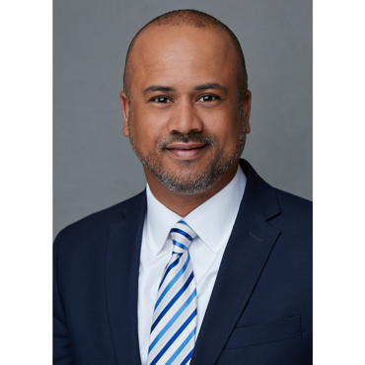
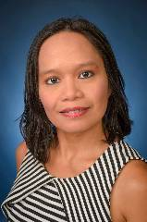
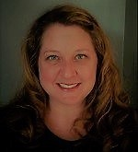
Promotion and Tenure
Dr. Alfred Hall, Dean’s Office
Promoted to Associate Professor
Dr. Charisse Gulosino, LEAD
Promoted to Professor
Dr. Michelle Brasfield, CEPR
Promoted to Associate Professor

Slide 42

Welcome to the COE

Slide 43


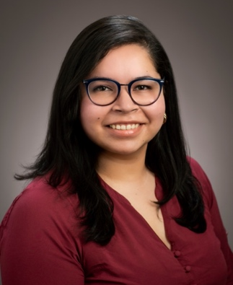
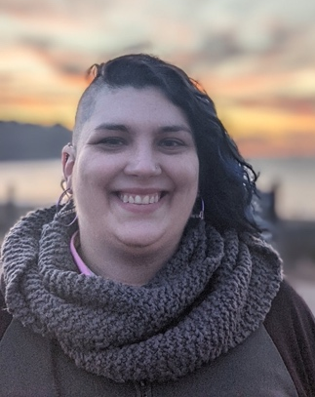
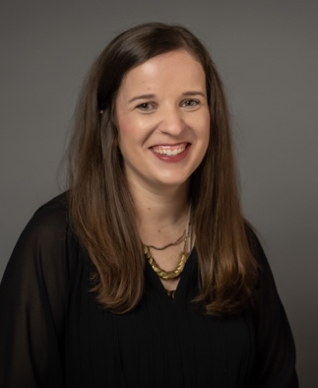
New Faces, CEPR
Talisa “Tally” Anderson
Current position: Administrative Associate II in the Department of Counsel Education Psych Research
Previous position: Administrative Assistant at an environmental waste plant
Fun fact: I am a former Miss Indiana Plus America
Dr. Sanchari Banerjee
Current position: Assistant Professor of Teaching, EDPR
Previous position: Doctoral candidate at University of Illinois, Urbana-Champaign
Teaching/research Area: Developmental psychology, early childhood, cultural diversity
Fun fact: Bought my first houseplant during the lockdown, and now the goal is to have a house full of plants
Dr. Madeline Brodt
Current position: Assistant Professor of Counseling Psychology
Previous position: Assistant Professor of Counseling and Counseling Psychology at Oklahoma State University
Teaching/research Area: Intersection of culture and mental health, particularly disability
Fun fact: I have two corgis, Daisy and Violet. I’m always happy to share a pic!
Dr. Claire Dempsey
Current position: Clinical Associate Professor of Counseling
Previous position: Assistant Professor of Counseling and Clinical Mental Health Practicum/Internship Coordinator
Teaching/research Area: Clinical Mental Health Counseling and for research: Child Sexual Abuse Survivors; Collaboration between School and Clinical Mental Health Counseling; and Women with Fertility Roadblocks
Fun fact: Prior to COVID, our blind weenie dog would run in weenie dog races! Once, she won her heat and made it to the championship race!

Slide 44

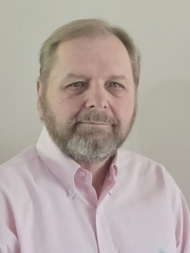
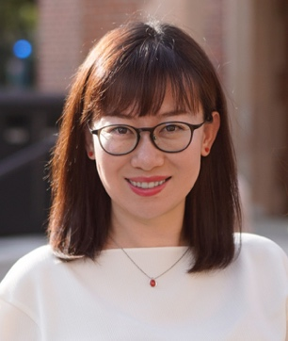
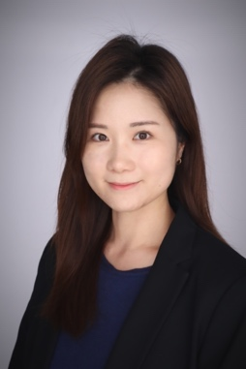
New Faces, ICL
Dr. George Falls
Current position: Assistant Professor of Teaching
Previous position: Adjunct Professor 1998-present
Special Education
Teaching/research Area: Special Education
Fun Fact: I was the son of one of the vice-presidents of Holiday Inn for one night (only), who now owns Paulette's.
Dr. Huan Gao
Current position: Assistant Professor in Elementary Education
Previous position: Before pursuing my Ph.D., I served as a foreign language instructor in China's higher education institutions and also at Portland State University.
Teaching/research Area: My areas of expertise and research interests include children's literature, elementary education and digital/information literacy.
Fun fact: For the longest time, I used to think that adjusting the brightness on phones could work wonders in improving the quality of pictures taken in dimly lit environments. I finally realized that this belief was not accurate!
Dr. Yeonji Jung
Current position: Assistant Professor of Instructional Design and Technology
Previous position: Ph.D. candidate in Educational Communication and Technology Program at New York University
Teaching/research Area: Facilitating actionable and seamless learning with educational data and analytics, based on learning sciences, learning design and educational data sciences
Fun fact: As a kid, I wanted to grow up and be a soccer player, and I still love watching soccer games.

Slide 45
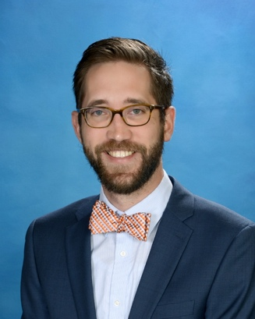
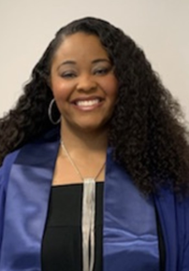
New Faces, ICL
Dr. Matthew Panozzo
Current position: Assistant Professor of Literacy
Previous position: Middle School Teacher at Annunciation Orthodox School in Houston, Texas
Teaching/research Area: Exploring identity, empathy and humanity through literacy; Arts-Based Education Research; LGBTQ Children’s and Young Adult Books
Fun fact: I’ve climbed the Sydney Harbour Bridge
Dr. Crystal White
Current position: Clinical Assistant Professor of Urban Education
Previous position: Assistant Professor of Teaching in Human Development in CEPR
Teaching/research Area: My teaching load includes a focus on teaching all learners (ICL/ELED courses) and human development (EDPR courses). Primary research interests include Critical, Qualitative and Ethnic theoretical lenses focusing on intersectional identities, development and urban education.
Fun fact: I once lived in Munich, Germany, and while there backpacked through Central Europe, where I was able to learn about their apprenticeship approach to education. I also got to explore Dachau, the Palace of Versailles, the Eiffel Tower, The Sound of Music House, the Swiss Alps and an original chocolatier factory!

Slide 46
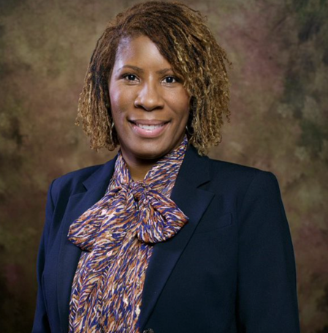
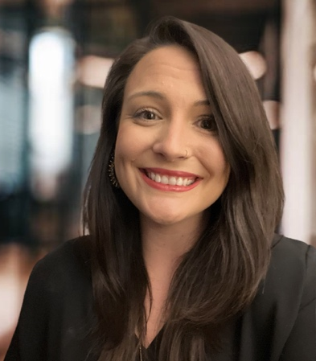
New Faces, LEAD
Dr. Canidra McGuire
Current position: Leadership/Clinical Assistant Professor
Previous position: Chief Operating Officer for Charter School Regional Network and Regional Manager (West TN) for TDOE/Grow Your Own Center
Teaching/research area: Principalship, Organizational Leadership and Measures of Principal Effectiveness for Teacher Retention
Fun fact: As a child, my family and I spent four summers in a row driving from Chicago, Illinois, to Phoenix, Arizona, for family vacation. For this reason, I can't beg my family to take a road trip longer than 8 hours.
Dr. Nikki L. Wright
Current position: Assistant Professor of Educational Leadership
Previous position: Postdoctoral Scholar of Educational Theory and Policy at The Pennsylvania State University
Teaching/research area: I'm a first-generation college student who is passionate about making academia a more accessible space for students from all backgrounds. My research interests are centered on teachers' work and well-being, including but not limited to teacher leadership, agency, voice, policy engagement, recruitment, preparation and retention. I also seek to better understand the intersections between student voice and teacher voice work (especially through youth-adult partnerships and participatory action research), and the role of other school leaders in supporting this work.
Fun fact: My favorite simple pleasure is enjoying my morning coffee while completing the daily NYT Crossword, Wordle and Spelling Bee.

Slide 47
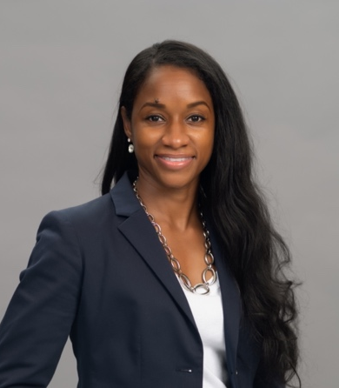
New Face, CREP
Dr. Racquel Harris
Current position: ​Research Associate II
Previous position: ​Career Specialist
Research Focus: Literacy in Elementary Education
Area of Expertise: ​ Communication, leadership, mentoring, time management/organizational skills Fun fact: I'm a Sneaker Head

Slide 48
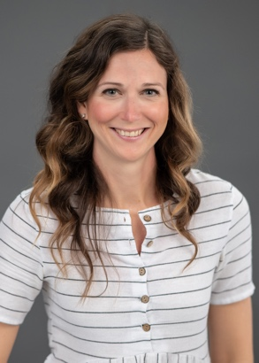
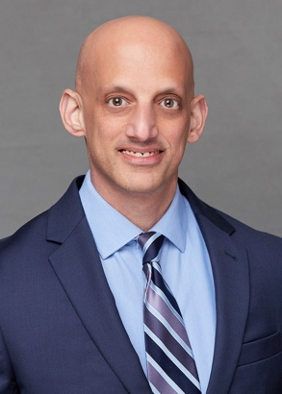
New Roles, CREP
Cindy Muzzi
Current position: Associate Director
Previous position: Research Associate II
Todd Zoblotsky
Current position: Research Director
Previous position: Research Professor

Slide 49
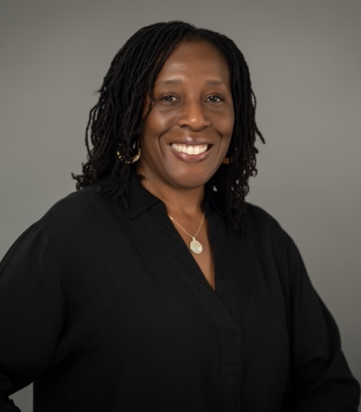
New Face, Dean’s Office
Dr. Teresa Banks
Current position: ​Director of Assessment, Accreditation and Accountability
Previous position: ​Assessment Coordinator/Assistant Professor
Teaching Area of Expertise: ​Math and Science Methods Research focus: using data for program improvement, math for P-12 teachers and students Fun fact: I love sunflowers

Slide 50
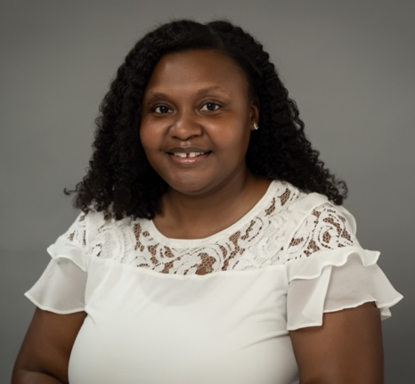
New Face, Office of Teacher and
Clinical Practice
Courtney Garland
Current position: ​Project Coordinator - River City Partnership Teachers Program (College of Education)
Previous position: ​Academic Advisor/Student Retention Specialist
Research/Teaching Interests: ​“Lack of diverse women in Strategic leadership roles at colleges and universities.”
Area of Expertise: ​ Communication, leadership, mentoring, time management/organizational skills Fun fact: ​​ “I’ll be bringing in 2024 in Ghana.”

Slide 51
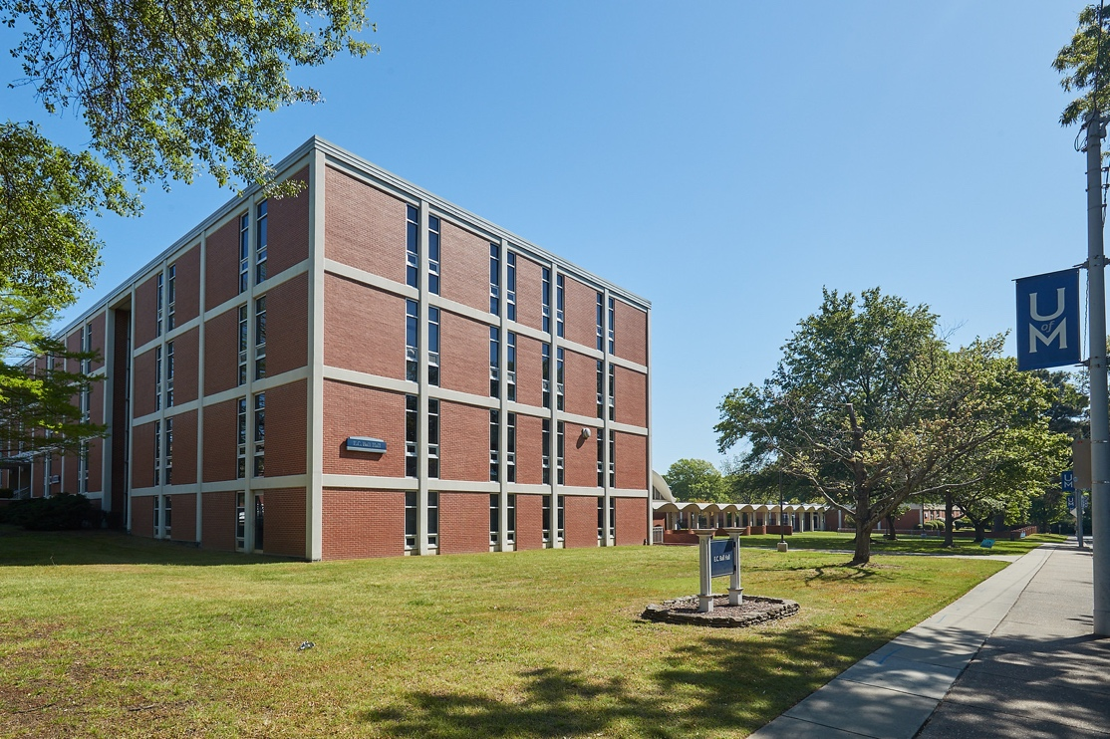
Have a wonderful and productive year!

