Slide 1

Board of Trustees Meeting
March 4, 2020
University Center

Slide 2
Call to Order and Opening Remarks
Vice-Chair Carol Roberts
Notes:
Notes:

Slide 3
Roll Call and Declaration of Quorum
Secretary Melanie Murry

Slide 4
Approval of Minutes
December 4, 2019
Vice-Chair Carol Roberts

Slide 5
Comptroller’s Presentation
Comptroller Justin P. Wilson

Slide 6
University of Memphis Board of Trustees
Sunset Termination June 30, 2021

Slide 7
Board Responsibility: Fiduciary Duty
What is a fiduciary?
A fiduciary is someone who has a special responsibility – stewardship – over the administration of an institution, including its property, its reputation, and its role in the community.
A university board member has fiduciary duties of care, loyalty, and obedience to the institution. Board members should
Be fully engaged
Attend meetings
Read and evaluate materials
Ask questions and get answers
Honor confidentiality
Avoid conflicts of interest
Demonstrate loyalty
Understand and uphold the mission
Ensure legal and ethical compliance

Slide 8
Board Responsibility: Fiduciary Duty
Questions to Consider
Does the board invite discussion and questions regarding matters before it?
Does the board encourage full engagement by board members and enforce attendance requirements?
Does the board involve experts to facilitate and enhance its understanding of matters before it?
Does the board assess its own performance in fulfilling its fiduciary duties?

Slide 9
Strategic Oversight & Accountability
Mission
Strategic Oversight
Accountability
Operational Objectives
Daily Functions

Slide 10
Shared Governance
Board of Trustees
Faculty
Management
Shared Governance in a university is typically composed of three groups:
Boards of Governance
Presidents and Chancellors
Faculty Members
Effective shared governance enables thoughtful decisions to enhance
Student Success,
Institutional Health, and
Innovation
Achieving the Mission

Slide 11
The Board and President Partnership
The Board should expect the President to
Provide relevant, accurate, and understandable information
Be forthcoming about problems and issues and be prepared to suggest solutions
Make effective use of the Board’s time
The President should expect the Board to
Be engaged and participate at the appropriate strategic level
Be open, candid, and forthright
Understand the president works for the board, not for individuals

Slide 12
Board and Committee Meetings
Board work directly impacts the university
Direction
Reputation
The Board and its Committees conduct work in meetings
Models of good governance and decorum
Focus on consequential matters
Board work should be grounded in the work of its Committees
Align work with vision and strategy
Monitor strategic progress

Slide 13

Open Meetings
All public policy and public business decisions must be made in meetings open to the public.
Prohibits multiple members of a governing body from meeting privately to deliberate towards or make decisions on public business.
Adequate Public Notice
Sufficient notice under the circumstances that would fairly inform the public of the meeting

Slide 14
Conflict-of-Interest Policies
Conflicts of interest represent
Undue influence on the work of the board
The appearance of such influence
The board’s Conflict-of-Interest Policy should define potential conflicts of interest and provide a process to:
Identify conflicts of interest;
Disclose conflicts of interest; and
Address conflicts of interest.

Slide 15
Conflict-of-Interest Policies
Questions to Consider
Has the board defined in writing what is considered a conflict of interest?
How are governing board members informed of the existence of the policy?
What are the expectations of board members if there is a conflict of interest on a board issue?
Does the governing board consistently apply its conflict-of-interest policy?
How does the policy protect the integrity of the institution?

Slide 16
Sunset Statute
Purpose
“It is the intent of the general assembly . . . to provide a responsible method to review state governmental entities to ensure that state governmental regulation is beneficial rather than detrimental to the public interest of the citizens of Tennessee.”
4-29-102(b), Tennessee Code Annotated (TCA)
Entity Review
TCA 4-29-101 through 122
Termination of Entities
TCA 4-29-201 et seq. currently lists entities with termination dates through June 30, 2027

Slide 17
Comptroller’s Role
Provide information through Performance Audits or Questions & Answers
“ The comptroller of the treasury shall perform limited program review audits to aid the review of the evaluation committee and shall, from time to time, counsel and consult with the committee on its informational requirements on the governmental entities being reviewed.”
TCA 4-29-111(b)

Slide 18
Criteria for Review
Federal and state law
Federal and state regulations
Entity internal policies and procedures
Other possible criteria:
Industry standards
Best practices
Contract or grant requirements

Slide 19
Audit Stages
Planning
Obtain an understanding of
Processes and management controls
Board operations and oversight or university operations
Detailed Audit
Reviewing supporting documentation
Sampling or testing of full data populations
Surveying employees or students
Assessing data reliability
Audit conclusions: based on facts and evidence in our audit work.

Slide 20
The Audit Report
Draft Report
Communicate findings, observations, and related recommendations
Management submits written responses to findings
Public Report
Provided to the Government Operations Committee members
Publicly available on the Comptroller’s website

Slide 21
Public Hearing
Prior to termination, continuation, or restructuring of any governmental entity, the evaluation committee must
Publish newspaper notice
Hold at least one public hearing
Review performance audit
Receive testimony from the administrative head of the governmental entity demonstrating the public need for its continued existence
Receive testimony from the public
TCA 4-29-104

Slide 22
Thank you

Slide 23
President’s Update
President M. David Rudd

Slide 24
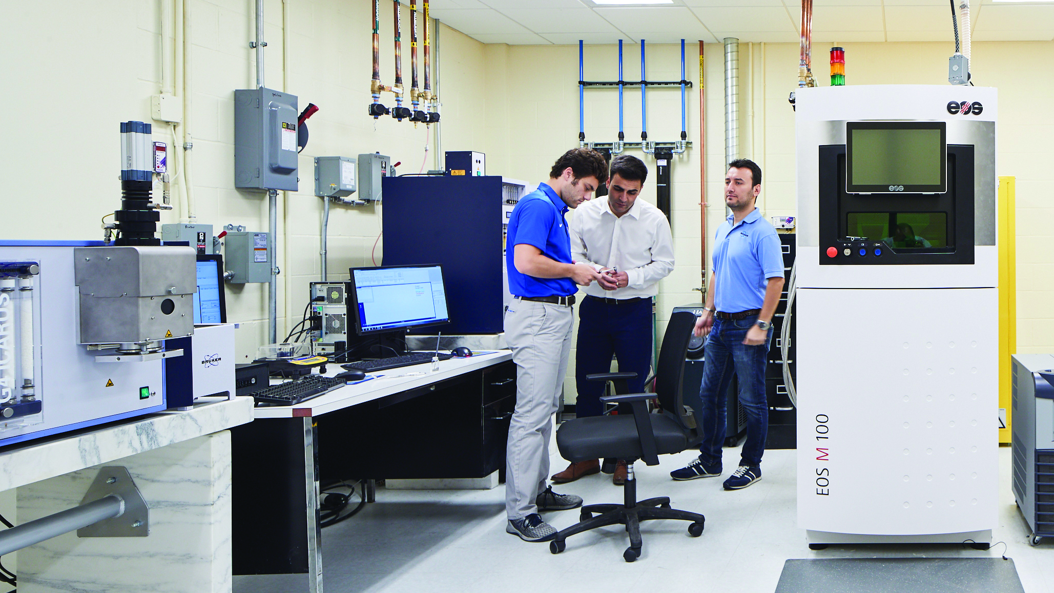
Our Vision
The University of Memphis is an internationally recognized, urban public research university preparing students for success in a diverse, innovative, global environment.

Slide 25
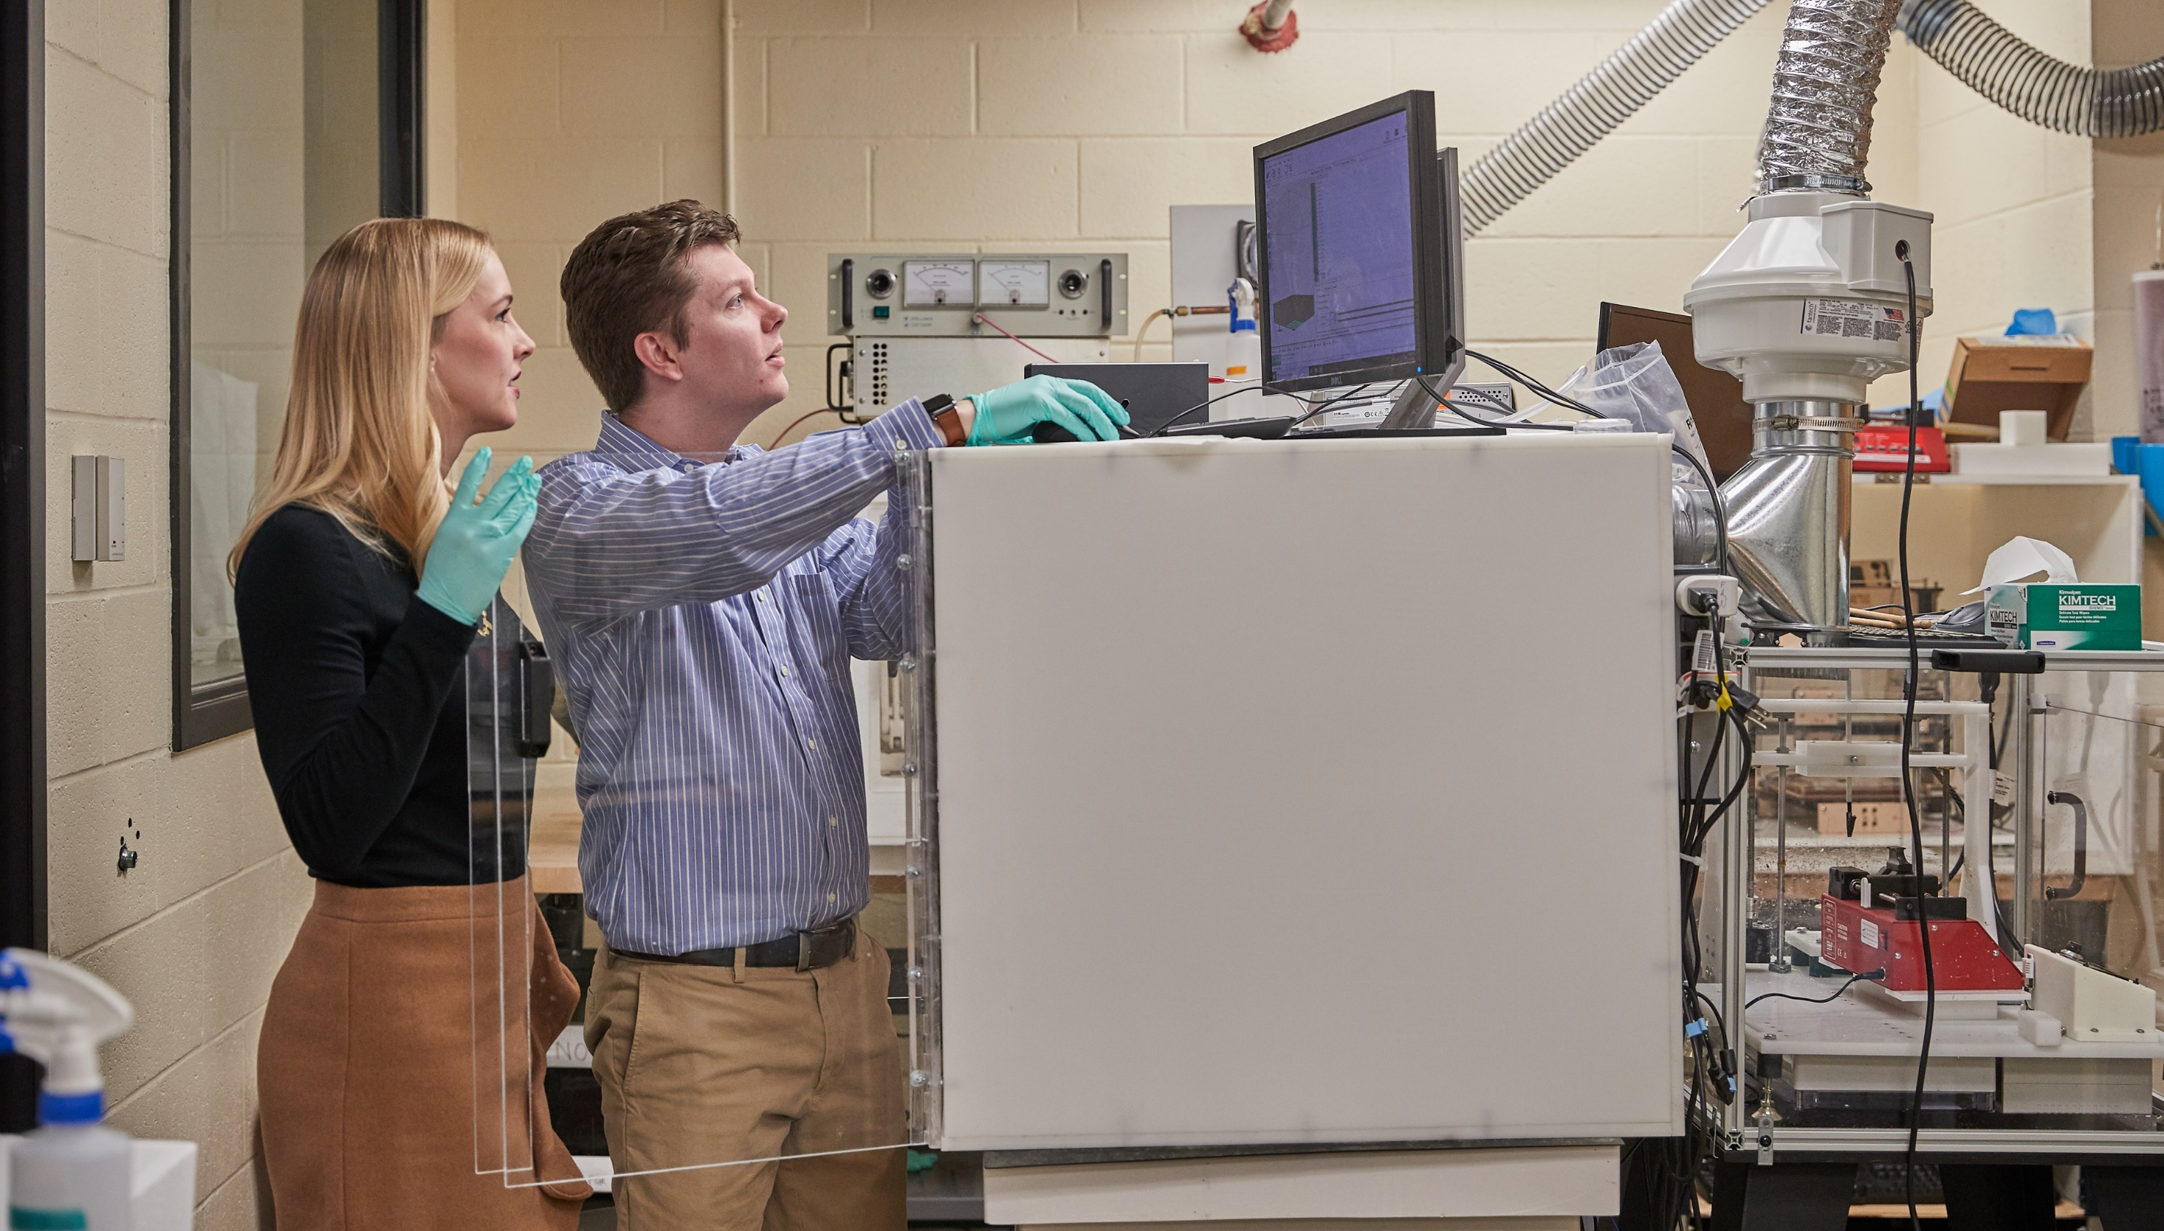
Commitment to achieving Carnegie 1 status
Internal investment for research expansion of $5M
Record research expenditures of $64M last fiscal year
Governor Lee budget recommendations
$5M for Carnegie 1 efforts
$41M for new STEM Building
$12.5M for maintenance funds
Student success
Continued expansion of community engagement
A campus that supports our families
Expansion of national/international brand equity
Critical Elements

Slide 26
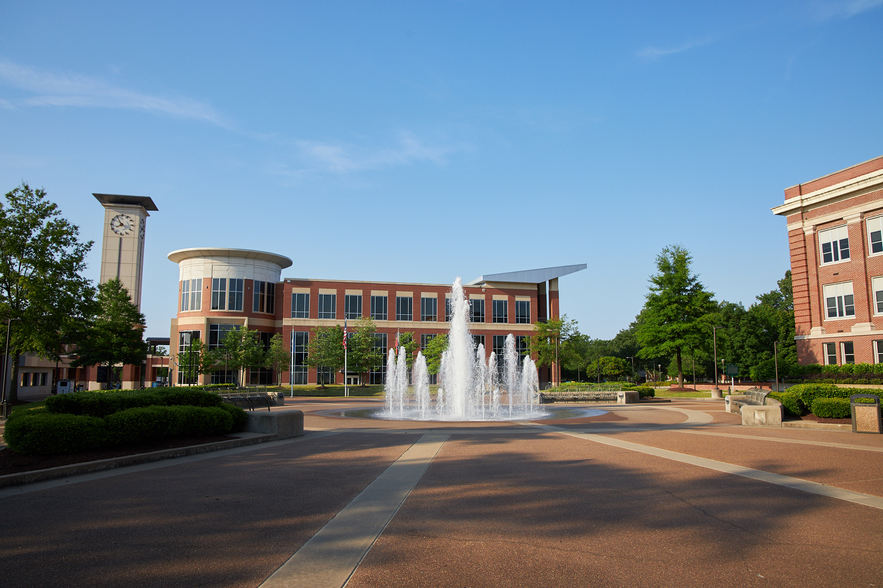
Accountability
Collaboration
Diversity and Inclusion
Innovation
Service
Student Success
Our Values

Slide 27
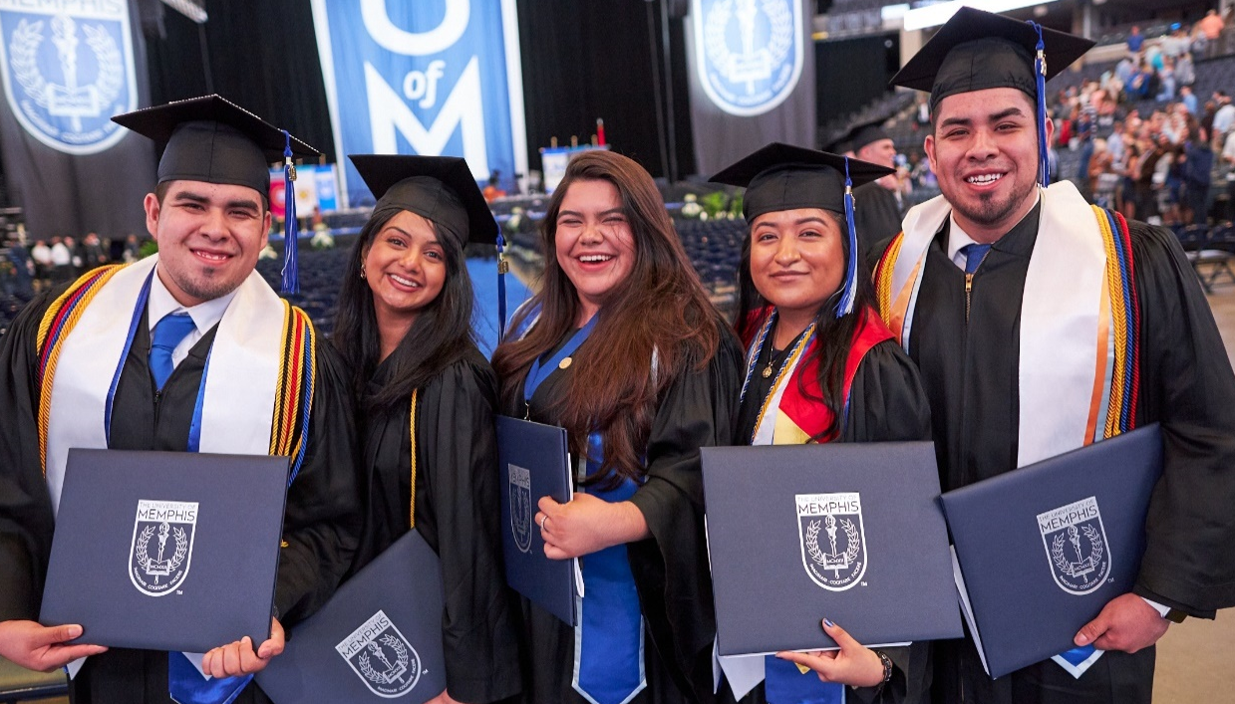

Dramatic Improvement in Outcomes
Graduation rate improved from 41% to 53.1% over past six years
Goal of 61%
Magnitude of increase of 29.5%
Overall growth over past 6 years: 2.7% despite regional and national contraction
Again 2nd largest public university in TN
Significant OOS growth secondary to OOS tuition reduction
Graduation numbers continue to be 4,000+
Continue to bring in strong freshman and transfer classes annually
UofM Global most significant growth across university
Lowest cost increases in the State of TN by significant margin

Slide 28

Nonresident Enrollment Trends
Reduction in the nonresident tuition rate has resulted in a 53% nonresident enrollment increase for FY20

Slide 29
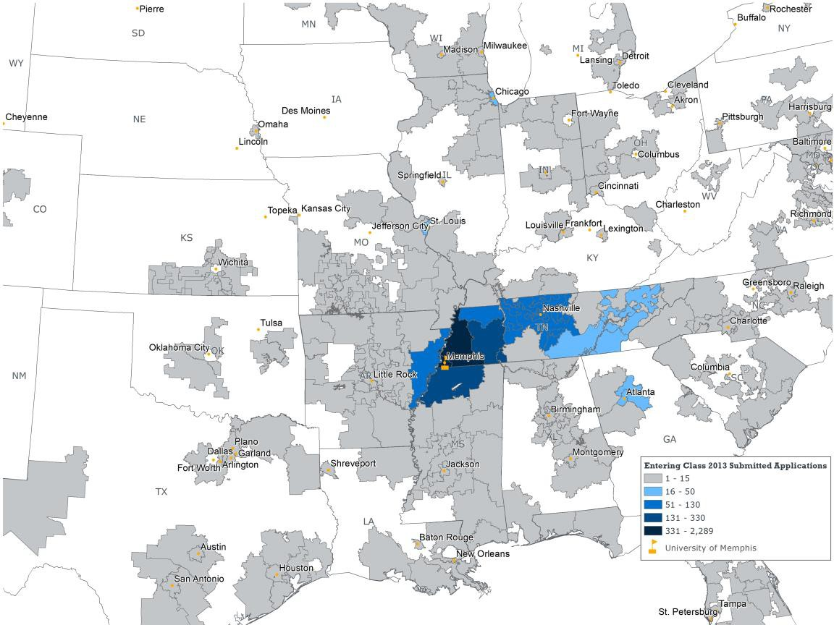
ENTERING CLASS 2013 – Freshman Applications
©2018 EAB Global, Inc.
• All Rights Reserved • eab.com

Slide 30
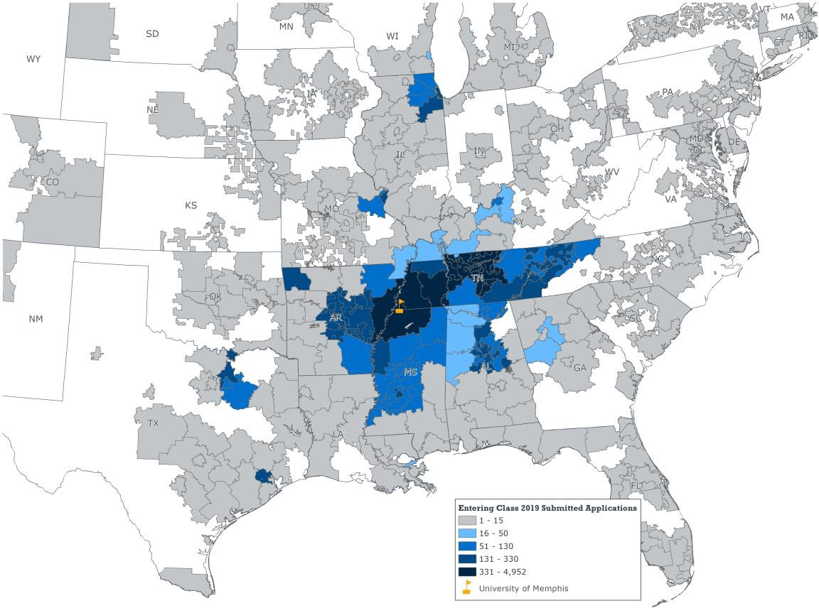
ENTERING CLASS 2019 – Freshman Applications
©2018 EAB Global, Inc
. • All Rights Reserved • eab.com

Slide 31
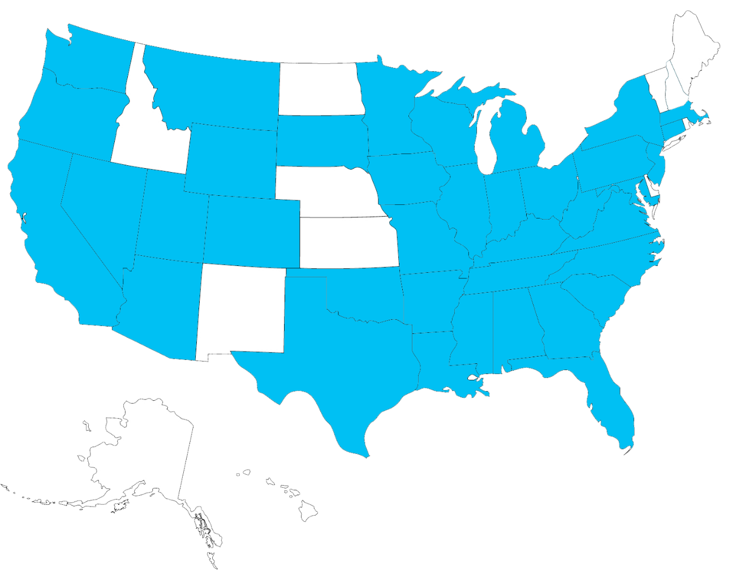



UofM Global Spring 2020 Enrollments
6,800 students in online courses
3,500+ fully online students (+50% since 2017)
1000+ Global applications = 500 new students
Students from 39 states & several foreign countries
Average credit hour load
8.9 credit hours undergrad
6.2 credit hours grad
Target: 6,000 fully online students by 2023

Slide 32
TOTAL TUITION INCREASE
OVER 6 YEAR
A COMMITMENT TO AFFORDABILITY & ACCESSIBILITY

Slide 33
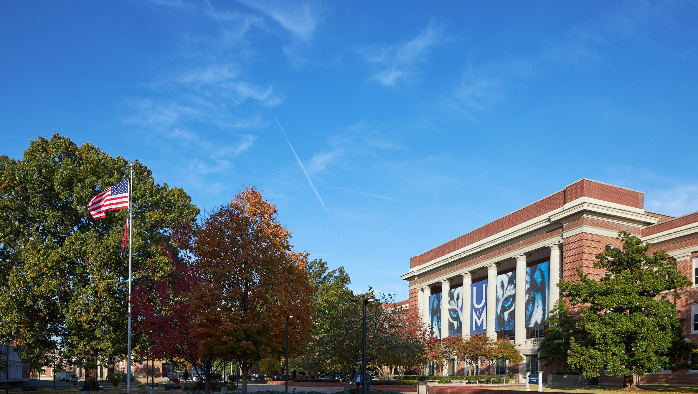
Budget Growth
Total budget has grown to $545M from $467M over past six years
Gain of $78M in annual budget, with average annual growth of $12.57M
Composite financial index of 3.2, 2nd only to UTK in TN
The result of strategic decision-making re: tuition structure
Dramatically reduced OOS tuition
Significant improvement in-state affordability relative to competition
UofM Global growth
Growth in strategic community partnerships
Significant gains in fundraising
Raised $206M, average of $33.4M over past six years
Previous ten year average of $23M
Majority of funds raised are for academic initiatives.

Slide 34
FY21 Governor's Budget - State Appropriations
Recurring State Appropriations |  | FY21
 | State Appropriation - Operating Increase | $4,054,000
 | State share - 2.5% Salary Pool | 3,455,100
 | Health Insurance Increases | 668,100
 | Outcomes Formula Adjustment | (243,600)
Net Recurring State Appropriation Amount |  | 7,933,600
Non-Recurring State Appropriations |  | FY21
 | One-time allocation for R1 Carnegie Classification | $5,000,000
 | Capital Maintenance - One-time State Appropriations | 12,500,000
 | STEM Research and Classroom Building | 41,000,000
Total Non-Recurring State Appropriations |  | 58,500,000
Increase of $7.9M base budget funding and $58.5M non-recurring toward march to Carnegie R1 and capital projects

Slide 35

Capital Maintenance ‐ Historical Funding
$16,000,000
$14,000,000
$15,010,000
Appropriation
$13,500,000
$12,000,000
$12,500,000
$10,000,000
$8,000,000
$8,970,000
$6,000,000
$5,350,000
$4,000,000
$3,000,000
$2,000,000
$‐
2015/16
2016/17
2017/18
2018/19
2019/20
2020/21
Fiscal Year
$49.98M over past 4 years

Slide 36
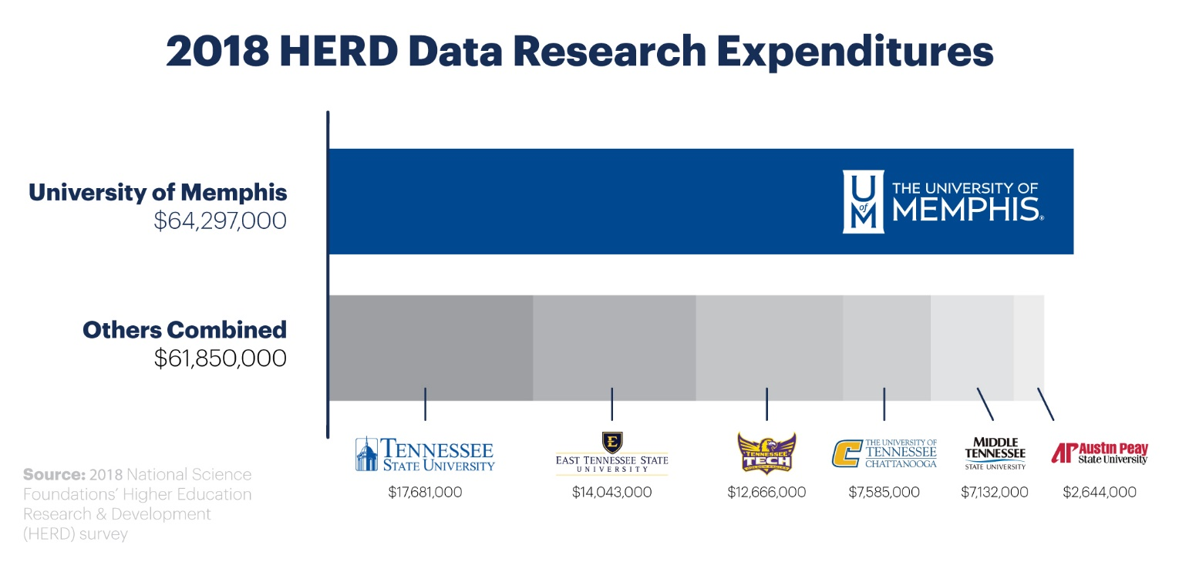

Slide 37
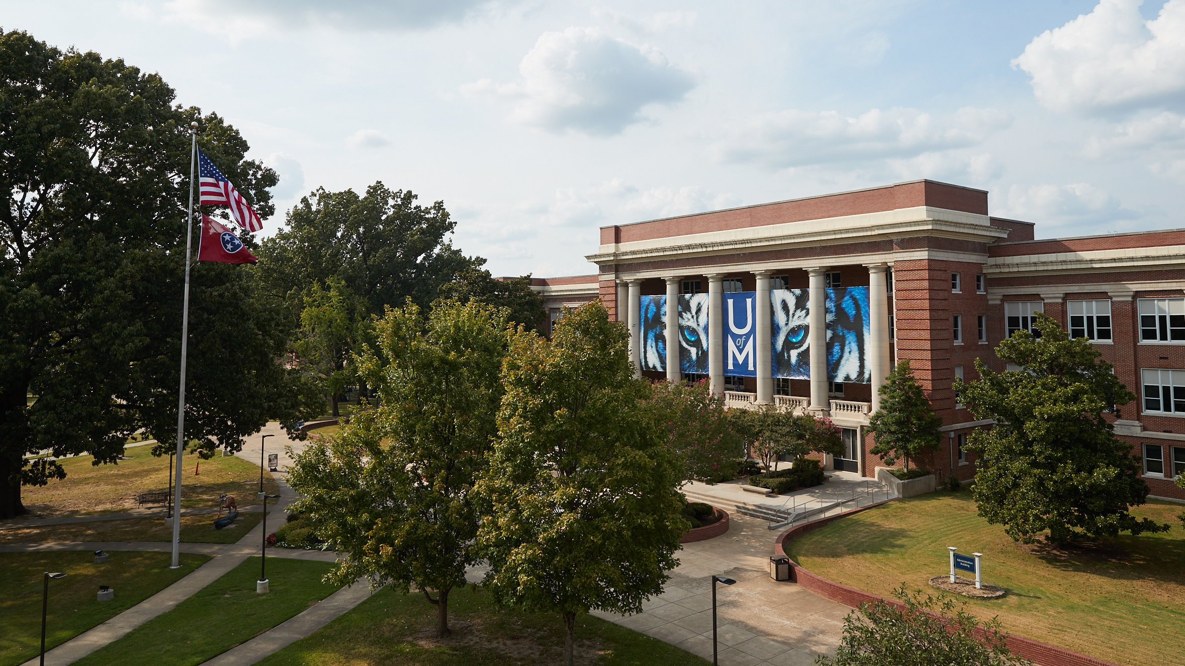
There are two
flagship universities in Tennessee: the University of Tennessee, Knoxville and the University of Memphis
Consistent with the original charter of the Tennessee Higher Education Commission

Slide 38

A Commitment to Recruiting High-Achieving Students

Slide 39
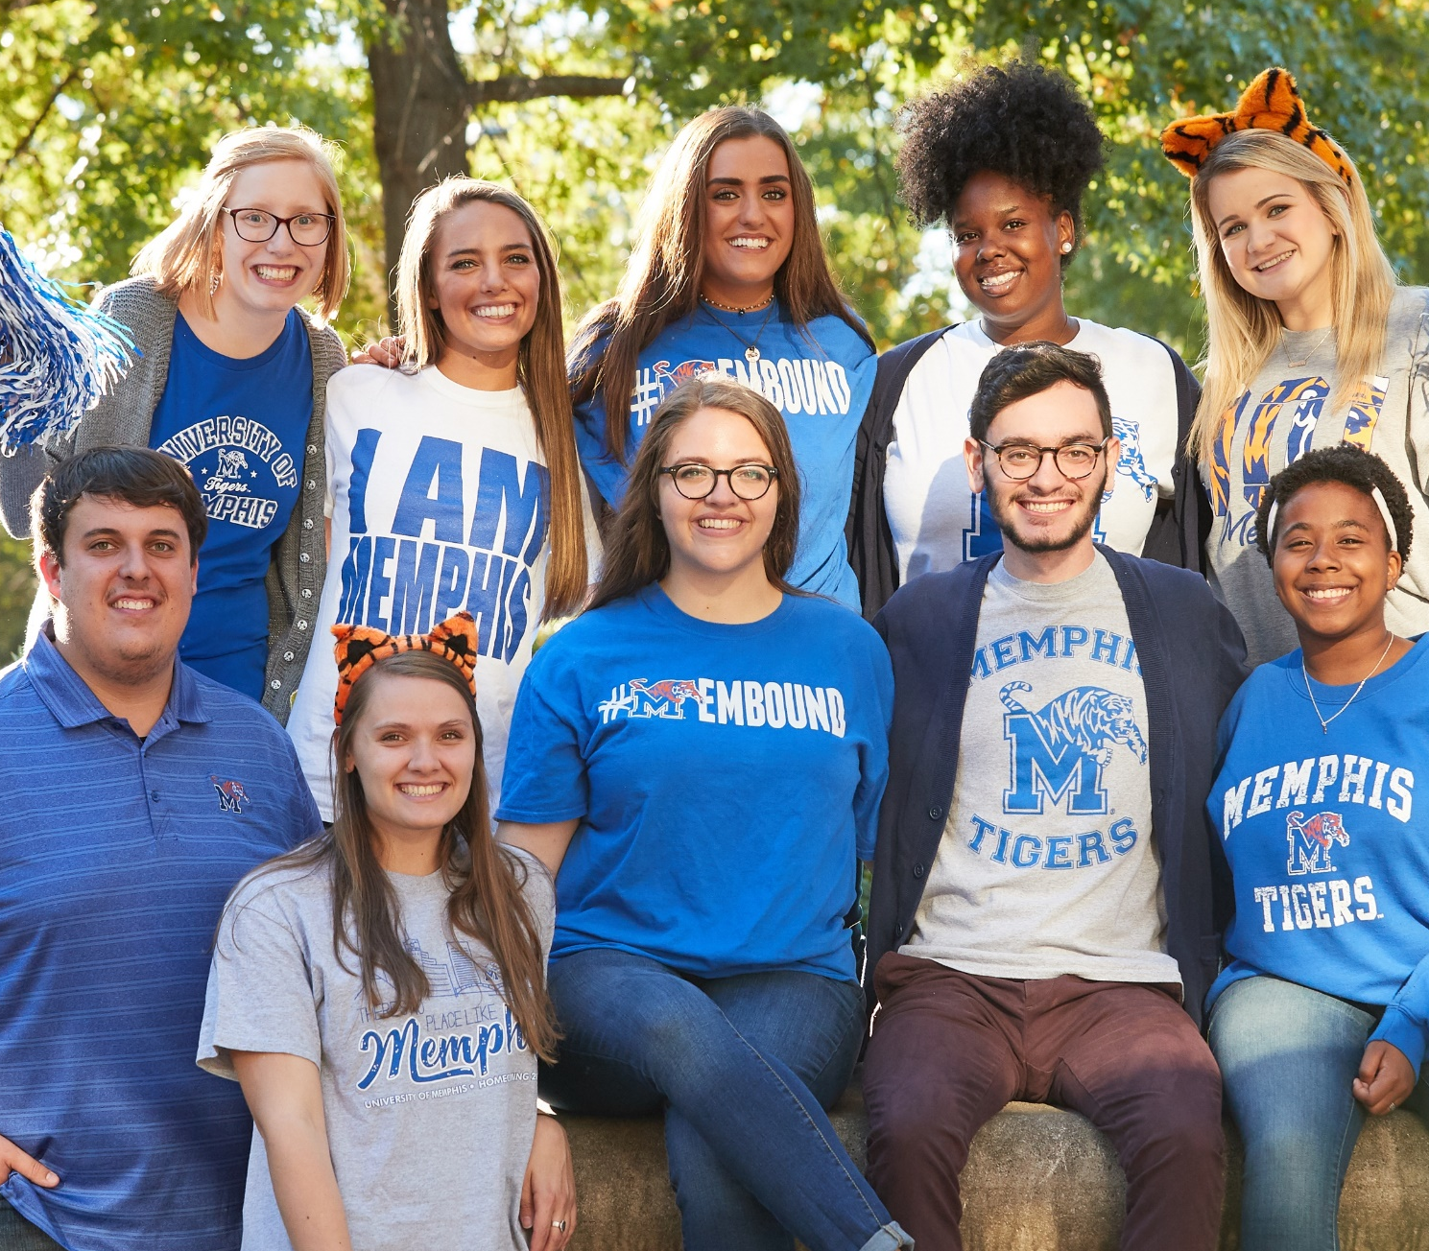
Strongest Freshman Classes in our History
Average ACT improved over each of the past three years to 22.8
Mean GPA improved each of past three years to 3.52
Best predictor of retention and graduation
One out of four of last year’s class was admitted to the Honors College
No internal financial pressure to increase class size
Provides unique opportunity to increase selectivity
Will always maintain access and affordability
Consistently improving national programmatic rankings each year

Slide 40
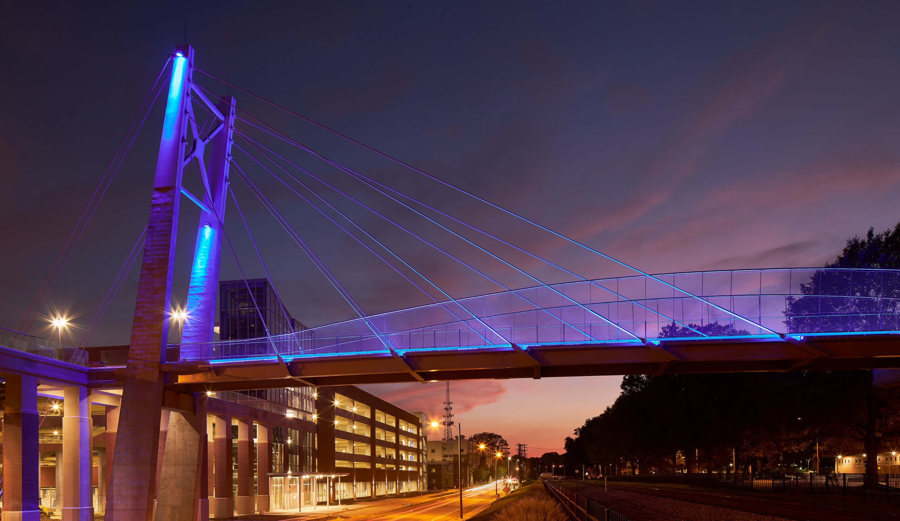
First time ranked in top tier
of public universities by
U.S. News & World Report

Slide 41
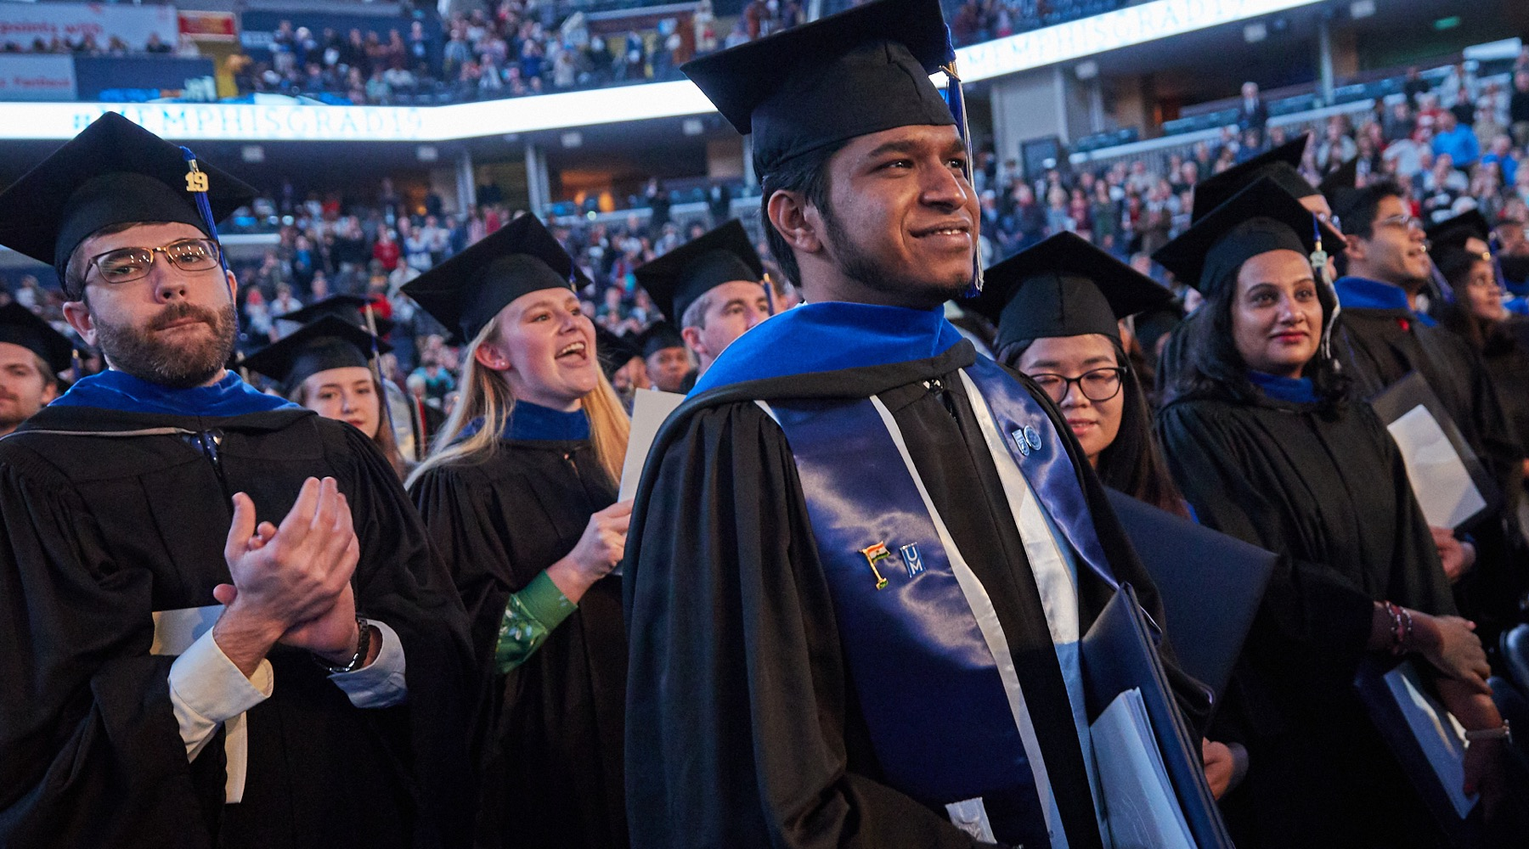
Nationally Ranked Programs
79 Programs Ranked
by U.S. News & World Report and online sites
5 Programs Ranked #1
by online sites
23 Programs Ranked
Top 5
by online sites
36 Programs Ranked
Top 10
by online sites
60 Programs Ranked
Top 25
by U.S. News & World Report and online sites

Slide 42
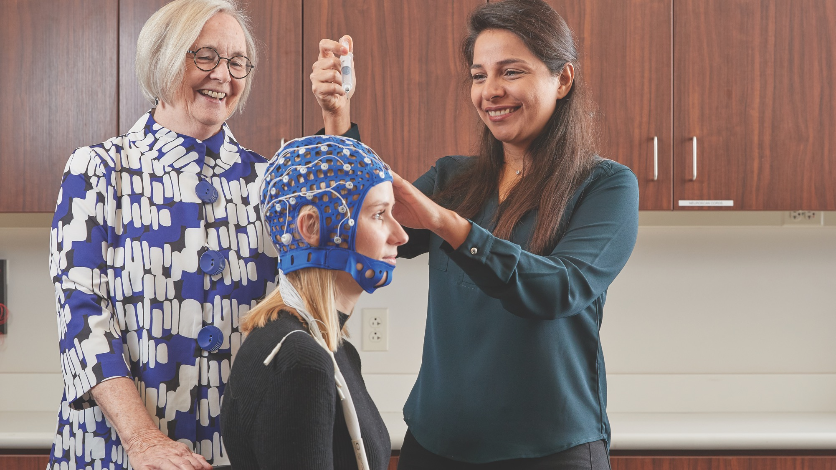
Advancements in 12
Program Rankings

Slide 43


Ranked in 9 New Categories

Slide 44
UofM Global
More than 1/3 of programs are nationally ranked
Program volume has doubled in 3 years
(100+ programs offered)
Since 2017
inception
1257 | Undergrad Students
752 | Grad Students

Slide 45
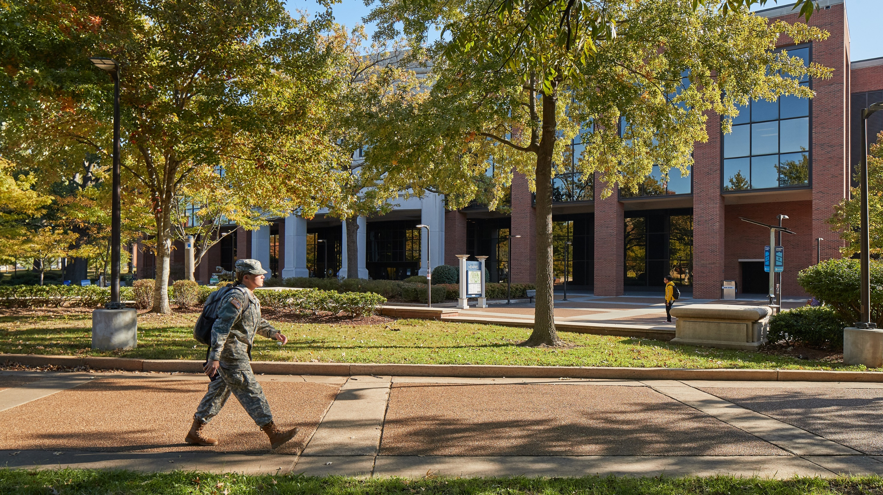


Ranked as Military Friendly for 5th Consecutive Year. Ranked 9th Nationally.

Slide 46
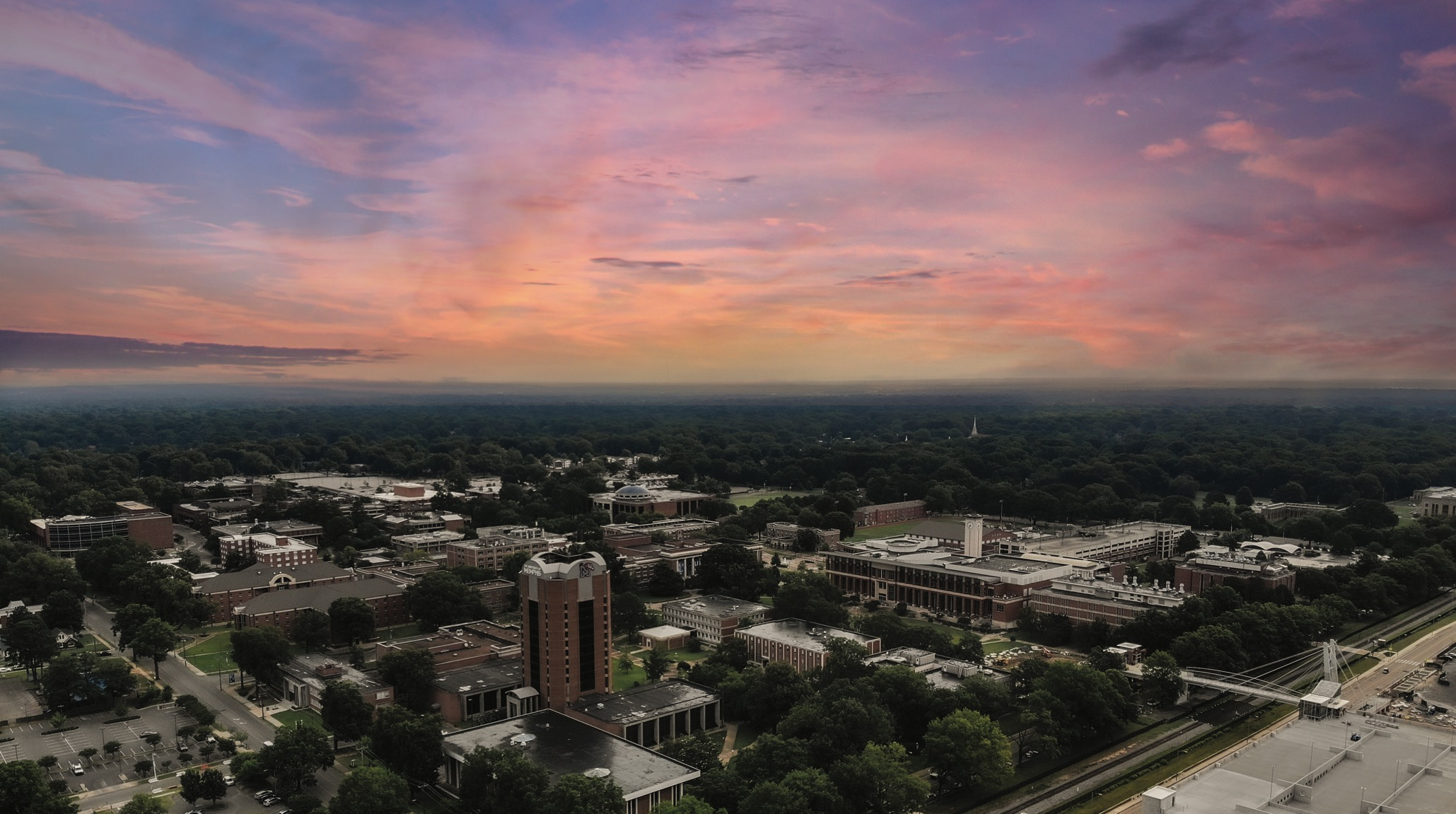
Unparalleled Investment in Campus Improvements
$261M in total investments past four years and projects funded and planned over the next three years
Significant private investment in campus neighborhoods
Extensive on-campus improvements that are not readily visible

Slide 47
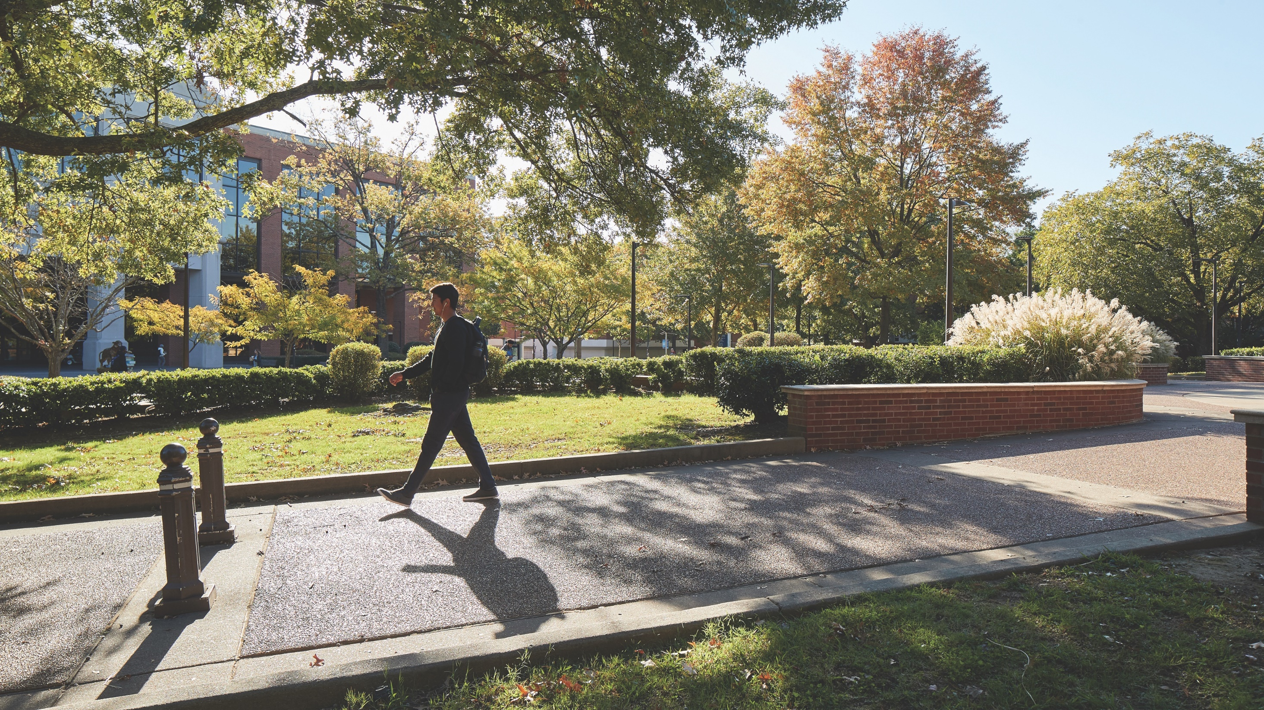
Innovative Efforts to Support Students
Reduce hours required to work with higher wage jobs, increase ability to focus on academics
UMRF Ventures
Peer Power Institute

Slide 48
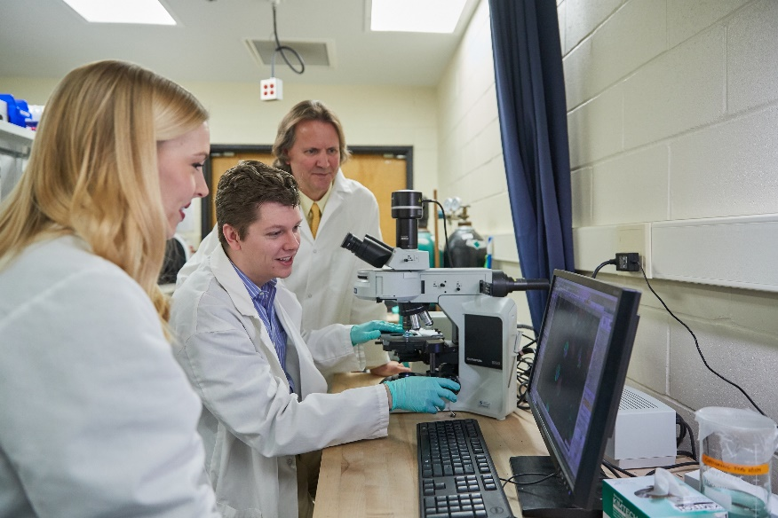

UMRF VENTURES Mission
Create good-paying part-time jobs for UofM students on their campus, so that they can meet their financial obligations, stay in school and graduate on time
Prepare students with excellent work experience and create pathways to future employment opportunities with our business partners
Become a sustainably profitable, growing enterprise
Profits returned to the University’s Research Foundation

Slide 49
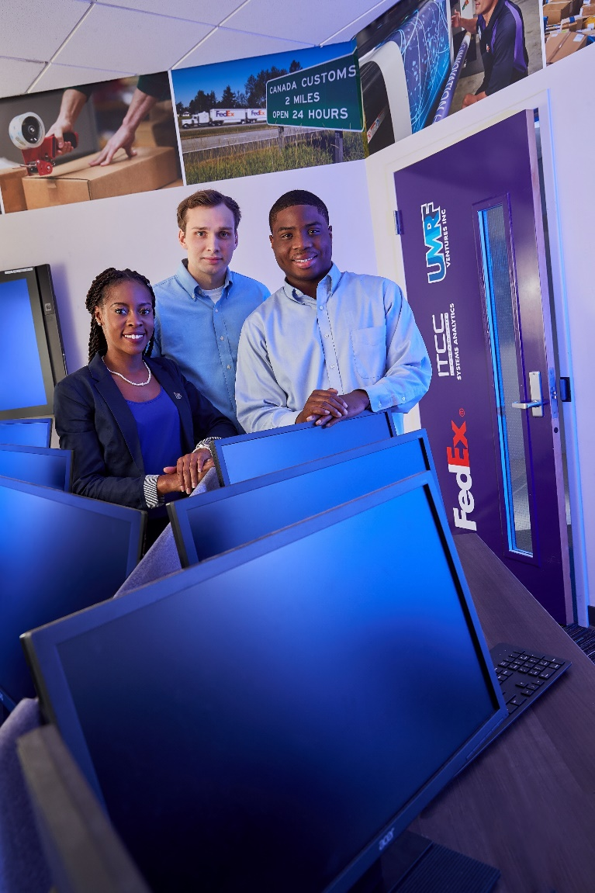
UMRF Since August 2017
Revenue has grown from $800,000
in year 1
Employed more than 400
students
Anticipates
$5,000,000Revenue in 3 years
Paid
more than
$4,000,000 in student wages
Paid
$300,000+ in rent and fees to the University
Paid
$50,000
of Dividends to UofM Research Foundation
Helped place 20 students into full-time positions with partner companies
Notes:
This is a prestigious opportunity.
Opportunity to make money while conveniently located on campus
Opportunity to network with our partnering companies.
This is not a place to play or waste time. We enjoy having a light-hearted environment where we can talk and laugh, but work comes first.
Not an average on-campus job. We expect you to be professional and take this job seriously.
What you put in is what you get out.

Slide 50
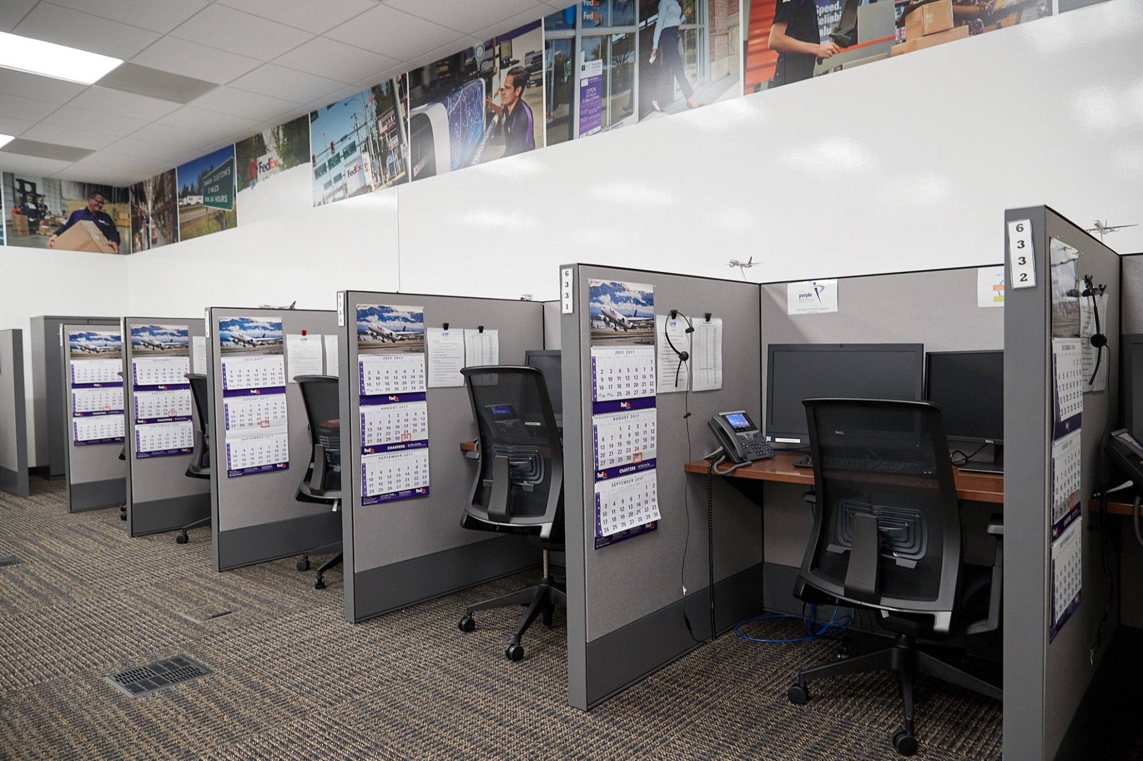
Expanding Student Opportunities
Operations now in FedEx Institute, on South Campus and on Lambuth Campus
Four separate Ventures with FedEx
Expanding to other partner companies
Memphis Symphony Orchestra
Northstar Partners
Sedgwick Claims Management (new partnership)
Plans to build out and expand onto the rest of the Student Ventures Building

Slide 51
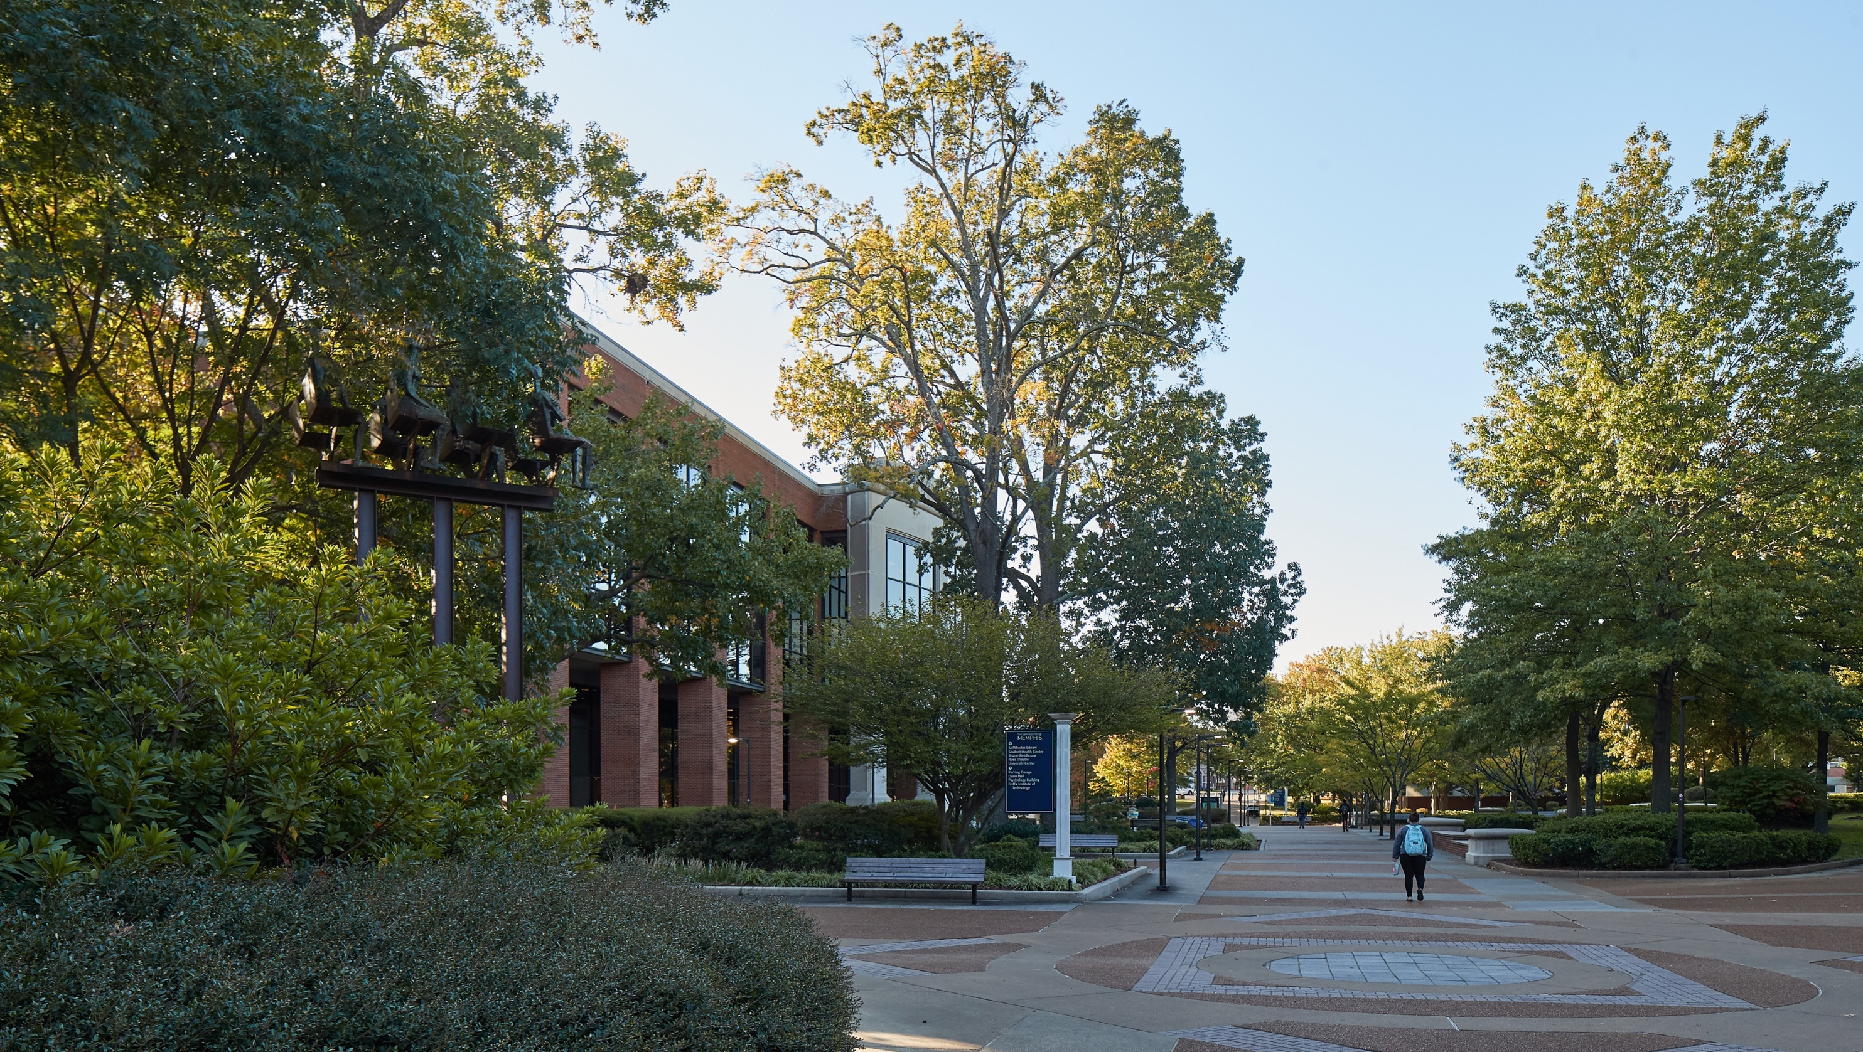

Key Community Partnerships
Peer Power is a nonprofit organization that recruits and trains high-performing college students to tutor in public school classrooms and mentor high school students
Peer Power Institute at the UofM has employed more than 600 students as Success Coaches since its launch
Currently employs more than 150 UofM students in positions that allow them to serve, learn and earn

Slide 52
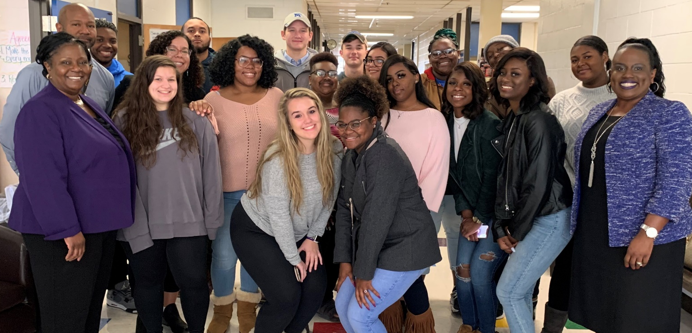

Key Community Partnerships
Partners: Shelby County Schools and local charter schools
River City Partnership is an urban education-focused program to prepare local future educators to practice and promote social justice, equity and inclusion
More than $6 million raised for student scholarships, programming and support
18 undergraduate students and 33 graduate students in the first cohort

Slide 53
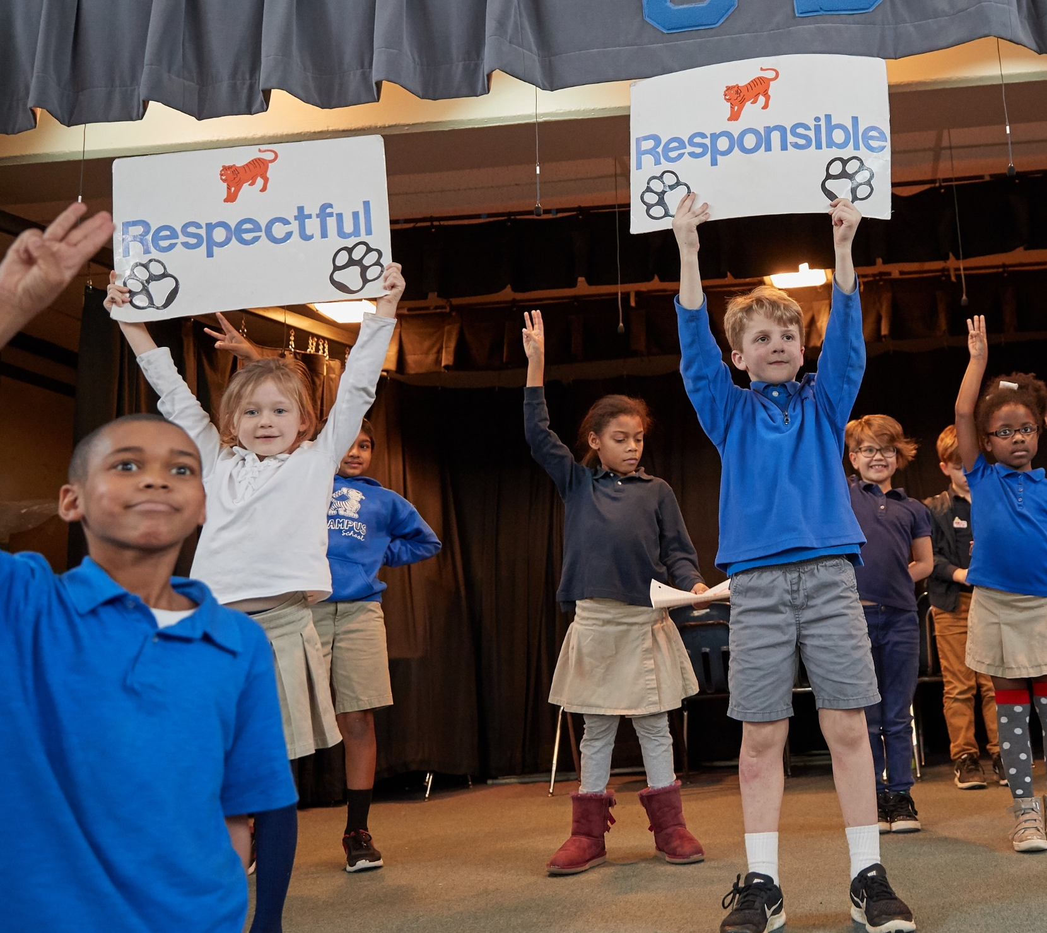
A Campus that Supports our Families
Parental leave enacted
ELRC expanded
Providing full-time services for students, faculty, staff with children
Expanded scholarships for students
Kindergarten classes added to Campus School
University Middle opened
Partnered with Porter-Leath to open a 0-3 childcare facility
Fully funded, groundbreaking will be in summer
UofM raised $3.5M for our portion
Exploration of University High
Madison Academic Dual Enrollment HS Lambuth to break ground in April
Fully funded through City of Jackson

Slide 54
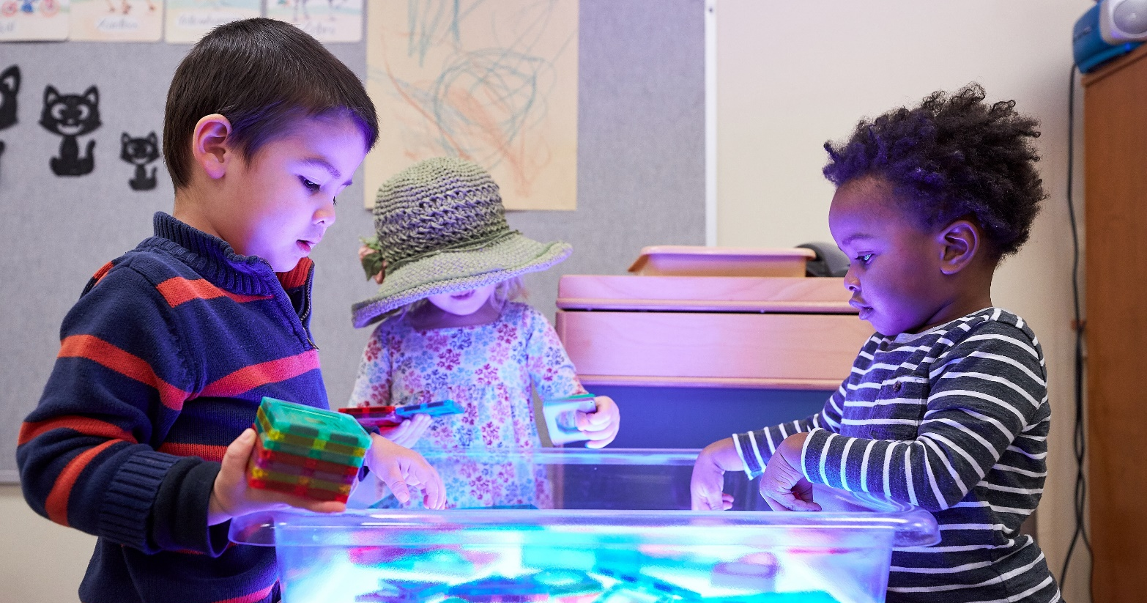

Key Community Partnerships
Collaborating to launch a state-of-the-art childcare facility close to the UofM for children 6-weeks through Pre-K
Expands the University Schools educational compendium to infants and toddlers
Porter-Leath serves over 10,000 children and families each year through its programs to meet developmental, health and social needs at the earliest opportunity
January 2022 target open date
Spaces reserved for UofM students, faculty and staff

Slide 55
Initiatives for AY 2020-2021
Student Service, Personnel Management
Health and Safety
TIF Expansion, grow external economic investment
Internal leadership identification/training/retention
Annual campus-wide survey re: strategic priorities

Slide 56
Vice President of Student Academic Success Update
Dr. Karen Weddle-West

Slide 57
CENTER FOR ATHLETIC ACADEMIC SERVICES (CAAS)
KAREN WEDDLE-WEST, PH.D.
VICE PRESIDENT FOR STUDENT ACADEMIC SUCCESS
DIRECTOR OF DIVERSITY INITIATIVES
FERNANDEZ WEST
ASSOCIATE ATHLETIC DIRECTOR, ACADEMIC SERVICES

Slide 58
Fall 2019 Highlights
Department GPA: 3.171
13th consecutive term with a 3.0 or higher
Tiger 3.0 GPA Club: 259 (63%)
Dean’s List: 159 (39%)
4.0 GPA Club 50 (12%)
Highest Male GPA: Men’s Golf: 3.48
Highest Female GPA: Women’s Golf: 3.72
All-time high/GPA record broken
Men’s Basketball GPA: 3.02
Freshmen: 3.415
Freshmen Women: 3.622
19 Graduates (11 different majors)
3 Summa Cum Laude (3.8-4.00): Evan Bell (MBA), Adam Neely (MTR), Jessica Lamb (WSB)
3 Magna Cum Laude (3.50-3.79): Tyler Webb (MBA), Rodij Vlasveld (MGO), Isabel Youree (WGO)
3 Cum Laude (3.25-3.49): Patrick Taylor (MFB), Dustin Woodard (MFB), Elizabeth Moberg (WSO)

Slide 59
Spring 2019 Academic Highlights
The following teams posted all-time high GPA’s in 2018-2019:
Women’s Basketball: 3.251 Spring 2019
Softball: 3.546 Spring 2019
Rifle: 3.695 Spring 2019
Football: 2.88 Spring 2019
Women’s XC: 3.772 Spring 2019
Memphis Women’s Teams have posted a 3.0 combined GPA in 35 of the last 36 semesters.
70 Graduated
25 different majors
20 different states
10 different countries

Slide 60
American Athletic Conference Academic Awards
202 Student-Athletes received All-Academic Team Honors, 3rd season that Memphis Athletics has had over 200 student-athletes receive this recognition.
Team Academic Excellence Award-Men’s Golf and Men’s Soccer earned the top academic team award for the AAC.
This marks the second consecutive year Men’s Soccer has earned the top spot for the AAC.
AAC Scholar-Athlete Award
Ashley Pryke, WTO
Lizzie Woerner, WSO
Olushola Olojo, MTO
David Zalzman, MSO
Tied for second highest GSR in the AAC with 92% for 2019
100% GSR -Women’s Golf, Men’s Golf, Women’s Tennis, Men’s Tennis, Rifle, Softball

Slide 61
Center for Athletic Academic Services (CAAS) Survey
My CAAS Counselor showed sincere interest in me as a person, not just a student-athlete.
105 (92%) agree
My CAAS Counselor was helpful in giving me needed advice regarding major selection.
99 (86%) agree
“CAAS Counselor took the time to ask me about my day and truly cares about my overall well-being which is quite evident in the time they put in with me and all their student-athletes.”
“The CAAS Counselors do a great job of working with you with scheduling and are always available as a resource.”

Slide 62
Center for Writing and Communication (CWC) Student Academic Success (SAS)
KAREN WEDDLE-WEST, PH.D.
Vice President For Student Academic Success
Director Of Diversity Initiatives
Scott Sundvall, Ph.D.
Director, CWC
Assistant Professor, Department of English

Slide 63

CWC Methodology and Outcomes
METHODOLOGY:
Assists with any writing or speech at any stage of development.
Uses a dialogic approach (consultation) that improves process rather than mere product.
Works with students one-on-one.
Employs non-evaluative methodology.
Utilizes synchronous consulting (in-person and online)
OUTCOMES:
Effectively communicate information, concepts, and arguments with clarity, coherence, and logical organization.
Develop revision strategies that improve composing practices writ large.
Identify intended audience and adhere to the form of the appropriate, corresponding genre.
Improve literacy practices, including grammar, syntax, sentence structure, and citations; language acquisition; and development of style and voice.
Notes:
Notes:

Slide 64

CWC Statistics
1,731 consultations provided 2018-2019 academic year (13% increase from previous year).*
15% of clients identify as ESL/ELL/EFL students.
36% of clients are first-year students; 15% of students are graduate students.
90%+ feedback on all surveys.**
80-85% utilization
*Does not include summer semester. ** See hand-out document for more information.
Notes:
Notes:

Slide 65
CWC Services, Activity, and Outreach
Compose Yourself! workshops with the Benjamin L. Hooks Central Library.
Prison outreach with Shelby County Department of Corrections.
No Stress Success workshops with University of Memphis (UofM) library.
Plagiarism workshops.
Dissertation Writing Retreats with Graduate College and UofM library.
“Right to Own Language” workshops in first-year writing courses.
Grant activity.
National and international conference activity.
Senior capstone thesis workshops.
Curricular development.
Graduate seminar on writing and communication center theory and praxis.
Notes:
Notes:

Slide 66
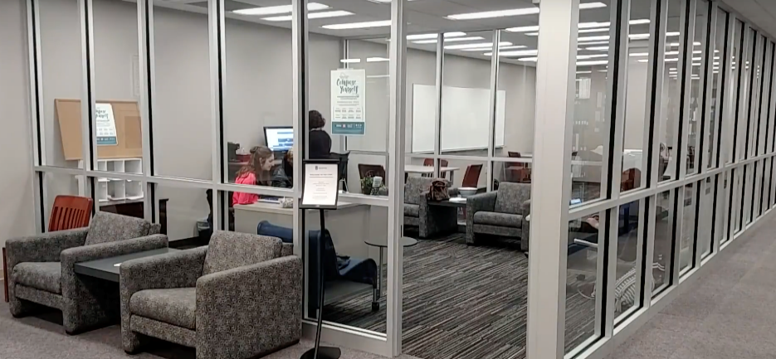
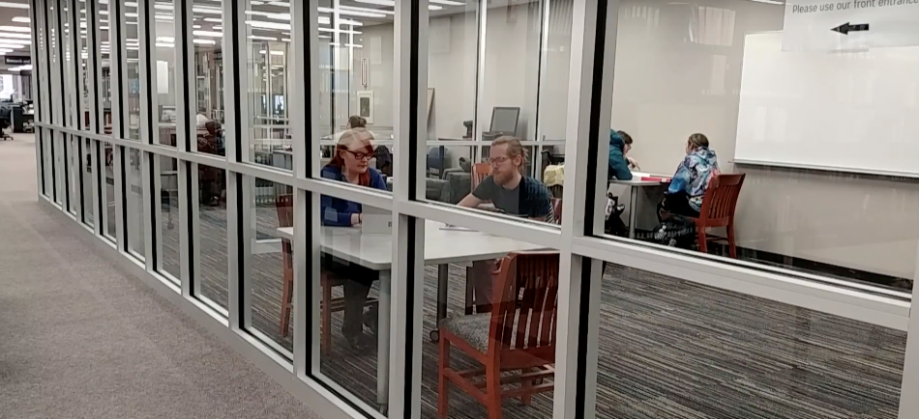
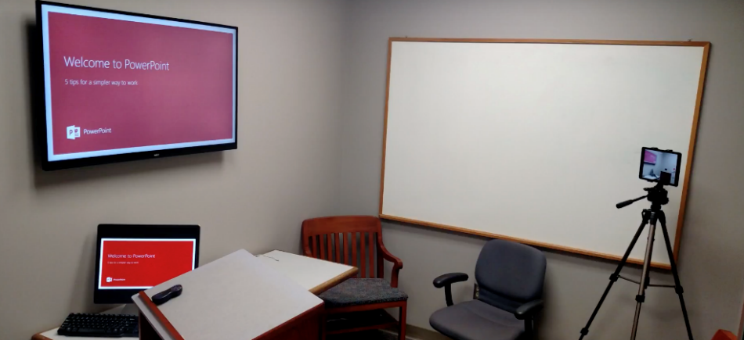
CWC Future & Return on Investment
RETURN ON INVESTMENT (ROI):
Retention
Rate to graduation
Academic success and excellence
Job placement (for graduate students)
Research production
Curricular innovation
SURVEY RESULTS
My consultant and I discussed objectives and goals for my session
Strongly Agree – 79% (187) Agree – 20% (48)
At the end of my session, I had a plan for completing my assignment
Strongly Agree – 83% (99) Agree – 15% (36)
How likely are you to return to the CWC?
Extremely Likely – 95% Somewhat Likely – 5%
Would you recommend the CWC to a classmate?
Yes – 100%
Notes:
Notes:

Slide 67
University School Initiatives
Sally Gates Parrish
Associate Vice President for Educational Initiatives

Slide 68
University Schools
History & recent reorganization under Educational Initiatives
The mission of University Schools is to provide the children of our community with educational experiences that enhance their development from birth to graduation and promote dynamic research, collaborative partnerships and innovative practices.
Our University Schools provide laboratory learning, practice, research & observation opportunities for faculty, staff, and students while meeting a critical community need for teacher & practitioner preparation and providing a faculty/staff recruitment & retention benefit to the UofM.
Notes:
Notes:
Schools in place since the founding of the university, but had lost lab component and connection with local school system. Reorganization to educational initiatives and refocus on collaboration, outreach, lab instruction. One of two public lab school environments in the state. Operate under TCA. Full compendium- birth to graduation model.

Slide 69
TCA 49-8-105
a) Any state college or university under the direction of the board of regents or a state university board is authorized to maintain a training school for grades pre-kindergarten through twelve (pre-K-12), or any combination of grades pre-kindergarten through twelve (pre-K-12), for the purpose of providing practice teaching experience for teachers in training, and the students enrolled in the school shall be taught the same course of study as prescribed by the state board of education for the public school system in grades pre-kindergarten through twelve (pre-K-12), or the grades appropriate for the particular school.
b) Each institution, acting through its governing board, is authorized to contract with the county or city board of education in the county or city in which the college or university is located to provide for the teaching of the children of public school age in the training school, whereby the training school shall receive all state and federal funds received by the county or city board of education as a result of this contract for the operation of the school, including per capita allocations, equalization funds, capital outlay funds, textbook funds, and any other funds that may be allocated for the operation of public schools of this state. The control of the training school shall be wholly under the direction of the respective institution.
Notes:
Contract schools. You authorize. University Schools Advisory Board advises on strategy and operations.

Slide 70

University Schools
Early Learning & Research Center
Campus School
University Middle
Summer Programs
University Schools Research Consortium
Notes:
Notes:
Diversity of our enrollment reflects the diversity of our faculty, staff, student, and neighborhood populations

Slide 71
Snapshot of our Schools
Partnership with Shelby County Schools
Partnerships with all academic colleges, 50+ community partners
Over 500 students ages 2-13
Growing to 1,300 by 2021; 1,800 by 2025
30 supervising teachers
10 full time staff positions
35 teacher residents, student interns, graduate assistants
Over 100 student observations
9 active research projects
$4.4 million budget- mostly funded through tuition & BEP dollars
Research
Innovative Education
Observation, Practice, Reflection
Campus & Community Engagement
Notes:
Notes:size is comparable to a number of small TN standalone school districts, and by 2021 enrollment will outpace the enrollment of 4 UofM colleges/schools in the next three years.

Slide 72
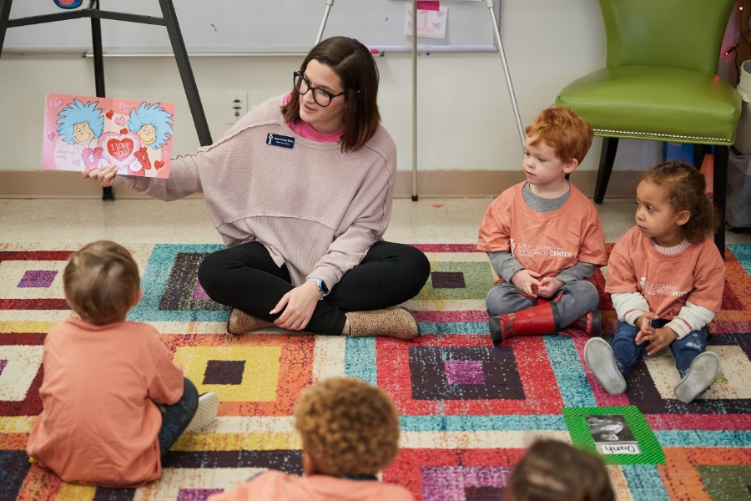
Key Successes-ELRC
Only NAEYC accredited US lab school with three demonstrations
Increase in enrollment; serving over 100 children aged 2-6
Including children from 20+ UofM students
Full-day model with enrichment experiences
Full summer camp
Sustained entirely by tuition & grant revenue which
increased by $500,000 in 19/20.
Department of Education Grant
Keep TN Beautiful/Keep America Beautiful Grant
Hire of new Director, Brooke Willis
Notes:
Closure of CDC- incorporating students at ELRC

Slide 73


Key Successes-Campus School
National Blue Ribbon School
Top 5% academic performance in the state
Campus School State Report Card Data
4 out of 4 overall, on academic achievement, attendance
76% at or above grade level (compared to 23% in the district, 36% in state)
Demonstrated “high absolute achievement” for Black, Hispanic, Native American
& combined student groups
Applications double availability
Adding Kindergarten in 20/21
Projected enrollment in 20/21- 400, increase of 100
Sustained entirely by BEP revenue
Increasing by $1.6 million for next FY
Hire of new Director, Dr. Rebecca Scott
Notes:
Addressing salary inequities 67% , adjusted calendar, Friday frenzy

Slide 74

Key Successes-University Middle
Project Based Learning Model
PBL Explore
Diversity of student enrollment
Academic achievement despite no academic requirement for entry
Mid-year program review
High engagement
High quality of instruction and curriculum
High quality university partnerships
Positive school culture
Evidence of student learning
Innovation & excellence
Hire of new Director, James Smith

Slide 75
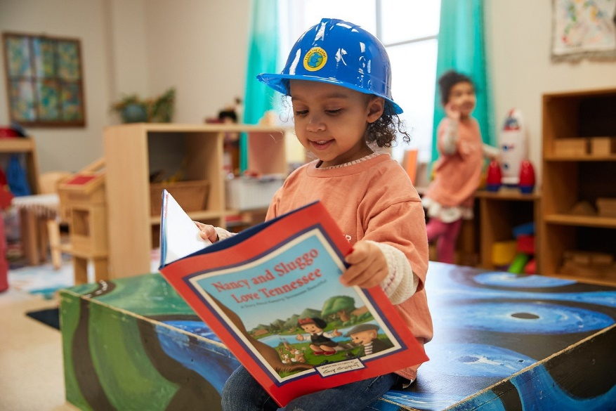
On the Horizon
Harwood Partnership
Laboratory learning for children with special needs, with an emphasis on autism
Porter-Leath Partnership
$3.5 million grant to create a new laboratory infant/toddler program
University High School
Dual enrollment, entrepreneurship themed laboratory high school
Dual Enrollment High School Partnership in Jackson
Located on our University of Memphis Lambuth Campus

Slide 76
AY19-20 Tuition and Fee Payment Initiatives Update
Raajkumar Kurapati
Executive Vice President and Chief Financial Officer

Slide 77
Purpose
Provide the appropriate resources and increase planning time for our students and parents to manage their financial obligations to the University.
Reduce the number of students canceled (dropped for non-payment) as of date of census
Positively impact graduation and retention rates
Increase student credit hour and tuition revenue generation
Reduce the potential financial impact of the bad debt expense and write-offs
Notes:
Notes:

Slide 78
New Actions for AY19-20
Generated billing statements and posted charges to student accounts 3.5 weeks earlier.
Moved to a single payment plan option for all balances vs. separate payment plans for tuition & fees and housing/dining.
Offered 50% off payment plan fee for early enrollees.
Moved initial drop for non-payment date from the Friday prior to the first day of class to the Monday prior the first day of class (4 days earlier)
Reduced stress on students of dealing with being cancelled from classes the day before the first day of class.
Enabled University personnel to provide four (4) additional business days of outreach to students
Collaborative outreach effort amongst all student support areas.
Notes:
Notes:

Slide 79
Outcome
*Early Payment Plan Enrollment (50% savings): Fall 2019 - 507; Spring 2020 - 449
**Over 2/3 of the final DNP were dropped in the initial DNP
Notes:
Notes:

Slide 80
Impact of Fee Restructuring
Questions?

Slide 81
Report and Recommendations of the Academic, Research and Student Success Committee
Trustee David Kemme

Slide 82
Report and Recommendations of the Governance and Finance Committee
Trustee Cato Johnson

Slide 83
Report and Recommendations of the Audit Committee
Trustee Susan Springfield

Slide 84
Additional Business
Vice-Chair Carol Roberts

Slide 85
Adjournment
Vice-Chair Carol Roberts

